Slide 1
Live The Luxury

Slide 2
Flows
Ingest (Source2Vector)
Consume (Vector2Prompt)

Slide 3
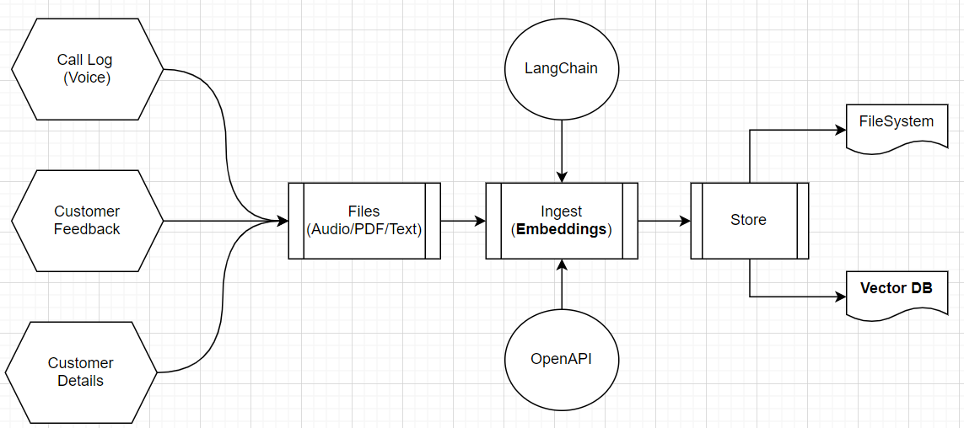
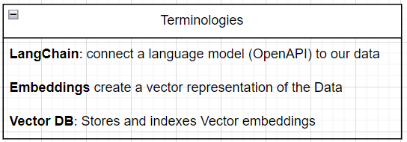
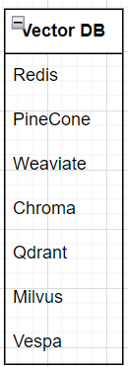
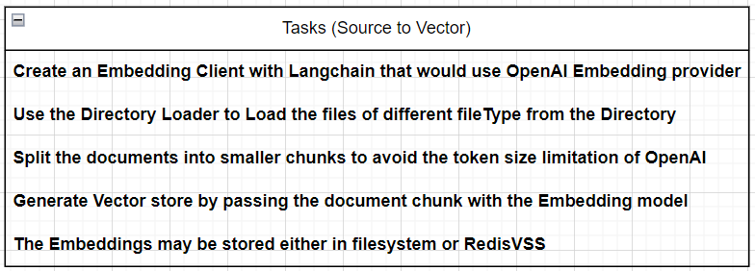
Ingest

Slide 4
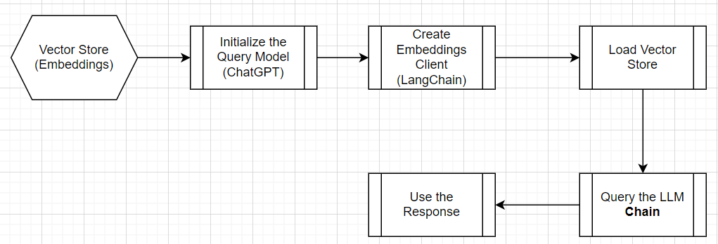
Consume – Vector2Flow
The Vector Store may be grouped as unique Data Source (e.g. Collection, Handover, Sales)
Token limit may be managed as the data would be converted to embeddings

Slide 5
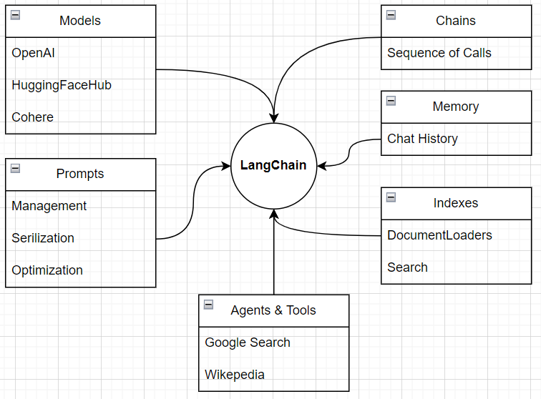
Use of LangChain

Slide 6
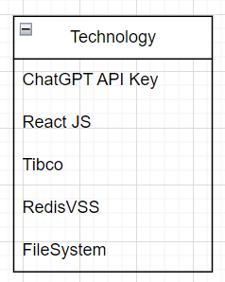
Technology Footprint

