Slide 1

Airline Reservation System
By Samarth Sunil Navale

Slide 2

Index
Problem Statement
Solution
Working (Method/Mind map)
Conclusion.

Slide 3
Problem Statement
Airline reservation systems manage flight schedules, seat availability, and passenger bookings. Manual management can lead to errors such as overbooking, duplicate seat allocation, and poor reservation tracking.
This project develops a console-based Airline Reservation System using C++.
Key Focus:
Manage flight information (flight number, source, destination, seat capacity)
Allow passengers to book and cancel seats
Track reservations using a unique PNR number
Display seat availability and booking records
The system demonstrates how basic programming concepts like classes, arrays, loops, and conditional logic can be used to simulate real-world reservation management.

Slide 4
2. Solution
A console-based Airline Reservation System was developed in C++ to simulate basic airline booking operations and manage seat allocation efficiently.
System Features:
Store and manage multiple flight records
Display flight schedules and seat availability
Allow passengers to book seats
Generate a unique PNR for each reservation
Enable booking cancellation using PNR
Show seat map and passenger booking details
The system uses object-oriented programming, arrays, and menu-driven interaction to manage reservations and update seat availability dynamically.

Slide 5
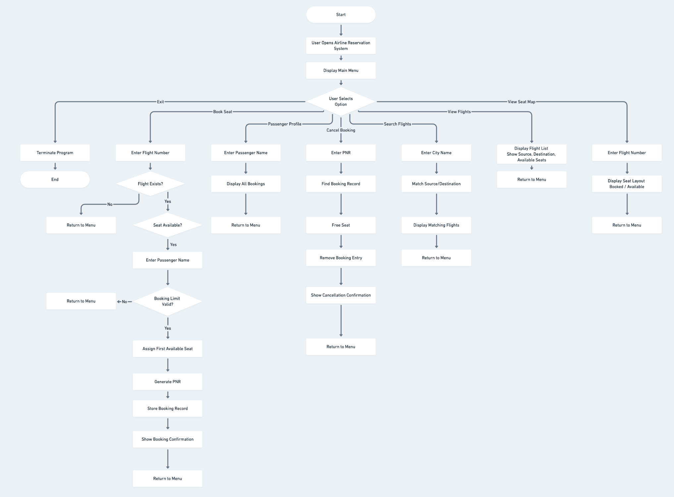
3. Working (Mind map)

Slide 6
4. Conclusion
This project successfully implements a basic Airline Reservation System using C++ that manages flights, seat allocation, and passenger bookings.
Key Outcomes:
Efficient seat booking and cancellation system
Unique PNR-based reservation tracking
Dynamic seat availability updates
Clear menu-driven user interaction
The system demonstrates how fundamental programming concepts such as classes, arrays, loops, and conditional logic can be applied to build a functional reservation management system.

Slide 7
Thank You

