Slide 1

Online Quiz Tournament Platform
By Samarth Navale

Slide 2

Index
Problem Statement
Solution
Working (Method/Mind map)
Conclusion.
Note: Slides (excluding Thank-you and Introduction slide) should not be more than 4.

Slide 3
Problem Statement
Problem Statement
Many online quiz platforms only provide single-player quizzes and do not offer a structured competitive environment. Users cannot compete through multiple rounds or track their performance against other players.
Key Issues:
Lack of tournament-style quiz systems
No round-based competition (Quarterfinal, Semifinal, Final)
Limited ranking or leaderboard tracking
Reduced engagement compared to competitive platforms
Goal of the Project: Develop a responsive Online Quiz Tournament Platform where users compete through multiple rounds, answer timed questions, and view their rankings on a leaderboard.

Slide 4
2. Solution
A responsive Online Quiz Tournament Platform was developed using HTML5, CSS3, and JavaScript to simulate a competitive quiz environment.
Key Features:
Multi-round tournament structure Round 1 → Quarterfinal → Semifinal → Final
Timed multiple-choice questions with automatic countdown
Dynamic scoring system based on correct answers and response speed
Leaderboard system to display player rankings
Player registration and profile tracking using localStorage
The platform runs entirely in the browser without a backend, demonstrating how core web technologies can build an interactive and competitive learning application.

Slide 5
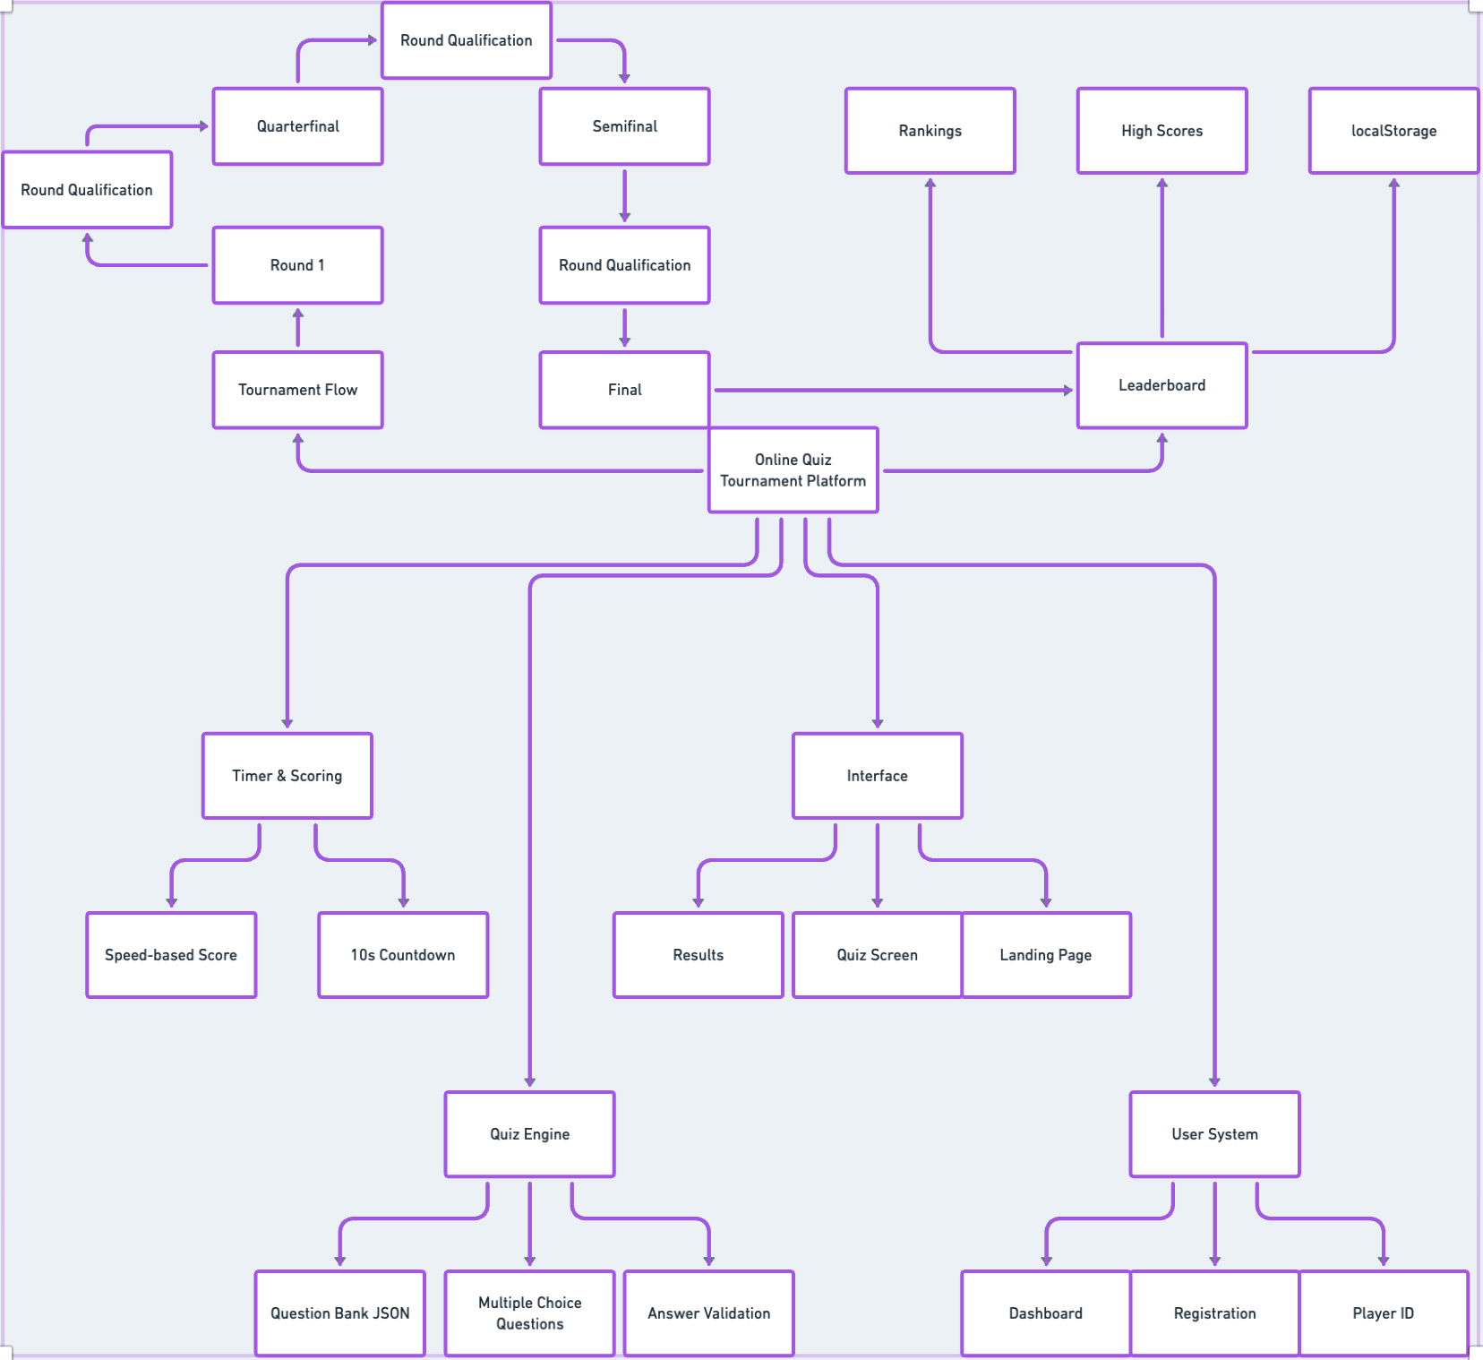
3. Working(Mind Map)

Slide 6
4. Conclusion
The Online Quiz Tournament Platform successfully demonstrates how an interactive quiz competition can be built using HTML5, CSS, and JavaScript.
Key Outcomes:
Implemented a multi-round tournament structure
Integrated timed questions and dynamic scoring
Developed a leaderboard system for player rankings
Built a fully functional platform without backend integration
The project shows how core web technologies can be used to create an engaging and competitive learning platform that simulates real tournament-style quizzes.

Slide 7
Thank You

