Slide 1
ML-Augmented CPU Scheduling with
Adaptive Fallback
A Decision-Tree-Based Predicted-SJF Approach within a Unified
Operating System Resource Management Simulator
Dr. Amar Buchade (Guide) | Dept. of AI and Data Science, VIT Pune
Swaroop Lenka | Samarth Kulkarni | Madhur Nichal
Vishwakarma Institute of Technology, Pune
Operating Systems | Academic Year 2026-27

Slide 2
SECTION I
Problem Statement & Objectives
THE PROBLEM
PROJECT OBJECTIVES
SJF is provably optimal for minimizing average
waiting time, but requires future burst knowledge
that is impossible to obtain in real systems [1].
Operational schedulers must resort to FCFS, Round
Robin, or static priorities -- none of which adapt
to actual workload characteristics.
Similar rigidity affects deadlock avoidance and disk
scheduling subsystems.
Predict CPU burst times from pre-submission telemetry using Decision Tree Regression
Implement Predicted-SJF scheduling achieving near-Oracle optimal waiting times
Design a two-tier adaptive fallback (process-level + workload-level circuit breakers)
Integrate classical Banker's Algorithm for deterministic deadlock avoidance
Implement FCFS, SSTF, SCAN, C-SCAN disk scheduling with seek-distance accounting
Build an interactive web-based simulator with real-time Gantt charts and telemetry

Slide 3
SECTION II
Related Work & Literature Survey
Design and scope decisions validated by literature from 2015 to 2026
[1] Helmy et al., IEEE AIMS 2015
[2] IEEE DELCON 2022
[3] ResearchGate 2025
ML-based burst-time prediction
Burst-Time Estimation using ML
Predicted SJF/SRTF with ML
Established feature extraction pipeline for burst estimation
Compared RF, XGBoost, KNN, DT; tree ensembles best
20-50% higher throughput, 31-36% lower response time
[4] arXiv:2609.13701, 2025
[5] arXiv:2511.11628, 2025
[6] arXiv:2505.15213, 2025
Leakage-Safe Feature Design
Mixture-of-Schedulers
KernelOracle
Pre-submission-only feature policy for grid job prediction
Learned router selecting between expert scheduling policies
Deep learning forecasting Linux CFS scheduler decisions

Slide 4
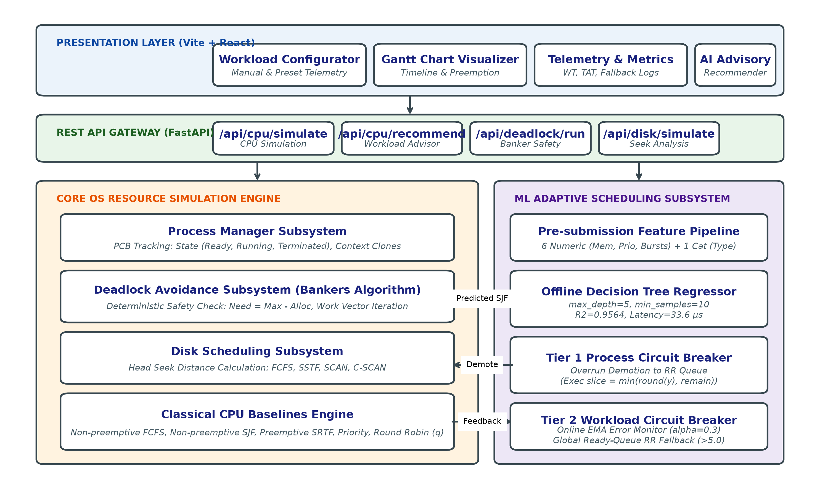
SECTION III
System Architecture
Four-layer modular design: Presentation, API Gateway, Core Engine, ML Intelligence
Fig. 1. Unified Operating System Resource Management Simulator Architecture

Slide 5
SECTION III-B
Technology Stack & Implementation
FRONTEND
BACKEND
ML & DATA
TESTING
React 18.2 (Component-based UI)
Vite 5.2 (Build tooling & HMR)
Tailwind CSS 3.4 (Utility-first styling)
Lucide React (Icon system)
Axios (HTTP client for REST calls)
Python 3.14 (Runtime)
FastAPI (Async REST framework)
Uvicorn (ASGI server)
Pydantic 2.0 (Schema validation)
Scikit-learn 1.3 (DecisionTreeRegressor)
NumPy (Numerical operations)
Pandas (Dataframe operations)
Joblib (Model serialization)
Pytest (11 automated unit tests)
3 Deadlock + 4 Disk + 4 CPU/ML
All 11 tests passing

Slide 6
SECTION IV-A
Classical CPU Scheduling Baselines
Non-preemptive and preemptive baselines for controlled benchmarking
FCFS
SJF
SRTF
First-Come, First-Served
Shortest Job First
Shortest Remaining Time First
Processes execute in arrival order. Simple but susceptible to the convoy effect where short processes wait behind long ones.
Non-preemptive. Provably minimizes average waiting time but requires future burst knowledge -- impossible in real systems.
Preemptive variant of SJF. Shorter arriving processes interrupt longer running ones. Theoretical optimum for preemptive scheduling.
Round Robin
Priority
Time-Sliced Fair Scheduling
Static Priority-Based
Fixed quantum q=2 ensures equal CPU distribution. Fair but can increase average waiting time for heterogeneous workloads.
Higher-priority processes execute first. Risks starvation of low-priority processes without aging mechanisms.
Metrics Computed: Waiting Time (Wi = Starti - Arrivali) | Turnaround Time (Ti = Completioni - Arrivali) | Response Time (Ri = FirstRuni - Arrivali)

Slide 7
SECTION IV-B
ML-Based Burst-Time Prediction
Decision Tree Regressor trained on leakage-safe pre-submission features
7-DIMENSIONAL FEATURE VECTOR
MODEL CONFIGURATION
NUMERIC (6 features)
requested_memory_mb (64 - 4096 MB)
static_priority (0 - 19)
historical_burst_avg (auto-derived)
past_burst_1 (most recent)
past_burst_2 (second recent)
past_burst_3 (third recent)
CATEGORICAL (1 feature)
process_type: interactive | bursty | batch
Model: DecisionTreeRegressor
max_depth = 5
min_samples_leaf = 10
criterion = squared_error
random_state = 42
Pipeline: ColumnTransformer
Numeric: StandardScaler
Categorical: OneHotEncoder(handle_unknown='ignore')
Leakage Safety [4]:
Enrichment never exposes true future burst
Historical bursts auto-derived from burst_time

Slide 8
SECTION IV-B.2
Synthetic Workload Generation & Process Types
Training: 2,000 records | Testing: 500 records | Fixed random seed
INTERACTIVE
BURSTY
BATCH
GUI, Terminals, Shells
Database Queries, Web Servers
Compilers, Data Processing
Distribution: Exponential (mean=3)
Burst Range: 1-4 ms
Memory: 64-256 MB
Priority: 0-5 (high)
real: expovariate(1/3)
Distribution: Pareto (alpha=1.5)
Burst Range: 5-13 ms (heavy-tailed)
Memory: 256-1024 MB
Priority: 5-10 (medium)
real: paretovariate(1.5) * 5
Distribution: Gaussian (mean=25, std=5)
Burst Range: 14-30+ ms
Memory: 1024-4096 MB
Priority: 10-19 (low)
real: gauss(25, 5)

Slide 9
SECTION IV-C/D
Predicted-SJF Scheduling & Two-Tier Adaptive Fallback
Bounded execution slicing with process-level and workload-level circuit breakers
PREDICTED-SJF DISPATCH
TIER 2: WORKLOAD-LEVEL EMA CIRCUIT BREAKER
Ready queue sorted by predicted burst y (not actual).
Bounded slice: slice = min(max(1, round(y)), remaining)
Prevents unbounded execution on any single prediction.
Exponential Moving Average of prediction errors:
EMA_k = alpha * |Actual_k - Predicted_k|
+ (1 - alpha) * EMA_{k-1}
Parameters:
alpha = 0.3 (smoothing factor)
threshold = 5.0 ticks
When EMA > 5.0:
-> Entire ready queue reverts to Round Robin
-> EMA resets to 0.0 to allow ML recovery
-> Inspired by Mixture-of-Schedulers [5]
TIER 1: PROCESS-LEVEL CIRCUIT BREAKER
If a process exceeds its predicted slice without
completing (actual burst > predicted burst):
-> Process is demoted to Round Robin queue
-> Prediction error logged for EMA tracking
-> Prevents starvation of other ready processes

Slide 10
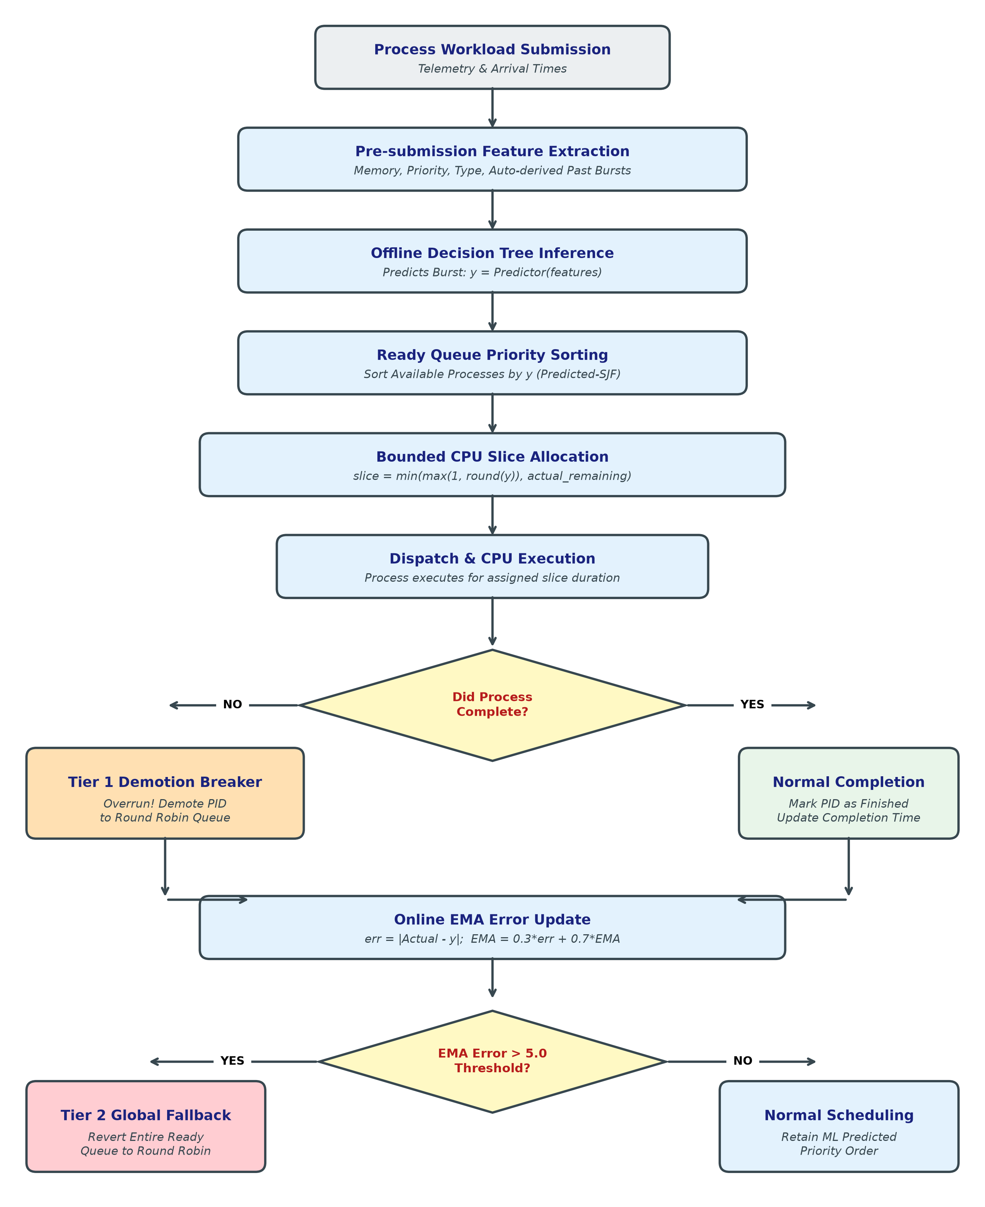
SECTION IV-D.2
Scheduling Decision Flowchart
Complete execution flow from process submission to fallback resolution
Fig. 2. Flowchart of ML-Augmented CPU Scheduling with Two-Tier Adaptive Fallback Mechanism

Slide 11
SECTION IV-E
AI Auto-Select Algorithm Recommender
Meta-learning classifier for workload-aware algorithm selection
WORKLOAD FEATURE EXTRACTION
CLASSIFICATION RULES
Feature vector X = [count, mu_burst, sigma_burst, var_arrival]
count: Total processes in ready queue
mu_burst: Mean CPU burst duration
sigma_burst: Standard deviation of bursts
var_arrival: Variance in arrival times
Model: DecisionTreeClassifier
Maps workload statistics -> optimal algorithm
High burst variance (sigma high)
-> SJF
Convoy effect prevention
Low variance, high count
-> Round Robin
Fair time-slicing
Short uniform bursts at t=0
-> FCFS
Minimal queueing overhead
Mixed arrival, staggered priority
-> Priority
Urgency-based allocation

Slide 12
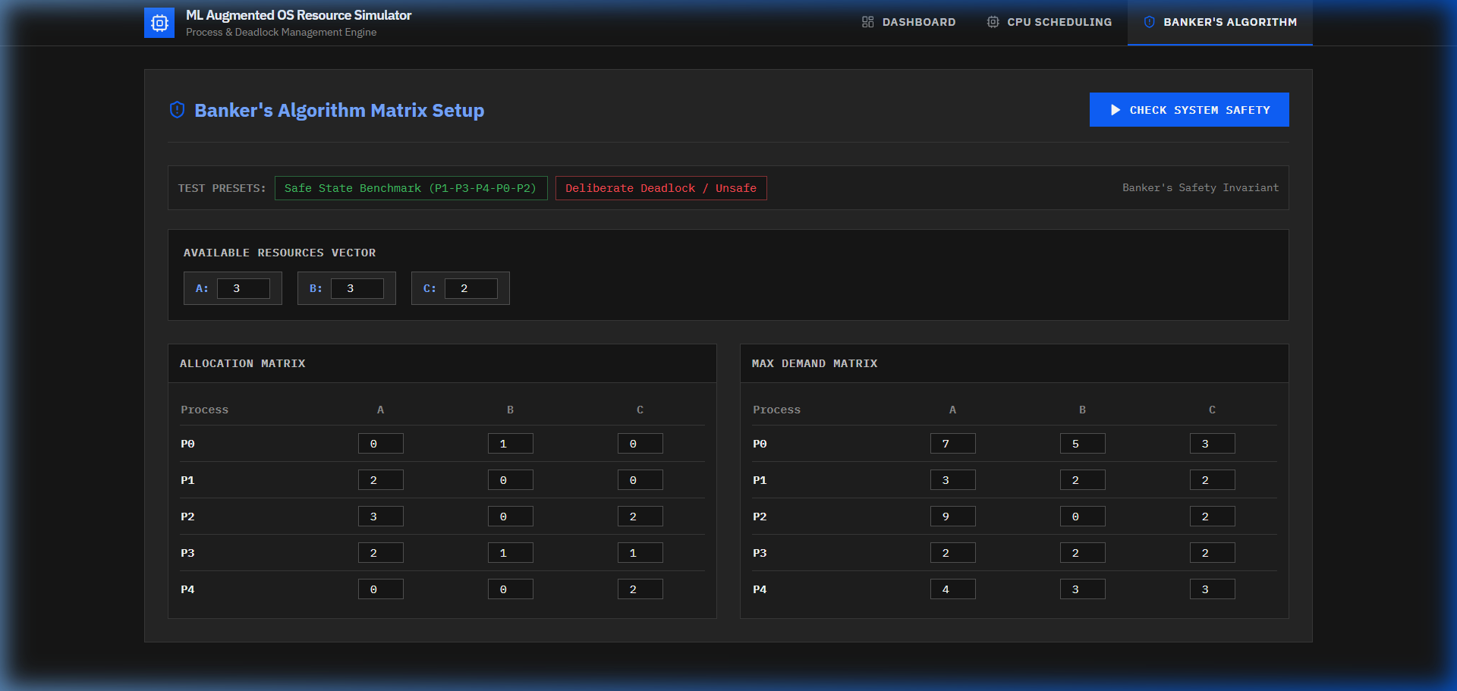
SECTION IV-F
Deadlock Avoidance: Banker's Algorithm
Deterministic safety verification -- ML deliberately excluded from safety-critical path
BANKER'S ALGORITHM (DIJKSTRA)
Need[i][j] = Max[i][j] - Allocation[i][j]
For each unfinished process:
Check: Need[i] <= Work
If true: Work += Allocation[i]
Mark process as finished
If all processes finish -> SAFE STATE
If stuck -> UNSAFE STATE (deadlock risk)
Why no ML here?
False-negative = missed deadlock path
Cost of error >> any throughput gain [11]
Fig. 3. Banker's Algorithm interface with safe sequence verification

Slide 13
SECTION IV-G
Disk Scheduling Subsystem
Classical seek-distance algorithms with ML extension identified for future work [12]
FCFS
SSTF
SCAN
C-SCAN
Arrival Order
Shortest Seek Time First
Elevator Algorithm
Circular SCAN
Serves requests in order of arrival.
Simple but produces inefficient head movement.
Serves nearest request first.
Reduces seek time but risks starvation of distant requests.
Head sweeps in one direction servicing requests, then reverses.
Balances seek time with fairness.
Like SCAN but returns to start without servicing on return.
Provides more uniform wait times.
Metrics: Total Seek Distance | Service Sequence | Average Seek Time per Request
Future Work: Predict-then-shortest-first I/O scheduling, structurally analogous to CPU approach [12]

Slide 14
SECTION V
Experimental Setup
Training Dataset
2,000 synthetically generated process records from a mixture of distributions:
Interactive: Exponential (mean=3) | Batch: Gaussian (mean=25, std=5) | Bursty: Pareto (alpha=1.5)
Fixed random seed (42) for reproducibility.
Test Dataset
500 records from subsequent block of the same generator stream.
Deliberately injected burst anomaly to probe fallback resilience.
Strictly sequentially partitioned (no data leakage).
Scheduling Benchmarks
All scheduling comparisons conducted on identical process streams.
Five policies under test: FCFS, Round Robin (q=2), Predicted-SJF, Oracle SJF, Oracle SRTF.
Automated Testing
11-unit test suite: 3 deadlock (safe/unsafe/boundary) + 4 disk (FCFS/SSTF/SCAN/C-SCAN) + 4 CPU/ML.
All 11 tests passing.

Slide 15
SECTION VI-A
Results: ML Model Validation
Burst-time prediction accuracy on held-out 500-record test set
MAE
RMSE
R-squared
Tree Inference
Pipeline
1.19 ms
2.21 ms
0.9564
5.80 us
33.6 us
Mean Absolute Error
Root Mean Squared Error
Coefficient of Determination
Raw decision traversal
End-to-end serving
FEATURE IMPORTANCE (Gini)
requested_memory_mb
92.29%
past_burst_1
7.32%
historical_burst_avg
0.26%
static_priority
0.07%
other features
0.06%

Slide 16
SECTION VI-B
Results: Comparative Scheduling Performance
Default 5-process batch benchmark: Waiting Time and Turnaround Time comparison
Scheduling Policy
Avg WT (ms)
Avg TAT (ms)
vs FCFS
FCFS
9.0
14.2
Baseline
Round Robin (q=2)
13.0
18.2
+44.4%
Predicted-SJF (ML)
7.2
12.4
-20.0%
Oracle SJF (Ideal)
7.2
12.4
Theoretical
Oracle SRTF (Ideal)
6.8
12.0
Theoretical
Predicted-SJF achieves 20-35% reduction in avg waiting time vs FCFS across tested batches.
Oracle Gap: 0.0% to 3.6% -- operating within a few percent of theoretical optimum.

Slide 17
SECTION VI-C
Adversarial Fallback Evaluation
Deceptive workload testing confirms both circuit breakers activate correctly
Adversarial Workload Design:
Processes with deceptive low-burst telemetry (predicted ~2.8 ms)
but true burst times of 18-24 ms.
process_type='interactive', memory=128MB, past bursts all ~2.0ms
Tier 1 Activation:
Deceptive process executes its predicted slice (~3 ticks).
Process not complete -> immediate demotion to RR queue.
Logged: 'Exceeded predicted burst (3ms predicted vs 18ms actual)'
Tier 2 Activation:
Sustained errors drive EMA above 5.0-tick threshold.
Entire ready queue reverts to Round Robin globally.
Catastrophic starvation bounded in both single-process and workload-wide cases.
Validated by: test_cpu_adversarial_circuit_breaker() in test_cpu.py

Slide 18
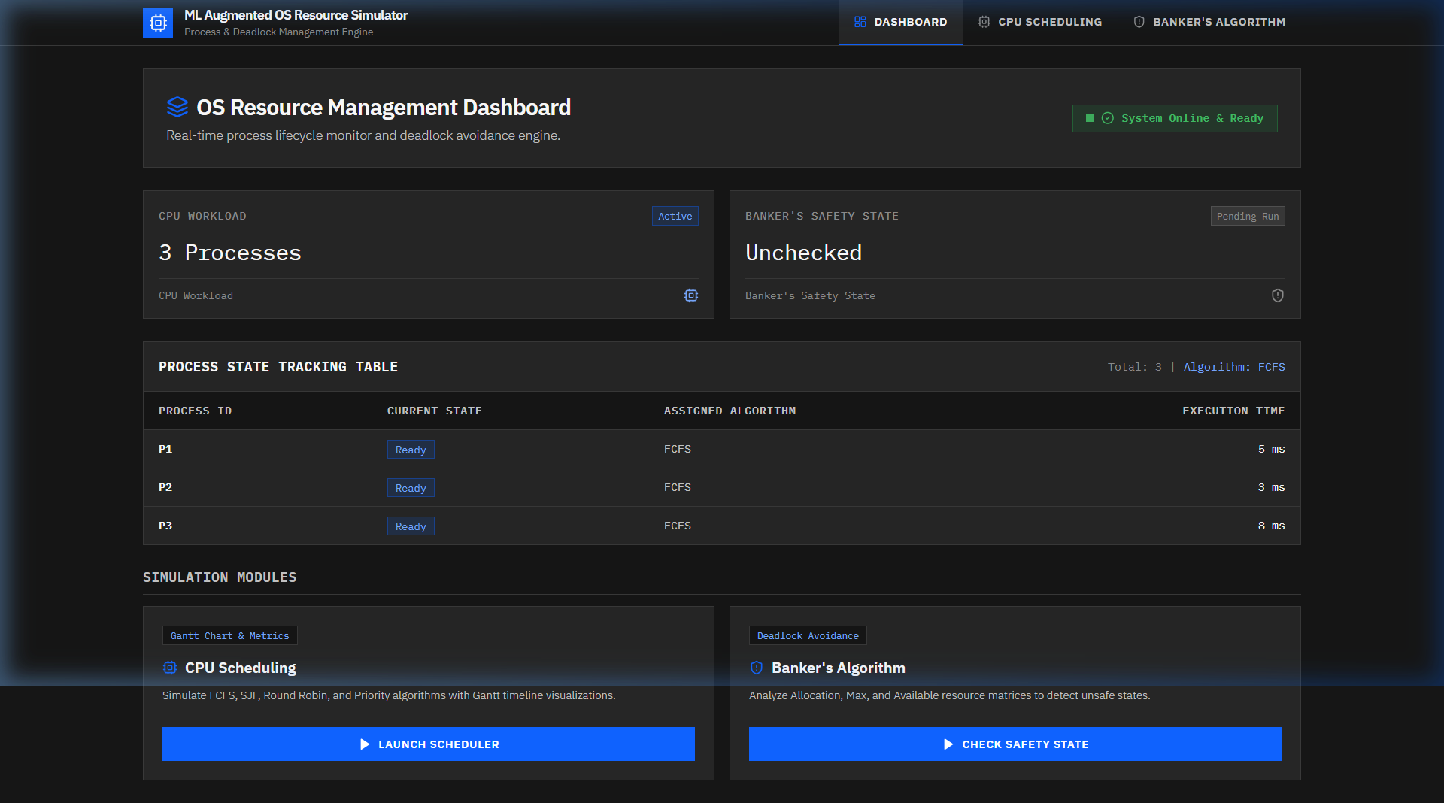
SECTION VII
Interactive Dashboard & Visualization
Fig. 4. Executive Dashboard with unified monitoring across CPU, Deadlock, and Disk subsystems

Slide 19
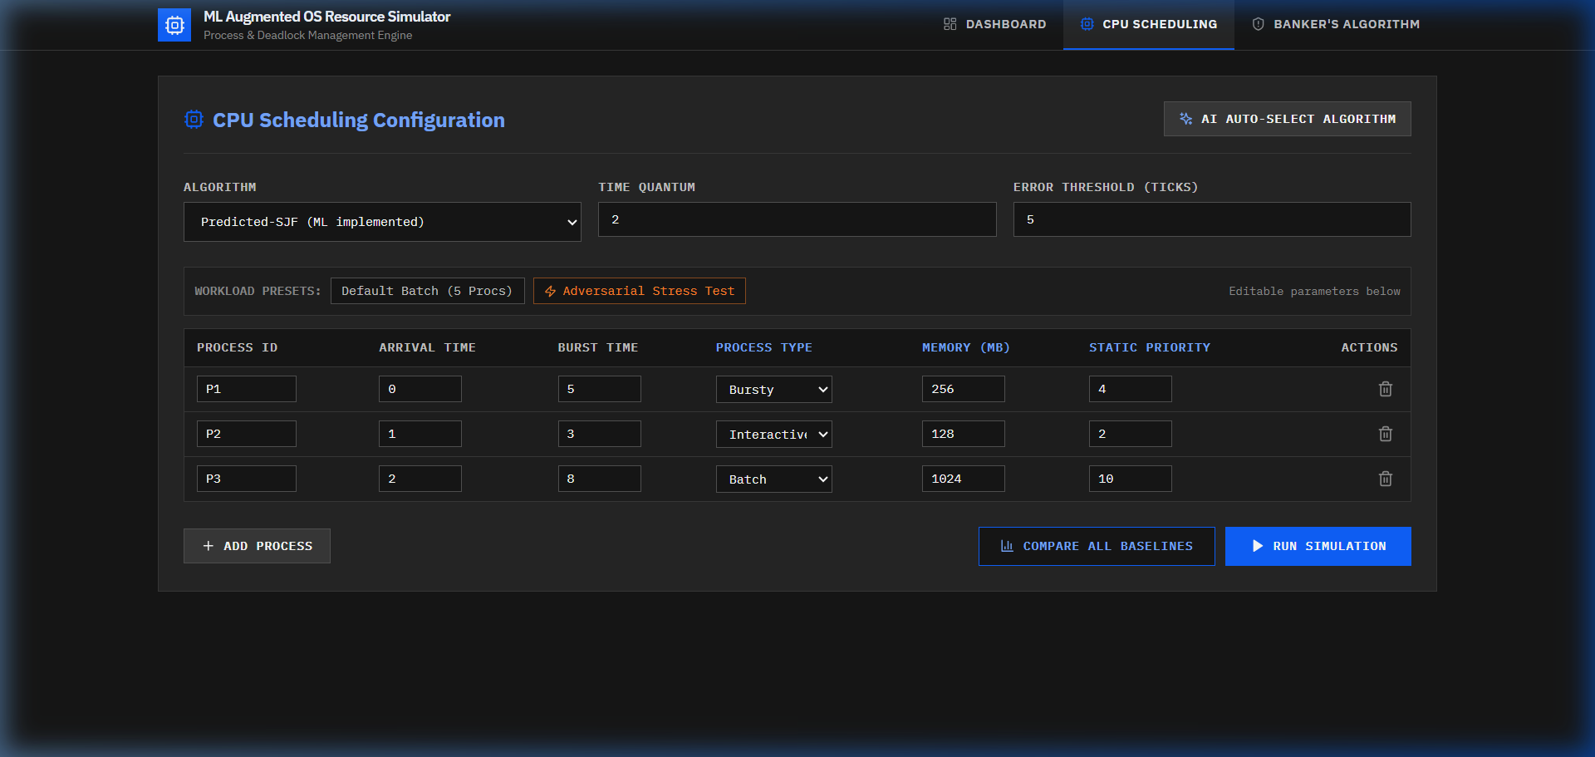
SECTION VII-B
CPU Scheduling Interface: Predicted-SJF Execution
Fig. 5. ML-Augmented CPU Scheduling: Process telemetry inputs, Gantt timeline, and performance metrics

Slide 20
SECTION VIII
Discussion, Scope & Limitations
KEY DESIGN DECISIONS
LIMITATIONS
Banker's Algorithm kept deterministic:
Cost of false-negative (missed deadlock) >>
any gain from ML prediction [11].
Disk scheduling implemented classically:
ML extension identified as future work.
Predict-then-shortest-first pattern validated
on CPU side has analogous I/O precedent [12].
Decision Tree over ensemble models:
Interpretable, inspectable decision rules.
Meets 50us dispatch latency budget.
7.8 KB fits in L1/L2 CPU cache.
Test set drawn from same generator stream
and distributional family as training set.
Generalization to structurally different
workload distributions or real production
traces is untested.
Single-core scheduling only.
Multicore extension left for future work.
AI recommender uses synthetic heuristic
training data, not empirical benchmarks.

Slide 21
SECTION IX
Conclusion & Future Work
CONCLUSION
FUTURE WORK
Decision Tree Regressor predicts CPU burst
times with R-squared = 0.9564, MAE = 1.19 ms.
Two-tier adaptive fallback controls risks
of wrong predictions at both process and
workload levels.
20-35% reduction in avg waiting time vs FCFS.
0.0-3.6% gap from theoretical Oracle SJF.
All within 33.6 us inference latency budget.
11/11 automated tests passing.
1. ML-Enhanced Disk Scheduling
Predict-then-shortest-first I/O scheduling
as proposed in [12].
2. Model Comparison
Small MLP vs Decision Tree to evaluate
accuracy-interpretability tradeoff [8].
3. Multicore Scheduling
Extend to multi-queue architectures
as described in [10].
4. Real Workload Traces
Validate on Google Borg or Azure traces.

Slide 22
SECTION
References
[1] T. Helmy et al., "ML-based approach to estimate CPU-burst time," IEEE AIMS, 2015.
[2] "CPU Burst-Time Estimation using ML," IEEE DELCON, 2022.
[3] "Predicting CPU Burst Times with ML for SJF/SRTF," ResearchGate, 2025.
[4] "Leakage-Safe ML for Grid Job Runtime Prediction," arXiv:2609.13701, 2025.
[5] "Mixture-of-Schedulers: Learned Router for Expert Policies," arXiv:2511.11628, 2025.
[6] "KernelOracle: Predicting Linux CFS with Deep Learning," arXiv:2505.15213, 2025.
[7] "Aegis: A Learning-Based Linux Scheduler," arXiv:2510.08479, 2025.
[8] "ML for Energy-Performance-aware Scheduling," arXiv:2601.23134, 2026.
[9] "ML for Scheduling: Solver-Centric to Data-Centric," arXiv:2512.22642, 2025.
[10] "CPU scheduling: classical to learning-based," Computing, Springer, 2026.
[11] "Deep Learning for Deadlock Detection," IEEE, 2025.
[12] A. Joukov et al., "ML-Based I/O Scheduling," Stony Brook, FSL-25-07, 2025.

Slide 23
Thank You
Questions & Discussion
Dr. Amar Buchade | amar.buchade@vit.edu
Swaroop Lenka | Samarth Kulkarni | Madhur Nichal
Department of AI and Data Science, VIT Pune

