Slide 1
Predict Profit Value of the Company
By,
Samarth Pandey
EXPOSYS DATA LABS
Data Science Internship

Slide 2

Introduction:
The profit earned by a company for a particular period depends on several factors like how much time and money a company spends on R&D, marketing and many more. So, for predicting the profit of a company for a particular period we need to train a machine learning model with a dataset that contains historical data about the profit generated by the company.

Slide 3
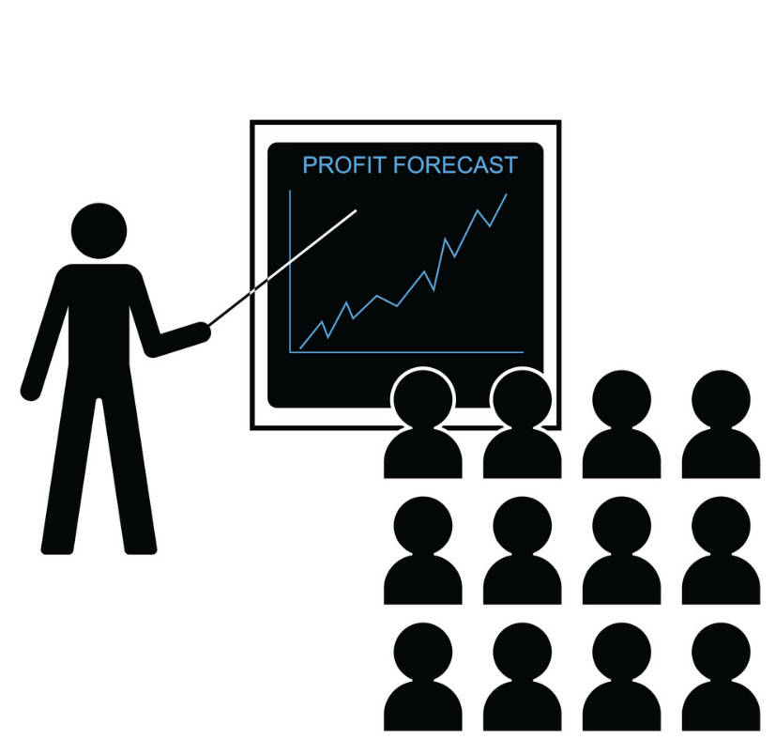
Abstract:
A company should always set a goal that should be achievable, otherwise, employees will not be able to work to their best potential if they find that the goal set by the company is unachievable. The task of profit prediction for a particular period is the same as setting goals. If you know how much profit you can make with the amount of R&D and marketing you do, then a business can make more than the predicted profit provided the predicted value is achievable.

Slide 4
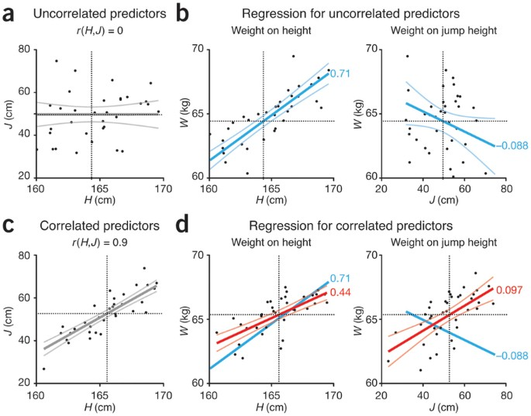
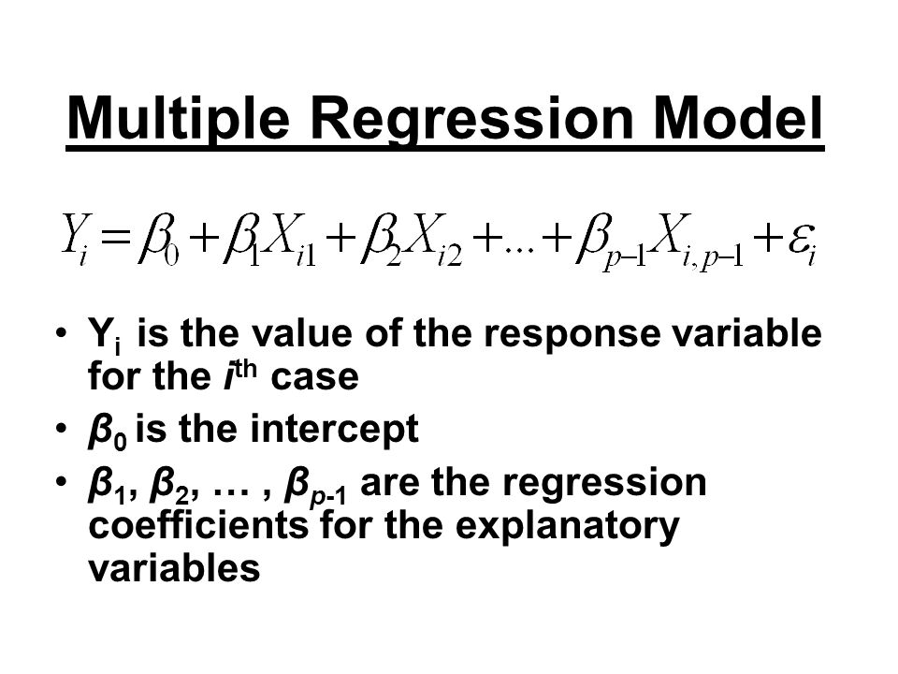
Proposed System:
We use multiple regression in this model because we have to predict profit (dependent variable) on bases of multiple field(independent variables) rather than one field just like we done in Simple Linear Regression. This model can help those people who want to invest in start-up company by analysing profit of the company.
Multiple Linear Regression, is a statistical technique that uses several explanatory variables to predict the outcome of a response variable.

Slide 5
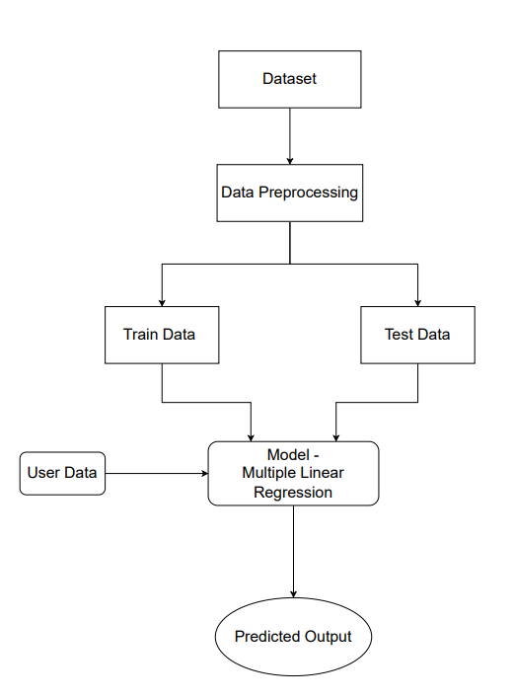
Architecture

Slide 6
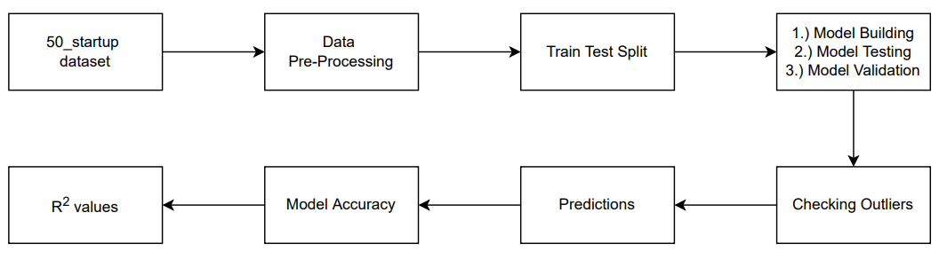
Methodology:

Slide 7
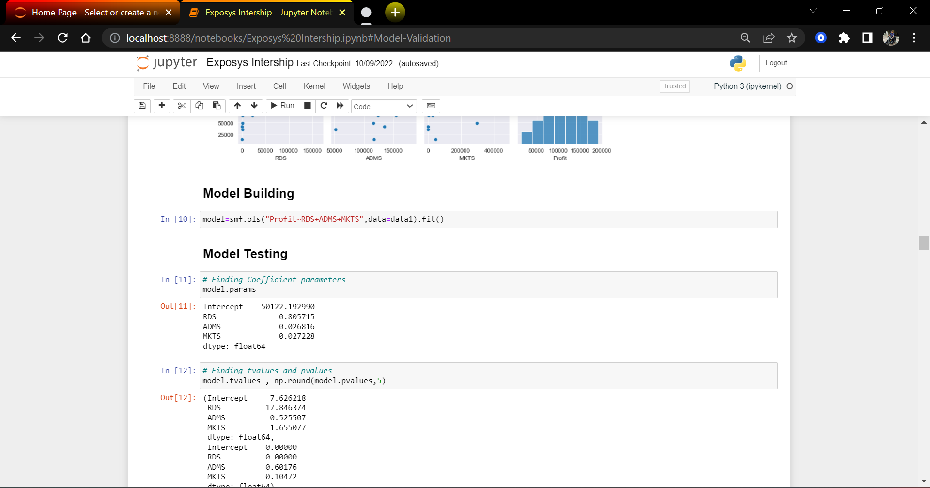
Implementation and working:

Slide 8
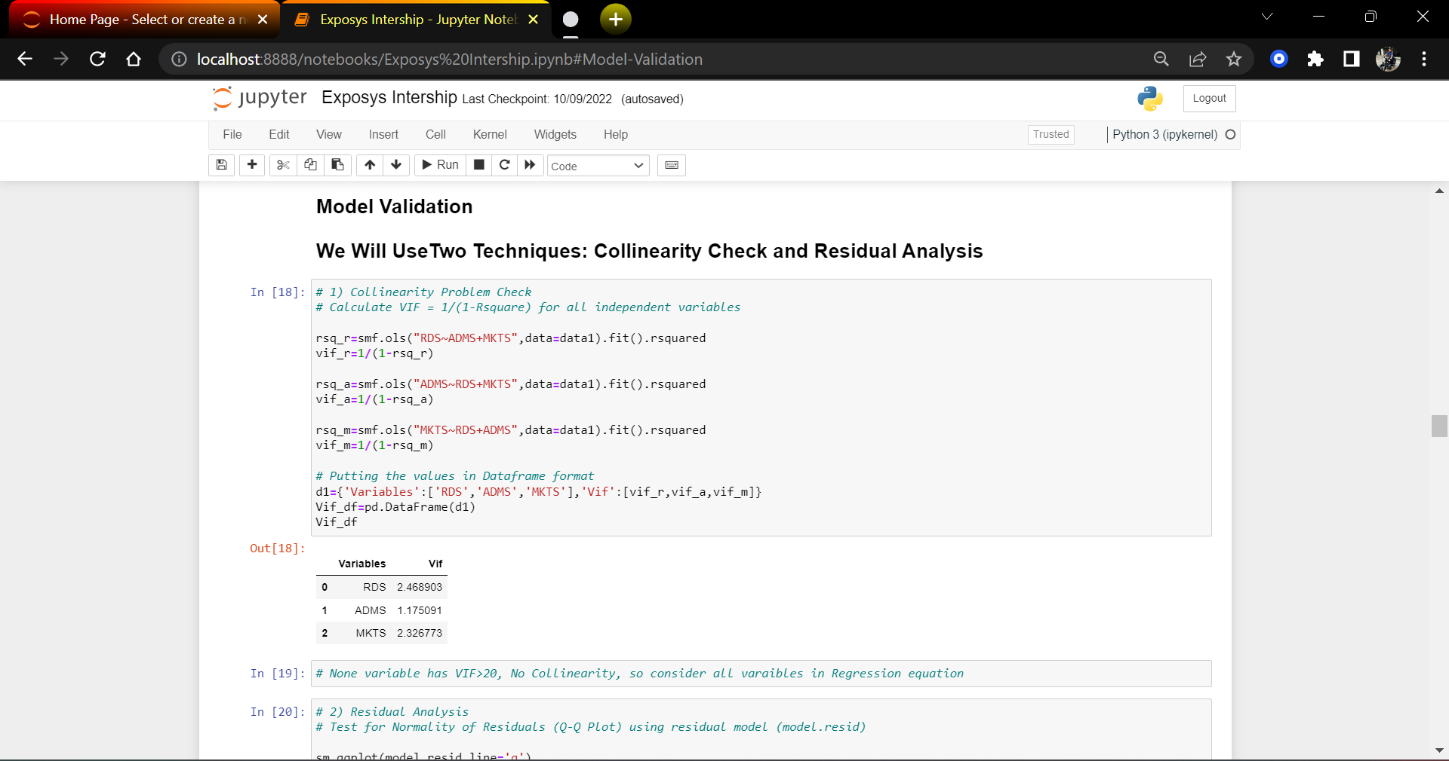

Slide 9
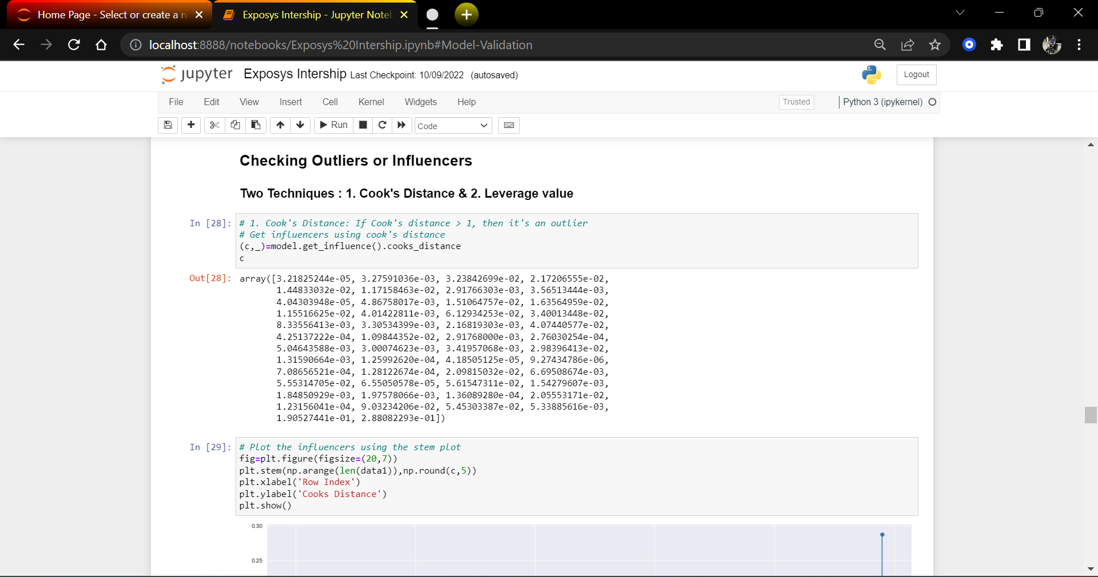

Slide 10
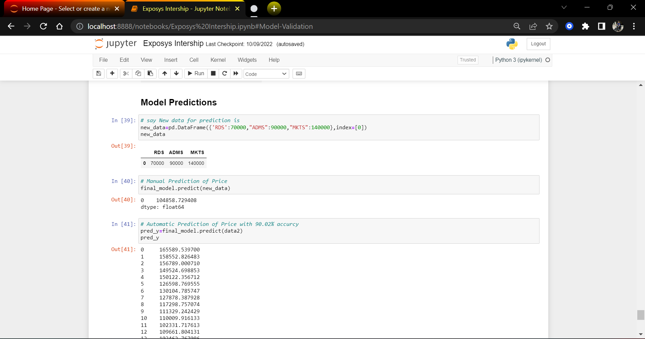

Slide 11
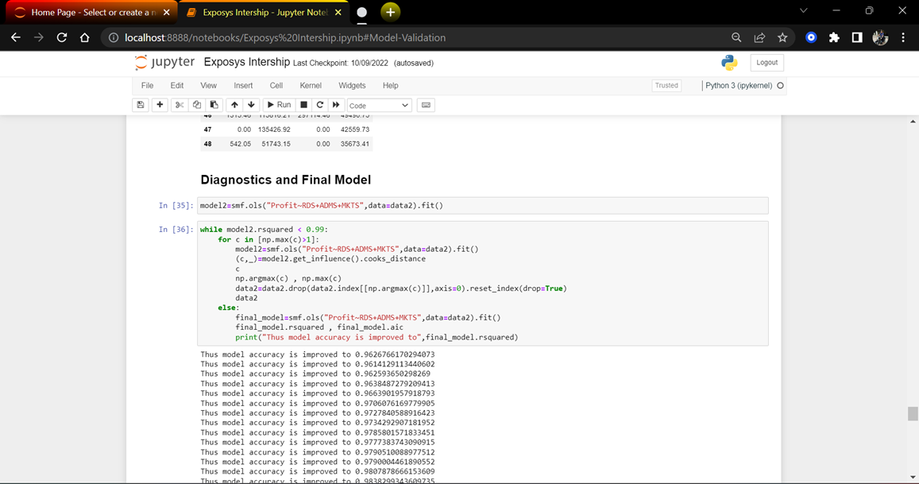

Slide 12
Conclusion:
The project’s primary goal was to prepare an ML model which can predict the profit value of a company if the value of its R&D Spend, Administration Cost and Marketing Spend are given.
Multiple Linear Regression Analysis consists of more than just fitting a linear line through a cloud of data points. It consists of three stages: 1) analysing the correlation and directionality of the data, 2) estimating the model, i.e., fitting the line, and 3) evaluating the validity and usefulness of the model.

