Slide 1
Small Language Models: Survey, Measurements, and Insights
Authors: Zhenyan Lu, Xiang Li, Dongqi Cai, et al.
Affiliation: Beijing University of Posts and Telecommunications, Peng Cheng Laboratory, etc.
Short Story by: Samarth Sharma

Slide 2
Introduction
Small Language Models (SLMs) focus on efficiency and resource constraints.
Aim for democratizing AI by making it affordable and accessible.
Scope: Models between 100M–5B parameters with on-device deployment.

Slide 3
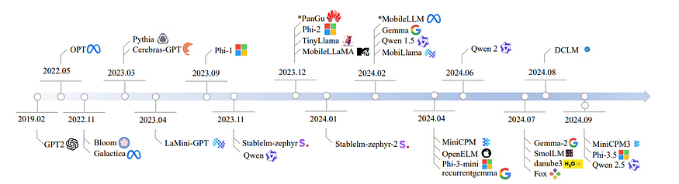

Slide 4
Key Contributions
Comprehensive review of 59 state-of-the-art SLMs.
Benchmarking:
- Commonsense reasoning.
- Mathematics.
- In-context learning.
Evaluation of runtime costs like memory footprint and latency.

Slide 5
SLM Architectures
Decoder-only transformer models.
Innovations:
- Group Query Attention (GQA).
- RMS Normalization.
Vocabulary size trends (>50k for latest SLMs).

Slide 6
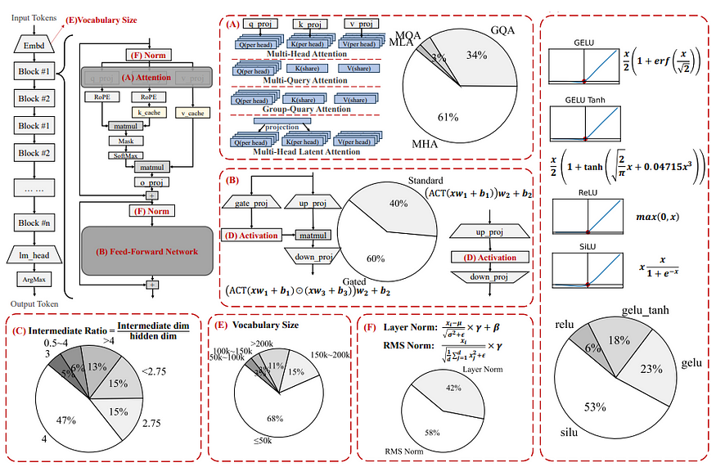

Slide 7
Training Insights
Popular datasets include The Pile, RedPajama, and RefinedWeb.
Trends toward using model-based filtering.
Overtraining compared to Chinchilla law for better deployment.

Slide 8
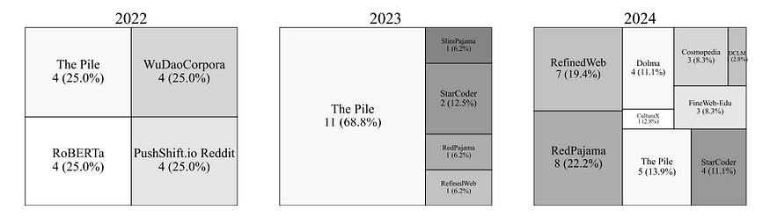

Slide 9
Evaluation
Tasks:
- Commonsense reasoning.
- Problem-solving.
- Mathematics.
Key Metrics: Accuracy (e.g., Phi-3-mini leads in Math).
Insights: SLMs closing gaps with LLMs in many tasks.

Slide 10
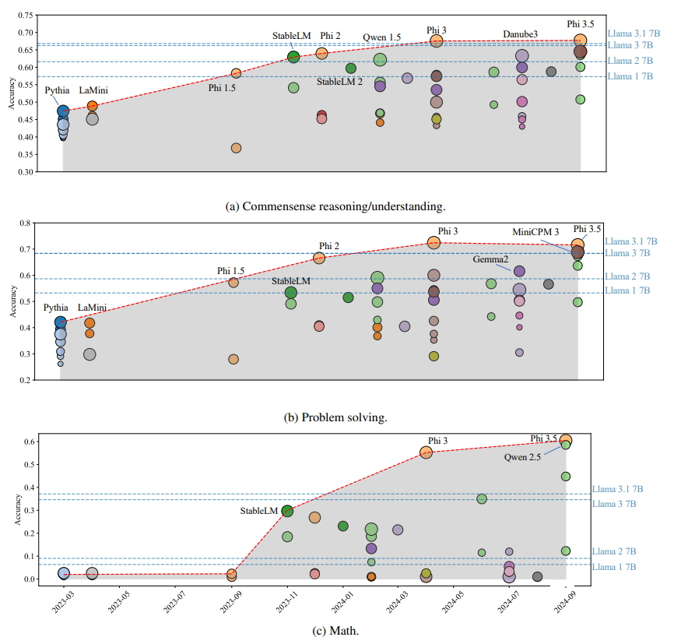

Slide 11
In-Context Learning
Improves accuracy by ~2.1% on average.
Larger models excel more in this capability.
Tasks like the ARC Challenge benefit significantly, simpler tasks less so.

Slide 12
Runtime Costs
Measured on Jetson Orin (GPU) and smartphones (CPU).
Quantization reduces latency and memory usage.
Challenges: Larger vocabularies increase memory demands.

Slide 13
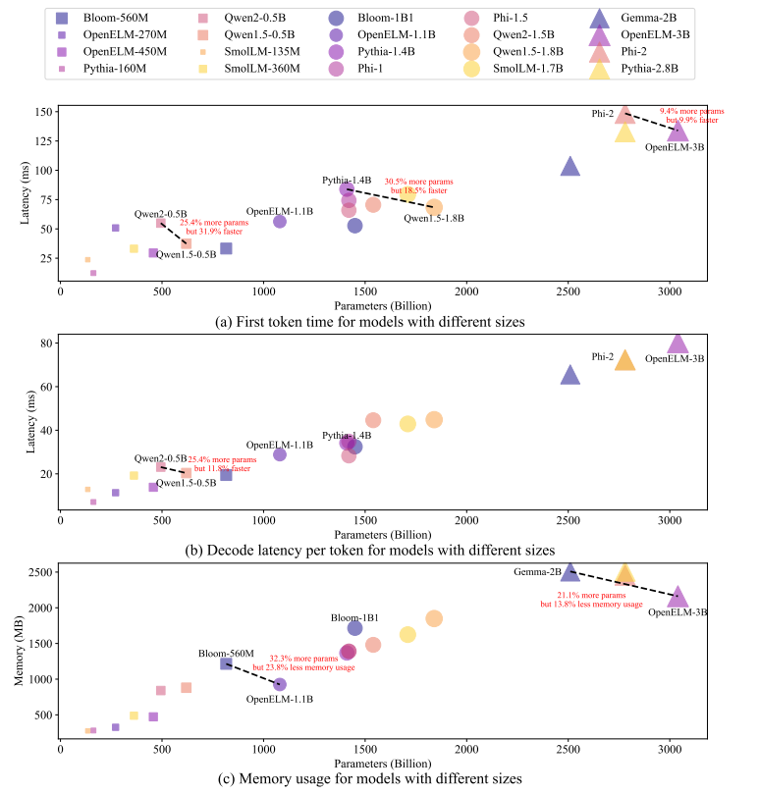

Slide 14
Insights and Future Directions
Architectural choices impact runtime costs more than parameter count.
SLMs are significantly overtrained for robustness in real-world deployment.
Need for specialized datasets for tasks like mathematics and logic.

Slide 15
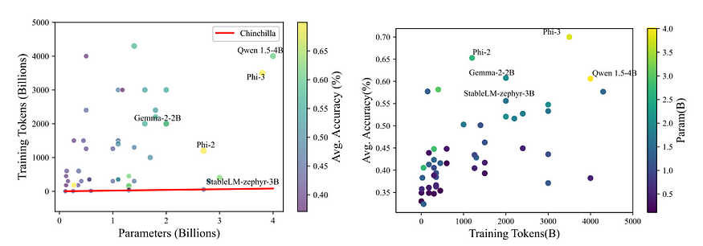

Slide 16
Conclusion
SLMs show remarkable growth and potential.
Practical for on-device applications, with progress in commonsense reasoning and efficiency.

Slide 17
References
GitHub repository link for more details: https://github.com/UbiquitousLearning/SLM_Survey.

