Slide 1

CINEVERSE
Presented by:
SAMARTH VARMA (241FA04F69)
ABHINAY CHOWDARY (241FA04696)
THARUN (241FA04470)

Slide 2



MERN STACK
Training Program Project
CineVerse
Full-Stack Movie Discovery & Management Platform
TEAM NAME
TEAM MEMBERS & REGISTRATION
DevDynamos
Samarth Varma Mandapati (241FA04F69) — Lead
Swarna Abhinay (241FA04696) • Devarapalli Tharun (241FA04470)

Slide 3


CONTEXT & CHALLENGE
Introduction & Problem Statement
The Core Problem
The CineVerse Solution
Digital streaming content overload makes film discovery difficult. Standard student prototypes rely on static mock files (db.json) with zero real database persistence or concurrent updates.
A full-stack MERN web application engineered with a real-time reactive UI and cloud persistence powered by MongoDB Atlas.
Dispersed streaming interfaces lack community ratings and instant personal watchlists.
Pre-seeded with 36+ curated films, offering live search, genre filtering, watchlists, and verified reviews.

Slide 4
STRATEGIC GOALS
Project Objectives & Scope
MERN Integration
Full CRUD Operations
Secure Authentication
High-Performance UI
End-to-end web system connecting MongoDB, Express, React, and Node.
Complete record creation, updating, and deletion for movies and reviews.
Stateless token authorization using JSON Web Tokens (JWT) & bcrypt.
Matte-black cinema interface featuring 250ms debounced live search.

Slide 5

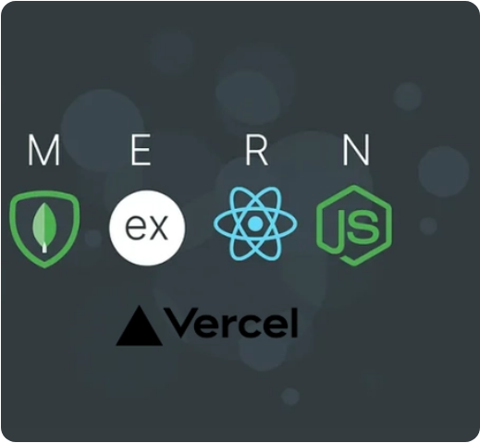
TECH STACK
Technologies & Tools Used
MongoDB Atlas
Cloud NoSQL document database with replica sets & Mongoose ODM pipeline.
Express.js & Node.js
Asynchronous REST API with MVC architecture and CORS management.
React 18 & Vite 5
Single Page Application with React Router v6 & Axios bearer interceptors.

Slide 6
ARCHITECTURE
System Architecture & 3-Tier Workflow
TIER 1
Presentation Layer (Client)
React 18 & Vite SPA • UI Rendering • Optimistic Watchlist Updates • Debounced Search
(HTTPS JSON Requests & JWT Header)
TIER 2
Application Layer (API Server)
Express.js & Node.js (Port 5000) • Request Validation • JWT Middleware • Routing
(Mongoose ODM Driver Queries)
TIER 3
Persistence Layer (Database)
MongoDB Atlas Cloud Cluster • Collections: Movies, Users, Reviews • Analytics Pipelines

Slide 7
CAPABILITIES
Key Features & Functionalities
36+ Movie Catalog
250ms Live Search
Genre Pill Navigation
Curated films across Sci-Fi, Drama, Action, Animation, and Thriller.
Debounced real-time search matching titles, genres, and directors.
Fast 1-click filtering across all main cinema categories.
Interactive Watchlist
Community Reviews
Analytics Dashboard
Instant favourite toggling with optimistic UI updates.
5-star rating system with user feedback timestamps.
Visual metrics for catalog volume and genre breakdowns.

Slide 8
PERSISTENCE & API
Database Design & REST API Endpoints
Mongoose Schemas
Key Endpoints
Movie: Title, genre, language, year, rating, duration, poster, director.
GET /api/movies — Fetch catalog with filters
POST /api/movies — Add new movie record
PUT /api/movies/:id — Update movie metadata
PATCH /api/movies/:id/favourite — Toggle watchlist
POST /api/movies/:id/reviews — Submit user review
GET /api/stats — Real-time analytics aggregate
User: Name, email (unique), password (bcrypt hash), role.
Review: Movie ref, user ref, rating (1-5), comment, compound index.

Slide 9

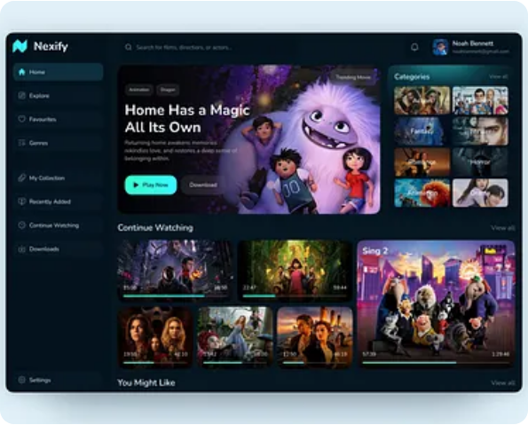
USER EXPERIENCE
Application UI Walkthrough
Catalog Grid
Dark matte-black cinema UI with hover effects, rating tags, and quick watchlist buttons.
Details & Reviews
Full film synopsis, director metadata, formatted duration, and community review section.
Catalog Analytics
Responsive breakdown metrics displaying genre percentages and ratings leaderboard.

Slide 10
ENGINEERING & ROADMAP
Challenges Faced & Future Scope
Challenges & Solutions
Future Roadmap
DNS SRV Errors: Fixed Windows/ISP connection failures by adding automated DNS fallback resolvers.
AI Recommendations: Integrate Gemini API for personalized suggestions based on watchlists.
Search Lag: Eliminated redundant API calls by implementing 250ms debouncing.
TMDB Integration: Connect external APIs for live trailer playback and metadata syncing.
UI Latency: Added optimistic state updates for favorites with automatic rollback.
Cloud Storage: Enable direct custom poster uploads via Cloudinary.

Slide 11
PROJECT SUMMARY
Conclusion & Accomplishments
Successfully engineered and deployed a production-ready MERN stack application featuring a robust 36+ movie catalog, secure authentication, cloud persistence with MongoDB Atlas, and a high-performance React client.
github.com/Samarth-Varma-M/cineverse-mern-project
Thank you! We are open to your questions and feedback.

