Slide 1
DOCKER CONTAINERIZATION
Finance Tracker Project
Name:-Samarth Chandrashekhar Sabale
Batch :- AWS batch 01

Slide 2
PROBLEM STATEMENT
Traditional deployment of financial applications like Finance Tracker often faces significant challenges, primarily the "it works on my machine" syndrome where code behaves differently across local development and cloud production environments. Without containerization, manual setup on AWS EC2 involves complex dependency management, inconsistent Python configurations, and potential library conflicts that lead to deployment failures and wasted time. Furthermore, managing persistent data—such as financial transactions—is a major hurdle, as data can be lost during container restarts or environment updates. Docker containerization solves these issues by packaging the Flask application with all its dependencies into an isolated, portable container, ensuring reliable performance and data persistence through volume mounting on the cloud..

Slide 3
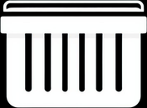


KEY DOCKER CONCEPTS
Containers: Lightweight, standalone executable packages that run the Python-Flask application in an isolated environment on AWS EC2, ensuring the app behaves the same regardless of host configurations.
Images: Read-only templates built using the python:3.9-slim base image. These contain all project dependencies like Flask and sqlite3, ensuring consistent deployment across environments..
Dockerfile: A script containing specific instructions to build the Finance Tracker image. It sets the working directory to /app, installs dependencies via requirements.txt, and exposes port 5000 for web traffic..

Slide 4
Eliminates environment-related bugs by ensuring the development, testing, and production (AWS) environments stay perfectly synchronized.
Eliminates environment-related bugs by ensuring the development, testing, and production (AWS) environments stay perfectly synchronized.
DOCKER BENEFITS
Portability
Docker allows the Finance Tracker app to be packaged with all dependencies, enabling it to run seamlessly from a local machine to an AWS EC2 cloud instance without any code changes.
Consistency:-
Eliminates environment-related bugs by ensuring the development, testing, and production (AWS) environments stay perfectly synchronized.

Slide 5
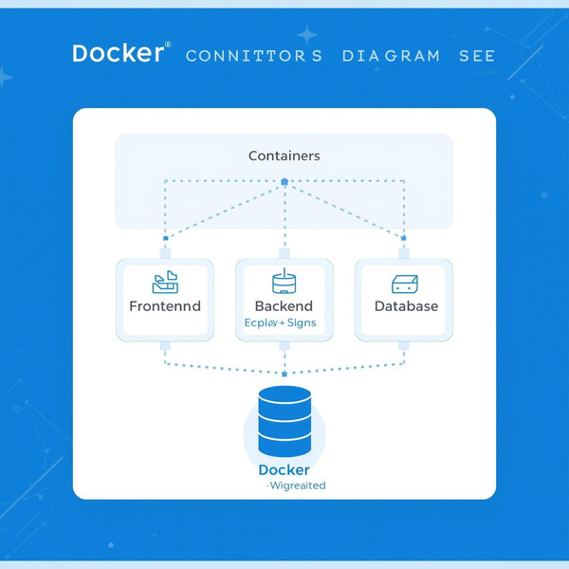
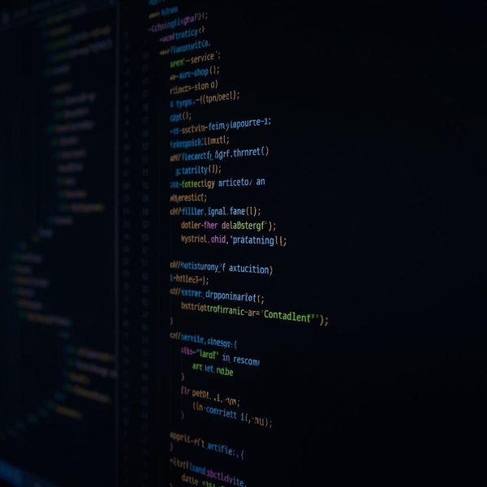
Cloud Infrastructure: The entire containerized architecture is deployed on an AWS EC2 (Ubuntu) instance, leveraging Docker for consistent environment synchronization between development and production.
DOCKER ARCHITECTURE
Integrated Web Container: A monolithic container running the Python Flask backend along with the HTML/CSS/JS frontend, serving the Finance Tracker dashboard globally via port 8080..
Flask Application Service: A RESTful backend service built with Python Flask that handles core business logic, including transaction processing and real-time dashboard updates.
Persistent SQLite Database: A file-based SQLite3 database instance managing financial records. It utilizes Docker Volume Mounting to ensure transaction data persists on the AWS EC2 host even after container restarts.
Cloud Infrastructure: The entire containerized architecture is deployed on an AWS EC2 (Ubuntu) instance, leveraging Docker for consistent environment synchronization between development and production.

Slide 6

DEPLOYMENT WORKFLOW
Build Image: Create a Dockerfile in the project root to define the base image and install dependencies. Run docker build -t finance-tracker-app . to generate the container image
Run Container: Execute docker run -d -p 8080:5000 --name my-finance-container -v "$(pwd):/app" finance-tracker-app to launch the application
External Access: Map host port 8080 to container port 5000 to allow global access via the AWS EC2 Public IP.

Slide 7
DOCKER BEST PRACTICES
For the Finance Tracker application, implementing Docker best practices ensures optimal performance and security. We utilized a python:3.9-slim base image to create a lean production environment, significantly reducing the image size. Sensitive configurations, such as the Flask secret key, are managed through environment variables rather than being hardcoded. A critical practice implemented is Volume Management, which persists the SQLite financial data outside the container, ensuring transaction history survives container restarts or updates. Additionally, we optimized the build process by using a .dockerignore file to exclude unnecessary files like __pycache__, further streamlining the deployment on AWS EC2..

Slide 8
THANK YOU!
Finance Tracker - Docker Containerization Project

