Slide 1
Smart Voting System
Modern Voting with Face Recognition

Slide 2
Project:- Smart Voting System Using Face Recognition
Student Name Roll No
Aditya Kapure AI4056
Samarth Deshmukhe AI4017
Shreyash Babar AI4018
Vinayak Bhise AI4019
Department- Artificial Intelligence and Machine Learning
Guide: Prof. R.P.Bhilawade.
Date: 08/09/2025

Slide 3
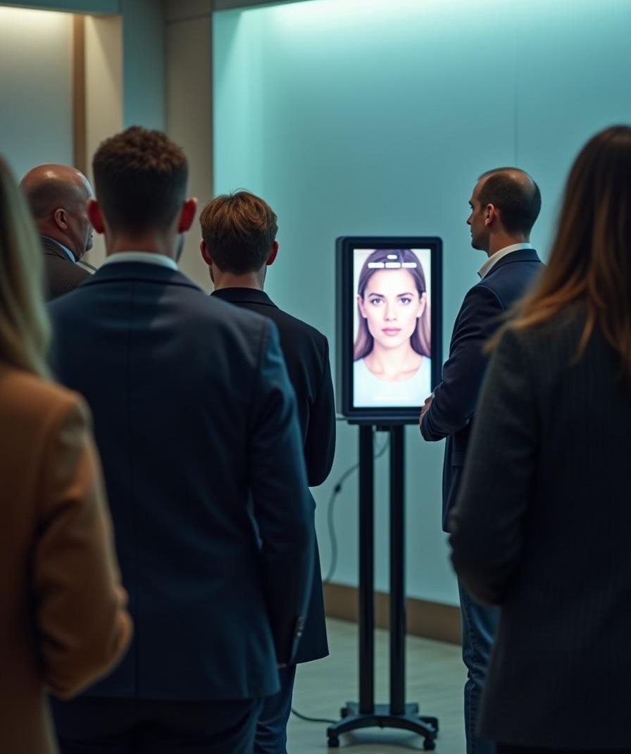
Introduction
This project addresses the need for a secure voting system using face recognition technology. It aims to improve election integrity by preventing fraud and ensuring voter authenticity in today’s digital era.

Slide 4
Problem Statement
Current voting methods are vulnerable to fraud and malpractice.
Manual voter verification is time-consuming and prone to human error.
Existing biometric systems (fingerprint, iris) have limitations: duplication risks, cost, or intrusive nature.
Gap: Lack of a user-friendly, automated, and fully integrated voting solution using face recognition.

Slide 5
Objectives
To design and develop a secure voting system using face recognition technology.
To analyze system performance and improve voter authenticity and election transparency.
To ensure unique and secure voter identification.
To develop a user-friendly digital voting interface.

Slide 6
01
Overview of Smart Voting System

Slide 7
Scope of Work
Development of a prototype voting system using face recognition.
Covers data collection, preprocessing, authentication, and secure voting.
Voters can cast votes only after successful face verification.
Limitations: Requires good camera quality, proper lighting, and a pre-registered voter database.

Slide 8
Literature Review
Biometric Voting Systems: Fingerprint and iris recognition widely studied, but fingerprints are prone to duplication, and iris scanners are costly/intrusive.
Face Recognition Advantages: Non-intrusive, user-friendly, requires only a camera.
Earlier Approaches: Traditional methods worked only in controlled environments.
Modern Approaches: CNN-based models (e.g., FaceNet, ArcFace) improved accuracy and robustness.
Limitations: Accuracy drops in poor lighting, pose variations, or occlusion; few systems address anti-spoofing.
Research Gap: Most works focus only on authentication, not full end-to-end secure voting integration.

Slide 9
Methodology
Step 1: Data Collection
Collect and store registered voters’ facial images in a secure database.
Step 2: Preprocessing
Image normalization, resizing, and enhancement.
Noise reduction and face detection using Convolution Neural Network.
Step 3: Feature Extraction
Use CNN models (FaceNet, ArcFace, or custom deep CNN) to generate embeddings.
Step 4: Authentication
Compare live image embedding with stored template.
If match is successful → voter is authenticated.

Slide 10
Step 5: Secure Voting Interface
Authenticated user can cast vote digitally.
Vote is encrypted and securely stored in a database.
Step 6: Anti-Spoofing & Security
Liveness detection to prevent photo/video attacks.
Database encryption and secure login for admins.
Tools & Technologies: Python, OpenCV, TensorFlow, MySQL, Flask
CNN, NLP, Blockchain Technology.
Our Contribution: Build a complete smart voting system combining robust face recognition + secure voting interface for transparency and reliability.

Slide 11
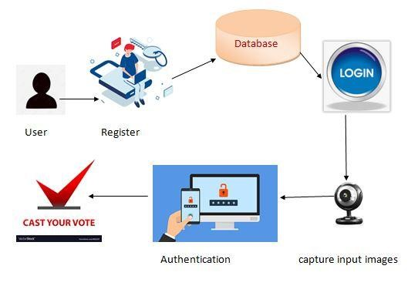

Slide 12
Expected Outcomes
Secure, automated voting system using biometric authentication.
Prevention of fake voting and impersonation.
Improved trust and transparency in elections.
Potential real-world deployment for local and national elections
Utilize a flowchart showing system process.
Implement facial recognition algorithms and secure data handling.
Expected outcomes include reduced fraud and increased trust in elections.

Slide 13
Work Plan / Timeline
Phase 1: Literature Survey & Requirement Analysis
Phase 2: System Design & Database Setup
Phase 3: Implementation of Face Recognition Module
Phase 4: Voting System Integration
Phase 5: Testing, Evaluation & Documentation

Slide 14
Conclusion
This project proposes a secure and efficient voting system using face recognition. It aims to enhance election security, reduce fraud, and build public trust through innovative technology.

Slide 15
Reference
IEEE Papers on Biometric and Face Recognition Systems.
Springer Journals on Smart Voting Technologies.
OpenCV & TensorFlow official documentation.
Election Commission Guidelines on Secure Voting Systems

Slide 16
Thank You

