Slide 1
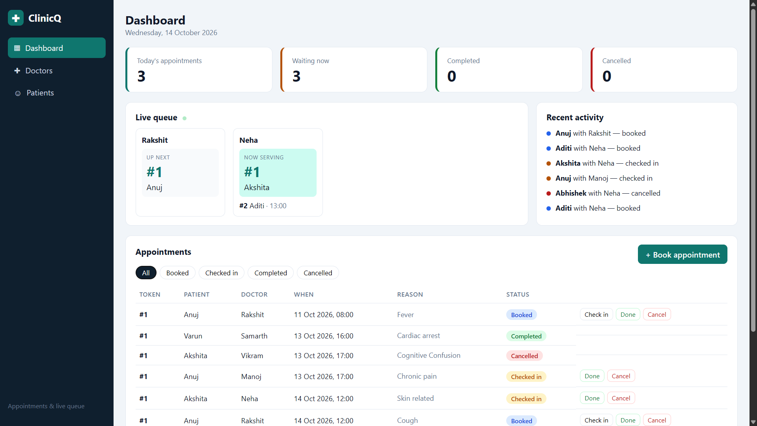
ClinicQ
Less waiting, better care
Clinic appointment booking and live queue, shipped end to end on AWS
DevOps Final Capstone · Samarth
github.com/Samarth1-glitch/ClinicQ
Notes:
Introduce yourself and the project. ClinicQ is a small clinic system: patients book a slot with a doctor, the front desk checks them in, and a live queue shows who is next. The point of the capstone is not the app itself but everything around it: tests, containers, a security-gated pipeline, Terraform-built AWS infrastructure, Helm on Kubernetes, autoscaling and monitoring. Roughly 15 to 20 minutes including the live demo.

Slide 2
ClinicQ: booking and queue on one screen
INTRO
Small clinics run on paper tokens and a receptionist's memory. ClinicQ puts booking and the queue on one screen.
Book a slot with a doctor
Check-in issues a token per doctor
Booked, checked in, completed
Double-booking gives HTTP 409
ClinicQ dashboard: stats, live queue per doctor, appointments
Notes:
Keep this short. The problem: walk-in clinics hand out paper tokens and shout names. ClinicQ gives each doctor a numbered queue per day. Mention the double-booking rule (the same doctor and slot returns HTTP 409) because it shows up again in the tests. The dashboard on the right is the real running app: stat cards, the live queue per doctor, recent activity and the appointment table with check-in, done and cancel actions.

Slide 3
The stack, layer by layer
INTRO
FRONTEND
BACKEND
DATABASE
QUALITY
React 18 + Vite
FastAPI
PostgreSQL
pytest + ruff
served by nginx
SQLAlchemy 2, Pydantic
Alembic migrations
24 tests on SQLite
PACKAGING
PIPELINE
PLATFORM
OPERATIONS
Docker
GitHub Actions
Terraform + EKS
Prometheus
multi-stage, non-root
GHCR registry, Trivy
VPC, Spot nodes
Helm, Grafana, HPA
Notes:
One slide to orient the audience before the details. Frontend is React 18 with Vite, served by nginx. The backend is FastAPI with SQLAlchemy 2 and Pydantic, talking to PostgreSQL, with Alembic managing the schema. Quality gates are pytest and ruff. Docker packages it, GitHub Actions builds and scans it, Terraform builds the AWS platform, and Helm plus Prometheus and Grafana run and observe it. Every layer is code in one repository.

Slide 4
From one commit to a running pod
INTRO
1
2
3
4
5
Commit
CI
Image
Scan
Registry
push to main
ruff, pytest, build
Docker, tagged by SHA
Trivy blocks HIGH
GitHub Container Registry
Slide 10
Slide 10
Slide 8
Slide 11
Slide 12
6
7
8
9
Terraform
Helm
Ingress
Observe
VPC and EKS
chart to the cluster
one public address
HPA, Prometheus, Grafana
Slide 13
Slide 16
Slide 18
Slide 20
Notes:
This is the map for the rest of the talk. Each numbered box is a slide that follows. The idea: nothing reaches the cluster by hand. A push to main triggers tests, a build, a security scan, a push to the registry and a Helm deploy. Terraform builds the platform underneath once.

Slide 5
Architecture at a glance
BUILD
Developer
git push
AWS ap-south-1 · VPC and EKS, built with Terraform
Ingress
NGINX
Frontend
React, nginx x2
Backend
FastAPI x2
PostgreSQL
StatefulSet, PVC
GitHub Actions
test, build, scan
helm
Prometheus
scrapes /metrics
Grafana
dashboards
An HPA scales the backend from 2 to 5 pods on CPU load.
GHCR
images by SHA
pull
Notes:
Walk left to right. Developer pushes to GitHub, Actions builds and scans, images land in GHCR. Terraform created the AWS network and the EKS cluster. Inside the cluster the ingress sends the root path to the React frontend (nginx) and /api to FastAPI. FastAPI talks to PostgreSQL, which is a StatefulSet with a volume. Prometheus scrapes the backend, Grafana reads Prometheus, and an HPA scales the backend between 2 and 5 pods.

Slide 6
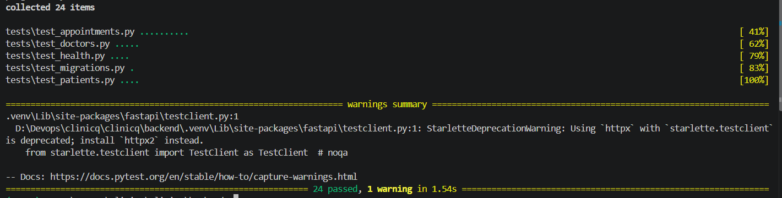
A tested API: 24 tests on every push
BUILD
24
pytest tests, run on every push. FastAPI, SQLAlchemy 2, Alembic with 2 migrations.
/api/doctors /api/patients
/api/appointments (+ /stats)
/api/queue
/health /ready /metrics
pytest -v: 24 collected, 24 passed in 1.54s
Notes:
FastAPI with SQLAlchemy 2 and Alembic migrations. Two migrations: core tables, then indexes on appointments. The tests run against in-memory SQLite so the pipeline needs no database service. They cover booking, the 409 on a double booking, token numbering per doctor per day, and the status flow. Health, ready and metrics endpoints exist for Kubernetes probes and Prometheus. The screenshot is pytest -v on my machine: 24 collected, 24 passed in 1.54 seconds.

Slide 7
A small data model with strict rules
BUILD
doctors
appointments
STATUS FLOW
booked
id PK
name
specialization
room
id PK
doctor_id FK
patient_id FK
scheduled_at
reason
status
token_number
checked_in
completed
patients
id PK
name
phone
age
cancelled
Indexes: scheduled_at, and (doctor_id, scheduled_at) from migration 0002
Token numbers are per doctor per day. Double-booking returns 409.
Notes:
Three tables. Doctors and patients are simple. Appointments link them and carry the queue: a scheduled time, a status and a token number. The token number is per doctor per day, so each doctor has their own line. Alembic migration 0001 creates the tables and 0002 adds two indexes used by the queue and schedule lookups. Status changes are validated in code, so a completed appointment cannot be re-opened. Booking the same doctor and slot twice returns HTTP 409.

Slide 8
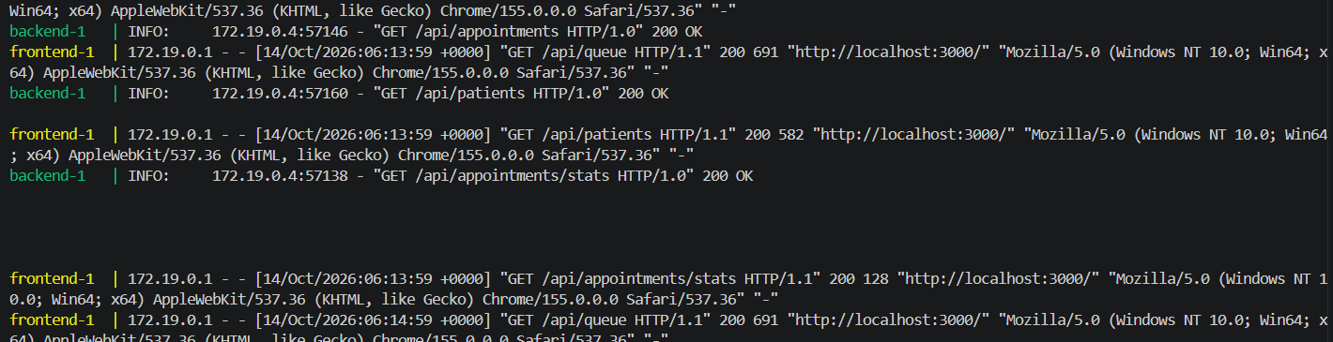
Small containers that run as non-root
BUILD
Backend
Frontend
Compose
Python 3.12 slim, UID 10001, runs migrations on start
Multi-stage build, nginx on 8080, proxies /api
Postgres, backend :8000, frontend :3000
docker compose logs: frontend (nginx) proxies each /api call to the backend, all 200 OK
Notes:
Both images run as non-root. The backend uses UID 10001 and the frontend is nginx-unprivileged on port 8080, so Kubernetes can enforce runAsNonRoot. The frontend is a multi-stage build: Node builds the bundle, nginx only serves it. nginx proxies /api to the backend using the BACKEND_URL variable. The screenshot is docker compose logs: the browser calls the frontend on port 3000, the frontend proxies to the backend, and the backend answers 200.

Slide 9
One repository holds everything
BUILD
clinicq/
backend/ FastAPI, Alembic, tests
frontend/ React + Vite, nginx
terraform/ VPC + EKS
helm/clinicq/ the Helm chart
k8s/ namespace, StorageClass
monitoring/ Prometheus, Grafana
troubleshooting/ two broken manifests
scripts/ seed, kind, load test
.github/workflows/ ci-cd.yml
docker-compose.yml
RUN IT LOCALLY
docker compose up --build
# app on localhost:3000
cd backend && pytest
# 24 tests
The same code runs locally, on a kind cluster, and on EKS.
Notes:
The whole project is in a single repository, so a reviewer can find any layer quickly. Backend and frontend are the application. Terraform, the Helm chart and the k8s folder are the platform. Monitoring holds the Prometheus values and the Grafana dashboard. Troubleshooting holds the two broken manifests for the lab. Scripts has the seed data, the kind setup and the load test. The same code runs locally with docker compose, on a local kind cluster, and on EKS.

Slide 10
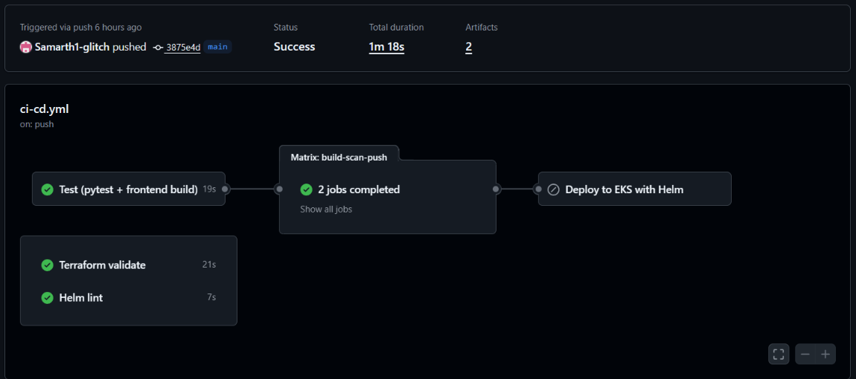
Every push runs the same gates
SHIP
1
test
ruff, pytest, build
2
terraform-validate
init, validate
3
helm-lint
lint, render
4
build-scan-push
matrix: 2 images
Actions run #14: every gate green in 1m 18s (deploy gated by DEPLOY_ENABLED)
5
deploy
helm to EKS
Look for Status Success, 1m 18s, and Deploy to EKS shown as skipped because DEPLOY_ENABLED was off.
Notes:
Three quality jobs run in parallel: test (ruff, pytest, frontend build), terraform validate, and helm lint. Only if test passes do the two build jobs start, one per image, in a matrix. The deploy job runs last and only on pushes when the DEPLOY_ENABLED variable is true, which is how I keep AWS costs under control. In this screenshot, run 14, deploy shows as skipped because the variable was off at that moment. The whole run took 1 minute 18 seconds.

Slide 11
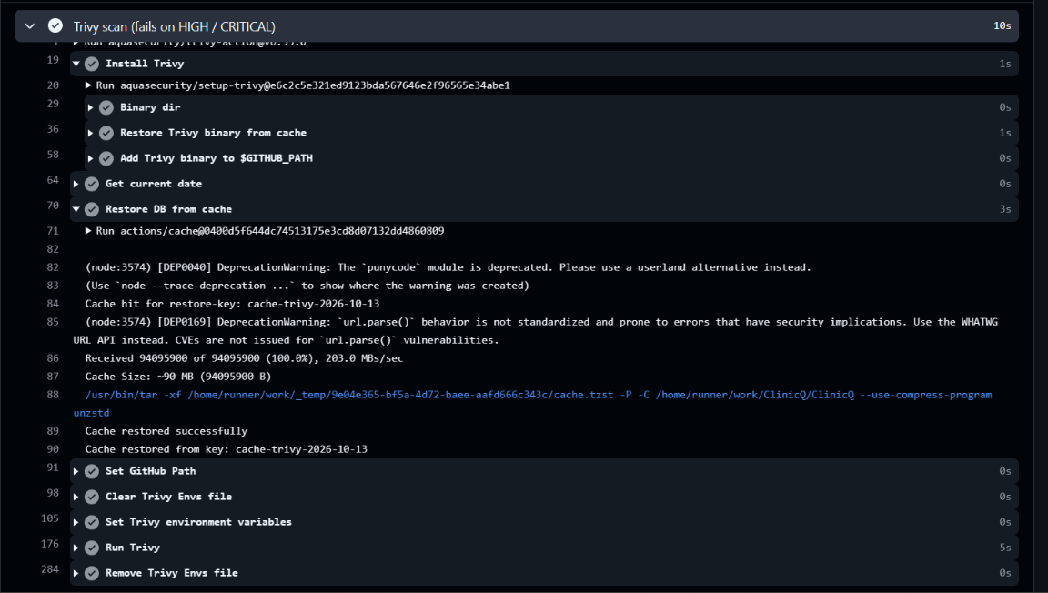
Nothing vulnerable reaches the registry
SHIP
What happened
First scan failed on HIGH findings
All inside libraries vendored in pip
Fix: remove pip, setuptools, wheel from the runtime image
Gate: HIGH and CRITICAL, fixed only
Backend job: Trivy scan step succeeded, then image pushed
Notes:
Trivy scans each image inside the pipeline. The job fails on any fixed HIGH or CRITICAL finding, and the push step comes after the scan so a failing image never reaches the registry. My first scan failed. The findings were in libraries bundled inside pip itself, not in my code. The app does not need pip at runtime, so the Dockerfile now removes pip, setuptools and wheel after installing requirements, and the scan is clean. The screenshot shows the Trivy step and the whole backend job passing.

Slide 12
Every image is tagged with its commit
SHIP
ghcr.io/samarth1-glitch/clinicq-backend:3875e4d
ghcr.io/samarth1-glitch/clinicq-frontend:3875e4d
tag = commit SHA (shown short) | no :latest
1
2
3
Traceable
Scanned first
Easy rollback
A running pod maps to one commit
Push step runs only after Trivy passes
Redeploy an older SHA with helm
Notes:
Images are pushed to GitHub Container Registry only after the Trivy scan passes. The tag is the full commit SHA, never latest. For run 14 the commit was 3875e4d, so that run produced clinicq-backend and clinicq-frontend images tagged with that SHA. Every running pod can be traced to a commit, and a rollback is just a previous SHA. Helm receives the same SHA as its image tag, so what was scanned is exactly what is deployed.

Slide 13
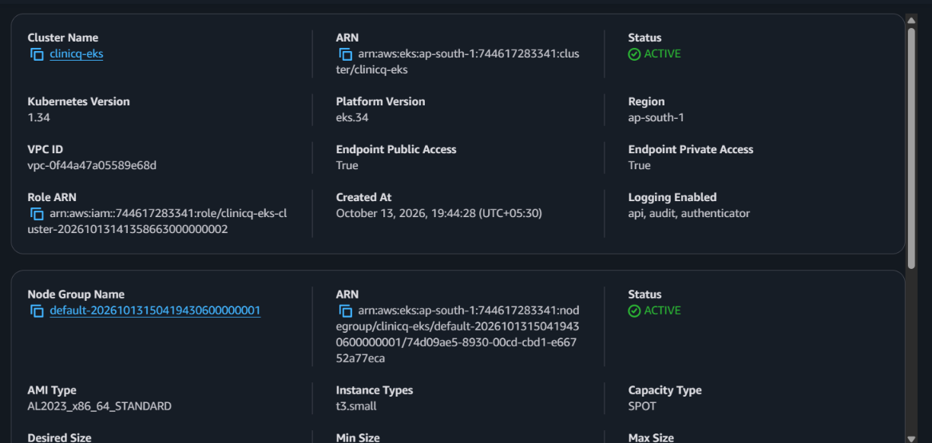
An EKS cluster built entirely by Terraform
RUN
VPC: 2 public and 2 private subnets
One NAT gateway, to save cost
EKS 1.34 in ap-south-1
Managed node group on Spot, t3.small
EBS CSI addon through IRSA
AWS console: cluster ACTIVE (Kubernetes 1.34), node group ACTIVE (Spot)
Look for Status ACTIVE on both, Kubernetes 1.34, capacity type SPOT.
Notes:
Terraform builds the network and the cluster: a VPC with two public and two private subnets across two zones, one NAT gateway to save money, an EKS 1.34 cluster, a managed node group of two Spot t3.small instances, and the EBS CSI addon wired through IRSA so PostgreSQL can get a volume. The screenshot is the AWS console after apply: the cluster is ACTIVE on Kubernetes 1.34 in ap-south-1 and the node group is ACTIVE with capacity type SPOT.

Slide 14
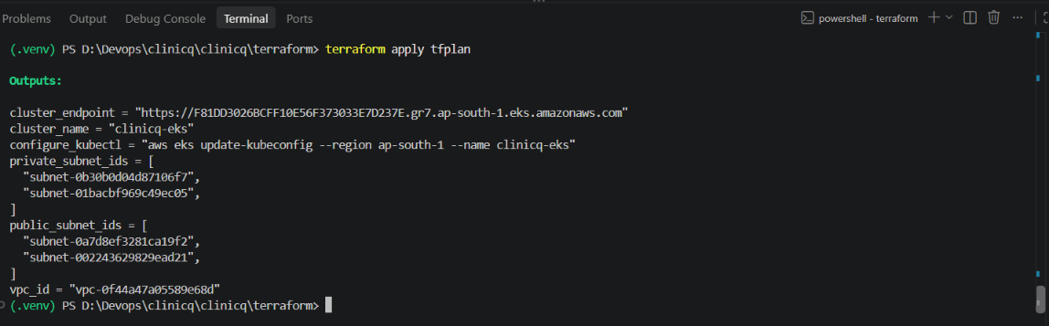
One terraform apply, and the platform exists
RUN
terraform apply: outputs
The configure_kubectl output is the bridge to the next step: one command points kubectl at the new cluster.
Notes:
This is the end of terraform apply: the outputs block. It prints the cluster name and endpoint, the VPC id, the two private and two public subnet ids, and the exact aws eks update-kubeconfig command that connects kubectl to the new cluster. The state of all this lives in code, so it can be rebuilt or destroyed with one command.

Slide 15
Designed to stay inside a student budget
RUN
1
2
3
Spot nodes
One NAT gateway
A deploy switch
Two Spot instances instead of on-demand nodes
A single gateway serves both private subnets
The EKS job runs only when DEPLOY_ENABLED is true
The platform is code: terraform apply builds it for the demo, terraform destroy removes it.
Notes:
Cost was a real constraint, so it shaped the design. Nodes are Spot instances, which are much cheaper than on-demand. One NAT gateway serves both private subnets, since NAT gateways are a major hourly cost. And the deploy job only runs when the DEPLOY_ENABLED variable is true, so ordinary pushes cost nothing. Because the platform is Terraform, it can be created for a demo and removed with one command afterwards.

Slide 16
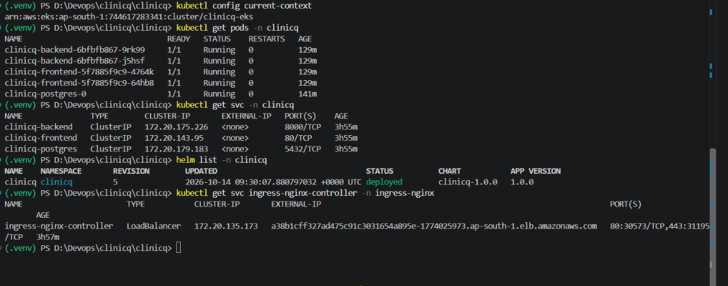
One Helm release runs the whole app
RUN
EKS: 5 pods Running, ClusterIP services, helm list at revision 5, load balancer address
Chart: backend x2, frontend x2, PostgreSQL + PVC, secret, ingress, HPA.
Notes:
One chart deploys everything: backend and frontend with two replicas each, ClusterIP services, PostgreSQL as a StatefulSet with a persistent volume, a secret for credentials, the ingress, and the HPA. A ServiceMonitor is optional. The pipeline runs helm upgrade --install with --atomic, so a failed rollout rolls itself back. The screenshot is from the EKS cluster: five pods Running with zero restarts, three ClusterIP services, Helm revision 5 with status deployed, and the ingress controller's load balancer address.

Slide 17
Security and reliability built in
RUN
Security
Reliability
Non-root containers (UID 10001 and 101)
runAsNonRoot enforced in the chart
Trivy gate on HIGH and CRITICAL
Database password in a Kubernetes Secret
Commit-SHA tags, never latest
Liveness and readiness probes
CPU and memory requests and limits
Two replicas of backend and frontend
helm --atomic rolls back a failed deploy
Migrations under a database advisory lock
Notes:
These are settings in the chart and Dockerfiles, not extras. Security: containers run as non-root, the chart enforces runAsNonRoot, Trivy gates the pipeline, the database password lives in a Kubernetes Secret, and images use pinned tags. Reliability: every workload has liveness and readiness probes, requests and limits are set, backend and frontend run two replicas, helm upgrade uses atomic so a failed release rolls back, and migrations take a database advisory lock so two pods cannot migrate at once.

Slide 18
One address for the whole app
RUN
Browser
one URL
AWS load balancer
ap-south-1
ingress-nginx
routes by path
Services
ClusterIP
Path | Goes to | Port
/ | clinicq-frontend (React, nginx) | 80
/api | clinicq-backend (FastAPI) | 8000
Same origin for page and API, so the app needs no CORS settings.
Notes:
ingress-nginx creates one AWS load balancer, the LoadBalancer service you can see in the kubectl output. The browser only ever talks to that address. Requests for the root path go to the frontend service on port 80, and requests under /api go to the backend service on port 8000. Because everything is the same origin, no CORS configuration is needed.

Slide 19
Autoscaling: 2 to 5 backend pods
RUN
desired replicas =
ceil(current x usage / target)
e.g. 2 pods at 90% CPU, target 60%: ceil(2 x 90 / 60) = 3 pods
2 always on
3 burst capacity
Setting | Value
Minimum replicas | 2
Maximum replicas | 5
Target CPU | 60% average
Metrics source | metrics-server
scripts/load-test.sh sends traffic to push CPU over the target.
Notes:
The backend scales between 2 and 5 replicas when average CPU passes 60 percent of the requested CPU. metrics-server provides the numbers. The Kubernetes rule is: desired replicas equals the current replicas times current utilisation divided by the target, rounded up. The two filled squares are the always-on baseline, the three outlined squares are headroom the cluster only uses under load. The repo has a load-test script if you want to trigger it live.

Slide 20
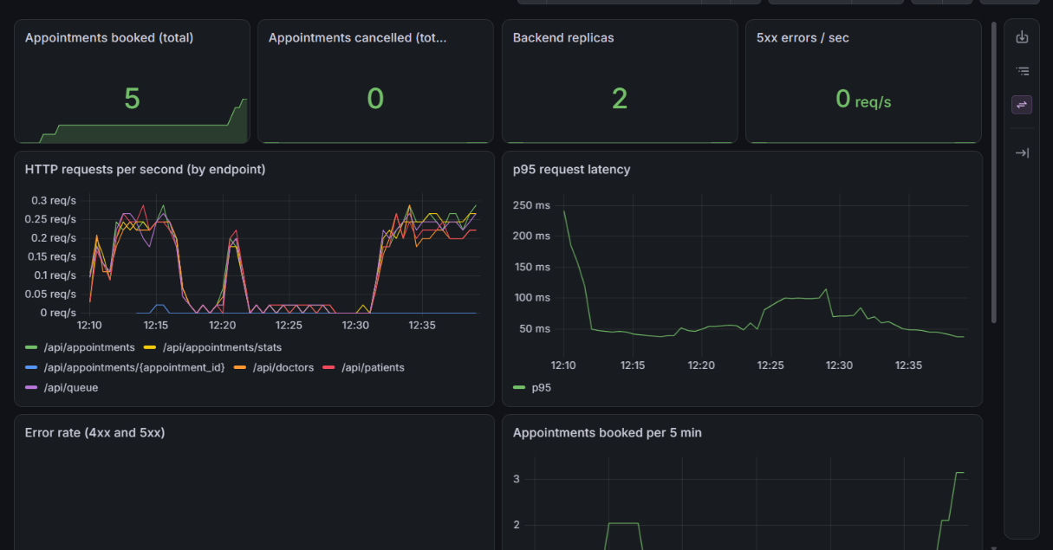
Grafana shows the app, not just the cluster
RUN
Booked and cancelled counters come from the app itself
Replica count and errors from Kubernetes and HTTP metrics
p95 latency settles near 50 ms
Grafana: ClinicQ Overview
Notes:
The backend exposes /metrics through prometheus-fastapi-instrumentator plus two custom counters: appointments booked and appointments cancelled. kube-prometheus-stack runs Prometheus and Grafana. The ClinicQ Overview dashboard shows, at the top, booked total 5, cancelled 0, backend replicas 2 and 5xx errors zero per second. Below are request rate per endpoint and p95 latency, which settles near 50 milliseconds after a first-request spike.

Slide 21
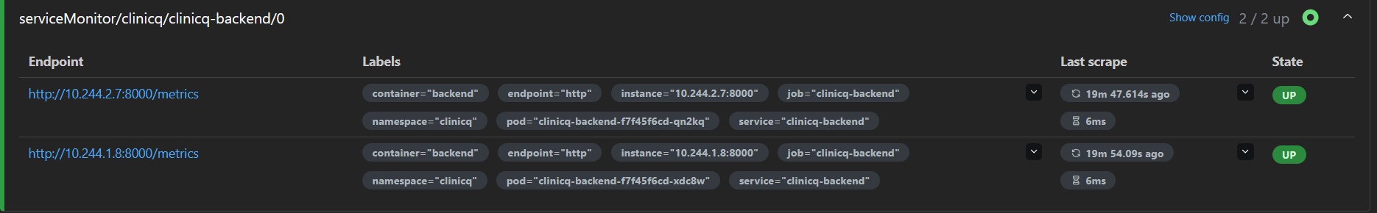
Prometheus scrapes every backend pod
RUN
Prometheus > Status > Target health: clinicq-backend 2/2 up
2 / 2
ServiceMonitor
Auto-join
backend pods scraped at /metrics
finds pods through the backend Service
new pods from the HPA appear as targets
Notes:
This is Prometheus, Status then Target health. The first block is serviceMonitor/clinicq/clinicq-backend with 2 of 2 up: both backend pods are scraped on port 8000 at /metrics, with last-scrape times and durations of a few milliseconds. The ServiceMonitor selects the backend Service, so if the HPA adds pods they join the scrape list automatically. Grafana, the API server and CoreDNS are also scraped.

Slide 22
Two breakages, one debugging method
RUN
1. ImagePullBackOff
2. Service without endpoints
Symptom pod never starts
Symptom pods Running, no traffic
$ kubectl get pods -n clinicq
STATUS: ImagePullBackOff
$ kubectl describe pod <pod>
Events: Failed to pull image ... not found
$ kubectl get pods --show-labels
$ kubectl get endpoints -n clinicq
ENDPOINTS: <none>
selector does not match pod labels
Fix correct the image tag and re-apply
Fix make the Service selector match the pod labels
Notes:
Two deliberate breakages kept in the repo under troubleshooting. First, broken-image: the pod sits in ImagePullBackOff, kubectl describe pod shows the event with the bad tag, and fixing the tag recovers it. Second, broken-service: the pods are Running but the service has no endpoints because its selector does not match the pod labels. kubectl get endpoints shows it empty and fixing the selector restores traffic. Same method both times: read the status, describe, compare, fix.

Slide 23
The results, in numbers
RESULTS
24
1m 18s
5
2 / 2
tests passed
pipeline run
pods Running
backend targets UP
in 1.54 s
test, scan, push
on EKS
in Prometheus
Plus: two images scanned and pushed per commit, no latest tags, nothing deployed by hand.
Notes:
Every number here comes from a screenshot in this deck. 24 tests pass in about a second and a half. The pipeline from push to pushed images took 1 minute 18 seconds. On EKS, five pods are running. In Prometheus both backend pods show as UP, and Grafana shows five appointments booked during testing with two backend replicas.

Slide 24
What broke, and what fixed it
WRAP-UP
PROBLEM
FIX
Pipeline went red with no code change
A third-party Trivy action tag disappeared
Run the pinned official Trivy image directly
Helm timed out on EKS
PostgreSQL volume stuck Pending: no default StorageClass
Add a gp3 default class, applied by the pipeline
Commands failed on Windows
Bash syntax pasted into PowerShell
Git Bash for scripts, PowerShell syntax for the rest
Notes:
These are real problems from building this and they are worth telling because they show debugging, not just a happy path. The Trivy action tag vanished and broke a previously green pipeline, so I pinned the official image. On EKS the PostgreSQL volume stayed Pending because the cluster had no default StorageClass, so I added a gp3 class and the pipeline applies it. And the Windows shell differences cost me time: bash syntax does not work in PowerShell.

Slide 25
Live demo: one change, end to end
WRAP-UP
Step | Do this | Audience sees
1 | Edit the tagline in frontend/src/App.jsx | A one-line change
2 | git add, git commit, git push | New commit on main
3 | Open the Actions tab | test, scan, push, deploy go green
4 | kubectl rollout status deployment/clinicq-frontend -n clinicq | Pods replaced one by one
5 | Refresh the app at the load balancer URL | The new tagline is live
Notes:
The demo the rubric asks for. Before the talk, make sure DEPLOY_ENABLED is true and the cluster is up. Change the tagline in frontend App.jsx, commit and push. Open the Actions tab and show the stages going green. Then run kubectl rollout status to show new pods replacing old ones, and refresh the app to show the new text. If the pipeline is slow, narrate the stages while it runs, or show the earlier run 14 screenshots as the fallback.

Slide 26
What I would build next
WRAP-UP
1
HTTPS
cert-manager and a real domain on the ingress
2
Managed database
RDS instead of PostgreSQL inside the cluster
3
Keyless deploys
GitHub OIDC role instead of stored AWS keys
4
Shared Terraform state
S3 backend with locking for a team
5
Alerting
Alertmanager rules on errors and latency
Notes:
Showing awareness of the gaps is part of engineering. HTTPS with cert-manager and a real domain. A managed database like RDS instead of PostgreSQL inside the cluster. A GitHub OIDC role so the pipeline needs no stored AWS keys. Terraform remote state in S3 with locking so a team can share it. And Alertmanager rules so the metrics we already collect page someone on errors or latency.

Slide 27
Thank you
App
FastAPI, React, PostgreSQL, 24 passing tests
Pipeline
GitHub Actions: lint, test, build, Trivy scan, push by SHA
Platform
Terraform: VPC and EKS. Helm: app, ingress, autoscaling
Visibility
Prometheus and Grafana, plus two troubleshooting labs
Notes:
Close with a one-breath summary: a working app, tested and containerised, built and scanned by a pipeline, running on AWS EKS through Terraform and Helm, with autoscaling and monitoring on top. Then take questions.

