Slide 1

TITLE OF THE PROPOSED IDEA
Marutham (Agricultural land)
Team: Terra Byte Innovators
Technology That Speaks the Farmer’s Language.
MANTHAN 3.0 · India Beyond the Borders
Domain: Rural Development
AI-Powered Smart Agriculture
Notes:
Introduce yourselves, then the project: KisanMitra is a website that talks to farmers in their own language. Mention team PRERNA X and the Rural Development domain.

Slide 2


Details of the Team
School Name:
Army Public School MLIRC
Team Terra Byte Innovators
1
2
3
TEAM LEADER
MEMBER 2
MEMBER 3
[Prajwal Ammanagi]
[Samarth Patil]
[Sagar Hosamani]
Std: [ 10th ]
Std: [ 10th ]
Std: [ 10th ]
Notes:
Fill in school name, names and standards before submitting. Each member should say one line about their role.

Slide 3

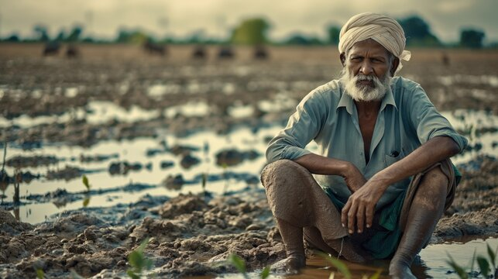




Problem Statement
Five barriers that keep farmers from digital help
1
Reliable information is hard to find
Trusted agricultural information is hard to reach.
2
Language barriers
Digital farm services are not always in the farmer’s language.
3
Crop and soil confusion
Crop health and soil reports are hard to understand.
4
Low scheme awareness
Farmers may not know which schemes could apply.
The farmer gets left out of the digital shift
5
Complicated interfaces
Text-heavy screens are difficult for some farmers.
Notes:
Walk through the five points quickly. The key idea: the information exists, but language and interface barriers stop many farmers from using it.

Slide 4







Proposed Solution
One integrated website that guides farmers by voice and simple visuals
AI Crop Doctor
Soil Intelligence
Scheme Discovery
Agri Marketplace
Upload a crop photo for AI-assisted health information.
Understand soil test results with relevant guidance.
Find agricultural schemes and understand likely eligibility.
Browse agricultural product information.
OUR INNOVATION
AI Farming Assistant
Voice Navigation
No-Read Mode
Multilingual voice-guided accessibility
Get answers to farming questions.
Speak in your language to move around the site.
Large buttons, visuals and spoken instructions.
Notes:
KisanMitra puts all services in one website. Our main innovation is the voice-guided, multilingual experience, which lowers language and digital-literacy barriers.

Slide 5
System / Workflow
How a farmer moves from a voice or tap to useful guidance
Farmer
Marutham Website
Language Selection / Voice Assistant
Service Selection
Crop Doctor
Soil Intelligence
Government Schemes
Marketplace
Relevant Information and Guidance
Major software components
Dashed gold = planned
Frontend
HTML · CSS · JS
Voice Layer
Recognition + Synthesis
Feature Modules
Crop · Soil · Schemes
AI Backend
Python
Database
Future, if needed
Notes:
Follow the arrows: the farmer opens the website, picks a language or speaks, chooses a service, and receives guidance. The dashed gold boxes are planned, not built yet.

Slide 6







Implementation Details
What we have built, and what comes next
IMPLEMENTED
PLANNED
Step 1 · HTML
Website structure and pages
Step 5 · Python backend
AI and backend integration
Step 2 · CSS
Styling, layout and large buttons
Step 6 · Database
Future storage, if needed
Step 3 · JavaScript
Interactions and navigation
AI features such as Crop Doctor depend on the planned backend.
Step 4 · Voice
Voice recognition and speech synthesis
Notes:
Be clear and honest: HTML, CSS, JavaScript and the voice features are what we have built. The Python AI backend and the database are our next steps.

Slide 7
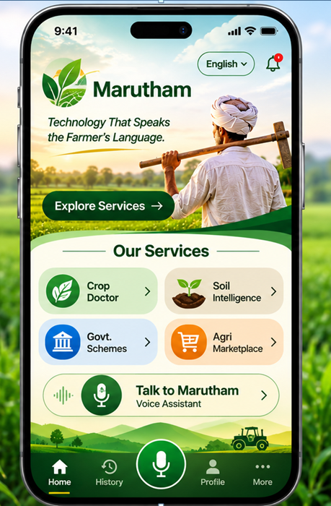
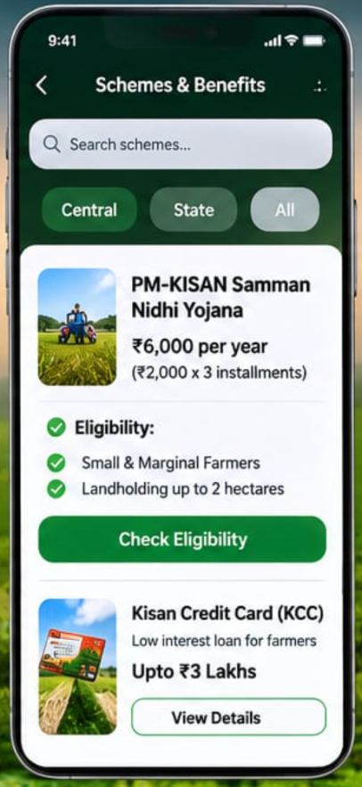
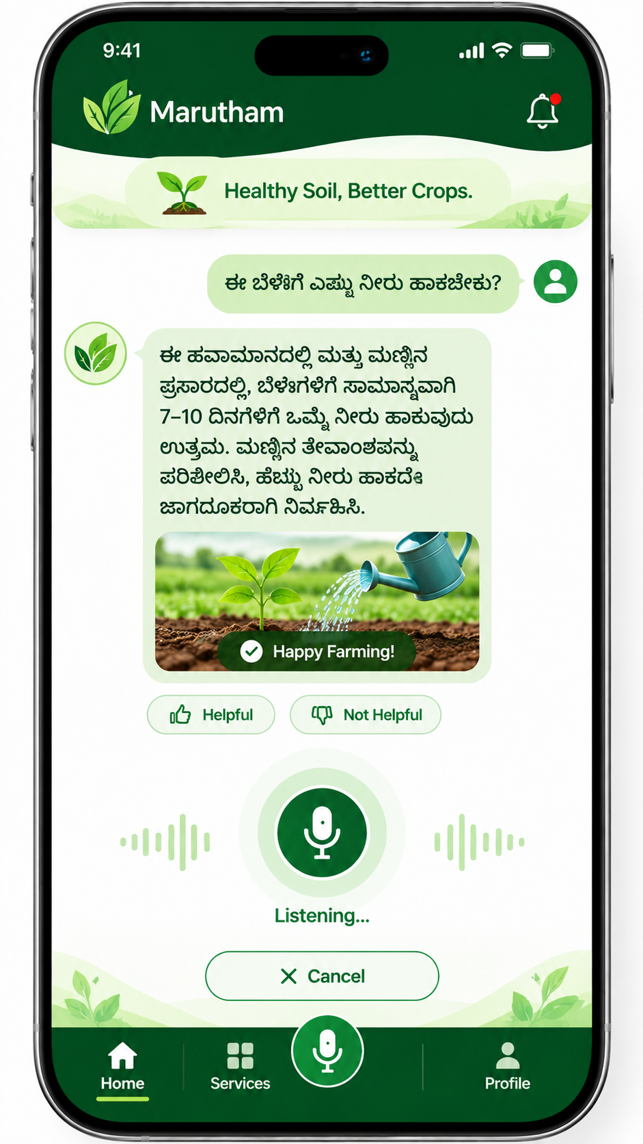
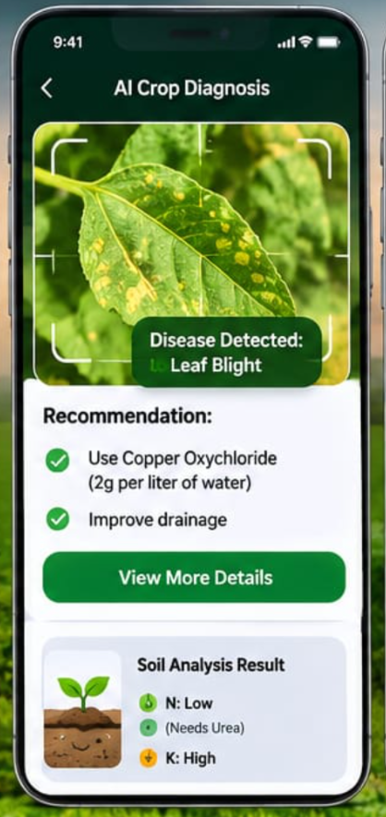
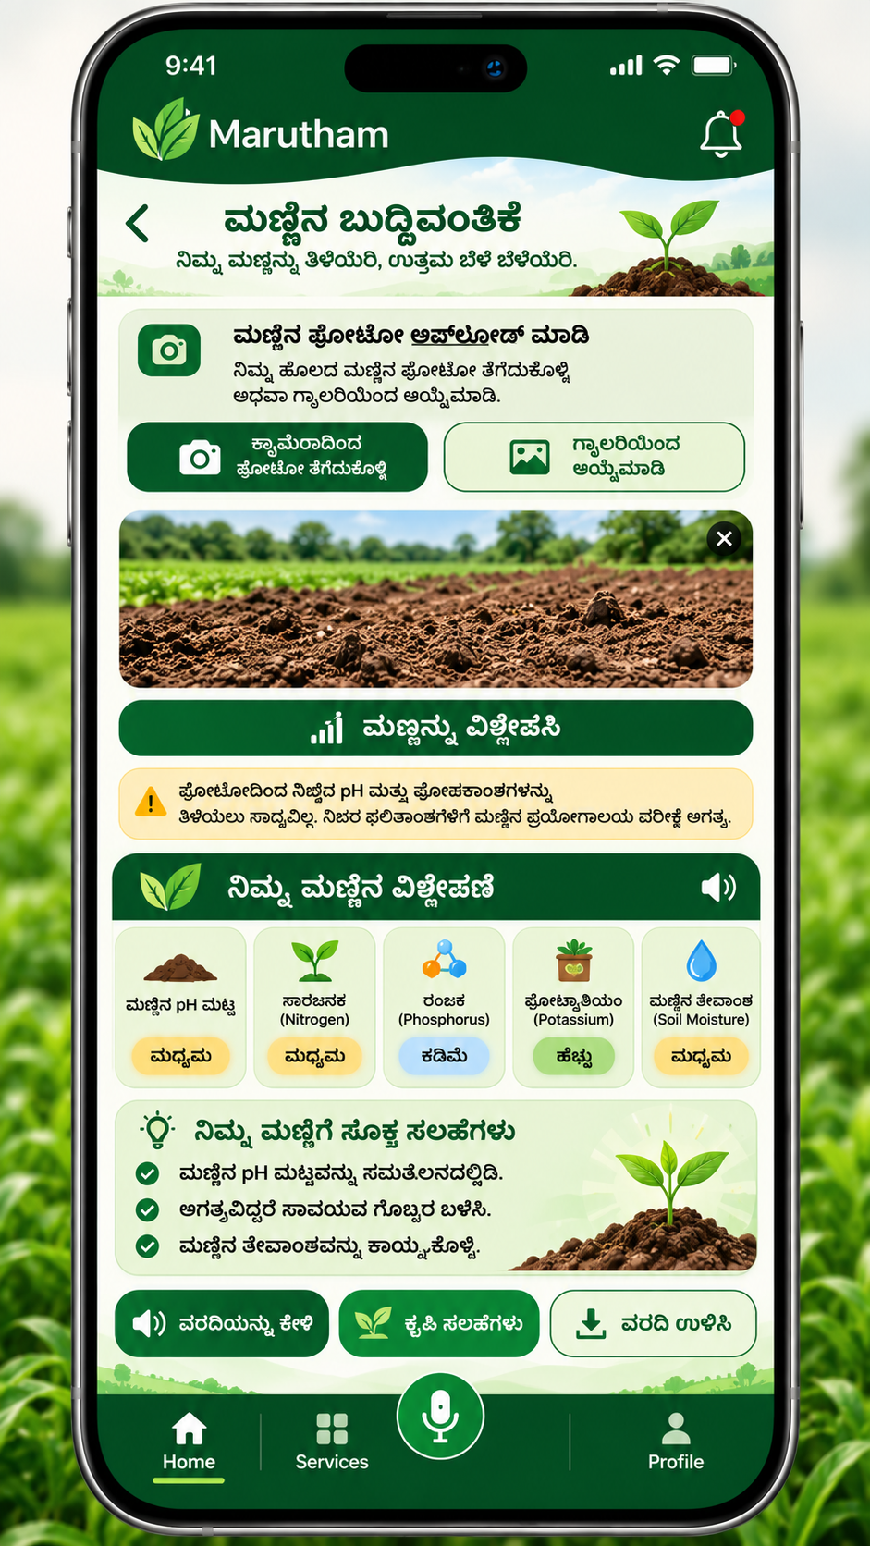
Demonstration / Prototype
Main Dashboard
Scheme Finder
Voice Assistant
Crop Doctor
Soil Intelligence
Notes:
These are design mockups, not screenshots of a finished product. Replace each one with a real screenshot of your prototype before the final submission, or show a live demo.

Slide 8


Results and Outcomes
What the prototype shows today, and what we expect it to enable
What the prototype demonstrates
Expected benefits
Voice input and spoken guidance
Easier access to agricultural information
Simple, large-button No-Read navigation
Improved accessibility for more farmers
Several farm services in one website
Simplified navigation
Language-first way to start
A unified platform for farm services
Expected benefits are goals. We have not yet measured results with farmers.
Notes:
Be careful here: we have not run tests with farmers yet, so we only describe what the prototype demonstrates and the benefits we expect. No percentages.

Slide 9



Conclusion
Marutham brings crop, soil, scheme and market information into one website, and lets farmers use it through voice and simple visuals. Accessible technology is what lets every farmer benefit from digital agriculture.
One platform
Voice first
For every farmer
Crop, soil, schemes and market together
Speak in your own language
Simple, large-button, no-read design
“Making Smart Farming Accessible to Every Farmer.”
Notes:
Summarise in two sentences, then say the closing line slowly.

Slide 10

Thank You!
KisanMitra
Team Terra Byte Innovators · Manthan 3.0
Questions & Answers
Notes:
Thank the judges and invite questions. Keep answers short and honest about what is built and what is planned.

