Slide 1

GROUP-7_FANATICS
Vatsal Patel-AU2040043
Digant Patel-AU2040086
Samarth Chauhan-AU2040097
CRYPTOGRAPHY
Ciphering/Deciphering data using Affine Cipher Algorithm in Java language

Slide 2
Introduction
“Crypt-” means ‘hidden’ and “graphy” means ‘writing’.
It is a term used to refer to the assemblage of operations such as encryption, decryption and hashing.
Cryptography is mainly used to maintain secrecy in communication and easily convey encrypted messages.
Affine cipher uses singular-alphabetic substitution where every alphabet is assigned a numeric key and basic mathematics is used to encrypt the text messages.
Right now there exists a total of 286 affine ciphers; since there are multiple variations possible, it can be considered one of the best if not the best cipher known to humans till date.

Slide 3
Problem Statement
A secret text message is to be delivered to a particular recipient.
We have to create a system in which we perform matrix multiplication of the original matrix and a matrix of our own to encrypt the message so that not everyone can access it.
Thereafter we also have to create a system to decrypt the message. In that, we are creating the algorithm by properties of matrix.
Our goal is to create an encryption and decryption system based on Affine Cipher algorithm.

Slide 4
Modifications to Affine Cipher that were implemented by us
To make the cipher program more viable for dynamic handling we made some modifications to the affine algorithm.
The original affine cipher with only 26 characters was not enough to read spaces and encrypt them so we increased the keys to 29 and used sentences for encryption.
We decided to use characters like space, ‘?’, and ‘.’ to increase the versatility of our code.
We even programmed the cipher that will append the space to make the string length multiple of the size of key matrix.

Slide 5
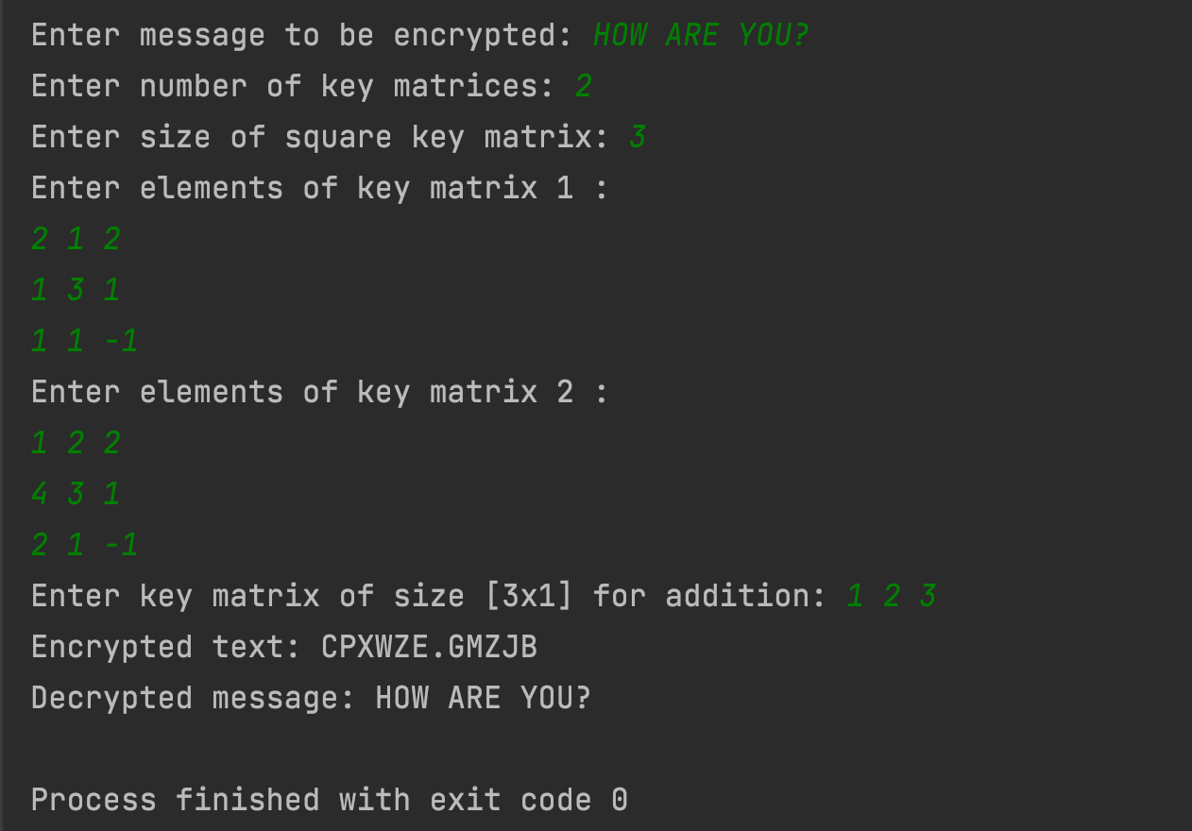
RESULT 1

Slide 6
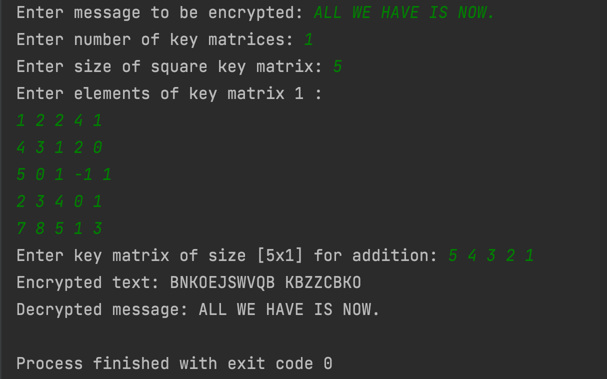
RESULT 2

Slide 7
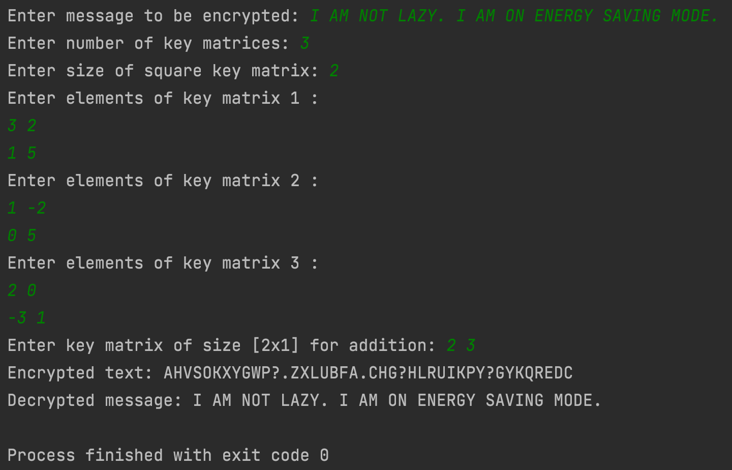
RESULT 3

Slide 8
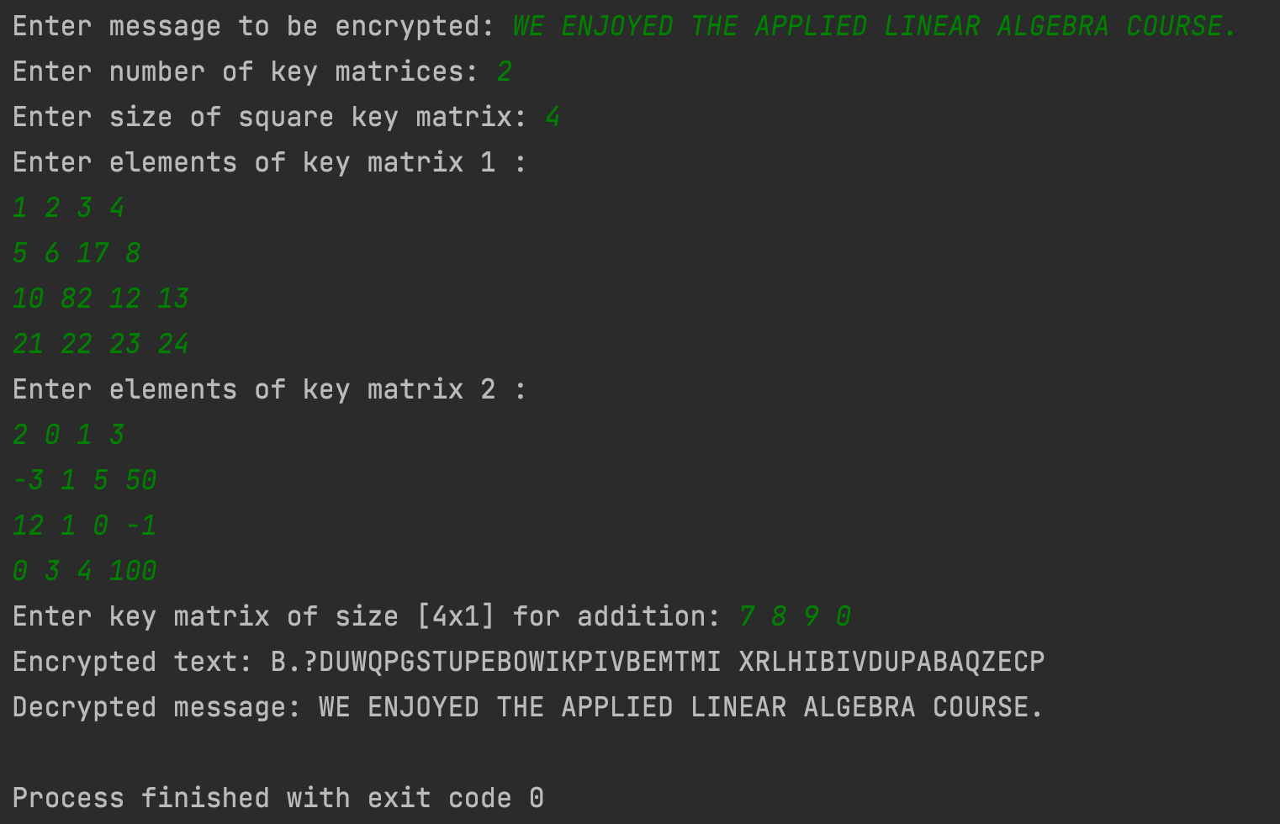
RESULT 4

Slide 9
CONCLUSION
The modified affine cipher proved to be efficient in encrypting strings with invertible key matrices.
In some cases when a sentence has space separated words, during encryption it may happen that the spaces get replaced by something else this will result into the word count not being predictable.
Inclusion of special characters made it harder to penetrate through the cipher.
Our study of affine cipher using matrices can be successfully implemented in cipher systems that uses the plaintext and converts every character mathematically.

Slide 10
Contributions
Vatsal
Documentation and report writing
Research on decryption and related cipher functions
Coding the encryption method
Digant
Code for decryption method
Research on affine cipher and its advantages
Documentation and report writing
Samarth
Mathematical Formulation
Research on encryption and algebraic operations
Coding the matrix multiplication and inversion method
Documentation and report writing

Slide 11
References
Richards, K. (2020, April 6). What is cryptography? - definition from whatis.com. SearchSecurity. Retrieved September 27, 2021, from What is Cryptography? Definition from SearchSecurity.
Sidhpurwala, H. (2019, March 19). A brief history of cryptography. Red Hat Customer Portal. Retrieved September 27, 2021, from A Brief History of Cryptography.
GeeksforGeeks. (2021, August 4). Implementation of Affine Cipher. Implementation of Affine Cipher.
Cryptography by means of linear algebra and number theory. (n.d.). Retrieved October 20, 2021, from http://i-rep.emu.edu.tr:8080/xmlui/bitstream/handle/11129/1420/ElfadelAjaeb.pdf?sequence=1

Slide 12
THANK
YOU

