Slide 1
Anomaly Detection in Computer Networks using
Machine Learning Classifiers
The Learning Machines
Anomaly detection in computer networks
Vatsalkumar Patel AU2040043
Shreya Karia AU2040076
Digant Patel AU2040086
Samarth Chauhan AU2040097
Anomaly detection in computer networks

Slide 2
Introduction
Anomaly detection in computer networks
Anomaly detection in computer networks refers to the process of identifying unusual or unexpected patterns of behavior in network traffic, which may indicate the presence of security threats or other network issues.
Nature of network threats and attacks are very dynamic making it difficult to be detected by simple rule based systems, thus Machine Learning comes into play.
Anomaly detection in computer networks

Slide 3
Problem Statement
Anomaly detection in computer networks
The aim of the project is to train a machine learning model based on CICIDS2017 dataset, that detects and classifies intrusion in a computer network, given the details of the network at the time.
Anomaly detection in computer networks

Slide 4
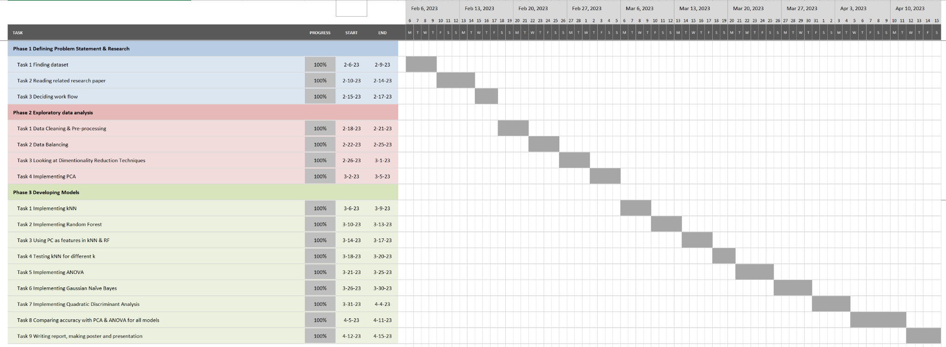
GANTT Chart
Anomaly detection in computer networks
Anomaly detection in computer networks

Slide 5
Existing body of work
The paper "Toward Generating a New Intrusion Detection Dataset and Intrusion Traffic Characterization"[1] describes the process of creating a new dataset of network traffic that includes both malicious and benign traffic.
The dataset was analyzed using various methods, including packet size distribution analysis, packet rate analysis, and traffic type analysis. The analysis showed that intrusion traffic tends to have larger packet sizes and higher packet rates than benign traffic, indicating increased activity and malicious intent. The most common types of intrusions in the dataset were network scanning, access attempts to vulnerable services, and denial-of-service attacks.
The paper also provides a list of features specific to each type of intrusion detection, which can be used to develop tailored intrusion detection systems.
Anomaly detection in computer networks
[1] Sharafaldin, I., Lashkari, A. H., & Ghorbani, A. A. (n.d.). Toward generating a new intrusion detection dataset and intrusion TRAFC ... Retrieved February 13, 2023, from https://pdfs.semanticscholar.org/2342/9b5be933e16e6988da9a322ad95dfdc8c4b0.pdf
Notes:
Web attack

Slide 6
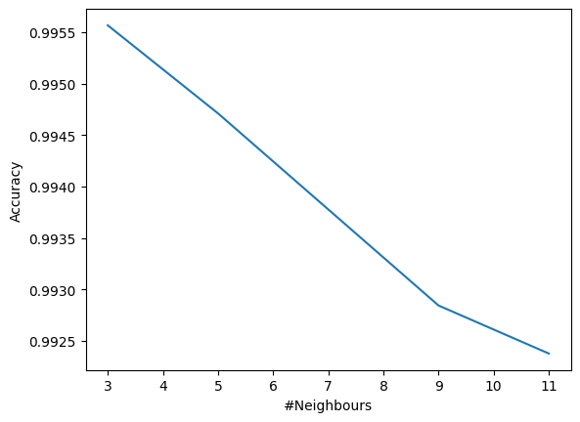
Approach
Anomaly detection in computer networks
Summary: Pre-mid sem
Testing kNN for different k
Literature Review and dataset selection
Cleaning, Preprocessing and Exploratory Analysis
Undersampling to balance the data
PCA for dimensionality reduction
Sample size: 51,430
Features: 41
kNN and Random Forest Implemented
Tested the accuracy of kNN for different values of k.
Best results for k=3.

Slide 7
Approach
Anomaly detection in computer networks
Analysis of Variance (ANOVA)
Gaussian Naive Bayes (GNB)
Quadratic Discriminant Analysis
F-test for ANOVA.
Features ranked by F-statistic
Top Features chosen
Less accurate as compared to PCA
Most time efficient
Least accurate
Better than GNB
Less accurate than RF and kNN
More time efficient than RF and kNN
[4] V. M. Deolindo, B. L. Dalmazo, M. V. B. da Silva, L. R. B. de Oliveira, A. de B. Silva, L. Z. Granville, L. P. Gaspary, and J. C. Nobre, “Using quadratic discriminant analysis by intrusion detection systems for port scan and slowloris attack classification.” [Accessed: 31-Mar-2023].
[5] Yoshifumimiya, “Feature selection using ANOVA,” Kaggle, 18-Oct-2022. [Online]. Available: https://www.kaggle.com/code/yoshifumimiya/feature-selection-using-anova . [Accessed: 21-Mar-2023].

Slide 8
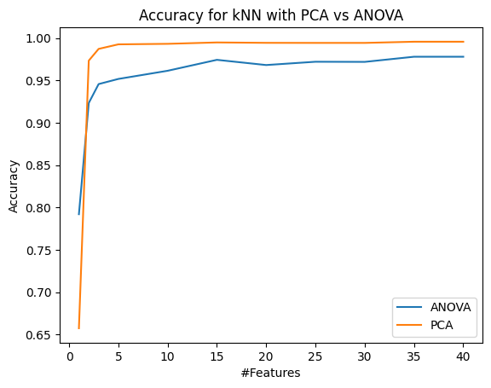
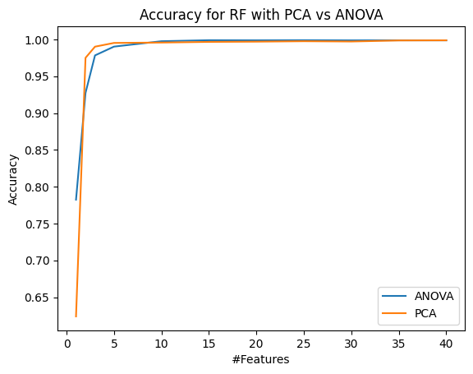
Final Results
kNN
Random Forest
Anomaly detection in computer networks

Slide 9
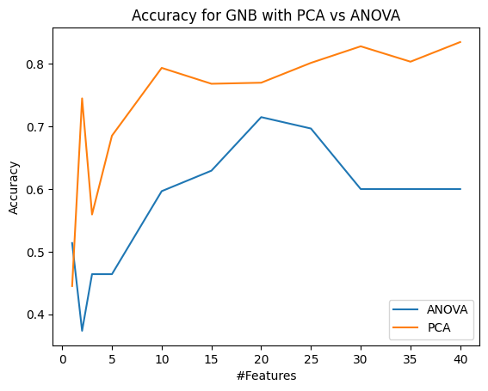
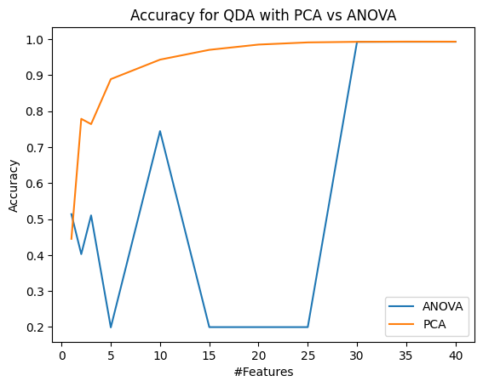
Final Results
GNB
QDA
Anomaly detection in computer networks

Slide 10
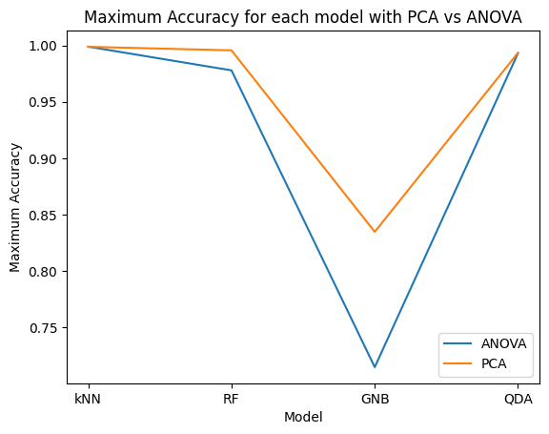
Final Results
Anomaly detection in computer networks

Slide 11
Conclusions
PCA performs better than ANOVA.
kNN with 3 neighbors is the best choice
kNN with PCA works best overall.
Random Forest works well but not the best
Gaussian Naive Bayes is most time efficient but least accurate
Quadratic Discriminant Analysis less accurate than RF and kNN.

Slide 12
Role of group members
Network security introduction workshop
Vatsal - Dataset selection, understanding related work, data preprocessing & cleaning, implementing and debugging the four models, report writing, presentation making.
Shreya - Finding related work, understanding related work, data cleaning & preprocessing, implementing and debugging the four models, report writing, presentation making.
Digant - Finding related work, understanding related work, Exploratory analysis and Data balancing, implementing and debugging the four models, report writing, presentation making.
Samarth - Dataset selection, understanding related work, data balancing and exploratory analysis, implementing and debugging the four models, report writing, presentation making.

Slide 13
References
Anomaly detection in computer networks
CICDataset. (2020, January 3). CICIDS2017. Kaggle. Retrieved March 11, 2023, from https://www.kaggle.com/datasets/cicdataset/cicids2017
Toward generating a new intrusion detection dataset and intrusion TRAFC ... (n.d.). Retrieved March 11, 2023, from https://pdfs.semanticscholar.org/2342/9b5be933e16e6988da9a322ad95dfdc8c4b0.pdf
A review on imbalanced data handling using undersampling and oversampling technique. (2017). International Journal of Recent Trends in Engineering and Research, 3(4), 444–449. https://doi.org/10.23883/ijrter.2017.3168.0uwxm
V. M. Deolindo, B. L. Dalmazo, M. V. B. da Silva, L. R. B. de Oliveira, A. de B. Silva, L. Z. Granville, L. P. Gaspary, and J. C. Nobre, “Using quadratic discriminant analysis by intrusion detection systems for port scan and slowloris attack classification.” [Accessed: 31-Mar-2023].
Yoshifumimiya, “Feature selection using ANOVA,” Kaggle, 18-Oct-2022. [Online]. Available: https://www.kaggle.com/code/yoshifumimiya/feature-selection-using-anova . [Accessed: 21-Mar-2023].
Anomaly detection in computer networks

