Slide 1
Anomaly Detection in Computer Networks using
Machine Learning Classifiers
The Learning Machines
Anomaly detection in computer networks
Vatsalkumar Patel AU2040043
Shreya Karia AU2040076
Digant Patel AU2040086
Samarth Chauhan AU2040097
Anomaly detection in computer networks

Slide 2
Introduction and Problem Statement
Anomaly detection in computer networks
Anomaly detection in computer networks refers to the process of identifying unusual or unexpected patterns of behavior in network traffic, which may indicate the presence of security threats or other network issues.
Nature of network threats and attacks are very dynamic making it difficult to be detected by simple rule based systems, thus Machine Learning comes into play.
Problem Statement: The aim of the project is to train a machine learning model based on CICIDS2017 dataset, that detects and classifies intrusion in a computer network, given the details of the network at the time.
Anomaly detection in computer networks

Slide 3
Existing body of work
The paper "Toward Generating a New Intrusion Detection Dataset and Intrusion Traffic Characterization" describes the process of creating a new dataset of network traffic that includes both malicious and benign traffic.
The dataset was analyzed using various methods, including packet size distribution analysis, packet rate analysis, and traffic type analysis. The analysis showed that intrusion traffic tends to have larger packet sizes and higher packet rates than benign traffic, indicating increased activity and malicious intent. The most common types of intrusions in the dataset were network scanning, access attempts to vulnerable services, and denial-of-service attacks.
The paper also provides a list of features specific to each type of intrusion detection, which can be used to develop tailored intrusion detection systems.
Anomaly detection in computer networks
Notes:
Web attack

Slide 4
Approach
Anomaly detection in computer networks
Data Selection
Cleaning and Preprocessing
Exploratory Analysis
Name: CICIDS2017
Sample Size: 2830743
Dimensionality: 79
Types of Classes: DDoS, PortScan, BENIGN
Duplicates Removed: 308381
Null Values Removed: 353
Removing classes with less than 10,000 rows to avoid loss of significant data while balancing.
Removed 37 highly correlated features, with correlation value more than 0.85.

Slide 5
Approach
Anomaly detection in computer networks
Balancing Dataset
Dimensionality Reduction
Model Training
Undersampled the data such that each class has 10,286 rows to avoid any bias.
Preferable as the dataset is large enough.
Principal Component Analysis for dimensionality reduction. (Studied outcomes for number of features)
kNN (k=3)
Random Forest
70% training set
30% testing set

Slide 6
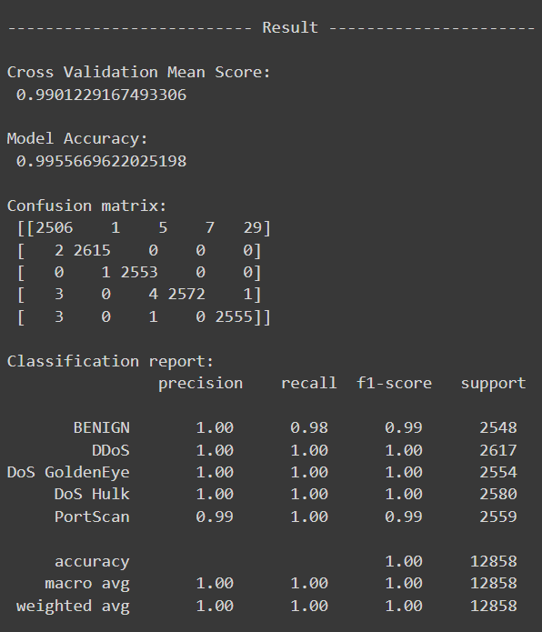
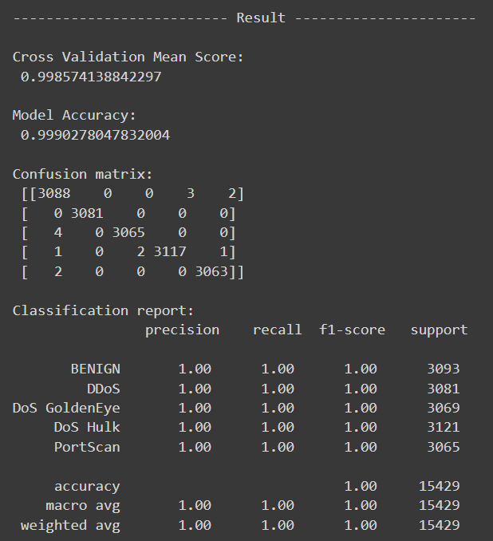
Initial Results
kNN
Random Forest
Anomaly detection in computer networks

Slide 7
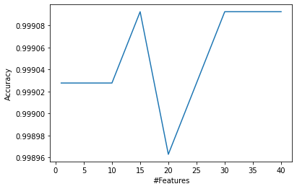
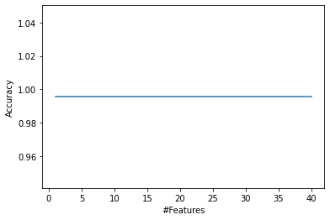
Initial Result
Random Forest
kNN
Anomaly detection in computer networks

Slide 8
Future Work
Anomaly detection in computer networks
Implement kNN with varied values of k.
Implement Naive-Bayes model
Implement Quadratic Discriminant Analysis
Compare ANOVA with PCA for Dimensionality Reduction
Compare various models and conclude the best fit

Slide 9
Role of group members
Network security introduction workshop
Vatsal - Dataset selection, understanding related work, data preprocessing & cleaning, implementing and debugging both models, report writing, presentation making.
Shreya - Finding related work, understanding related work, data cleaning & preprocessing, implementing and debugging both models, report writing, presentation making.
Digant - Finding related work, understanding related work, Exploratory analysis and Data balancing, implementing and debugging both models, report writing, presentation making.
Samarth - Dataset selection, understanding related work, data balancing and exploratory analysis, implementing and debugging both models, report writing, presentation making.

Slide 10
References
Anomaly detection in computer networks
CICDataset. (2020, January 3). CICIDS2017. Kaggle. Retrieved March 11, 2023, from https://www.kaggle.com/datasets/cicdataset/cicids2017
Toward generating a new intrusion detection dataset and intrusion TRAFC ... (n.d.). Retrieved March 11, 2023, from https://pdfs.semanticscholar.org/2342/9b5be933e16e6988da9a322ad95dfdc8c4b0.pdf
A review on imbalanced data handling using undersampling and oversampling technique. (2017). International Journal of Recent Trends in Engineering and Research, 3(4), 444–449. https://doi.org/10.23883/ijrter.2017.3168.0uwxm
Anomaly detection in computer networks

