Slide 1

MOVIE TICKET BOOKING SYSTEM
SRM INSTITUTE OF SCIENCE AND TECHNOLOGY
FACULTY OF ENGINEERING AND TECHNOLOGY
DEPARTMENT OF DATA SCIENCE AND BUSINESS SYSTEMS
21CSC206P- Advanced Object Oriented Programming/ Project Review 2
Shalok Gupta [RA2211003010727]
Samarth Agarwal[RA2211003010727]

Slide 2
Table of contents
Introduction – Problem statement
Objectives
Software Requirements
Architecture diagram / Block diagram of the modules
GUI Design
Database Design
Future Enhancement

Slide 3
PROBLEM STATEMENT
Web-based Movie Ticket Booking/ Reservation System for cinema halls and multiplex movie theaters which can be accessed over the internet. Presently most movie lovers book their tickets via Paytm or Bookmyshow mobile apps and websites. This web project will automate the reservation of movie tickets and inquiries about the availability of seats. This online java based application includes email confirmation for the movie tickets with seat numbers and movie time. This project was developed using Java & MySQL & Java Swing.

Slide 4
OBJECTIVES
USER LOGIN/REGISTER
SELECTION OF MOVIES/SHOWS
SELECTION OF THEATERS
NUMBER OF TICKET BOOKING MODULE
DISPLAY BOOKED TICKECTS WITH AMOUNT

Slide 5
SOFTWARE REQUIREMENTS
Java Development Kit (JDK): You will need a JDK to write and compile Java code. You can download the latest version of the JDK from the Oracle website or use an open-source alternative like OpenJDK.
Integrated Development Environment (IDE): An IDE makes development easier. Popular choices for Java development include Eclipse, IntelliJ IDEA, and NetBeans.
Database Management System (DBMS): You will need a DBMS to store data related to movies, theaters, bookings, and customer information. Common choices include MySQL, PostgreSQL, Oracle, or SQLite. Java provides database connectivity through JDBC (Java Database Connectivity).

Slide 6
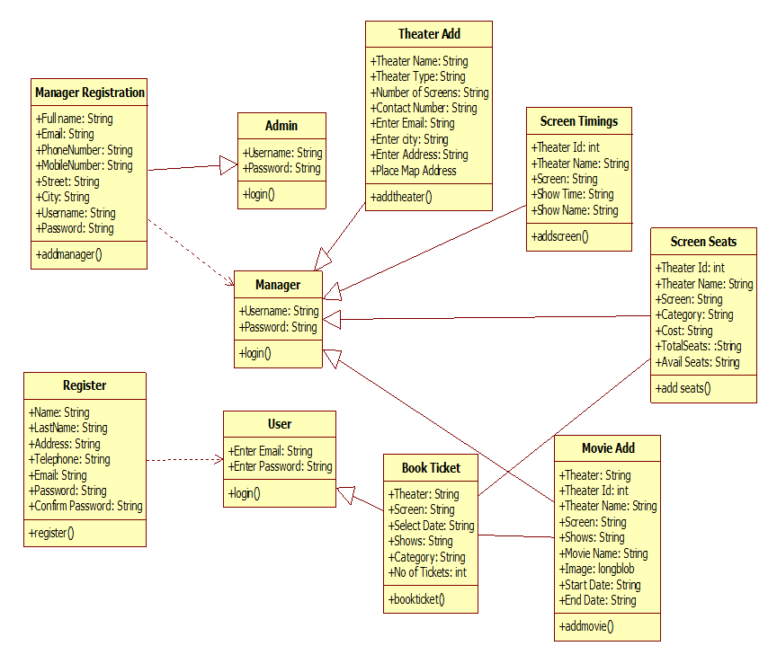
BLOCK DIAGRAM

Slide 7
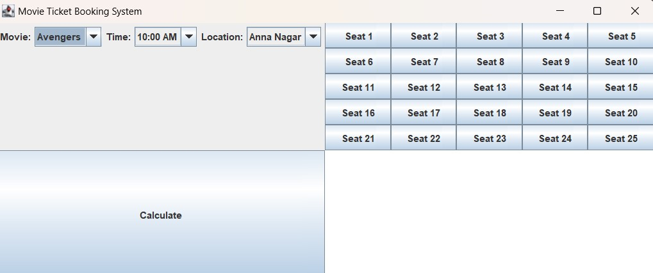
GUI DESIGN

Slide 8
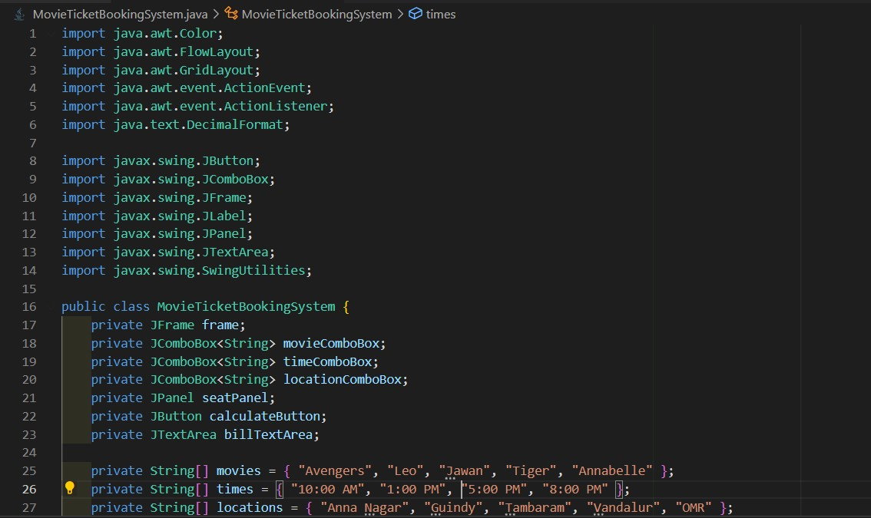
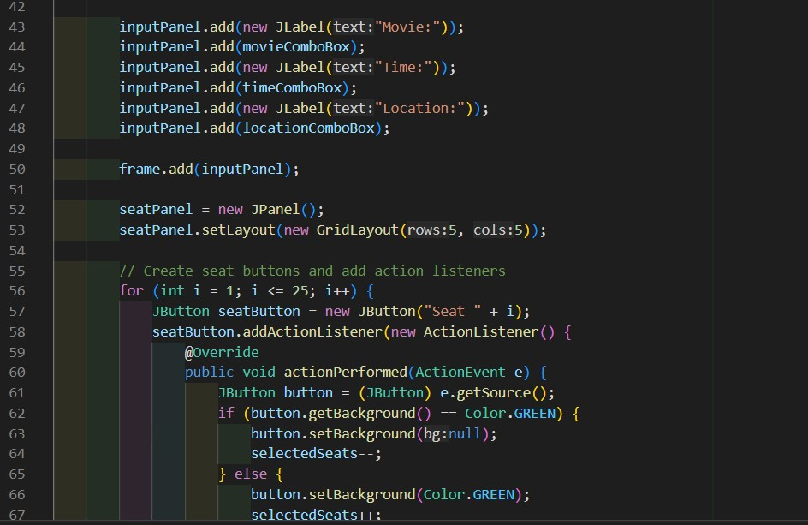
DATABASE DESIGN

Slide 9
FUTURE ENHANCEMENT
Web Development Framework (Optional): If you plan to create a web-based ticket booking system, you might consider a web development framework like Spring or JavaServer Faces (JSF). This can help with building the front-end and handling HTTP requests.
Front-End Technologies (Web-based): For a web-based system, you'll need HTML, CSS, and JavaScript. You can use libraries and frameworks like Bootstrap, jQuery, or React for a more feature-rich and responsive user interface.
Application Server (Web-based): If you are developing a web-based system, you will need an application server like Apache Tomcat, WildFly, or Jetty to host your web application.

Slide 10
Thanks

