Slide 1
Python Coding Standards

Slide 2
Python Coding Standards & Practices
PEP-8

Slide 3
PEP-8

Slide 4
What is PEP-8?
PEP-8 stands for Python Enhancement Proposal
PEP-8 provides the guidelines to make your code:
  More organized
  Have better readability

Slide 5
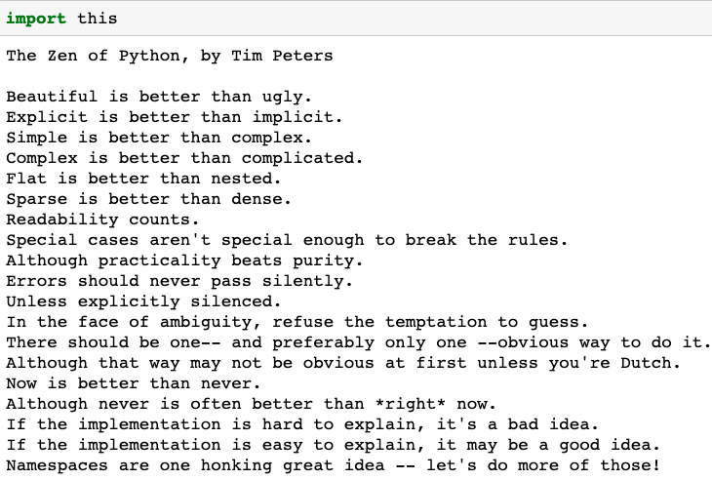
Python Programming Principles
“Readability counts”. This allows others to understand your code easily and hence contribute and maintain the code in a better way

Slide 6
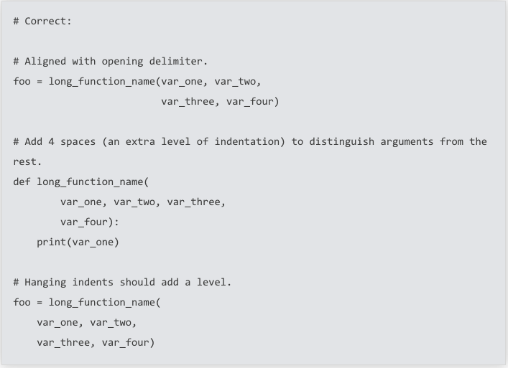
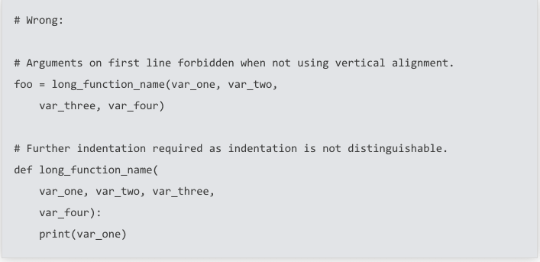
Indentation
Use 4 spaces per indentation level
Images source: python.org

Slide 7
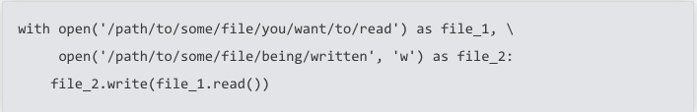
Maximum line length
It is a good idea to limit all lines to 72 characters. Use \ for continuation.
Images source: python.org

Slide 8
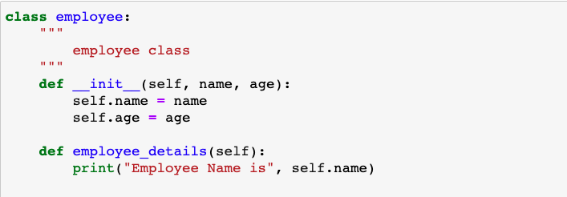
Blank lines
Top-level functions and classes are separated by two blank lines

Slide 9
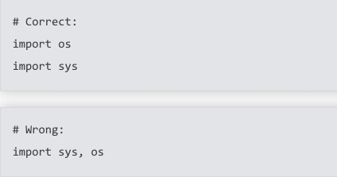

Imports
Import should usually be on separate lines
However, It is ok to say
Images source: python.org

Slide 10
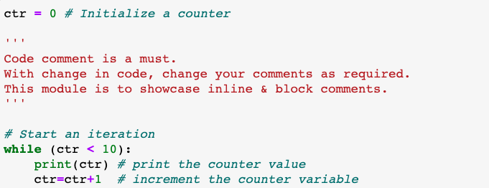
Code comments
Commenting code is a must. With change in code, change your comments

Slide 11
Naming conventions
Naming conventions of Python’s library are a bit messy. However it is recommended:
 | Naming Convention
Module | lowercase
Class | CapWords
Functions | lowercase
Methods | lowercase
Type variables | CapWords
Constants | UPPERCASE

Slide 12
Thank You

