Slide 1
Flask Installation and Create Directory

Slide 2




Error/ Warning
Information
Flashback
Class Exercise

Slide 3
Creating the application directory and virtual environment
Creating a virtual environment with Python 3 or Python 2
Working with a virtual environment
Installing Python packages with pip
Initializing the basic application structure
AGENDA

Slide 4
Creating the Application Directory and Virtual Environment

Slide 5

Creating the application directory and virtual environment
Application directory
An application directory helps keep a project organized.
Virtual environment
A virtual environment isolates project dependencies from other projects and the global Python environment.

Slide 6
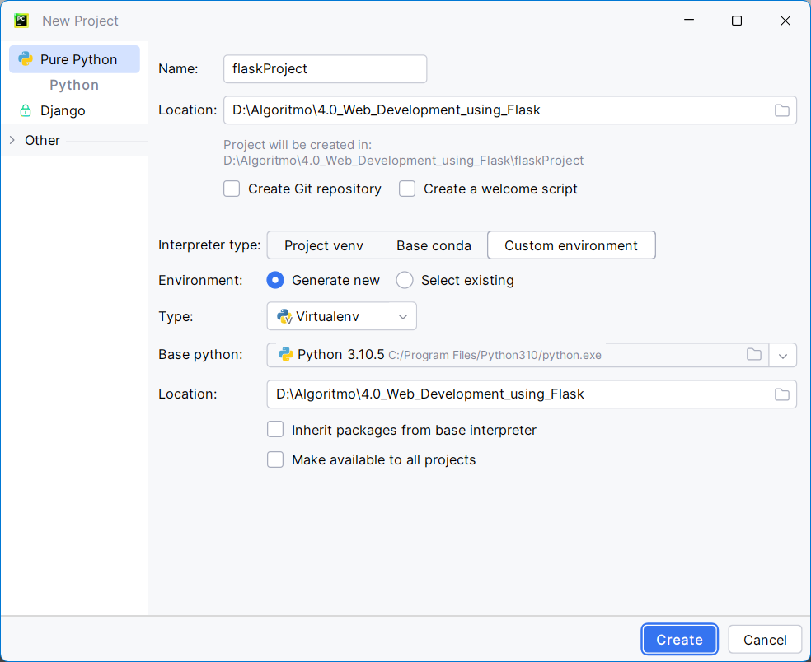
Creating the application directory and virtual environment
Implementation steps
Step 1: Open PyCharm.
Step 2: Create New Project
Step 3: Browse “Location” for the application directory.
Step 4: Choose “interpreter type” as “Custom environment”.
Step 5: Select “Generate new”.
Step 6: Type must be “Virtualenv” to create a new virtual environment for the new project.
Step 7: Select Base python version.
Step 8: Location for virtual environment.
Step 9: Click “Create” to let PyCharm create the project.

Slide 7
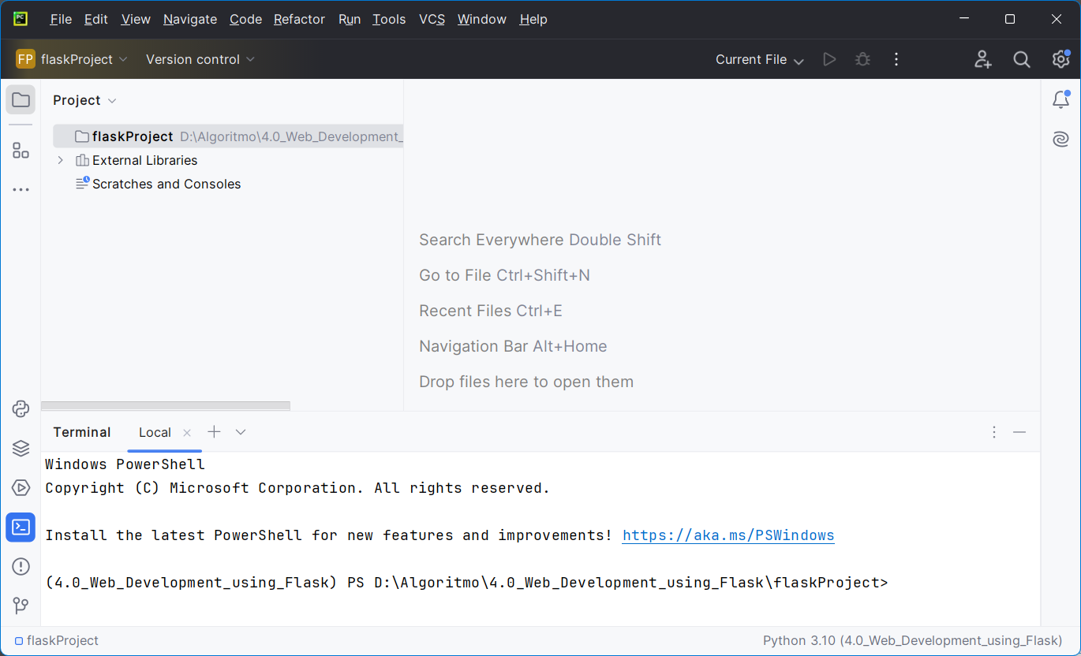
Creating the application directory and virtual environment
Implementation steps
Project name and location
Virtual environment name

Slide 8
Creating a Virtual Environment with Python 3 or Python 2

Slide 9
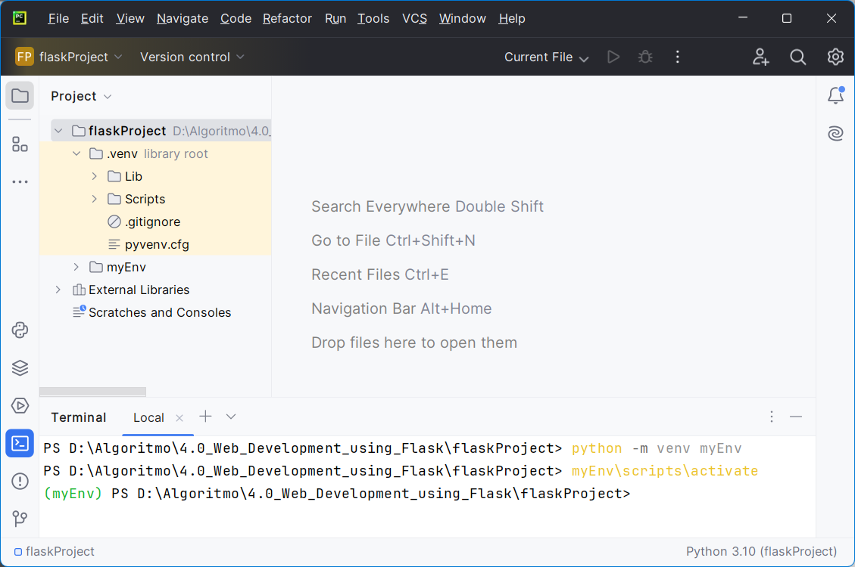
Creating a virtual environment with Python 3 or Python 2
With Python 3
PyCharm will handle the creation of the virtual environment automatically when setting up the new project. But the same task can be done using PyCharm terminal.
  Set up a virtual environment
  Open a terminal or command prompt.
  Ensure that Python3 is installed.
  Install the virtualenv package:
  pip install virtualenv
  Create a virtual environment:
  python -m venv myenv
  Activate the virtual environment
  myenv\Scripts\activate

Slide 10
Creating a virtual environment with Python 3 or Python 2
With Python 2
PyCharm will handle the creation of the virtual environment automatically when setting up the new project. But the same task can be done using PyCharm terminal.
  Set up a virtual environment
  Open a terminal or command prompt.
  Ensure that Python2 is installed.
  Install the virtualenv package:
  pip install virtualenv
  Create a virtual environment:
  python -m virtualenv myenv
  Activate the virtual environment
  myenv\Scripts\activate

Slide 11
Working with a Virtual Environment

Slide 12
Working with a virtual environment
“activate” and “deactivate”
PyCharm automatically activates the virtual environment when you open the project.
This can be verified by the presence of (venv) in the terminal prompt within PyCharm.
Manually “activate”
Run in terminal: .\venv\Scripts\activate
You should see “(<virtual_environment_name>)” at the beginning of the command line, indicating that the virtual environment is active.
Manually “deactivate”
Run in terminal: deactivate
This will return the terminal to the global Python environment.

Slide 13
Installing Python Packages with pip

Slide 14
Installing Python packages with pip
“pip”
It is the package installer for Python.
Used to install packages required.
Used to uninstall packages.
Install Flask
pip install Flask

Slide 15
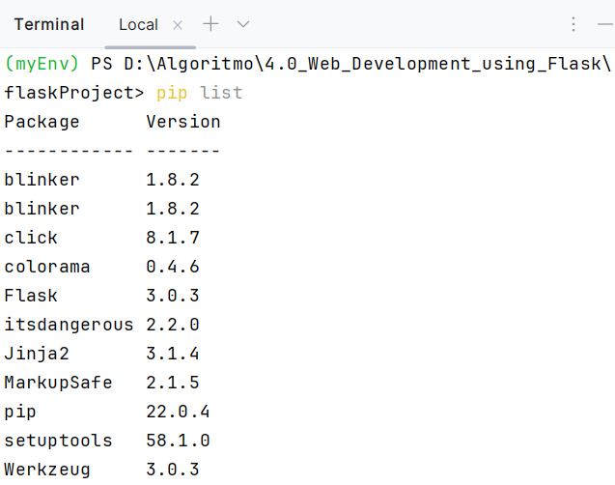
Installing Python packages with pip
“pip”
Install packages from requirements.txt
pip install -r requirements.txt
Verify the installation
List installed packages to confirm Flask is installed.
pip list

Slide 16
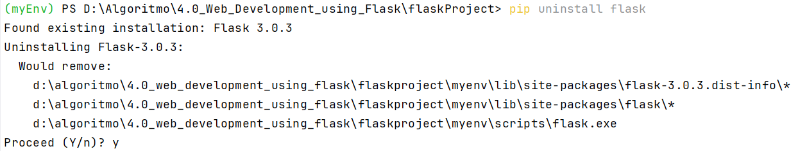
Installing Python packages with pip
“pip”
Upgrade Flask
pip install --upgrade Flask
Uninstall Flask
pip install flask

Slide 17
Initializing the Basic Application Structure

Slide 18
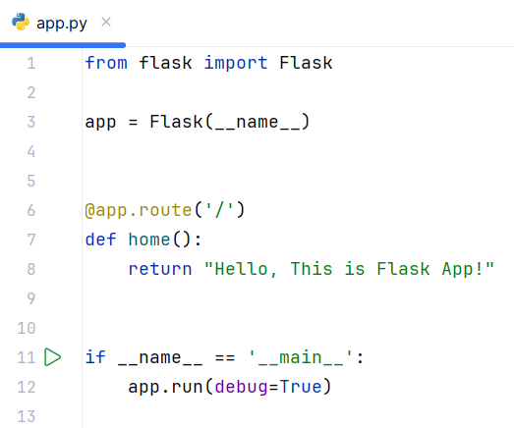
Initializing the basic application structure
Implementation steps
Setting up the basic structure of Flask application involves creating the main application file and defining a route.
Create the main application file
  In PyCharm, right-click the project directory (e.g. - flask_app) and select New > Python File.
  Name the file app.py.
Initialize the Flask application
  Open app.py in the editor and add the following code -

Slide 19
Initializing the basic application structure
Implementation steps
Run the application
  Right-click app.py and select Run 'app’.
Open the application
  Open browser and navigate to http://127.0.0.1:5000/ to see the application UI.

Slide 20
Initializing the basic application structure
What command do you use to activate the virtual environment in PyCharm's terminal?
How do you install Flask using pip in the virtual environment?
What should you check if you encounter a ModuleNotFoundError: No module named 'flask' error?
Explain the purpose of the if __name__ == '__main__': block in the app.py file.
How do you run the Flask application from within PyCharm?

Slide 21
Question?

Slide 22
Thank you

