Slide 1
3.0 Variables and Data Types

Slide 2



Error/ Warning
Information
Flashback
Class Exercise

Slide 3
Python Variables & Data Types
Variables, Data Types, and the Print Function

Slide 4
Variables

Slide 5
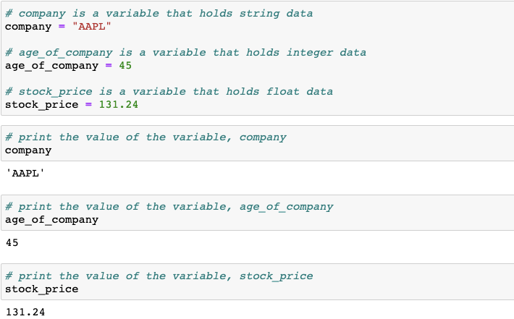
Variables
Variables are reserved memory that store data
The assignment operator, =, is used to assign a value to a variable

Slide 6
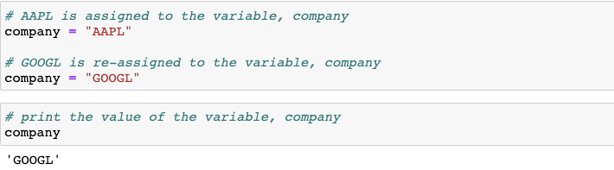
Reassigning variables
Two values are assigned to a single variable. We receive only the second assigned value as the output, since that was the most recent assignment

Slide 7
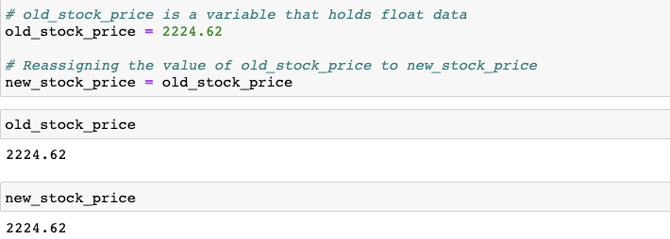
Reassigning variables
You can assign an existing variable to another new variable. The new variable will not have the value of the previously existing variable.

Slide 8
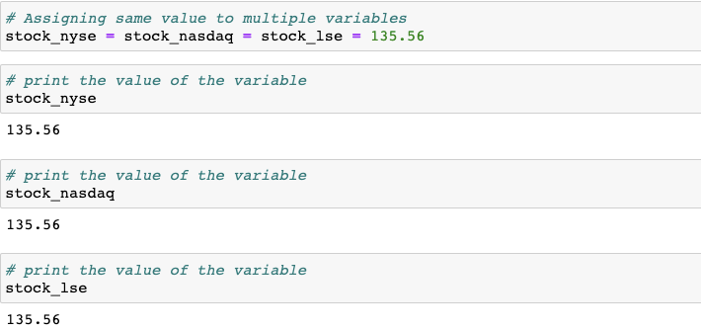
Multiple variables assignment
Assign same value to multiple variables

Slide 9
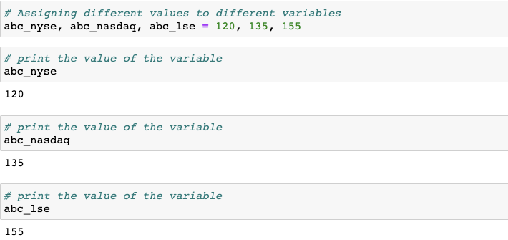
Multiple variable assignment
Assign different values to different variables

Slide 10
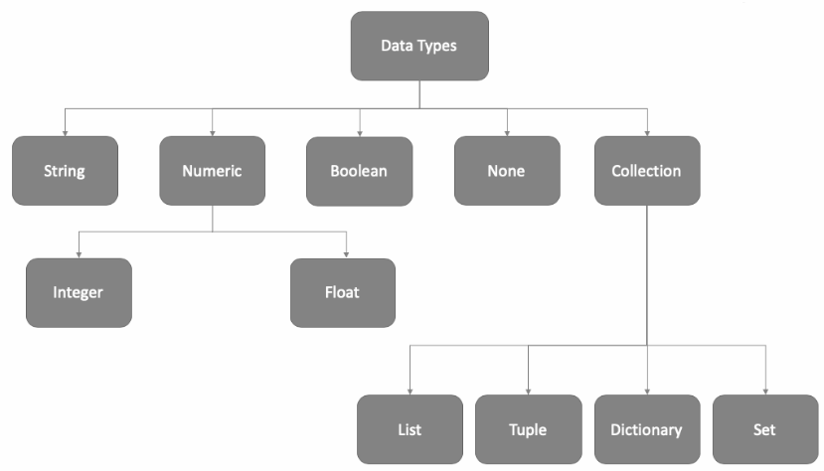
Data types in python

Slide 11

We cover the following data types in this session

Slide 12
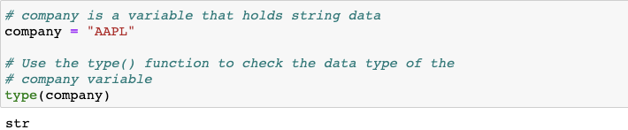
Creating string variables
String variables are created using single or double quotes
String variables are variables that hold zero or more characters such as letters, numbers, spaces, commas and other characters
Use type(variable name) to check the data type of the defined variable

Slide 13
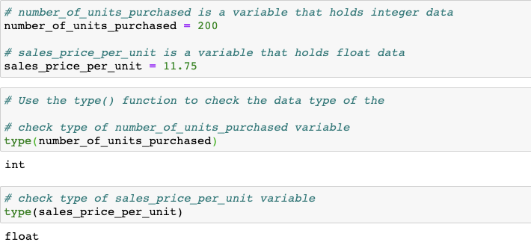
Creating numeric variables
A numeric variable is one that takes on any value within a finite or infinite interval
Numeric data types: integer and float

Slide 14
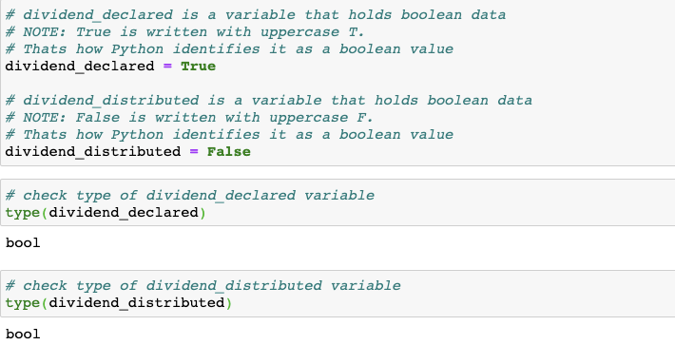
Creating boolean variables
Boolean variables can have only two possible values: True and False

Slide 15
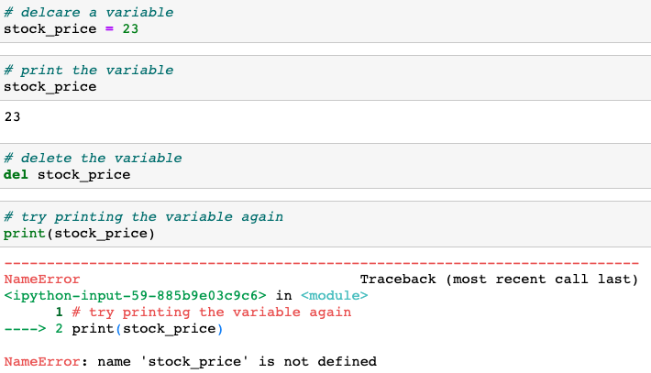
Deleting variables
The [del] keyword can be used to delete a variable
Because this variable is already deleted, it throws error when we try to print it.

Slide 16
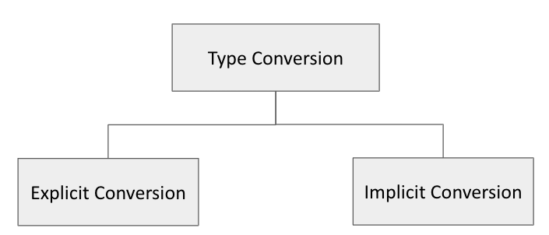
Data type conversion
Python supports conversion of one data type to another using various built-in functions
Explicit Conversion: Conversion that is user-defined that forces an expression to be of specific data type
Implicit Conversion: Conversion done by Python interpreter with programmer’s intervention

Slide 17
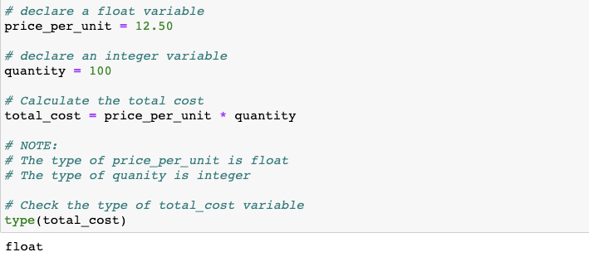
Implicit conversion
Implicit conversion is done by Python interpreter without programmer’s intervention
Note: The total_cost is by default a float variable in order to accommodate the decimal places of the price_per_unit variable. This is an example of implicit conversion.

Slide 18
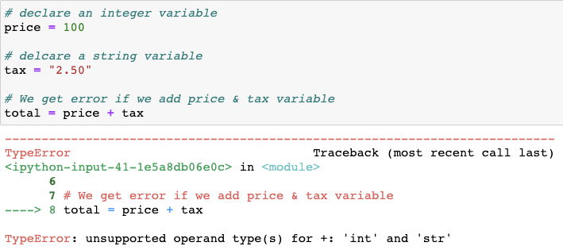
Explicit conversion is done by Python interpreter with programmer’s intervention
Note: The tax is a string type variable. And is not converted to numeric type data. Hence the addition of price (integer) and tax (string) is not possible. This requires explicit conversion.

Slide 19
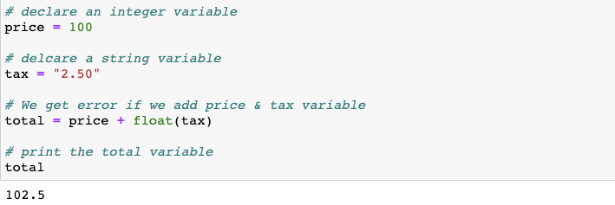
Explicit conversion
Explicit conversion is done by Python interpreter with programmer’s intervention.
Explicit data type conversion using float() function

Slide 20
Type casting functions
Built-in type-casting functions
int()
float()
str()
bool()

Slide 21
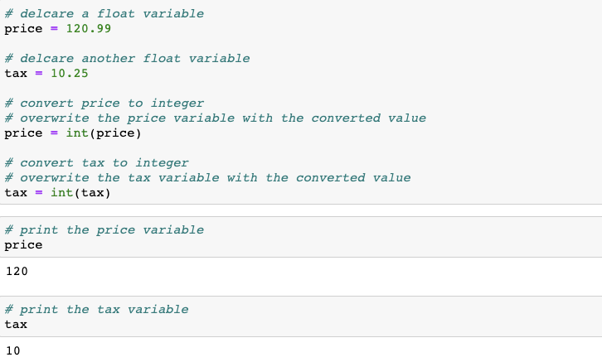
Type casting: float to integer
Converting a float variable to integer leads to loss of data.
Note: The conversion of 120.99 and 10.25 to integer truncates the decimal places. The values are not rounded off.

Slide 22
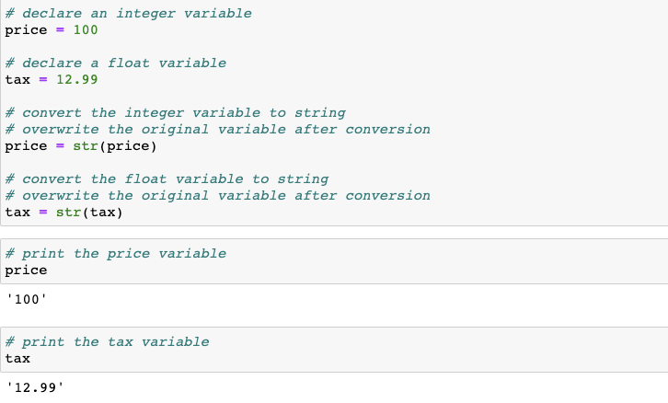
Type casting: integer, float to string
Any data can be converted to string type.
Note the quotes around the values when the variables are printed.
Note: Once converted to string, these variables cannot be used for computation.

Slide 23
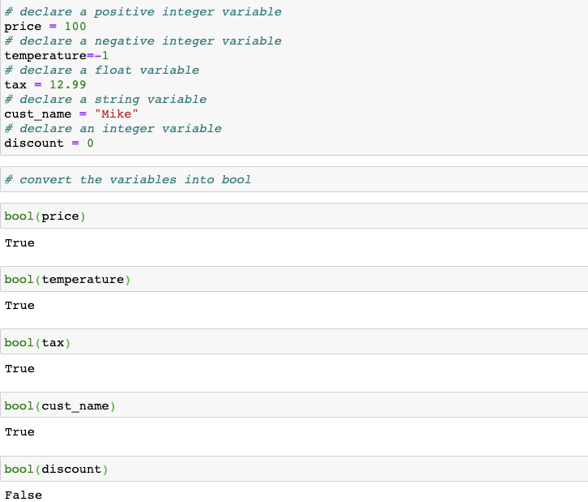
Type casting: string, integer, float to boolean
Any data can be converted to boolean type.
Only zero when converted to bool type returns a False. Everything else converted to bool returns a True.

Slide 24
TRY IT
Stock price of a company is stored in a variable as 37.99. After converting the stock price to integer the output will be 38.
True
False

Slide 25
TRY IT
Add 1.1 and 2.2 and discuss the result.

Slide 26
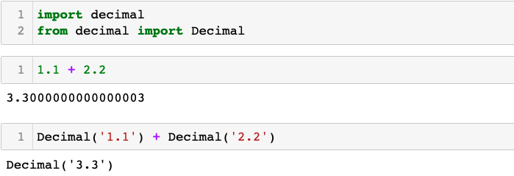
The decimal module
The decimal module provides support for fast correctly-rounded decimal floating point arithmetic. It offers several advantages over the float data type.

Slide 27
What is a function?

Slide 28
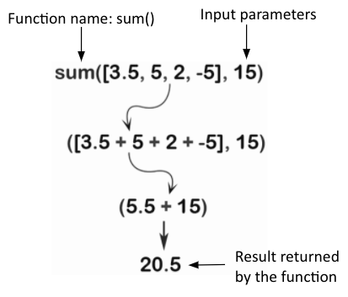
What is a function?
A function is a block of reusable code that runs when the function is called
A function has a name. A function is called by its name
A function can take input(s), known as input parameters. Input parameter(a) is/are optional
A function can return data as a result

Slide 29
What is a function?
Types of functions:
  Built-in Functions
  User-defined Functions
  Lambda Functions
Some of the built-in functions are:
  print() - to print the output
  input() - to take input from user
  int(), float(), str(), bool() - type casting functions
Built-in functions, user-defined functions and lambda functions are covered in upcoming sessions

Slide 30
The print() command

Slide 31
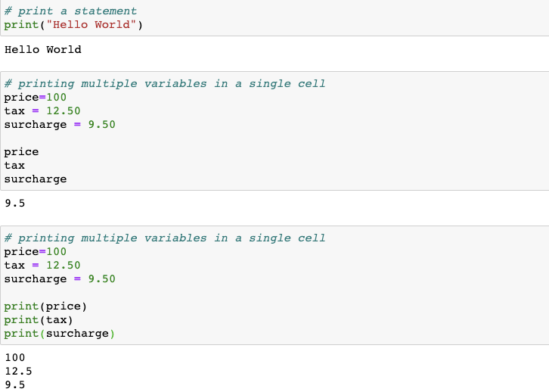
The print() in python
The print() function prints the specified variable to the screen
The variable can be a string or any other Python object
Note the difference between using and not using the print() in a single cell

Slide 32
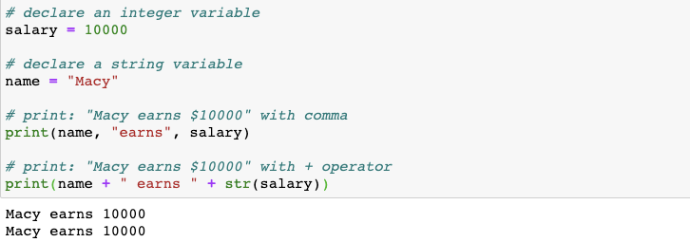
The print() in python
The print() function prints the specified message to the screen
The message can be a string or any other Python object
Strings separated by a comma within a print() function get concatenated
With + operator, a numeric variable needs to be converted to a string

Slide 33
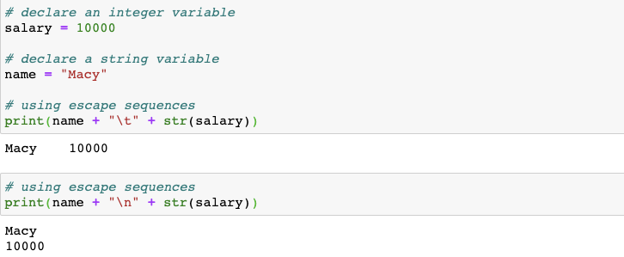
The print() in python
Using escape sequences like “\t” for tab and “\n” for new line

Slide 34
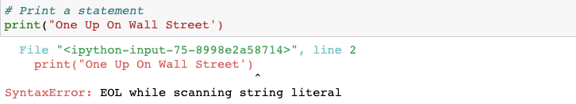
Invalid use of opening and closing quotes is not allowed

Slide 35
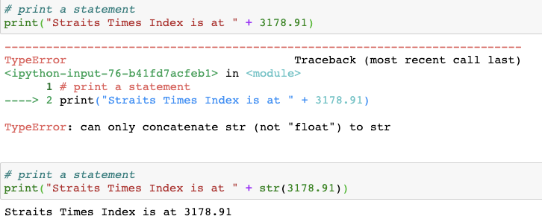
Repeat: You cannot concatenate string and number
Consider explicit conversion to convert the number to string, in order to join them together

Slide 36
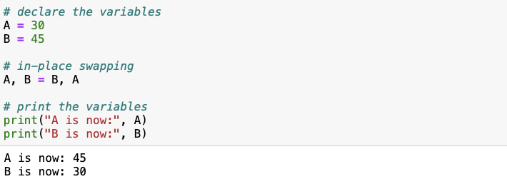
In-place value swapping
A = 30. B = 45. Swap the values without using a temporary variable such that B becomes 30 and A becomes 45.

Slide 37
Thank You

