Slide 1
Python Operators

Slide 2



Error/ Warning
Information
Flashback
Class Exercise

Slide 3
Python Operators
Arithmetic, Relational, Logical, Bitwise, Membership

Slide 4
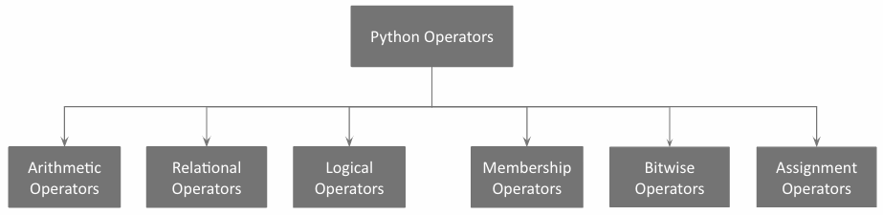
Python operators

Slide 5
Python operators
The most common arithmetic operators are:
+ | Addition
- | Subtraction
* | Multiplication
/ | Division
% | Modulus
// | Floor Division
** | Exponentiation

Slide 6
Arithmetic Operators

Slide 7
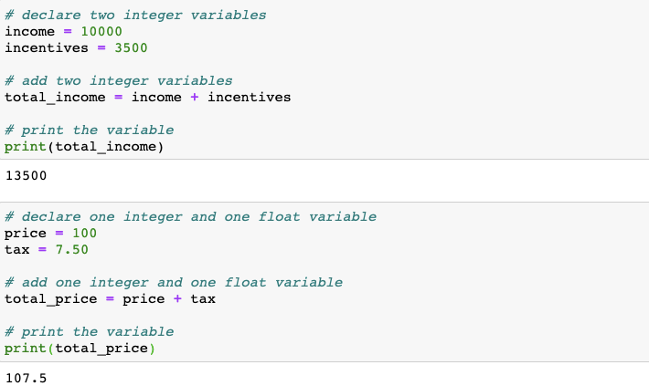
Arithmetic operators: Addition
Adding integer and float variables

Slide 8
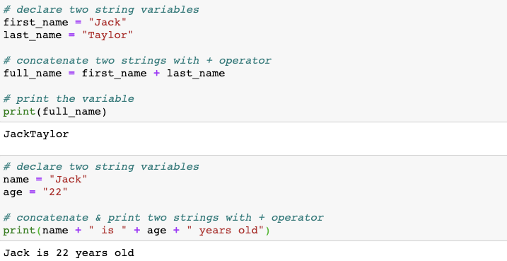
Arithmetic operators: Addition
When strings are added, the + (addition) operator concatenates the strings.

Slide 9
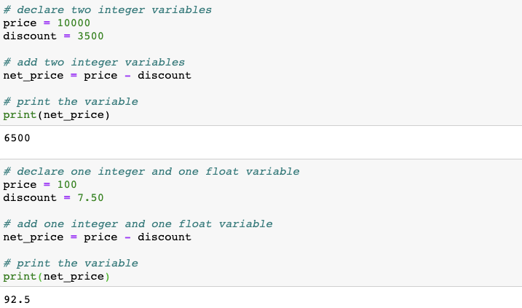
Arithmetic operators: Subtraction
Subtracting integer and float variables

Slide 10
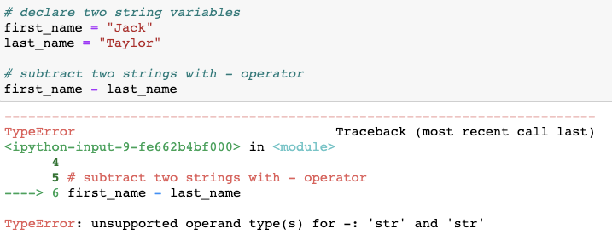
Arithmetic operators: Subtraction
When two strings are added, the + (addition) operator concatenates the two strings. Subtracting two strings does not make sense.

Slide 11
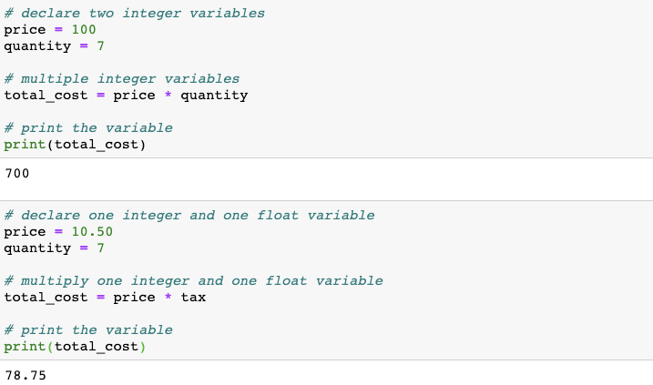
Arithmetic operators: Multiplication
Multiplying integer and float variables

Slide 12
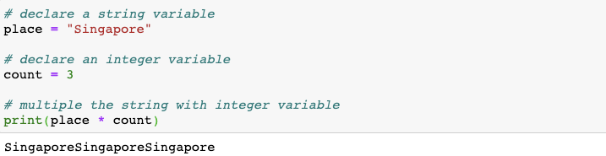
Arithmetic operators: Multiplication
Multiplying a string variable with an integer

Slide 13
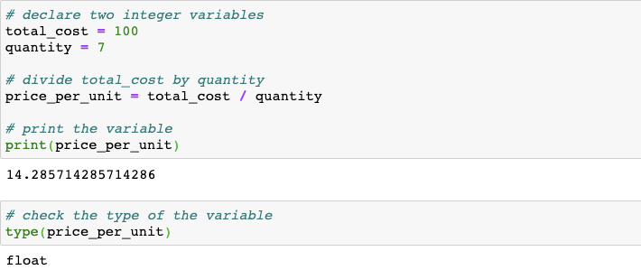
Arithmetic operators: Division
Dividing an integer/float with an integer or float.
Note: Even when an integer is divided by another integer, the data type of the result is of float type.

Slide 14
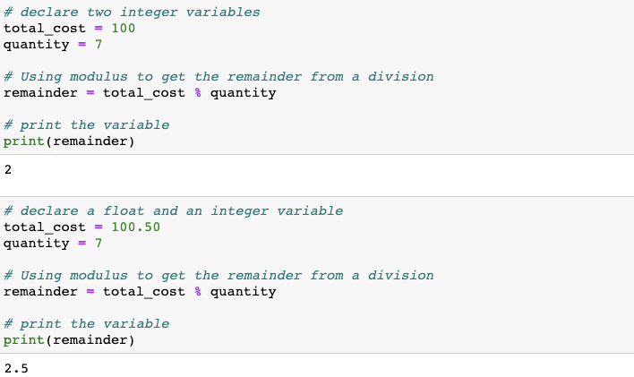
Arithmetic operators: Modulus
Modulus gives us the remainder when a value is divided by the divisor

Slide 15
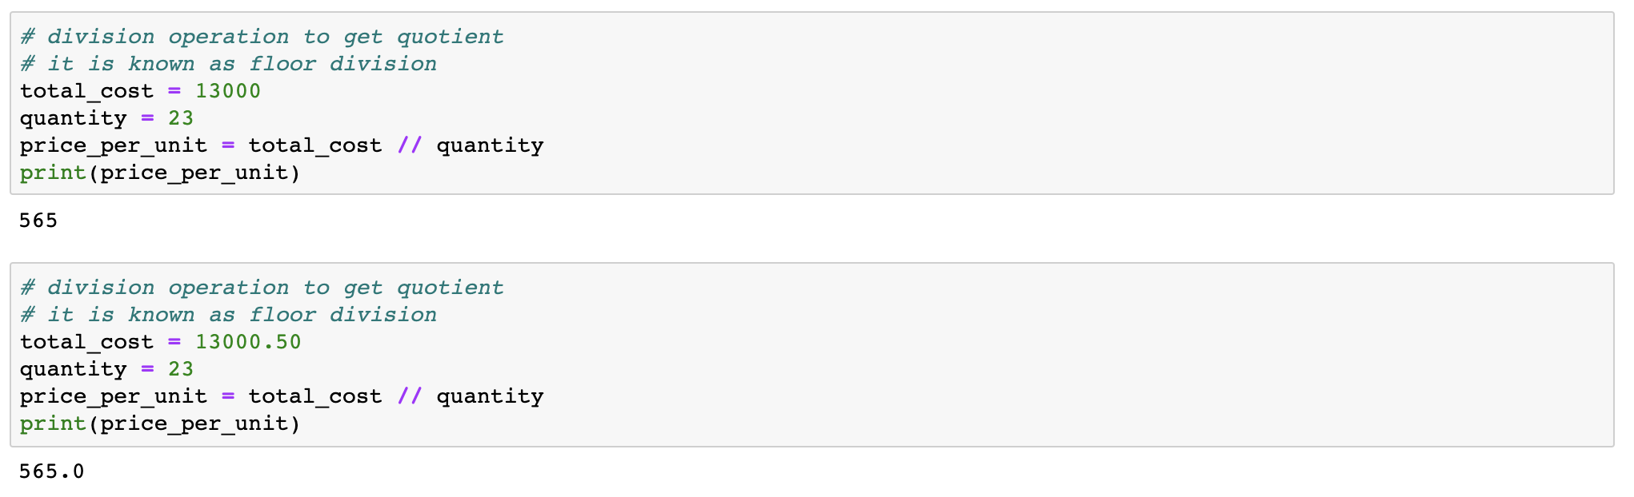
Arithmetic operators: Floor Division
Floor division gives us the quotient when a value is divided by the divisor

Slide 16
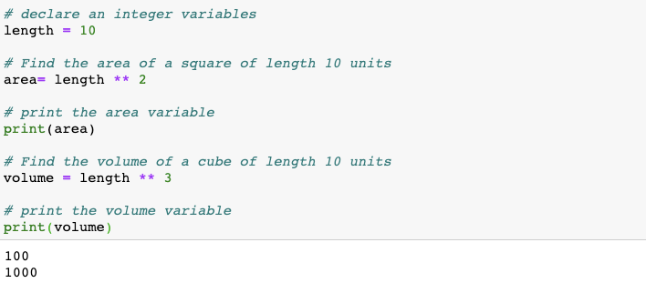
Arithmetic operators: Exponentiation
Exponentiation can calculate the power of a value

Slide 17
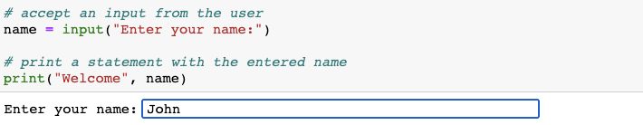
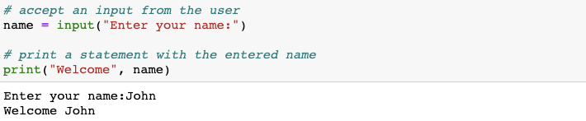
Runtime variable assignment
The input() function allows the user to enter a value. After entering the value press [Enter]

Slide 18
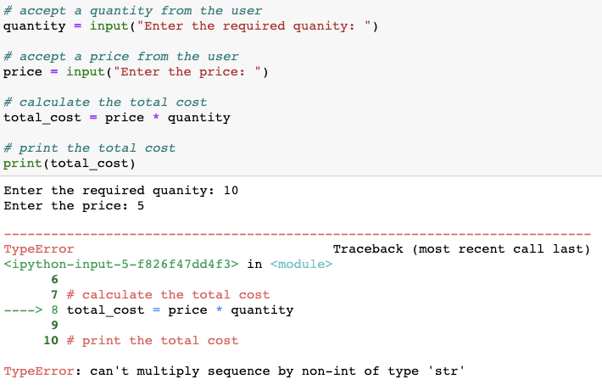
Runtime variable assignment
Note: When you use the input() function, the entered value by default is stored as string. To perform computations, the string data needs to be converted to numeric data

Slide 19
Relational Operators

Slide 20
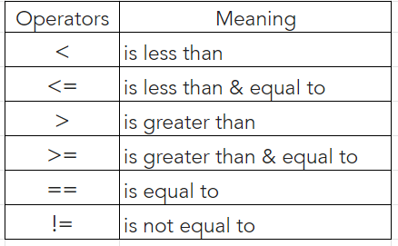
Relational operators
Relational operators are used to compare values

Slide 21
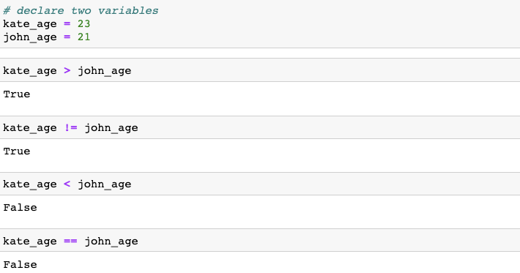
Relational operators
Relational operators are used to compare values
Note: Relational operators return boolean values - True or False

Slide 22
Logical Operators

Slide 23
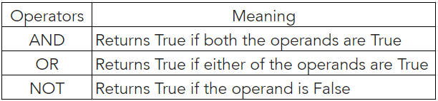
Logical operators
Logical operators in python allow a program to make a decision based on multiple conditions
Each operand is considered a condition that can be evaluated to a True or False value

Slide 24
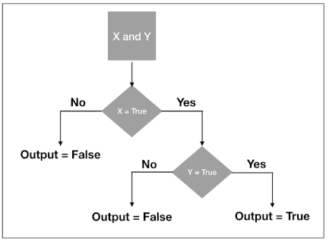
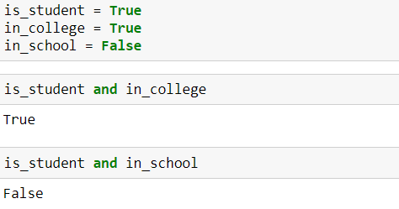
Logical operators: and
If both the operands are true then it returns true

Slide 25
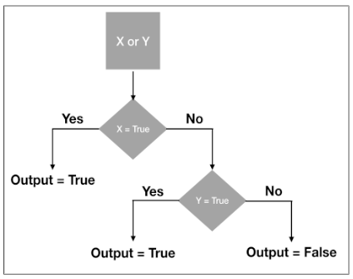
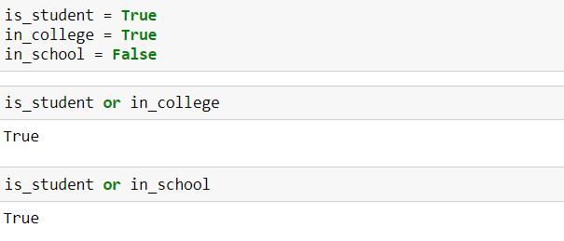
Logical operators: or
If one of the operands are true then it returns true

Slide 26
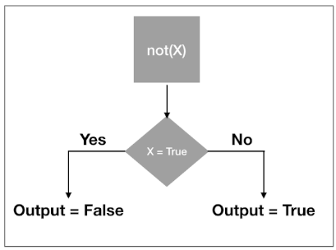
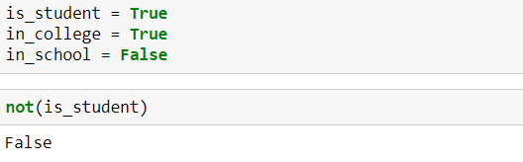
Logical operators: not
Reverses the result

Slide 27
Membership Operators

Slide 28
Membership operators
Membership operators check whether a value is a member of a sequence. The sequence may be a list, a string, a tuple, or a dictionary
in
The ‘in’ operator is used to check if a value exists in any sequence object or not.
A ‘not in’ works in an opposite way to an ‘in’ operator. A ‘not in’ evaluates to True if a value is not found in the specified sequence object. Else it returns a False.
not in

Slide 29
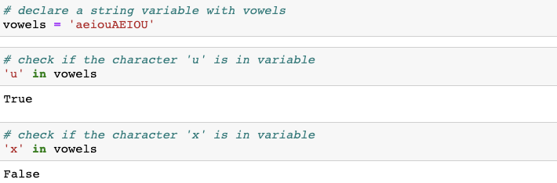
Membership operators: in
The ‘in’ operator check if a value exists in a string.

Slide 30
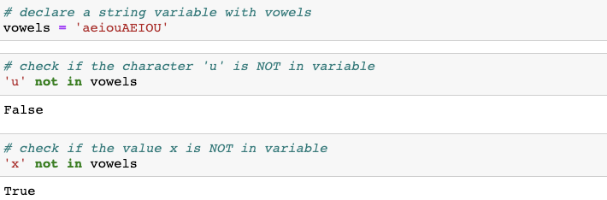
Membership operators: not in
The ‘in’ operator check if a value is missing in a string.

Slide 31
Bitwise Operators

Slide 32
Bitwise operators
Computers store all kinds of information as a stream of binary digits called bits.
When you work with text, images, or videos, computers handle them in the form of ones and zeros. The bitwise operators let you manipulate those individual bits of data at the most granular level.
Integers are first converted into binary and then operations are performed bit by bit. And hence the name bitwise operator. Note: Bitwise operators work only on integers.
In this course, we are more focussed towards using Python for data analytics and hence we will not deep dive into the computer science aspect of bitwise operators. Instead we learn how to use them.

Slide 33
Bitwise operators
Python Bitwise Operators take one to two operands, and operates on them bit by bit, instead of whole
&
(Bitwise and)
|
(Bitwise or)
The binary and (&) takes two values and performs an AND-ing on each pair of bits.
Compared to &, this one returns 1 even if one of the two corresponding bits from the two operands is 1.

Slide 34
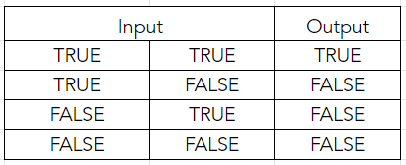
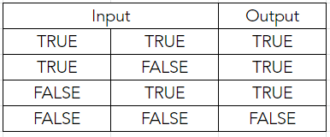
Bitwise operators: Truth tables
&
(Bitwise and)
|
(Bitwise or)

Slide 35
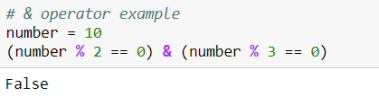
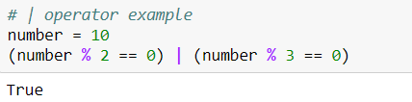
Bitwise operators
& operator
| operator
(10 % 2 == 0) & (10 % 3 == 0)
Implies True & False. This results in Fasle
(10 % 2 == 0) | (10 % 3 == 0)
Implies True | False. This results in True

Slide 36
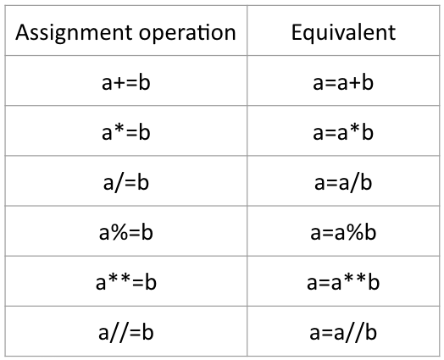
More assignment operators
The assignment operators are used to store data into a variable

Slide 37
TRY IT
You have a string variable as follows:
quote = “In this World nothing Can be said to be Certain, Except Death and Taxes.”
Check if the words “world” and “World” exist in the variable, quote.

Slide 38
Thank You

