Slide 1
Data Modeling in Flask

Slide 2




Error/ Warning
Information
Flashback
Class Exercise

Slide 3
Creating an SQLAlchemy DB instance
Creating a relational category model
Migrating databases using Alembic and Flask-Migrate
Installing required packages with mongo and redis
Indexing model data with Redis
Opting for the NoSQL way with MongoDB
AGENDA

Slide 4
Creating an SQLAlchemy DB instance

Slide 5

Creating an SQLAlchemy DB instance
SQLAlchemy
SQLAlchemy is a SQL toolkit and Object-Relational Mapping (ORM) library for Python.
It provides a full suite of well-known enterprise-level persistence patterns, designed for efficient and high-performing database access.
Flask-SQLAlchemy is an extension for Flask that adds support for SQLAlchemy to your Flask application.

Slide 6
Creating an SQLAlchemy DB instance
Example - SQLAlchemy DB instance
Steps
Set up a Flask application: Begin by setting up a basic Flask application.
Install Flask-SQLAlchemy: Use pip to install Flask-SQLAlchemy.
Configure the Flask application: Set the SQLAlchemy Database URI in the configuration.
Create the SQLAlchemy DB instance: Initialize the SQLAlchemy object with the Flask app.
Define models: Define the database models (tables).
Create the database: Create the database and tables.
SQLite is included with the Python, no separate installation is required.

Slide 7
Creating an SQLAlchemy DB instance
Example - SQLAlchemy DB instance
Set up a Flask application
Open PyCharm: Launch PyCharm and create a new project.
Set Up a Virtual Environment: Create a virtual environment for your project to manage dependencies.
Go to File > New Project.
Choose “Location” for your project.
Select New environment using: “Virtualenv” and make sure the base interpreter is set to Python 3.10.
Click “Create”.
Create a New Python File:
Right-click on the project directory in the Project panel.
Select New > Python File.
Name the file “app.py”

Slide 8
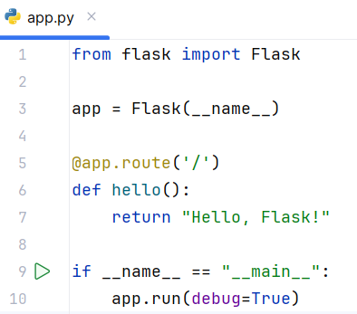
Creating an SQLAlchemy DB instance
Example - SQLAlchemy DB instance
Set up a Flask application
Add basic Flask application code -

Slide 9
Creating an SQLAlchemy DB instance
Example - SQLAlchemy DB instance
Install Flask-SQLAlchemy
Use pip to install Flask-SQLAlchemy.
Open the Terminal:
Open the terminal in PyCharm.
Install Flask-SQLAlchemy:
Run the following command to install Flask-SQLAlchemy in virtual environment:
pip install Flask Flask-SQLAlchemy

Slide 10
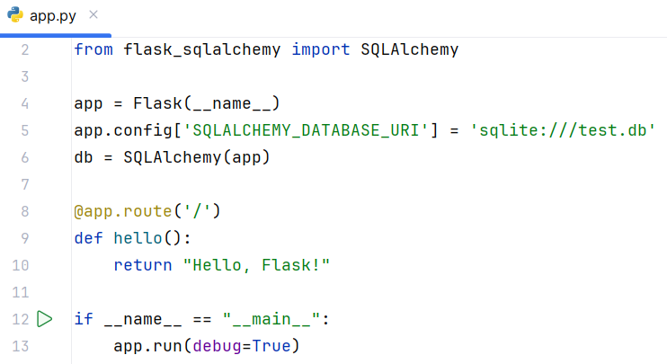
Creating an SQLAlchemy DB instance
Example - SQLAlchemy DB instance
Configure the Flask Application
Set the SQLAlchemy Database URI in the configuration.
Modify “app.py” to include the SQLAlchemy configuration.

Slide 11
Creating an SQLAlchemy DB instance
Example - SQLAlchemy DB instance
Create the SQLAlchemy DB Instance
Initialize the SQLAlchemy object with the Flask app.
No additional code is needed. The SQLAlchemy instance db already created and initialized with the Flask app in the previous step.

Slide 12
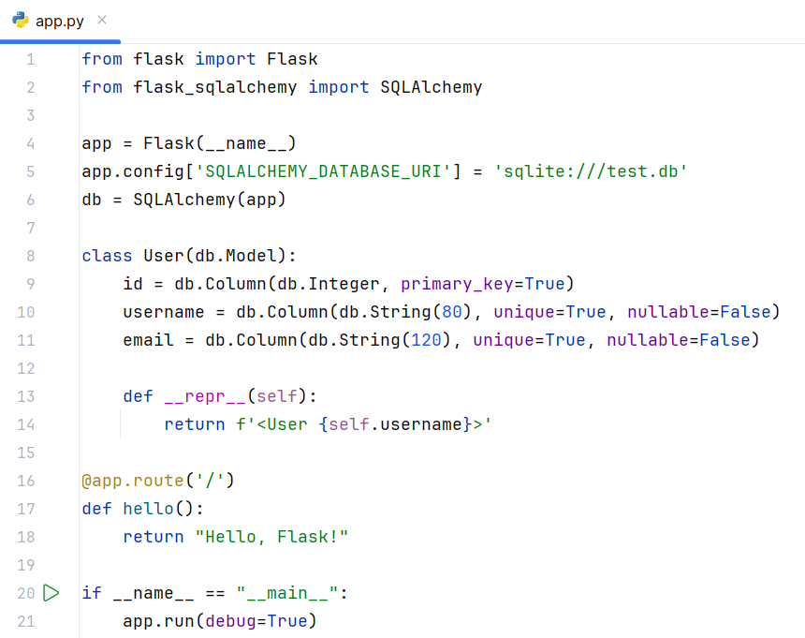
Creating an SQLAlchemy DB instance
Example - SQLAlchemy DB instance
Define Models
To define the database models (tables) update “app.py” and create a user model.

Slide 13
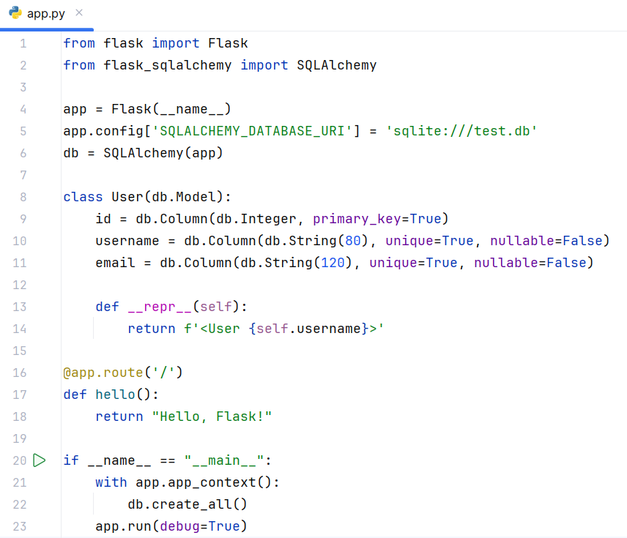
Creating an SQLAlchemy DB instance
Example - SQLAlchemy DB instance
Create the Database
Update “app.py” to create the database and tables by calling db.create_all() within the application context.

Slide 14
Creating an SQLAlchemy DB instance
Example - SQLAlchemy DB instance
Run
Click the green play button in the upper right corner of PyCharm to run the script.
Alternatively, you can right-click app.py and select Run 'app’.
Or execute “python app.py” in terminal.
Verify DB
Navigate to http://127.0.0.1:5000 to see the Flask application is running.
The SQLite database “test.db” will be created in project directory under the “instance” folder.

Slide 15
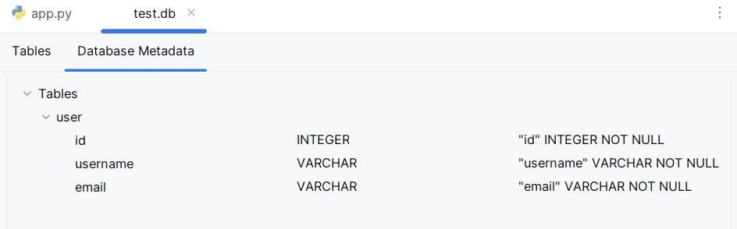
Creating an SQLAlchemy DB instance
Example - SQLAlchemy DB instance
DB Metadata

Slide 16
Creating an SQLAlchemy DB instance
Example - SQLAlchemy DB instance
Explanation
Database URI: The SQLALCHEMY_DATABASE_URI configuration key is used to specify the database URL. Here, we used sqlite:///test.db to create an SQLite database file named test.db.
Model Definition: Models in SQLAlchemy are defined as Python classes, making the codebase more organized and easier to manage.
Application Context: Certain operations like creating the database need to be executed within the Flask application context app.app_context().

Slide 17
Creating a Relational Category Model

Slide 18
Creating a relational category model
Definition
In a relational database, a category model can represent a hierarchical structure where each category can have multiple items.
A relational category model typically consists of two main components:
Category Model: Represents a category which can contain multiple items.
Item Model: Represents an item that belongs to a category.
The relationship between these models is usually one-to-many, where one category can have multiple items, but each item belongs to one category.

Slide 19
Creating a relational category model
Example – Relational category model
Let’s define a “Category model” and relate it to an “Item model”, establishing a one-to-many relationship where a category can have multiple items.
Steps
Set up a Flask Application: Begin by setting up a basic Flask application.
Install Flask-SQLAlchemy: Use pip to install Flask-SQLAlchemy.
Configure the Flask Application: Set the SQLAlchemy Database URI in the configuration.
Create the SQLAlchemy DB Instance: Initialize the SQLAlchemy object with the Flask app.
Define Models: Define the Category and Item models.
Create the Database: Create the database and tables.

Slide 20
Creating a relational category model
Example – Relational category model
Steps
Set up a Flask Application: Begin by setting up a basic Flask application.
Install Flask-SQLAlchemy: Use pip to install Flask-SQLAlchemy.
Configure the Flask Application: Set the SQLAlchemy Database URI in the configuration.
Create the SQLAlchemy DB Instance: Initialize the SQLAlchemy object with the Flask app.
Complete the above four steps, these are like the first four steps of previous example of SQLAlchemy DB instance.

Slide 21
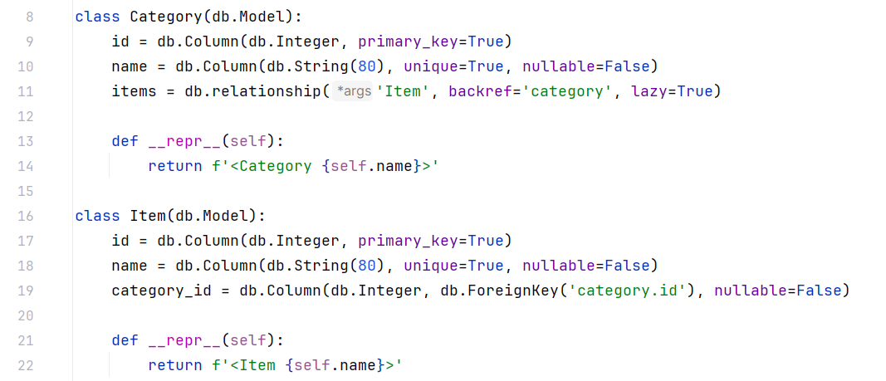
Creating a relational category model
Example – Relational category model
5. Define Models
Update “app.py” to define “Category” and “Item Models”.

Slide 22
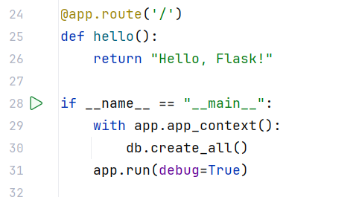
Creating a relational category model
Example – Relational category model
6. Create database
Ensure db.create_all() is called within the application context to create the database and tables.

Slide 23
Creating a relational category model
Example – Relational category model
Explanation
Relationship:
db.relationship: Used to define a relationship in the Category model.
db.ForeignKey: Used to define a foreign key in the Item model.
backref='category': Automatically adds a category to model, allowing easy access to the parent category.
lazy=True: Configures how the related items are loaded. In this case, they are loaded lazily (when accessed).

Slide 24
Creating a relational category model
Example – Relational category model
Run
Click the green play button in the upper right corner of PyCharm to run the script.
Alternatively, you can right-click app.py and select Run 'app’.
Or execute “python app.py” in terminal.
Verify DB
Navigate to http://127.0.0.1:5000 to see the Flask application is running.
The SQLite database “test.db” will be created in project directory under the “instance” folder.

Slide 25
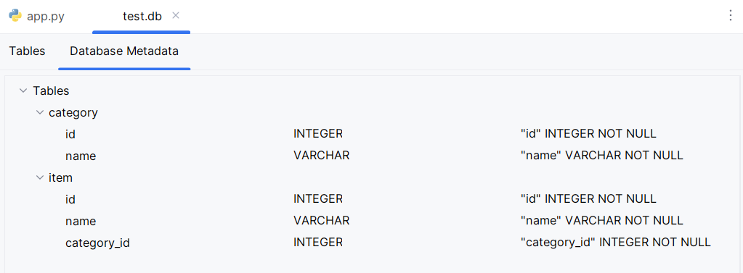
Creating a relational category model
Example – Relational category model
DB Metadata

Slide 26
Creating a relational category model
Case Study: Online Bookstore Category Management
Background
You are developing a web application for an online bookstore that needs to manage categories and books efficiently. Each book can belong to only one category, but each category can contain multiple books. Implement a relational model to handle this scenario using Python, Flask, and SQLAlchemy.

Slide 27
Creating a relational category model
Case Study: Online Bookstore Category Management
Requirements
Category Model:
Each category should have a unique identifier (id) and a name (name).
Implement a relationship where each category can have multiple books associated with it.
Book Model:
Each book should have a unique identifier (id), a title (title), and an author (author).
Implement a foreign key relationship linking each book to its corresponding category.
Functionality:
Create routes to add new categories and books.
Implement endpoints to list all categories and their associated books.
Allow for updating and deleting categories and books.

Slide 28
Migrating Databases using Alembic and Flask-Migrate

Slide 29
Migrating databases using Alembic and Flask-migrate
Alembic
Alembic is a lightweight database migration tool for SQLAlchemy.
It provides a way to automatically generate changes to your database schema over time, such as creating new tables, modifying existing ones, or dropping tables.
Alembic tracks these changes in migration scripts, allowing you to apply them to your database in a controlled manner.

Slide 30
Migrating databases using Alembic and Flask-migrate
Flask-migrate
Flask-Migrate is an extension for Flask that integrates Alembic into Flask applications, making it easier to manage database migrations within Flask projects.
It provides a command-line interface (CLI) through Flask's flask command to automate the generation and application of Alembic migration scripts.

Slide 31
Migrating databases using Alembic and Flask-migrate
Alembic and Flask-migrate
Alembic and Flask-Migrate together provide a powerful mechanism for managing database schema changes in SQLAlchemy-based Flask applications.
They automate the process of generating migration scripts based on changes to your SQLAlchemy models and applying these scripts to your database.
These tools are essential for maintaining data integrity and managing database changes efficiently in production environments.

Slide 32
Migrating databases using Alembic and Flask-migrate
Example – Migrate database
Steps
Set up a Flask Application: Begin by setting up a basic Flask application.
Install Flask-Migrate: Use pip to install Flask-Migrate.
Configure the Flask Application: Set up the necessary configurations for Flask-Migrate and SQLAlchemy.
Initialize Alembic: Initialize Alembic for managing database migrations.
Create a Database Model: Define a sample database model to demonstrate migrations.
Generate an Initial Migration: Create an initial migration script to set up the initial database schema.
Apply Migrations: Apply the initial migration and perform database upgrades and downgrades.

Slide 33
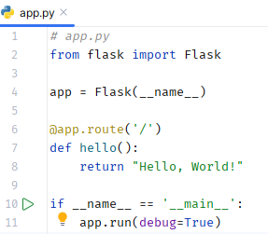
Migrating databases using Alembic and Flask-migrate
Example – Migrate database
Set up a Flask Application
First, create a basic Flask application. This will serve as the foundation for the database migrations.

Slide 34

Migrating databases using Alembic and Flask-migrate
What is @app.route(‘/’)

Slide 35
Migrating databases using Alembic and Flask-migrate
Example – Migrate database
2. Install Flask-Migrate
‘Flask-Migrate’ is an extension that handles SQLAlchemy database migrations for Flask applications using Alembic.
Use ‘pip’ to install ‘Flask-Migrate’ and its dependencies.
pip install Flask-Migrate Flask-SQLAlchemy

Slide 36
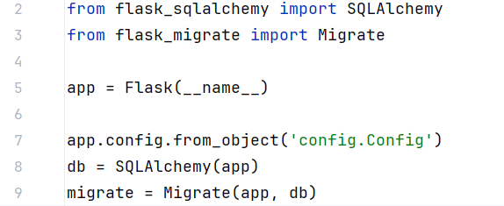
Migrating databases using Alembic and Flask-migrate
Example – Migrate database
3. Configure the Flask application
Modify app.py to include SQLAlchemy and Flask-Migrate configuration.

Slide 37
Migrating databases using Alembic and Flask-migrate
Example – Migrate database
Explanation
The line app.config.from_object('config.Config') in “app.py” file is used to load configuration settings from a configuration class defined in a separate file – “config.py”

Slide 38
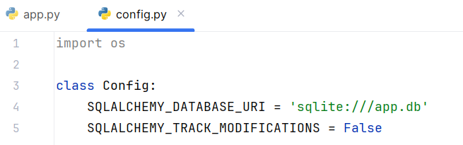
Migrating databases using Alembic and Flask-migrate
Example – Migrate database
3. Configure the Flask application
Create a new file “config.py” to setup app configuration.

Slide 39
Migrating databases using Alembic and Flask-migrate
Example – Migrate database
Explanation
SQLALCHEMY_DATABASE_URI specifies the database URL.
SQLALCHEMY_TRACK_MODIFICATIONS is set to False to disable a feature that signals the application every time a change is about to be made in the database.

Slide 40
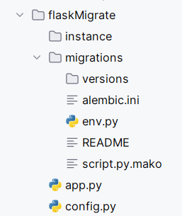
Migrating databases using Alembic and Flask-migrate
Example – Migrate database
4. Initialize Alembic
flask db init
This will create a new migrations directory.

Slide 41
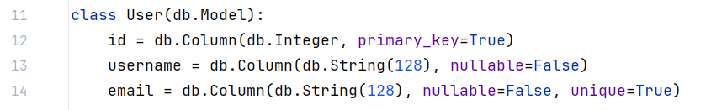
Migrating databases using Alembic and Flask-migrate
Example – Migrate database
5. Create a database model
Update the “app.py” to create a model “User” with the fields – ‘id’, ‘username’ and ‘email’.
Write these statements below the migrate configuration code.

Slide 42
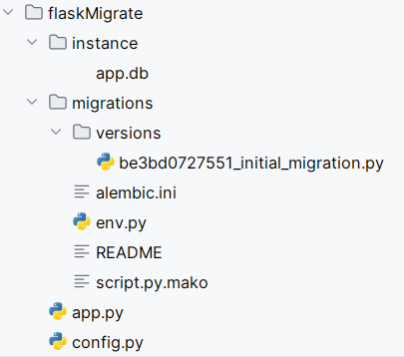
Migrating databases using Alembic and Flask-migrate
Example – Migrate database
6. Generate an initial migration
Run the command below to create an initial migration script to set up the initial database migration.
flask db migrate -m "Initial migration"
This will create a migration script under the migrations/versions directory based on the current state of the models.

Slide 43
Migrating databases using Alembic and Flask-migrate
Example – Migrate database
7. Apply migration
flask db upgrade – Apply the migration to the database.
flask db downgrade – Rollback the migrations if needed.

Slide 44
Migrating databases using Alembic and Flask-migrate
Example – Migrate database
Initialize the database and apply migration
flask db init
flask db migrate -m "Initial migration."
Flask db upgreade

Slide 45
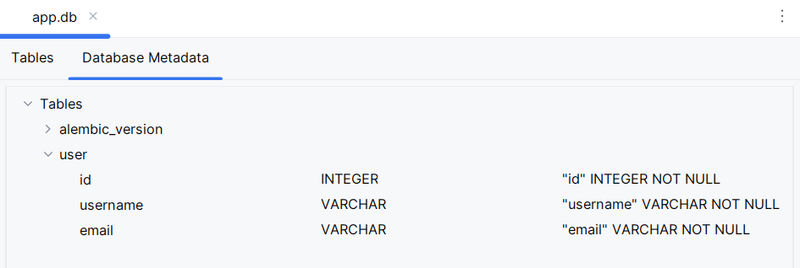
Migrating databases using Alembic and Flask-migrate
Example – Migrate database
After applying the migration “instance/app.db” file will be updated.

Slide 46
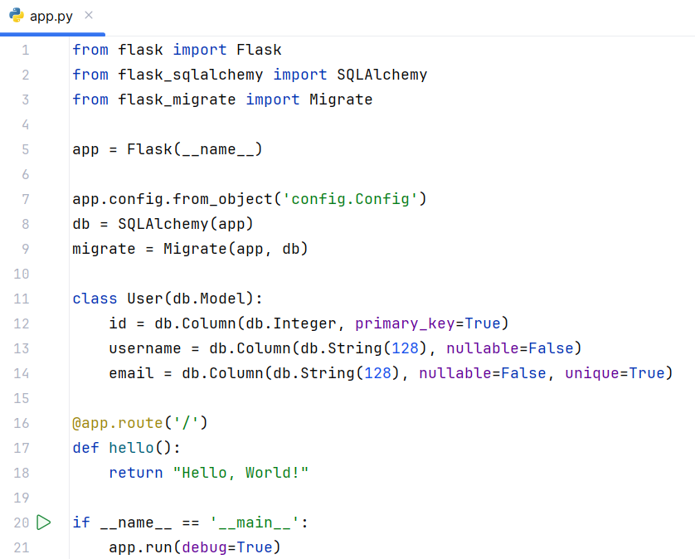
Migrating databases using Alembic and Flask-migrate
Example – Migrate database
app.py – complete code

Slide 47
Migrating databases using Alembic and Flask-migrate
Case Study: Employee Management System
Scenario
You are tasked with creating a simple Employee Management System using Flask. This system will store information about employees, including their names and positions within the company.
Requirements
Set up a Flask Application
Install Flask-Migrate
Configure the Flask Application
Initialize Alembic
Create a Database Model for Employees
Generate an Initial Migration
Apply Migrations

Slide 48
Installing Required Packages with Mongo and Redis

Slide 49
Installing required packages with mongo and redis
Definition
MongoDB:
MongoDB is a NoSQL database that uses a document-oriented data model.
It stores data in JSON-like documents with dynamic schemas.
Redis:
Redis is an in-memory key-value store known for its high performance and versatility.
It supports various data structures such as strings, hashes, lists, sets, and more.
Its a popular choice for caching and real-time analytics.

Slide 50
Installing required packages with mongo and redis
Steps to install mongo and redis
Step 1: Install Flask.
pip install Flask
Step 2: Install the ‘pymongo’ package for MongoDB.
pip install pymongo
Step 3: Install the ‘redis’ package for Redis.
pip install redis
Step 4 (optional): Install ‘Flask-PyMongo’ for easier integration with MongoDB.
pip install Flask-PyMongo
Step 5 (optional): Install ‘Flask-Redis’ for easier integration with Redis.
pip install Flask-Redis
Step 6: Generate a ‘requirements.txt’ file to keep track of your dependencies.

Slide 51
Indexing Model Data with Redis

Slide 52

Indexing model data with redis
Steps
1. Initialize Flask app and Redis client

Slide 53
Indexing model data with redis
Explanation
Flask App: app is the Flask application instance.
Client: Redis client instance connected to a Redis server running on localhost at port 6379 using database 0.
db=0
In Redis, the term "database 0" refers to the default database that Redis uses when a client connects.
Redis supports multiple databases, which are essentially namespaces for storing keys.
These databases are numbered starting from 0.
By default, Redis is configured to support 16 databases, numbered from 0 to 15.

Slide 54
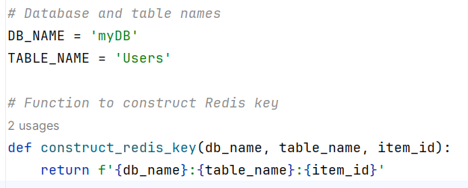
Indexing model data with redis
Steps
2. Construct Redis key

Slide 55
Indexing model data with redis
Explanation
The construct_redis_key function is designed to create a standardized and unique key format for storing and retrieving data in Redis.
This function helps organize and namespace the keys in Redis, making it easier to manage and avoid key collisions.

Slide 56
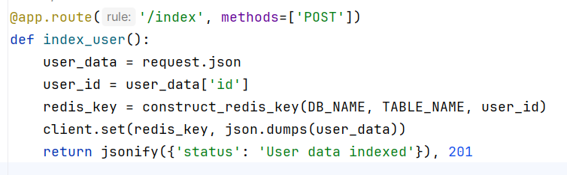
Indexing model data with redis
Steps
3. Index user data

Slide 57
Indexing model data with redis
Explanation
@app.route('/index', methods=['POST']): This decorator defines a route /index that accepts POST requests.
index_user: This function handles the request to index user data.
request.json: Access the JSON data sent in the POST request.
user_data['id']: Extract the id from the user data.
construct_redis_key: Generate the Redis key using the construct_redis_key function.
client.set: Store the user data in Redis with the generated key.
jsonify: Return a JSON response indicating success with a 201 status code.

Slide 58
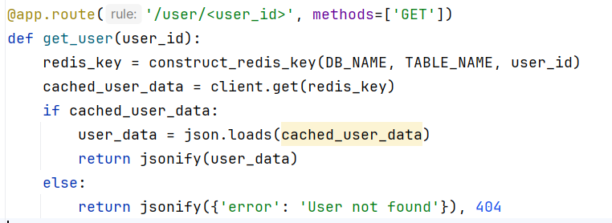
Indexing model data with redis
Steps
4. Retrieve user data

Slide 59
Indexing model data with redis
Explanation
@app.route('/user/<user_id>', methods=['GET']): This decorator defines a route /user/<user_id> that accepts GET requests. <user_id> is a variable part of the URL that will be passed to the function.
get_user: This function handles the request to retrieve user data.
construct_redis_key: Generate the Redis key using the construct_redis_key function.
client.get: Retrieve the user data from Redis using the generated key.
json.loads: Parse the retrieved JSON data back into a Python dictionary.
jsonify: Return the user data as a JSON response if found, otherwise return an error message with a 404 status code.

Slide 60
Indexing model data with redis
Case Study: Note Repo
Scenario
You are a developer tasked with creating a simple web application using Flask and Redis. The application will allow users to store and retrieve notes. Each note will have a unique identifier (ID), a title and a content field. Your task is to implement the necessary routes to index (store) and retrieve notes using Redis as the backend data store.
Requirements
Set up a basic Flask application.
Integrate Redis to store and retrieve note data.
POST - /note: Endpoint to store a new note.
GET - /note/<note_id>: Endpoint to retrieve a note by its ID.
Use Postman at the endpoints to test Flask-redis application.

Slide 61
Opting for the NoSQL Way with MongoDB

Slide 62
Opting for the NoSQL way with MongoDB
NoSQL
NoSQL databases provide a way to store and retrieve data that is modeled in means other than the tabular relations used in relational databases. MongoDB is a popular NoSQL database that stores data in flexible, JSON-like documents, allowing for dynamic schemas.
Benefits of MongoDB
Scalability: Horizontally scalable using sharding.
Flexibility: Schema-less design allows for easy evolution of data models.
Performance: Efficiently handles large volumes of data.

Slide 63
Opting for the NoSQL way with MongoDB
NoSQL
NoSQL databases provide a way to store and retrieve data that is modeled in means other than the tabular relations used in relational databases. MongoDB is a popular NoSQL database that stores data in flexible, JSON-like documents, allowing for dynamic schemas.
Benefits of MongoDB
Scalability: Horizontally scalable using sharding.
Flexibility: Schema-less design allows for easy evolution of data models.
Performance: Efficiently handles large volumes of data.
Download MongoDB Community Server - https://www.mongodb.com/try/download/community

Slide 64
Opting for the NoSQL way with MongoDB
Flask application with MongoDB – CRUD operations
CRUD stands for Create, Read, Update, and Delete.
It's a set of basic operations used in databases and data management:
Create: Adding new data records.
Read: Retrieving data from the database.
Update: Modifying existing data records.
Delete: Removing data records from the database

Slide 65
Opting for the NoSQL way with MongoDB
Example - CRUD operations with Flask – MongoDB application
Steps
Creating a Flask Application
Connecting Flask with MongoDB
CRUD Operations with Flask and MongoDB
Handling Data with Flask and MongoDB

Slide 66
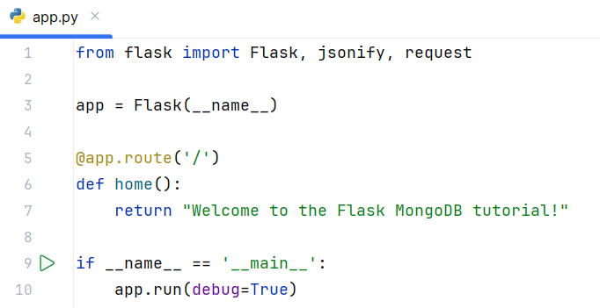
Opting for the NoSQL way with MongoDB
Example - CRUD operations with Flask – MongoDB application
Creating a Flask Application

Slide 67

Opting for the NoSQL way with MongoDB
Example - CRUD operations with Flask – MongoDB application
2. Connecting Flask with MongoDB
Update app.py to define a collection:
collection = db['users’]
MongoDB configuration
OFC - MongoDB database name.
EMP – MongoDB collection name.

Slide 68
Opting for the NoSQL way with MongoDB
Example - CRUD operations with Flask – MongoDB application
2. CRUD Operations with Flask and MongoDB
Create: Already covered in the previous section
.

Slide 69
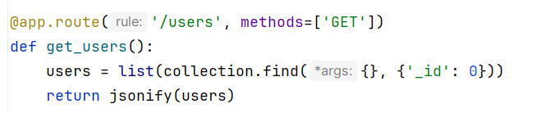
Opting for the NoSQL way with MongoDB
Example - CRUD operations with Flask – MongoDB application
2. CRUD Operations with Flask and MongoDB
Add a route to retrieve all users.

Slide 70
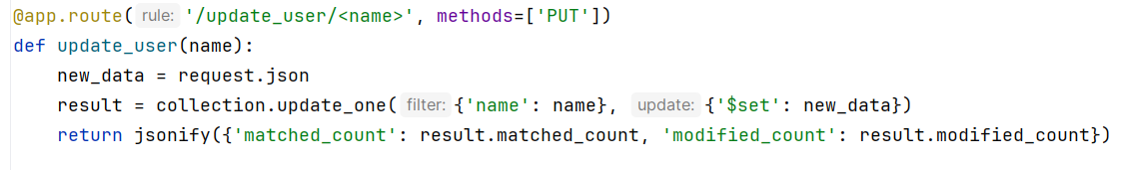
Opting for the NoSQL way with MongoDB
Example - CRUD operations with Flask – MongoDB application
2. CRUD Operations with Flask and MongoDB
Add a route to retrieve all users.

Slide 71
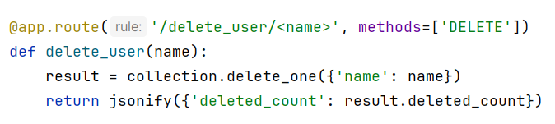
Opting for the NoSQL way with MongoDB
Example - CRUD operations with Flask – MongoDB application
2. CRUD Operations with Flask and MongoDB
Add a route to delete a users.

Slide 72
Opting for the NoSQL way with MongoDB
Example - CRUD operations with Flask – MongoDB application
Testing using CURL
curl -X POST -H "Content-Type: application/json" -d '{"name": "John Doe", "email": "john@example.com"}' http://127.0.0.1:5000/add_user
curl http://127.0.0.1:5000/users
curl -X PUT -H "Content-Type: application/json" -d '{"email": "new_email@example.com"}' http://127.0.0.1:5000/update_user/John Doe
curl -X DELETE http://127.0.0.1:5000/delete_user/John Doe

Slide 73
Opting for the NoSQL way with MongoDB
Example - CRUD operations with Flask – MongoDB application
6. Handling Data with Flask and MongoDB
JSON Handling: MongoDB stores data in BSON format, which is similar to JSON. Flask's request.json and jsonify methods make it easy to handle JSON data.
ObjectIDs: MongoDB generates unique _id fields for documents. Convert these to strings when returning JSON responses to avoid issues with BSON ObjectID.

Slide 74
Indexing model data with redis
Case Study: Book Inventory Management System
Background
You are a software developer tasked with creating a simple Book Inventory Management System for a local library. The library needs a web application to manage its collection of books, allowing librarians to add, view, update, and delete book records. You decide to use Flask as the web framework and MongoDB as the database to store the book data.
Task
Your task is to develop a web application using Flask and MongoDB that performs basic CRUD operations for managing the book inventory.

Slide 75
Question?

Slide 76
Thank you

