Slide 1
Python Database Framework

Slide 2




Error/ Warning
Information
Flashback
Class Exercise

Slide 3
Database Management with Flask SQLAlchemy
How to initialize and configure a simple SQLite database
Most common SQLAlchemy column types
Database Use in View Functions
AGENDA

Slide 4
Database management with Flask SQLAlchemy

Slide 5

Database management with Flask SQLAlchemy
Importance of database management in web development
1. Data Storage and Retrieval
2. Data Organization and Structure
3. Data Security and Integrity
4. Scalability and Performance
5. Data Sharing and Collaboration
6. Data Analysis and Insights
7. User Authentication and Authorization
8. Content Management
9. E-commerce and Transactions
10. Compliance and Regulatory Requirements

Slide 6
Database management with Flask SQLAlchemy
SQLAlchemy
SQLAlchemy is a popular Python library used for working with databases in a Pythonic way.
It provides a high-level, abstract interface for interacting with various databases, including MySQL, PostgreSQL, SQLite, Oracle, and Microsoft SQL Server.

Slide 7
Database management with Flask SQLAlchemy
SQLAlchemy
SQLAlchemy consists of two main components
Core:
This component provides a database abstraction layer, allows to interact with databases using a Pythonic SQL expression language.
It includes features like connection pooling, transaction management, and SQL query construction.
2. ORM (Object-Relational Mapper):
This component provides a way to map Python classes to database tables, enables to work with databases using Python objects and relationships instead of writing raw SQL.

Slide 8
Database management with Flask SQLAlchemy
SQLAlchemy
Key features
Database abstraction and SQL expression language
Object-Relational Mapping (ORM)
Support for various database engines
Connection pooling and transaction management
Query construction and execution
Database schema management
Migration support

Slide 9
Database management with Flask SQLAlchemy
Flask-SQLAlchemy
Its a tool that combines Flask and SQLAlchemy to create a web application with access to a database.
It allows Python classes to be connected to database tables and provides an interface to interact with the database.

Slide 10
Database management with Flask SQLAlchemy
Flask-SQLAlchemy
Flask-SQLAlchemy provides the following functionalities
Integration with Flask: Tight integration with Flask allows for easy use in web applications.
Database Connection: Manages connections to the database.
Model Definition: Allows defining models as Python classes that map to database tables.
CRUD Operations: Supports Create, Read, Update, and Delete operations on database records.
Querying: Provides a query interface to retrieve data from the database.
Relationships: Supports defining relationships between models (e.g., one-to-many, many-to-many).
Database Migrations: Integrates with Alembic to manage database schema migrations.
Session Management: Manages database sessions and transactions.
SQL Expression Language: Allows using SQLAlchemy's SQL expression language to write raw SQL queries.
Pagination: Supports pagination for querying large datasets.
Serialization: Allows serializing database objects to JSON or other formats.

Slide 11
Database management with Flask SQLAlchemy
Setting up Flask-SQLAlchemy
Open the terminal and run the following commands to install Flask and Flask-SQLAlchemy.
pip install Flask Flask-SQLAlchemy

Slide 12
Database management with Flask SQLAlchemy
Example – CRUD using Flask-SQLAlchemy
Directory structure
flask_sqlalchemy_example/
|── app.py
|── config.py
|── models.py
|── __init__.py
└── venv/

Slide 13

Database management with Flask SQLAlchemy
flask_sqlalchemy_example/
|── app.py
|── config.py
|── models.py
|── __init__.py
└── venv/
What is the use of ‘__init__.py’ ?

Slide 14
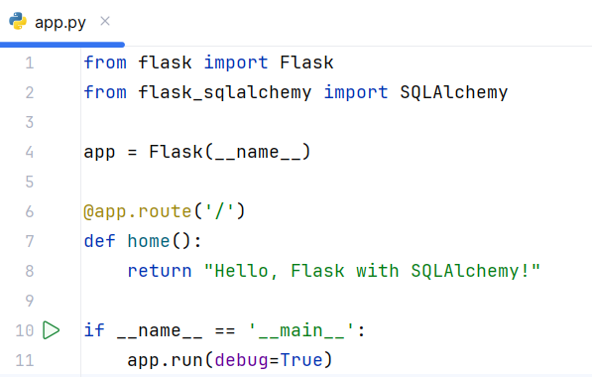
Database management with Flask SQLAlchemy
Example – CRUD using Flask-SQLAlchemy
1. Create a Flask application – “app.py”

Slide 15
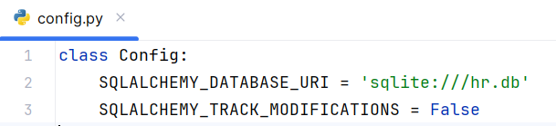
Database management with Flask SQLAlchemy
Example – CRUD using Flask-SQLAlchemy
2. Setup configuration for SQLAlchemy – Create a file “config.py”

Slide 16
Database management with Flask SQLAlchemy
Example – CRUD using Flask-SQLAlchemy
Explanation
SQLALCHEMY_TRACK_MODIFICATIONS is a feature that tracks changes to objects in the session, allowing Flask-SQLAlchemy to emit signals when objects are modified, deleted, or added to the session.
By setting SQLALCHEMY_TRACK_MODIFICATIONS = False we disabling this and stopping from emitting signals when objects are modified, deleted, or added to the session.

Slide 17

Database management with Flask SQLAlchemy
Implications of SQLALCHEMY_TRACK_MODIFICATIONS = False
Reduced memory usage:
Tracking modifications requires additional memory to store the modification history.
Improved performance:
Not tracking modifications can result in slightly better performance, as less overhead is required.
No signals emitted:
Since modification tracking is disabled, no signals will be emitted when objects are modified, deleted, or added.

Slide 18
Database management with Flask SQLAlchemy
Example – CRUD using Flask-SQLAlchemy
3. Defines three models for the ‘hr’ database using Flask-SQLAlchemy
Department:
  id: Unique integer primary key
  name: String column with a maximum length of 50 characters, unique and not nullable
  employees: Relationship with the Employee model, representing the department's employees
Role:
  id: Unique integer primary key
  name: String column with a maximum length of 50 characters, unique and not nullable
  employees: Relationship with the Employee model, representing the role's employees
Employee:
  id: Unique integer primary key
  name: String column with a maximum length of 100 characters, not nullable
  date_joined: DateTime column representing the date the employee joined, defaulting to the current
  department_id: Integer column referencing the Department model's id column, not nullable
  role_id: Integer column referencing the Role model's id column, not nullable

Slide 19
Database management with Flask SQLAlchemy
Example – CRUD using Flask-SQLAlchemy
3. Defines three models for the ‘hr’ database using Flask-SQLAlchemy
Department:
  id: Unique integer primary key
  name: String column with a maximum length of 50 characters, unique and not nullable
  employees: Relationship with the Employee model, representing the department's employees
Role:
  id: Unique integer primary key
  name: String column with a maximum length of 50 characters, unique and not nullable
  employees: Relationship with the Employee model, representing the role's employees
Employee:
  id: Unique integer primary key
  name: String column with a maximum length of 100 characters, not nullable
  date_joined: DateTime column representing the date the employee joined, defaulting to the current
  department_id: Integer column referencing the Department model's id column, not nullable
  role_id: Integer column referencing the Role model's id column, not nullable

Slide 20
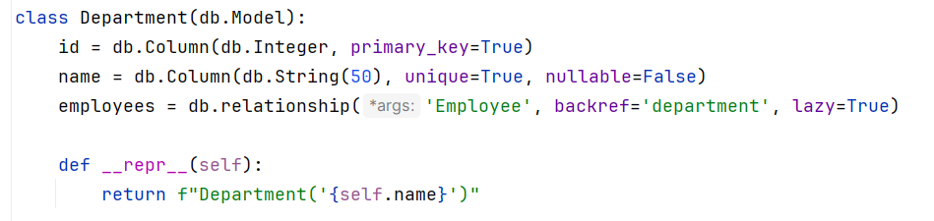
Database management with Flask SQLAlchemy
Example – CRUD using Flask-SQLAlchemy
3. Defines three models for the ‘hr’ database using Flask-SQLAlchemy in “models.py”

Slide 21
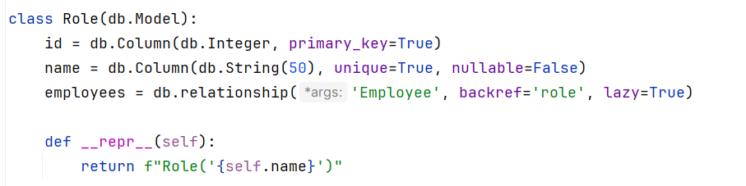
Database management with Flask SQLAlchemy
Example – CRUD using Flask-SQLAlchemy
3. Defines three models for the ‘hr’ database using Flask-SQLAlchemy in “models.py”

Slide 22
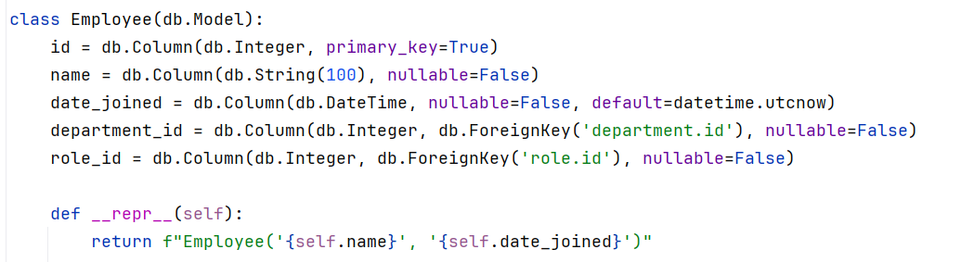
Database management with Flask SQLAlchemy
Example – CRUD using Flask-SQLAlchemy
3. Defines three models for the ‘hr’ database using Flask-SQLAlchemy in “models.py”

Slide 23
Database management with Flask SQLAlchemy
Example – CRUD using Flask-SQLAlchemy
Explanation
The __repr__(self) method in each model defines a string representation of the object, used for debugging and logging purposes.
The relationships between the models are established through the employees attributes in the Department and Role models, and the department_id and role_id attributes in the Employee model.
department_id = db.Column(db.Integer, db.ForeignKey('department.id'), nullable=False)
role_id = db.Column(db.Integer, db.ForeignKey('role.id'), nullable=False)

Slide 24
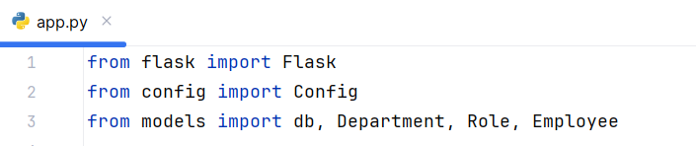
Database management with Flask SQLAlchemy
Example – CRUD using Flask-SQLAlchemy
4. Update “app.py” to import and use the configuration and models
These imports will connect the “models.py” and “config.py” with “app.py”.

Slide 25
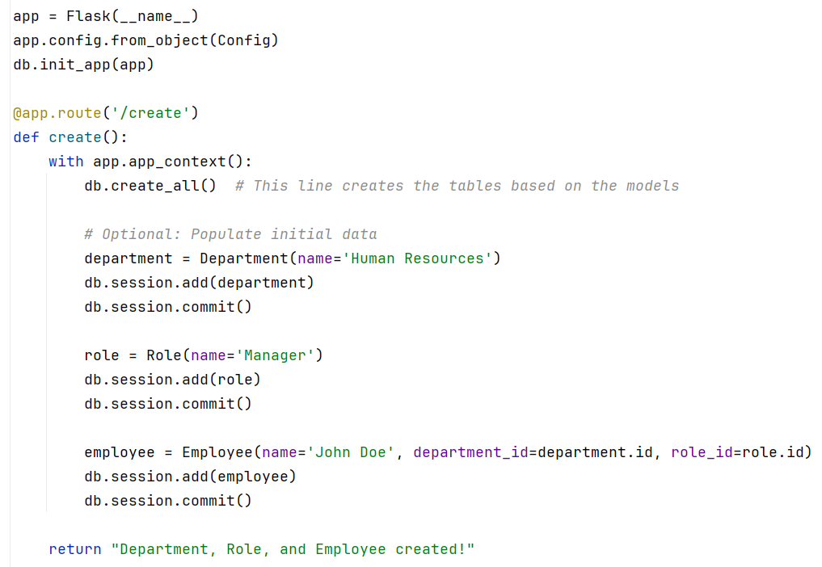
Database management with Flask SQLAlchemy
Example – CRUD using Flask-SQLAlchemy
5. Create all tables with initial data

Slide 26
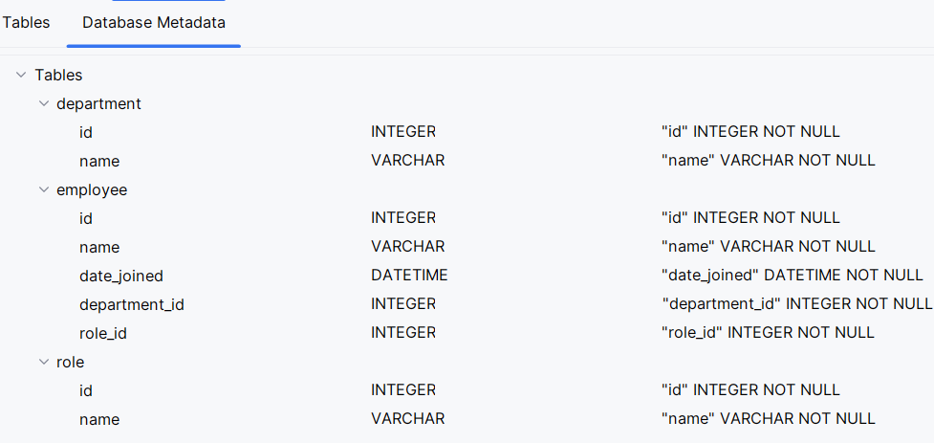
Database management with Flask SQLAlchemy
Example – CRUD using Flask-SQLAlchemy
The previous code will create the database along with the tables.

Slide 27
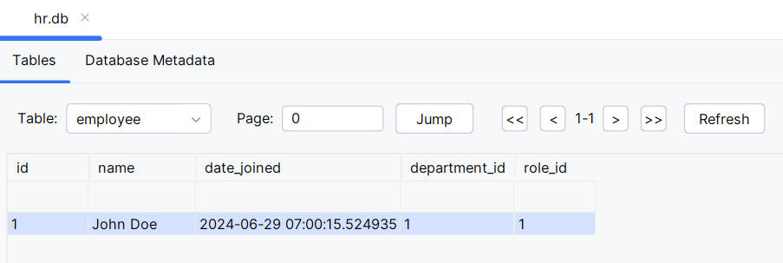
Database management with Flask SQLAlchemy
Example – CRUD using Flask-SQLAlchemy
The previous code will create the database along with the tables.

Slide 28
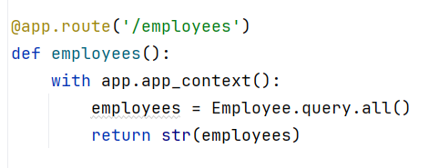
Database management with Flask SQLAlchemy
Example – CRUD using Flask-SQLAlchemy
6. Read and display all the data from Employee table

Slide 29
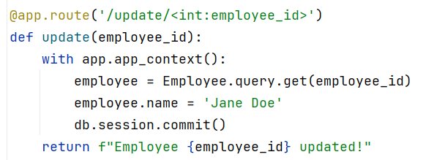
Database management with Flask SQLAlchemy
Example – CRUD using Flask-SQLAlchemy
7. Update data in Employee table

Slide 30
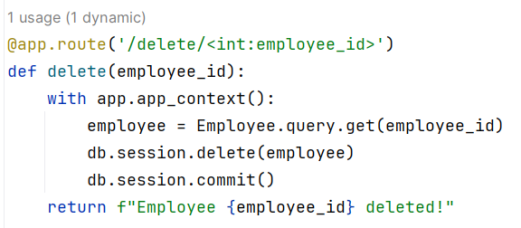
Database management with Flask SQLAlchemy
Example – CRUD using Flask-SQLAlchemy
8. Delete data from Employee table

Slide 31
Database management with Flask SQLAlchemy
Case Study: Employee Data Management System
Background
You are a software developer tasked with creating a Employee Data Management System for an IT Firm. The firm needs a web application to manage its employee information, allowing the HR to add, view, update, and delete records.
Task
Your task is to develop a web application using Flask and SQLAlchemy that performs basic CRUD operations for managing the employee records.

Slide 32
How to Initialize and Configure a Simple SQLite Database

Slide 33
How to initialize and configure a simple SQLite database
SQLite
The SQLite library is a C library that provides a SQL database engine.
It is compiled into a single file – ‘sqlite3.c’ which is then used to build the SQLite database engine.
Key features:
Serverless database engine
Zero-configuration database management system
Relational database management system (RDBMS)
Embedded database library
File-based database system (stores data in a single file)
Cross-platform database system (works on various operating systems)
Public domain software (free and open-source)
Lightweight database engine (small footprint and minimal resources required)
ACID-compliant database system (follows atomicity, consistency, isolation, and durability principles)

Slide 34
How to initialize and configure a simple SQLite database
SQLite
Use Cases
Embedded systems: SQLite is often used in embedded systems due to its small footprint and simplicity.
Mobile applications: Mobile applications, including those on Android and iOS, use SQLite for local data storage.
Web browsers: SQLite is used by web browsers to store data locally, such as bookmarks and history.
Standalone applications: Used in standalone applications that need a simple and efficient way to store data.
Prototyping: SQLite is great for quick prototyping and testing of database-driven applications.

Slide 35
How to initialize and configure a simple SQLite database
Example – Flask application using SQLite DB
Create the Flask application structure
Create a project directory and the following files:
flaskSQLite/
|── app.py
|── config.py
|── schema.sql
└── templates/

Slide 36
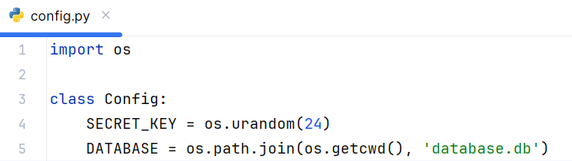
How to initialize and configure a simple SQLite database
Example – Flask application using SQLite DB
2. Set up configuration in “config.py”
Configuration to setup the SQLite database.

Slide 37
How to initialize and configure a simple SQLite database
Example – Flask application using SQLite DB
3. Initialize the Flask application – “app.py”

Slide 38
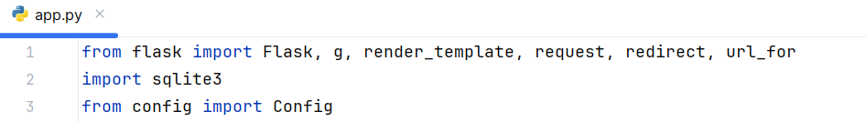
How to initialize and configure a simple SQLite database
Example – Flask application using SQLite DB
3. Initialize the Flask application – “app.py”
Update import statements of app.py as below.

Slide 39
How to initialize and configure a simple SQLite database
Example – Flask application using SQLite DB
Explanation
g: A special object in Flask that is used to store data for the duration of a request.
render_template: A function to render HTML templates with data.
request: An object that contains all data sent by the client in the request.
redirect: A function to redirect the user to a different endpoint.
url_for: A function to generate URLs for specific functions.
sqlite3: The SQLite database module.
Config: A configuration class defined in a separate config.py file.

Slide 40

How to initialize and configure a simple SQLite database
Example – Flask application using SQLite DB
3. Initialize the Flask application – “app.py”

Slide 41
How to initialize and configure a simple SQLite database
Example – Flask application using SQLite DB
Explanation
app = Flask(__name__): Creates an instance of the Flask application.
app.config.from_object(Config): Loads configuration settings from the Config class.

Slide 42
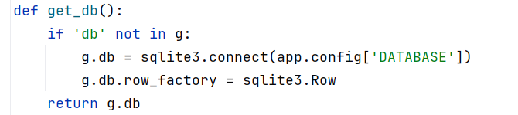
How to initialize and configure a simple SQLite database
Example – Flask application using SQLite DB
4. Database connection - – “app.py”

Slide 43
How to initialize and configure a simple SQLite database
Example – Flask application using SQLite DB
Explanation
get_db(): A function to get a database connection.
Checks if there is a db attribute in the g object.
If not, it connects to the SQLite database specified in the configuration and sets row_factory to sqlite3.Row for named access to columns.
Returns the database connection.

Slide 44
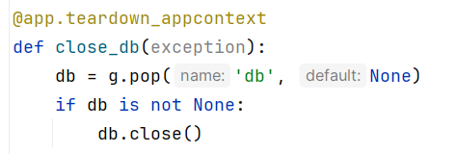
How to initialize and configure a simple SQLite database
Example – Flask application using SQLite DB
5. Closing the database connection – “app.py”

Slide 45
How to initialize and configure a simple SQLite database
Example – Flask application using SQLite DB
Explanation
@app.teardown_appcontext: A decorator that registers a function to be called when the application context is torn down.
close_db(exception): A function that closes the database connection.
Pops the db attribute from g.
Closes the connection if it exists.

Slide 46
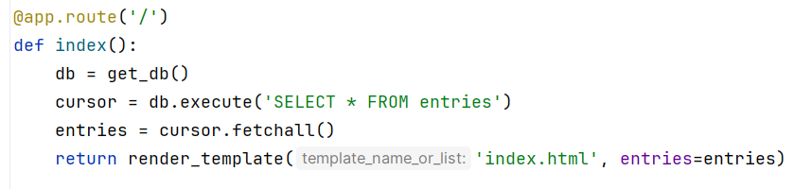
How to initialize and configure a simple SQLite database
Example – Flask application using SQLite DB
6. Create route for index page – “app.py”

Slide 47
How to initialize and configure a simple SQLite database
Example – Flask application using SQLite DB
Explanation
@app.route('/'): A decorator that binds the index() function to the root URL.
index(): A function that handles the root URL.
Gets a database connection.
Executes a query to select all rows from the entries table.
Fetches all rows from the result set.
Renders the index.html template with the fetched entries.

Slide 48
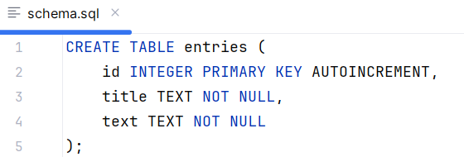
How to initialize and configure a simple SQLite database
Example – Flask application using SQLite DB
7. Create the schema – “schema.sql”

Slide 49
How to initialize and configure a simple SQLite database
Example – Flask application using SQLite DB
Explanation
This SQL script creates a table called entries with three columns: id, title, and text.
The id column is the primary key and is set to auto-increment, ensuring each entry has a unique identifier.

Slide 50
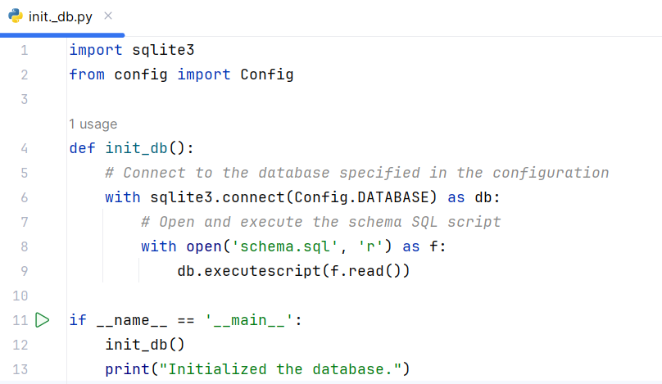
How to initialize and configure a simple SQLite database
Example – Flask application using SQLite DB
8. Initialize the database – “init_db.py”

Slide 51
How to initialize and configure a simple SQLite database
Example – Flask application using SQLite DB
Explanation
config: The configuration class from config.py where the database file location is specified.
Connects to the SQLite database using the file path specified in the Config class.
Opens the schema.sql file, which contains SQL commands to create the necessary tables.
Executes the SQL commands to create the tables in the database.
Calls the init_db() function to initialize the database.

Slide 52
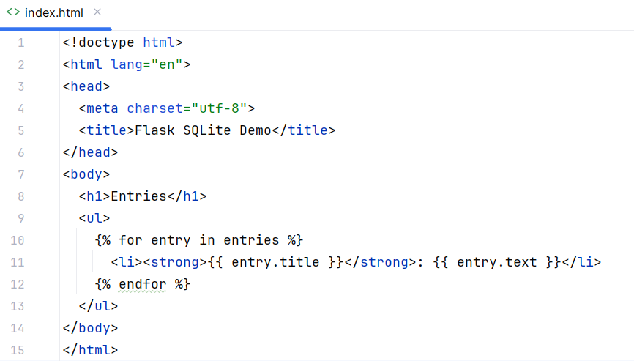
How to initialize and configure a simple SQLite database
Example – Flask application using SQLite DB
9. Create the html file to display data – “/templates/index.html”

Slide 53
How to initialize and configure a simple SQLite database
Example – Flask application using SQLite DB
10. Run the application
Initialize the database:
python init_db.py
Run the Flask application
python app.py
This will app will create a “database.db” and “entries” table without data.

Slide 54
Database management with Flask SQLAlchemy
Insert data into SQLite DB
Extend the previous example by allowing user to insert the data into “entries” table of SQLite database.

Slide 55
Most Common SQLAlchemy Column Types

Slide 56
Most common SQLAlchemy column types
Column types
db.Integer: Stores integer values.
db.String: Stores string values with a maximum length.
db.Float: Stores floating-point values.
db.Boolean: Stores True or False values.
db.DateTime: Stores date and time values.
db.Text: Stores large text values.
db.Enum: Stores enumerated values, useful for predefined choices.
db.PickleType: column type (for storing Python objects)
db.LargeBinary: column type (for storing large binary data)

Slide 57
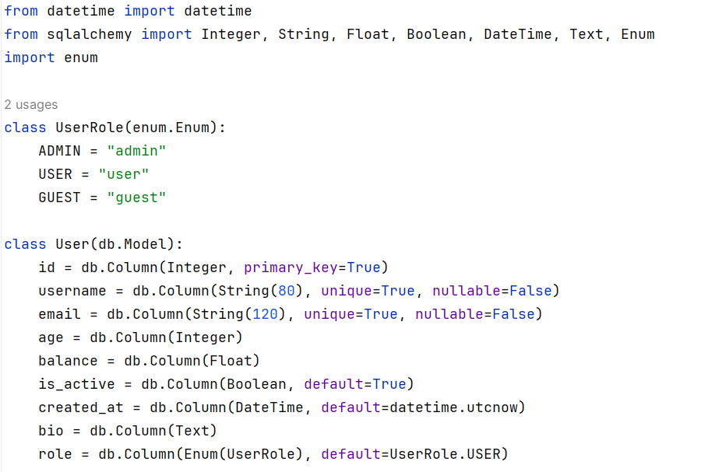
Most common SQLAlchemy column types
Example - Define a model using common SQLAlchemy column types

Slide 58
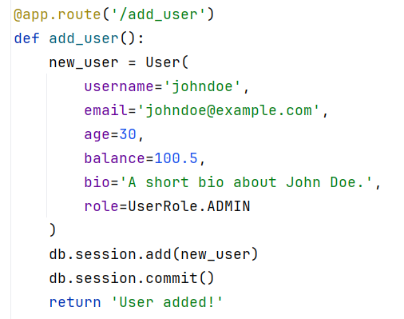
Most common SQLAlchemy column types
Example – Adding data using common SQLAlchemy column types

Slide 59
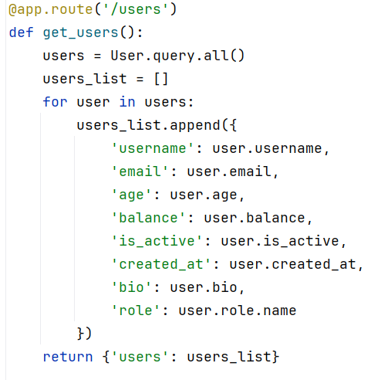
Most common SQLAlchemy column types
Example – Querying data using common SQLAlchemy column types

Slide 60
Most common SQLAlchemy column types
Case Study: Building a Library Management System
Background
you will practice using different SQLAlchemy column types by building a simplified library management system. The goal is to define models for authors, books, and loans, incorporating various SQLAlchemy column types
Task
Author Model
id: Integer, primary key.
name: String, unique, not nullable.
email: String, unique, nullable.
date_of_birth: Date, not nullable.
bio: Text, nullable.
Book Model
id: Integer, primary key.
title: String, not nullable.
isbn: String, unique, not nullable.
publication_date: Date, not nullable.
pages: Integer, nullable.
price: Float, nullable.
author_id: Integer, foreign key to Author.id.
Loan Model
id: Integer, primary key.
book_id: Integer, foreign key to Book.id.
borrower_name: String, not nullable.
borrow_date: DateTime,
return_date: DateTime, nullable.
returned: Boolean, default to False.

Slide 61
Database Use in View Functions

Slide 62
Database use in view functions
View function
View functions in the context of web development, especially with frameworks like Flask or Django, refer to Python functions that are mapped to specific URLs (routes) in your application.
These functions handle incoming requests from clients (web browsers or other applications) and return responses.
Example
@app.route('/hello')
def hello():
return 'Hello, World!'

Slide 63
Database use in view functions
Characteristics of view functions
Request handling: View functions are responsible for handling incoming HTTP requests. They process data sent via GET or POST methods, access form data, query parameters, or JSON payloads.
Business logic: They encapsulate the business logic of your application. This includes processing data, interacting with databases, performing calculations, and making decisions based on the request parameters.
Response generation: View functions generate HTTP responses to send back to the client. These responses can be HTML pages rendered from templates, JSON data for APIs, redirects, or error messages.
Route binding: In frameworks like Flask, view functions are associated with specific URLs (routes) using decorators or URL patterns defined in configuration files.
Context Access: They often have access to the request context, which includes details about the request (e.g., headers, form data, cookies) and the application context (e.g., configuration settings, database connections).

Slide 64
Database use in view functions
Example Use Cases
Rendering HTML pages: View functions can render HTML templates and pass data to them for dynamic content.
Handling Form submissions: Process form submissions, validate input and store or manipulate data in databases.
Implementing APIs: For building RESTful APIs, view functions return JSON responses, handle authentication, and implement CRUD operations (Create, Read, Update, Delete) on resources.
Middleware: View functions can act as middleware, performing preprocessing tasks such as logging, authentication, or authorization before passing control to other functions.

Slide 65
Database use in view functions
A Flask-SQLite application using “view functions”
To create a Flask application that interacts with an SQLite database to add and display users, follow these steps:
Set Up the Project Directory: Create a directory structure for the Flask app.
Initialize the Flask App: Create a Flask app and configure it to use SQLAlchemy with an SQLite database.
Define Models: Create a User model to represent the users in the database.
Create Routes: Define routes to handle displaying the homepage, adding users, and listing users.
Create Templates: Create HTML templates for the homepage and user list.

Slide 66
Database use in view functions
A Flask-SQLite application using “view functions”
Set Up the Project Directory
flaskSQLiteViewFunc/
|── app/
│ |── __init__.py
│ |── models.py
│ |── routes.py
│ └── templates/
│ |── index.html
│ └── users.html
|── config.py
|── requirements.txt
└── run.py

Slide 67
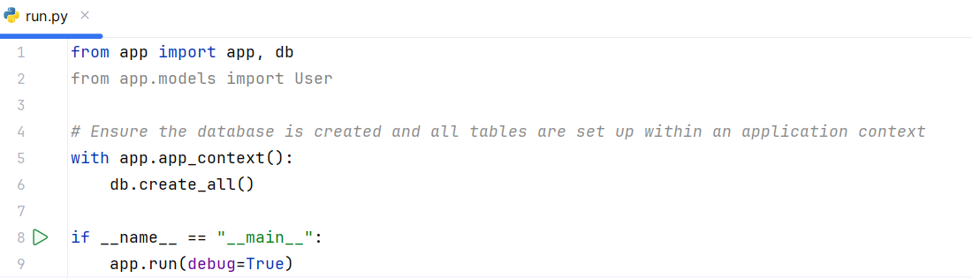
Database use in view functions
A Flask-SQLite application using “view functions”
2. Initialize the Flask App

Slide 68
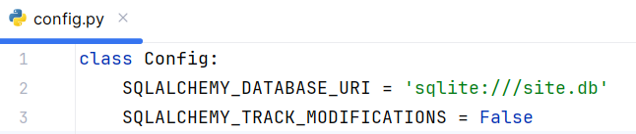
Database use in view functions
A Flask-SQLite application using “view functions”
2. Initialize the Flask App

Slide 69
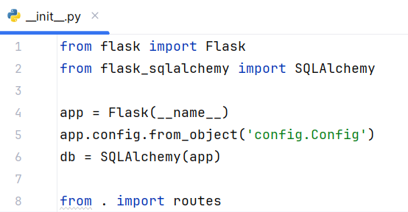
Database use in view functions
A Flask-SQLite application using “view functions”
2. Initialize the Flask App

Slide 70
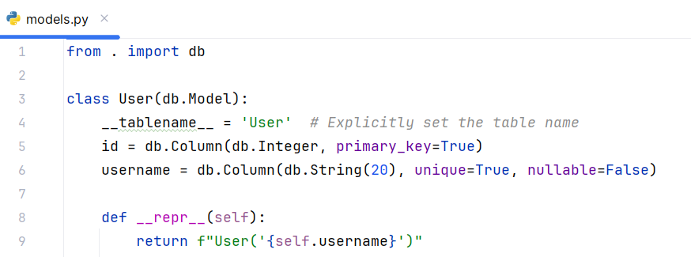
Database use in view functions
A Flask-SQLite application using “view functions”
3. Create model

Slide 71
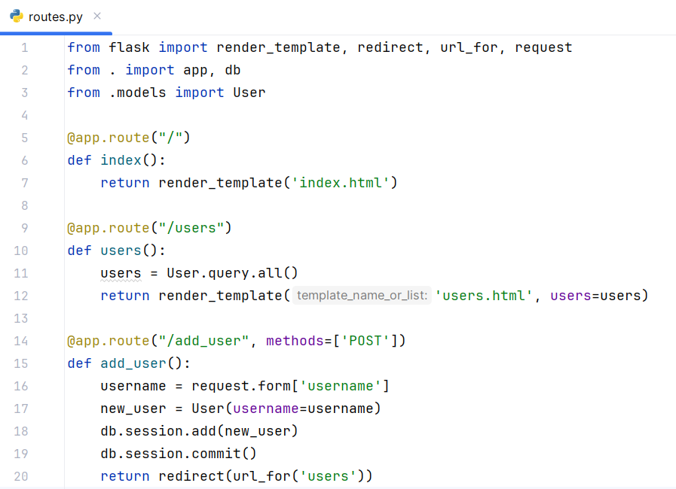
Database use in view functions
A Flask-SQLite application using “view functions”
4. Define the view functions

Slide 72
Database use in view functions
A Flask-SQLite application using “view functions”
Explanation
There are three view functions are defined in “routes.py” -
The index() renders the “index.html” template, which contains a form for adding new users.
The users() retrieves all users from the database and display those by rendering the “users.html” template.
The add_user() handles the form submission adds a new user to the database and redirects to the users page to show the updated list of users.

Slide 73
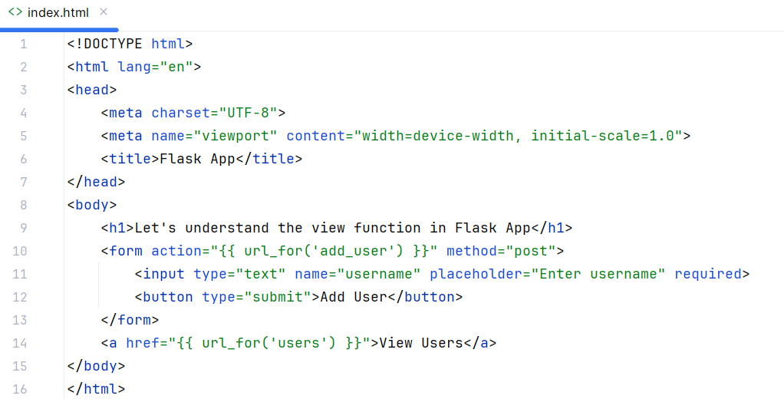
Database use in view functions
A Flask-SQLite application using “view functions”
5. Create html templates

Slide 74
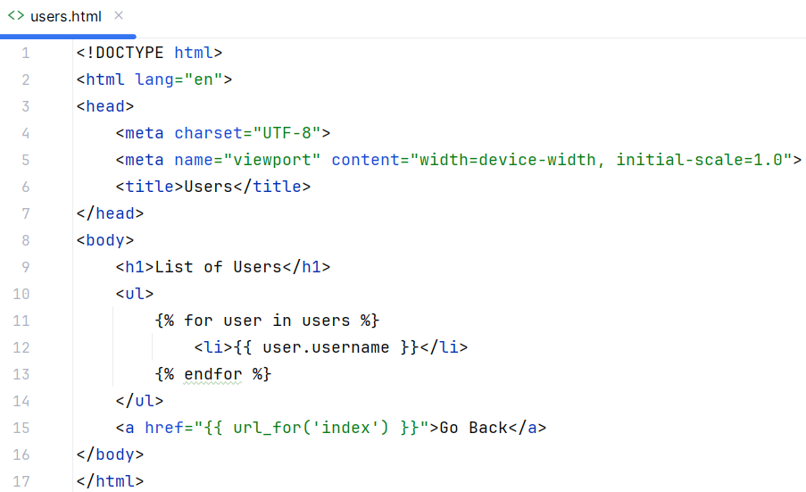
Database use in view functions
A Flask-SQLite application using “view functions”
5. Create html templates

Slide 75
Database use in view functions
A Flask-SQLite application using “view functions”
5. Create html templates

Slide 76
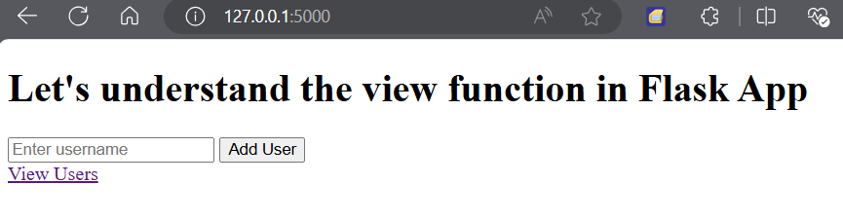
Database use in view functions
A Flask-SQLite application using “view functions”
6. Run the app
python run.py
Open your web browser and navigate to http://127.0.0.1:5000/

Slide 77
Database use in view functions
Case Study: User Management System
Background
You are tasked with developing a simple web application to manage user information using Flask and SQLite. The application should allow adding new users and displaying a list of existing users.
Scenario
You have been provided with a Flask application framework (app.py), along with auxiliary files (routes.py, models.py, and config.py). Additionally, an SQLite database (site.db) is set up with a User table, which includes columns id (Integer, Primary Key) and username (String, Unique).

Slide 78
Database use in view functions
Case Study: User Management System
Tasks
app.py: Implement view functions to display HTML form (index.html) where users can add new usernames. Upon submitting the form, the view function should add the new username to the SQLite database and redirect to a page (users.html) displaying all.
routes.py: Define routes for handling user interactions, such as adding new users and displaying existing users.
models.py: Create a SQLAlchemy model (User) to interact with the User table in SQLite, defining the schema for user data.
config.py: Configure Flask and SQLAlchemy settings, including the database URI and tracking modifications.
Requirements
Use Flask for routing and rendering templates.
Utilize SQLAlchemy to interact with the SQLite database (site.db).
Ensure each template (index.html and users.html) is properly rendered and functional.

Slide 79
Question?

Slide 80
Thank you

