Slide 1
GUI Development - Introduction

Slide 2


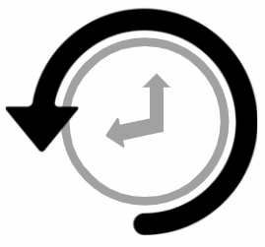

Error/ Warning
Information
Flashback
Class Exercise

Slide 3
Introduction to GUI Programming
GUI Programming, Installing Pycharm
Introduction to GUI Programming - Working on Pycharm
AGENDA

Slide 4
1. Introduction to GUI Programming

Slide 5

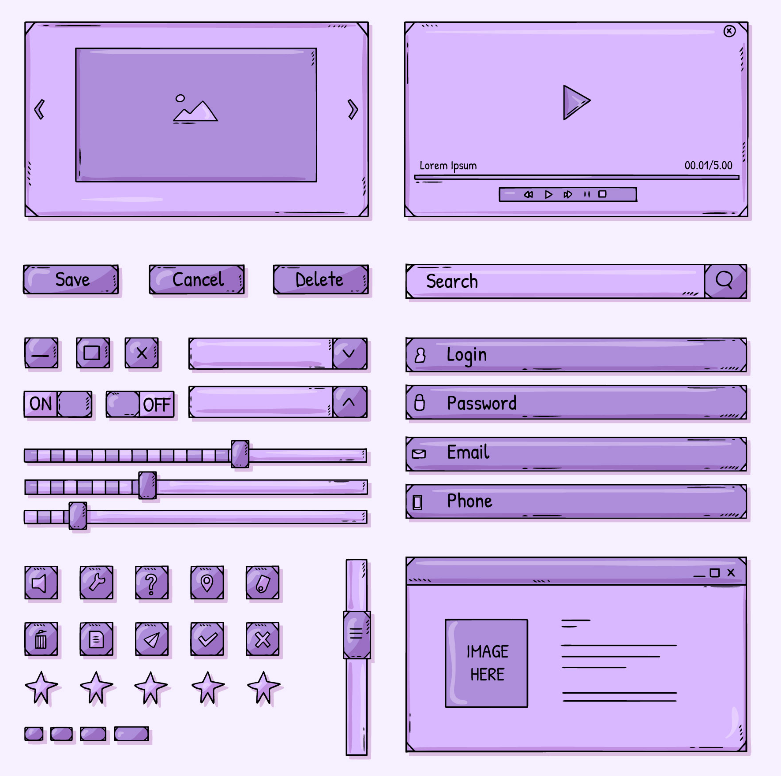
Introduction to GUI programming
What is GUI?
A Graphical User Interface (GUI) is a type of user interface that allows users to interact with electronic devices through graphical elements rather than text-based commands.
GUIs are designed to be intuitive and user-friendly, making it easier for users to understand and navigate software applications.

Slide 6
Introduction to GUI programming
Benefits of GUI?
User-Friendly: More intuitive for users, especially those not familiar with command-line interfaces.
Accessibility: Allows users of all skill levels to interact with software easily.
Efficiency: Provides quick access to functions and features through visual elements.
Multitasking: Users can manage multiple applications or tasks simultaneously in different windows.

Slide 7
Introduction to GUI programming
What is GUI programming?
GUI (Graphical User Interface) programming involves creating applications that have a visual interface through which users can interact.

Slide 8
Introduction to GUI programming
Key concepts in GUI programming?
Widgets: The building blocks of a GUI, such as buttons, labels, text boxes, and sliders.
Events: Actions triggered by user interactions, like clicking a button, moving a mouse, or pressing a key.
Event Loop: The mechanism that waits for and dispatches events or messages in a program. It runs continuously to keep the GUI responsive.
Layouts: Methods to arrange widgets within a window. Common layouts include grid, pack, and place.
Callbacks: Functions that are called in response to an event.

Slide 9
Introduction to GUI programming
Key widgets of GUI
Window: Rectangular areas on the screen where content is displayed.
Icon: Small graphical representations of programs, files, or functions that users can click.
Button: Clickable elements that perform actions or commands.
Menu: Lists of options or commands that drop down when selected.
Toolbar: Strips of buttons or icons that provide quick access to commonly used functions.
Textbox: Areas where users can input text.
Slider: Controls that allow users to adjust values by sliding a knob along a bar.
Dialog: Popup windows that prompt the user to make decisions or enter information.

Slide 10
2. GUI Programming and Installing PyCharm

Slide 11
GUI programming and installing PyCharm
GUI programming
Python offers several libraries for creating GUIs, with the most popular ones being:
Tkinter: Built-in Python library.
PyQt/PySide: Set of Python bindings for the Qt libraries.
Kivy: Open-source library for rapid development of applications.
In this course we will learn Tkinter and for development will use PyCharm IDE.

Slide 12
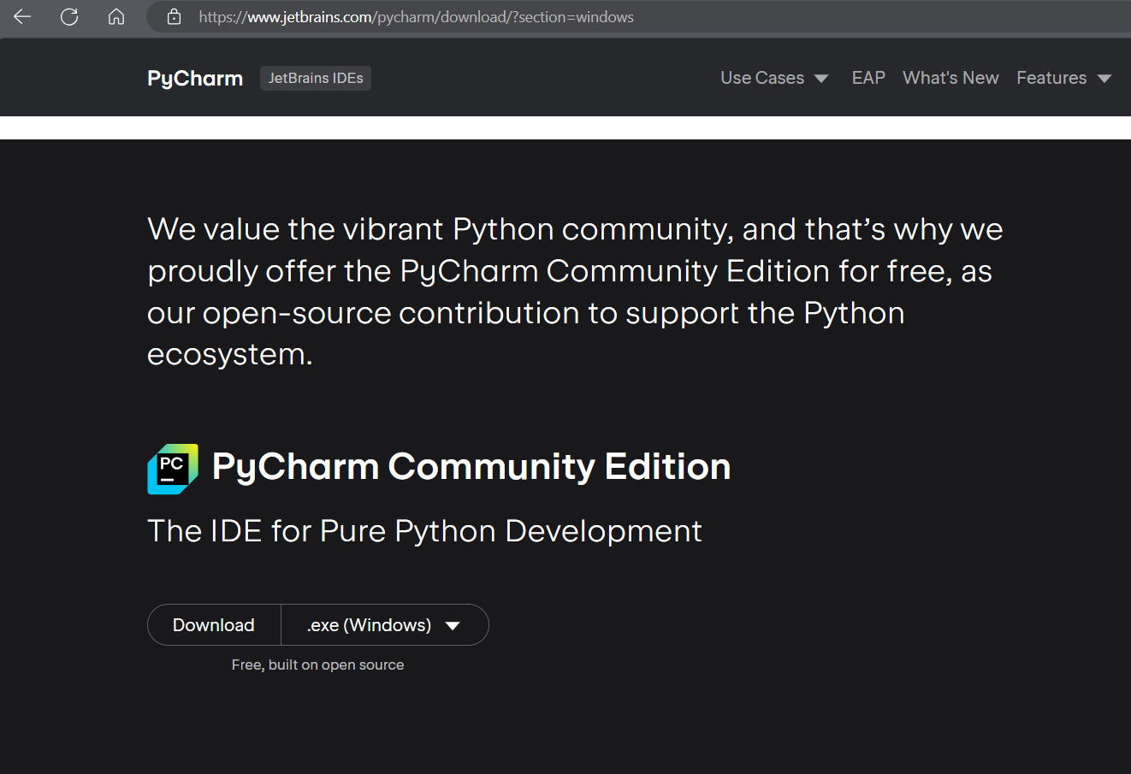
GUI programming and installing PyCharm
Download PyCharm
Visit the below link to download the PyChram Community edition.
https://www.jetbrains.com/pycharm/download/?section=windows

Slide 13
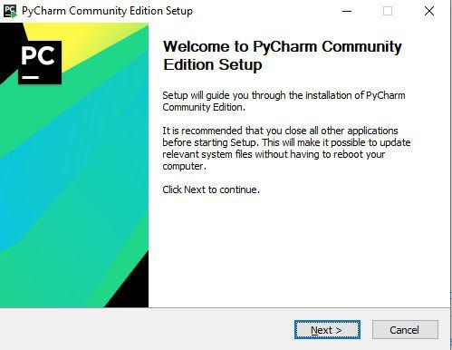
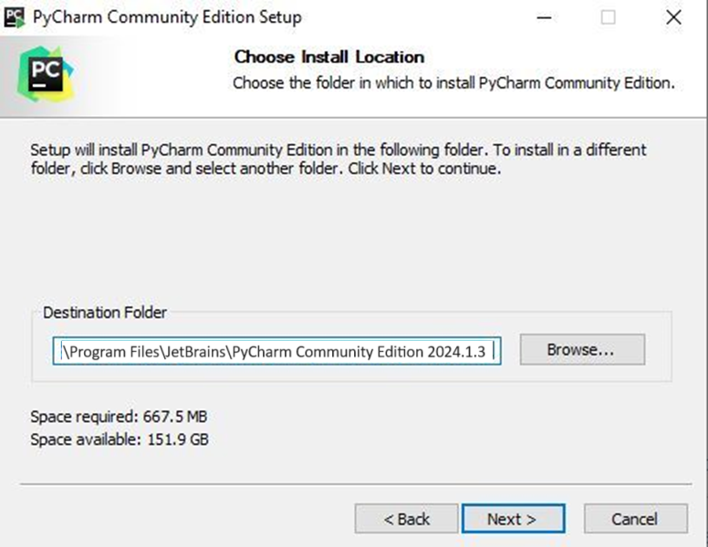
GUI programming and installing PyCharm (continued)
Installing PyCharm
1
2

Slide 14
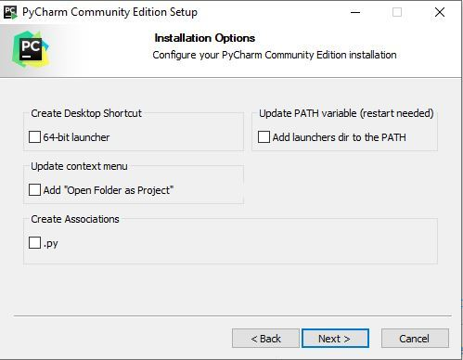
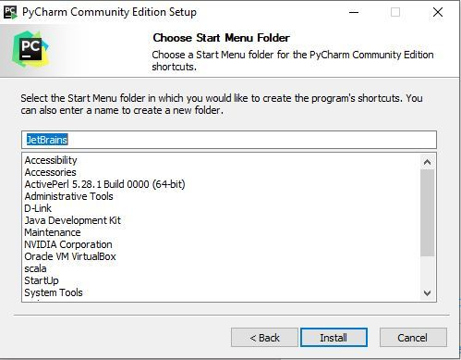
GUI programming and installing PyCharm (continued)
Installing PyCharm
3
4

Slide 15
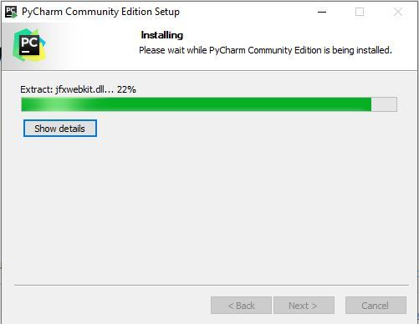
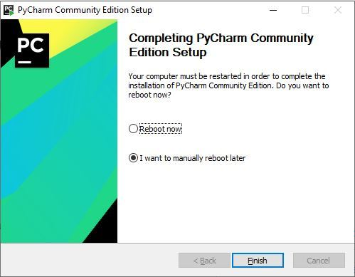
GUI programming and installing PyCharm (continued)
Installing PyCharm
5
6

Slide 16
3. Introduction to GUI Programming - Working on PyCharm

Slide 17
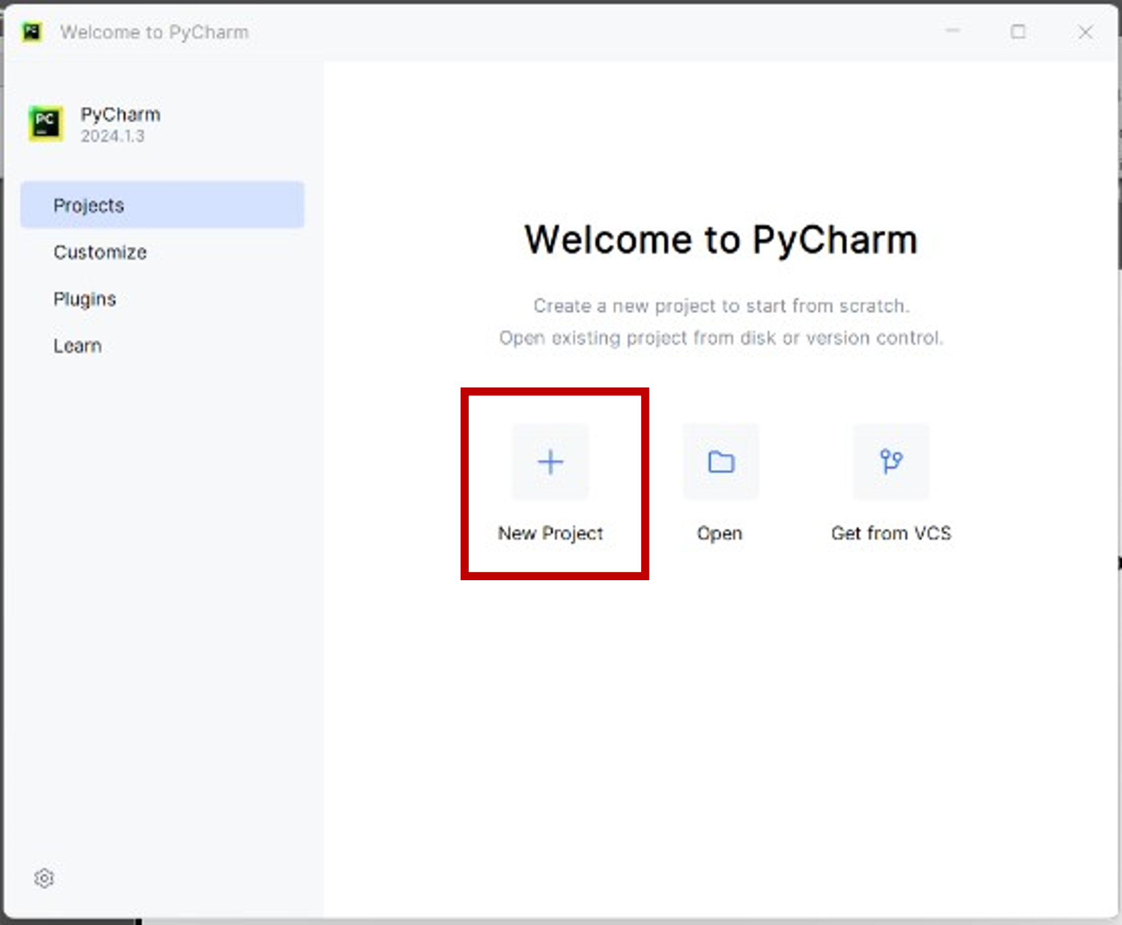
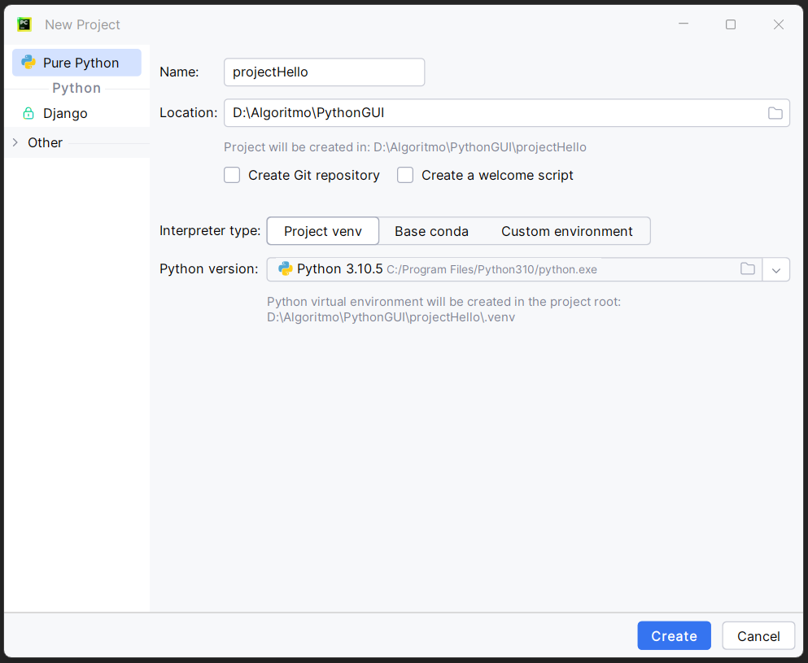
Introduction to GUI Programming - Working on PyCharm
Working on PyCharm
1
2

Slide 18
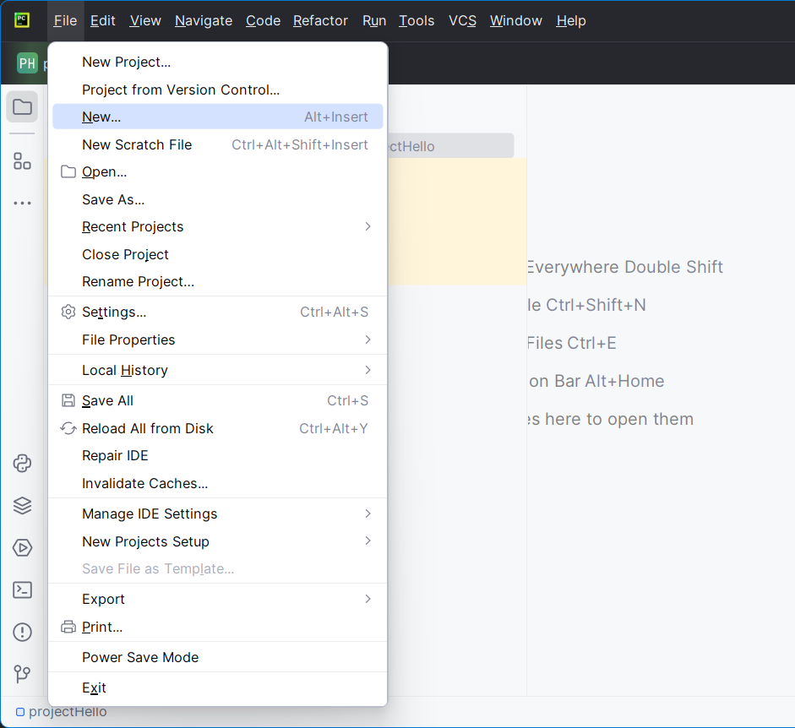
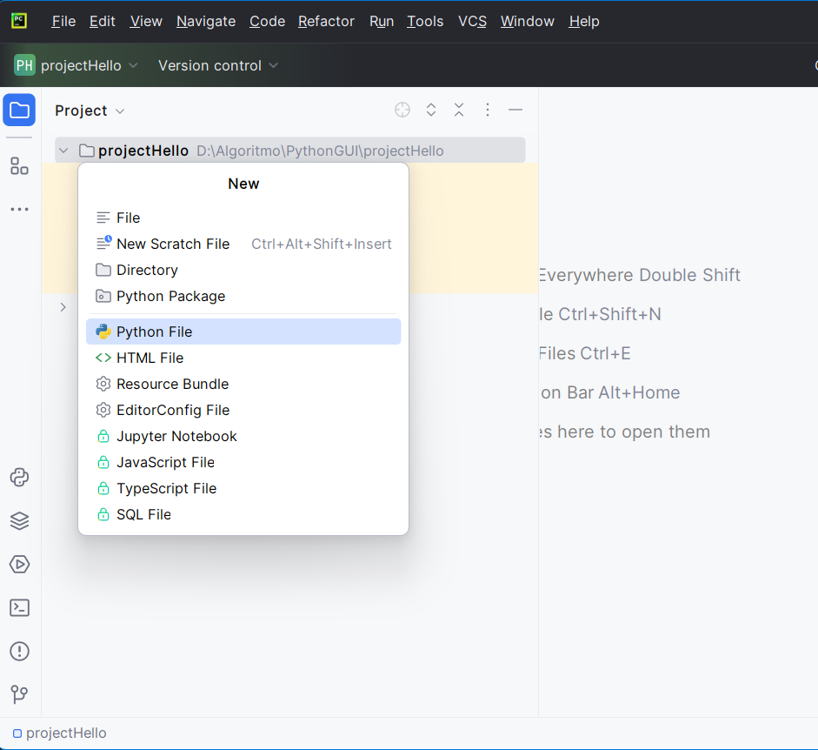
Introduction to GUI Programming - Working on PyCharm
Working on PyCharm
3
4

Slide 19
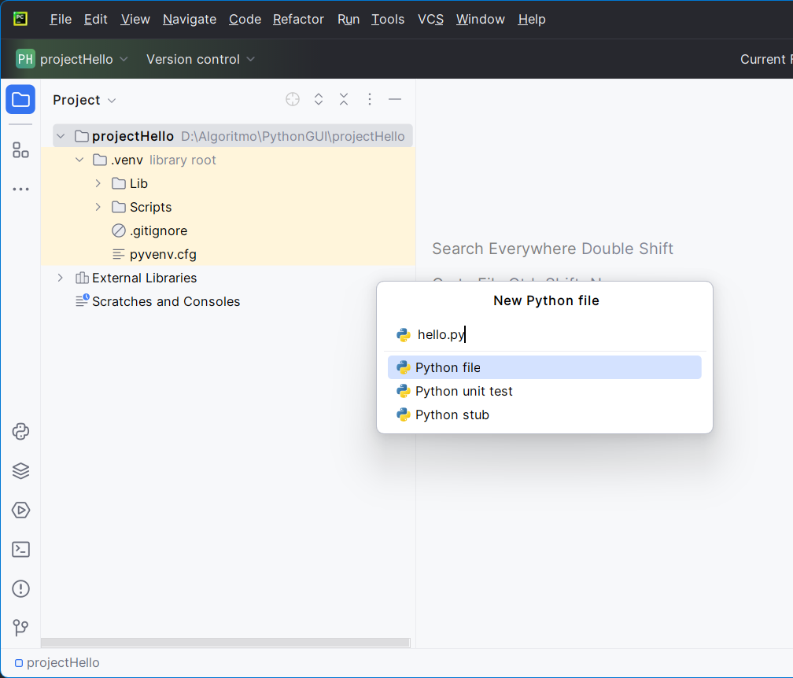
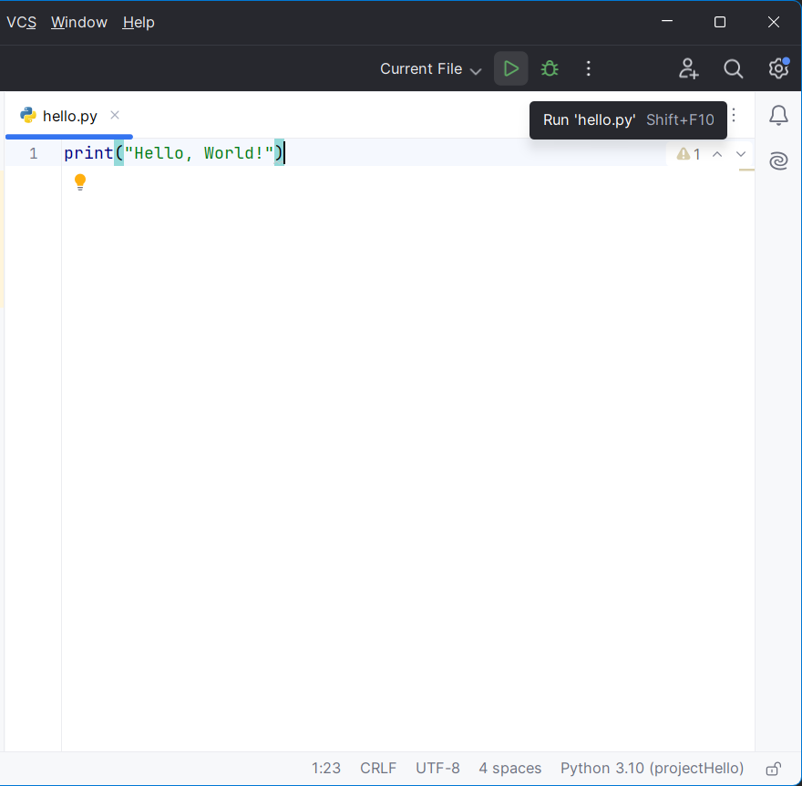
Introduction to GUI Programming - Working on PyCharm
Working on PyCharm
5
6

Slide 20
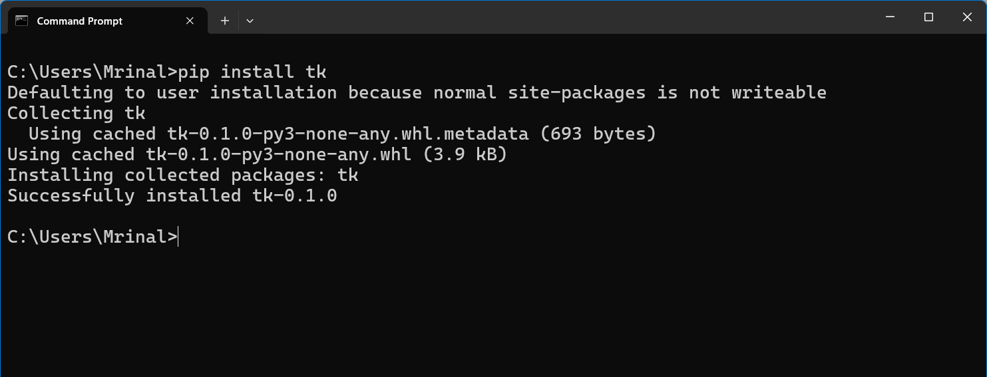
Introduction to GUI Programming - Working on PyCharm
Installing Tkinter
Use `pip` on command prompt to install Tkinter on windows.
pip install tk

Slide 21
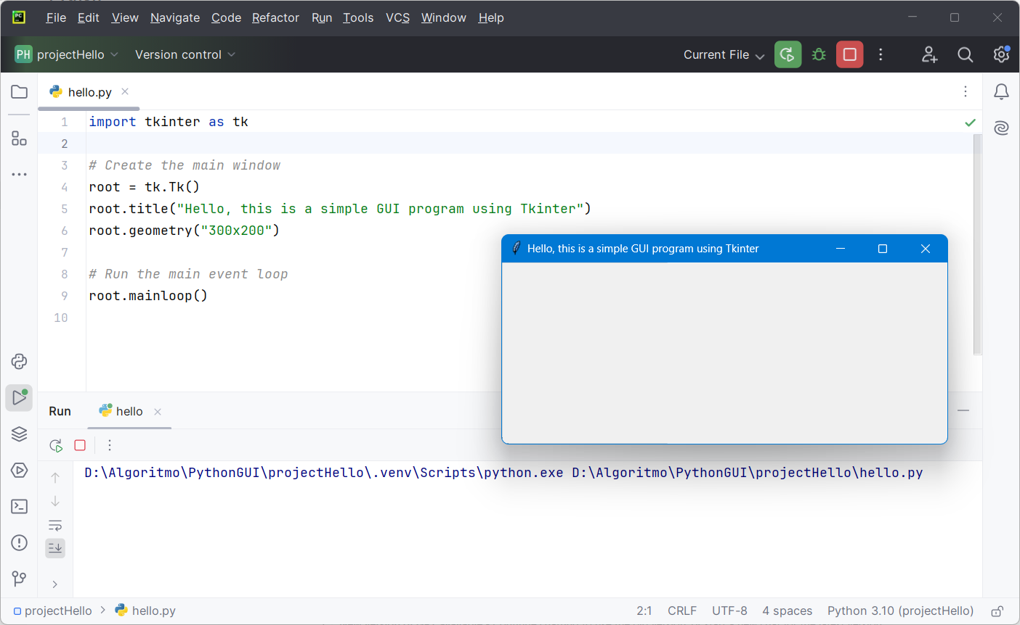
Introduction to GUI Programming - Working on PyCharm
Creating a Simple Window:
tk.Tk()
Initializes the main window.
root.title("Simple GUI")
Sets the window title.
root.geometry("300x200")
Sets the window size.
root.mainloop()
Starts the event loop to keep the window open.

Slide 22

Introduction to GUI Programming - Working on PyCharm
root.mainloop()
In Tkinter, root.mainloop() is a crucial function that starts the main event loop of the GUI application. This loop is responsible for handling all the events and updates within the application.
How it works?
Waiting for Events
Event loop waits for events like mouse click, key press and window action.
Handling Events
When an event occurs, it dispatches the event to the appropriate widget or handler function (e.g. - a button click executes its command).
Continuous Operation
The loop runs continuously until the application window is closed, keeping the GUI active and responsive.

Slide 23
GUI Development - Introduction
Case Study: Building a Simple Tkinter GUI Application
Scenario:
Create GUI - A window with title – “Welcome to Python GUI”
Steps to Create the GUI Application
  Setup and Import: Install Python and ensure Tkinter is available.
  Create the Main Window: Initialize the Tkinter window and set its properties.
  Run the Event Loop: Keep the window open and responsive.

Slide 24
Question?

Slide 25
Thank you

