Slide 1
Tkinter

Slide 2


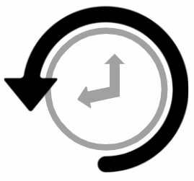

Error/ Warning
Information
Flashback
Class Exercise

Slide 3
Introduction to Tkinter
Tkinter - Making the first window
Introduction to Tkinter - Titles and Icons
Layouts in Tkinter - Introduction to Layouts
Introduction to Widgets in layouts, Grid layout
Integration using GUI-Designing User Interface
Events
Functions and Layouts
AGENDA

Slide 4
1. Introduction to Tkinter

Slide 5

Introduction to Tkinter
Tkinter
Tkinter is the standard GUI (Graphical User Interface) library for Python, providing a fast and easy way to create GUI applications.
It is a thin object-oriented layer on top of the Tcl/Tk GUI toolkit.
The name Tkinter comes from Tk interface.

Slide 6
Introduction to Tkinter
Features
Standard library integration
Cross-platform compatibility
Ease of use
Rich widget set
Event-driven programming
Flexible layout management
Customizable appearance
Canvas widget
Extensible
Good documentation
Integration with other libraries
Stable

Slide 7
2. Tkinter - Making The First Window

Slide 8
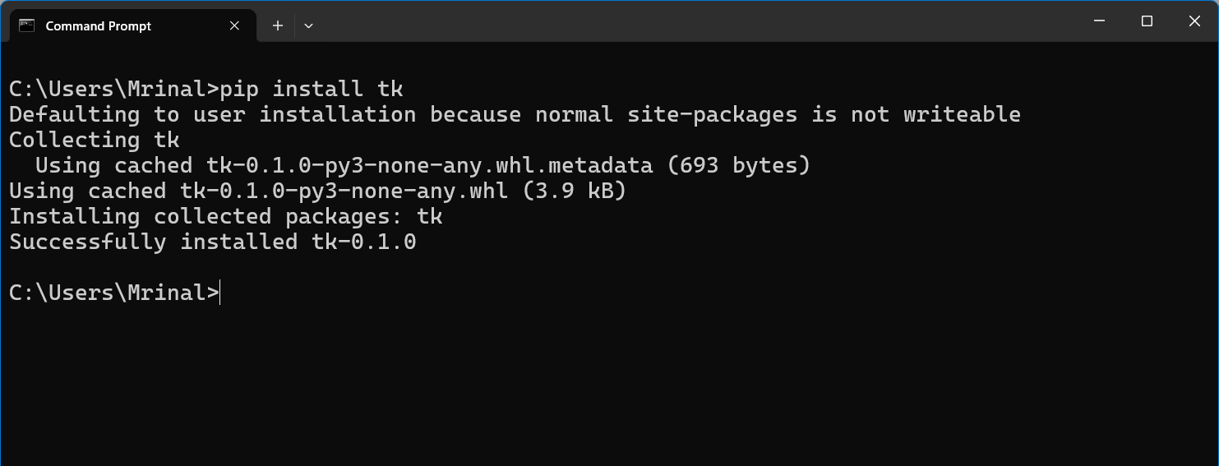
Tkinter - Making the first window
Installing Tkinter
Use `pip` on command prompt to install Tkinter on windows.
pip install tk

Slide 9
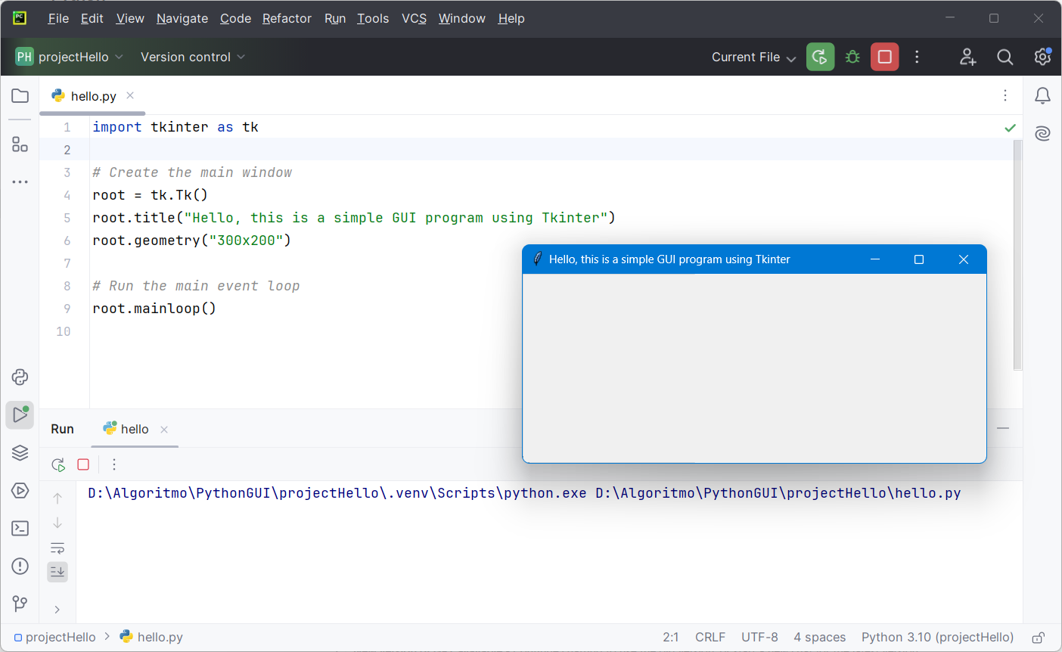
Tkinter - Making the first window
creating a simple window:

Slide 10
Tkinter - Making the first window
Explanation - creating a simple window
tk.Tk()
Initializes the main window.
root.title("Simple GUI")
Sets the window title.
root.geometry("300x200")
Sets the window size.
root.mainloop()
Starts the event loop to keep the window open.

Slide 11

Tkinter - Making the first window
Explanation - creating a simple window
In Tkinter the root.mainloop() is a crucial function that starts the main event loop of the GUI application. This loop is responsible for handling all the events and updates within the application.

Slide 12
Tkinter - Making the first window
How it works?
Waiting for Events
Event loop waits for events like mouse click, key press and window action.
Handling Events
When an event occurs, it dispatches the event to the appropriate widget or handler function (e.g. - a button click executes its command).
Continuous Operation
The loop runs continuously until the application window is closed, keeping the GUI active and responsive.

Slide 13
3. Introduction to Tkinter - Titles and Icons

Slide 14
Introduction to Tkinter - Titles and Icons
root.title()
To set the title of a Tkinter window, use the title() method of the Tkinter window object.
The title() method takes a single argument, which is a string representing the title you want to display.
root.title("My Tkinter App")
root.iconphoto()
To set the window icon, use the iconphoto() method of the Tkinter window object.
This method takes two arguments: a Boolean value and a PhotoImage object representing the icon.
icon = PhotoImage(file='path/to/icon.png')
root.iconphoto(True, icon)

Slide 15
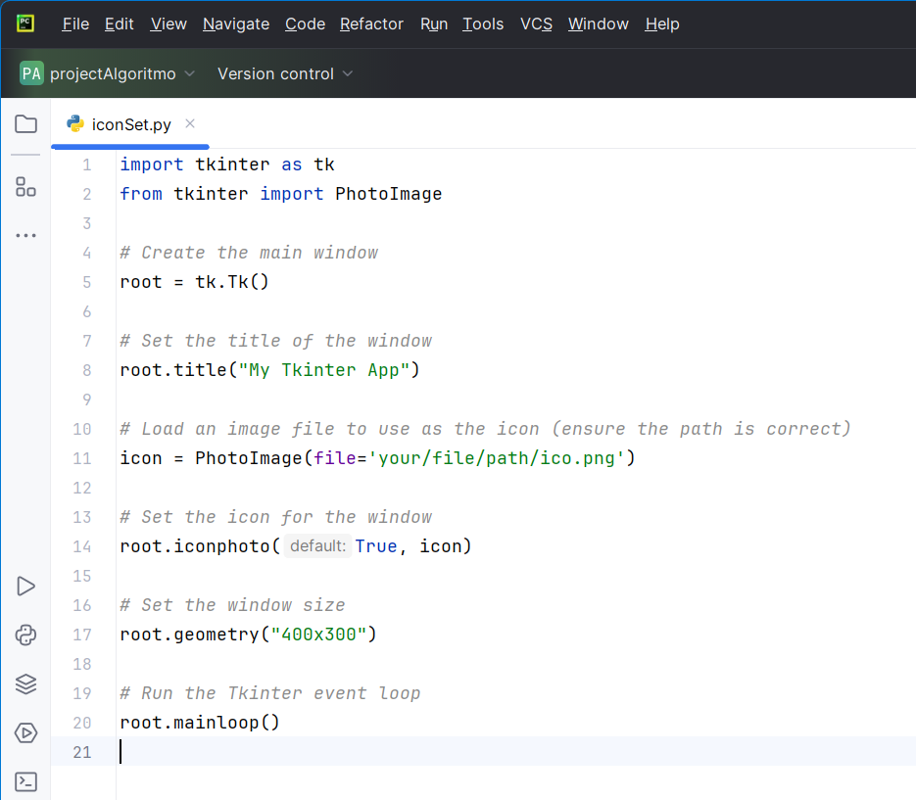
Introduction to Tkinter - Titles and Icons
Example

Slide 16
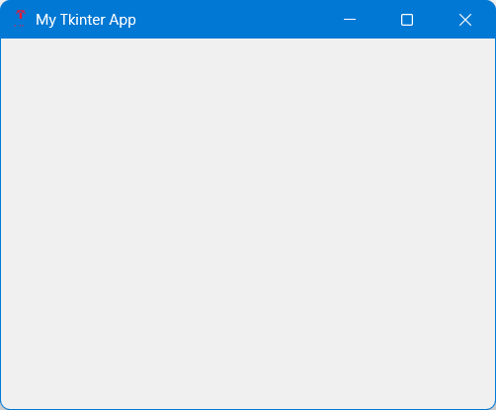
Introduction to Tkinter - Titles and Icons
The icon image file should be in a format supported by PhotoImage, such as PNG, GIF, or PPM/PGM.
Import PhotoImage from the Tkinter library to handle image files.

Slide 17
4. Layouts in Tkinter - Introduction to Layouts

Slide 18
Layouts in Tkinter - Introduction to layouts
Explanation
In Tkinter, a layout refers to the way widgets (such as buttons, labels, text boxes, etc.) are organized within a window or frame.
Type of layouts
Tkinter offers several ways to place widgets in the window, the most commons are -
Pack layout
Grid layout
Place layout

Slide 19
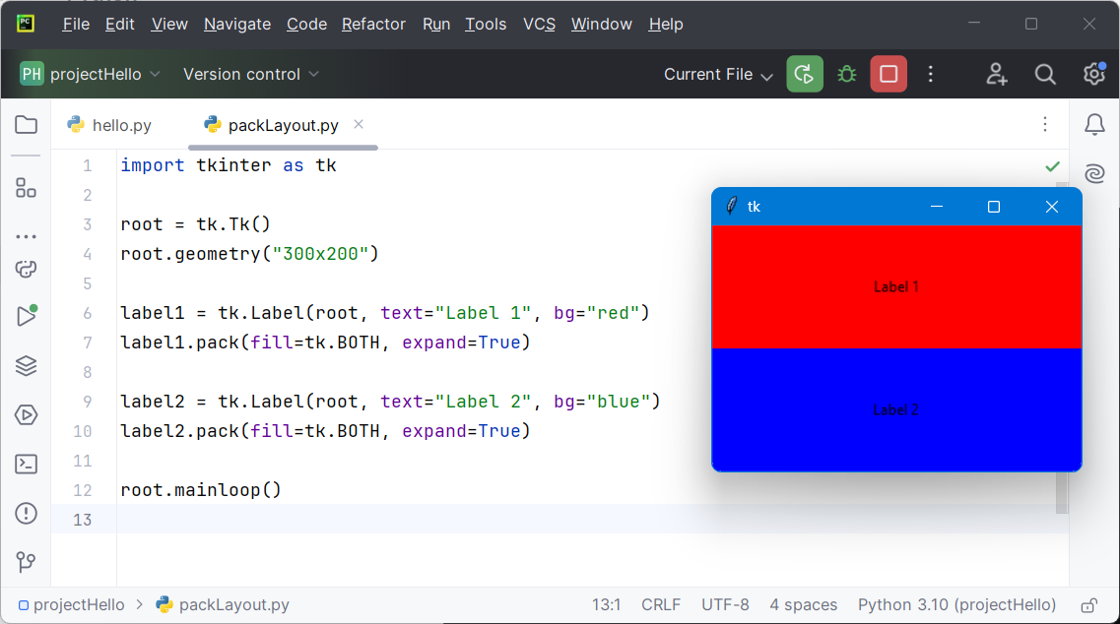
Layouts in Tkinter - Introduction to layouts
Pack layout
The `pack` geometry manager organizes widgets in blocks before placing them in the parent widget.

Slide 20
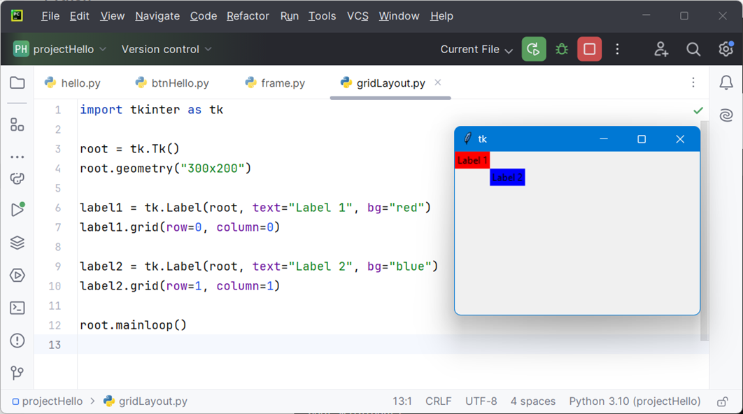
Layouts in Tkinter - Introduction to layouts
Grid layout
The `grid` geometry manager organizes widgets in a table-like structure using rows and columns.

Slide 21
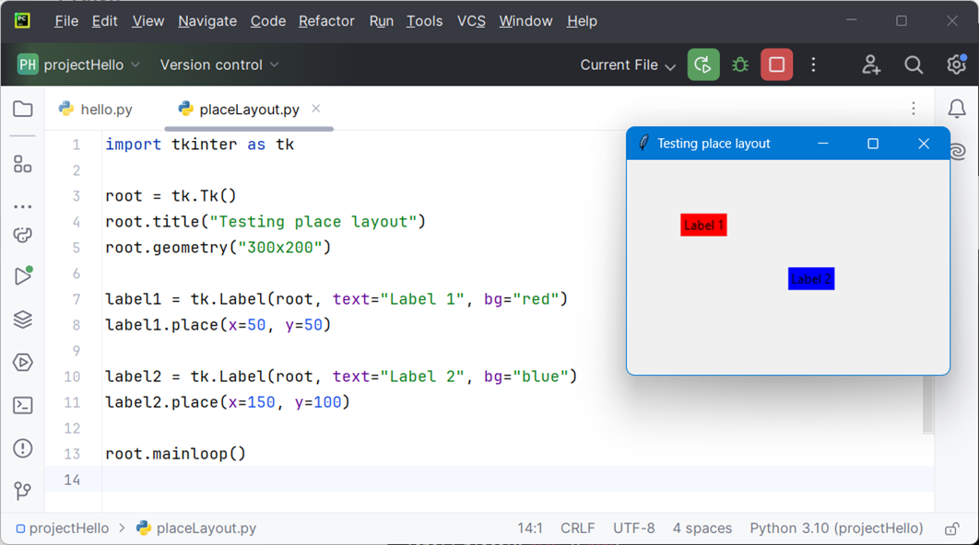
Layouts in Tkinter - Introduction to layouts
Place layout
The `place` geometry manager allows you to position widgets at an absolute location within the parent widget.

Slide 22
Layouts in Tkinter - Introduction to layouts
Choosing a layout manager
Pack: Suitable for simple layouts where you want widgets stacked vertically or horizontally.
Grid: Ideal for more complex layouts involving rows and columns, similar to a table.
Place: Useful for precise control over widget positioning for complex interfaces.

Slide 23
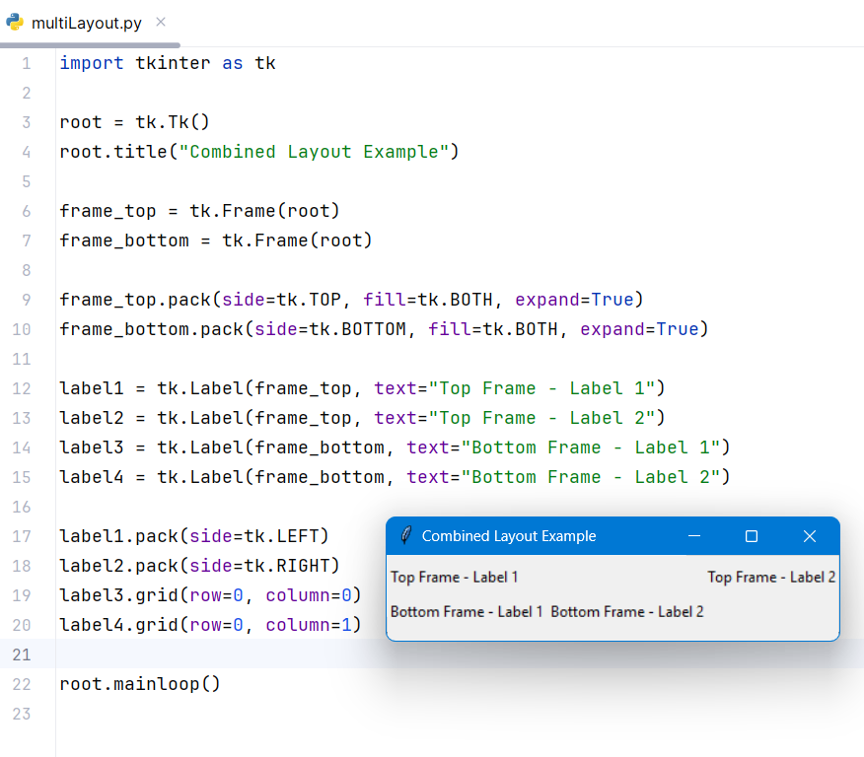
Layouts in Tkinter - Introduction to layouts
Combining layout managers
You can also combine layout managers within different containers to create complex layouts. It's common to use a Frame widget to group related widgets and apply different layout strategies within each frame.

Slide 24
Layouts in Tkinter - Introduction to layouts
Create a Tkinter application that displays a window with a title, an icon, and a simple layout using both pack and grid. Make the window size = (400x400).

Slide 25
5. Introduction to Widgets in Layouts, Grid Layout

Slide 26
Introduction to widgets in layouts, grid layout
Widgets
Widgets are the building blocks of a Tkinter GUI application.
Here, example of some widgets provided by Tkinter -
Label
Button
Entry
Text
Checkbutton
Radiobutton
Listbox
Combobox
Scale
Spinbox
Scrollbar
Frame
Canvas
Menu

Slide 27
Introduction to widgets in layouts, grid layout
Widgets in layouts
In Tkinter, we use geometry managers to control the layout of widgets within a window or a container (like a frame). The three main geometry managers are pack, grid, and place. Among these, the grid geometry manager is highly flexible and allows for more complex and precise widget arrangements.
Grid layouts
The grid geometry manager organizes widgets in a table-like structure, defined by rows and columns. This approach is similar to how a spreadsheet or HTML table works.

Slide 28
Introduction to widgets in layouts, grid layout
Parameters of grid()
label.grid(row=1, column=0, columnspan=2, rowspan=2, padx=10, pady=20, ipadx=5, ipady=5, sticky="nsew", in_=container_widget)
row: Specifies the row index of the grid.
column: Specifies the column index of the grid.
rowspan: Specifies the number of rows a widget should span.
columnspan: Specifies the number of columns a widget should span.
sticky: Specifies which sides of the cell the widget should stick to (n, s, e, w, or combinations like ns, ew, nsew).
padx: Specifies horizontal padding around the widget.
pady: Specifies vertical padding around the widget.
ipadx: Specifies internal horizontal padding within the widget.
ipady: Specifies internal vertical padding within the widget.
in_: Specifies the parent widget for the grid.

Slide 29
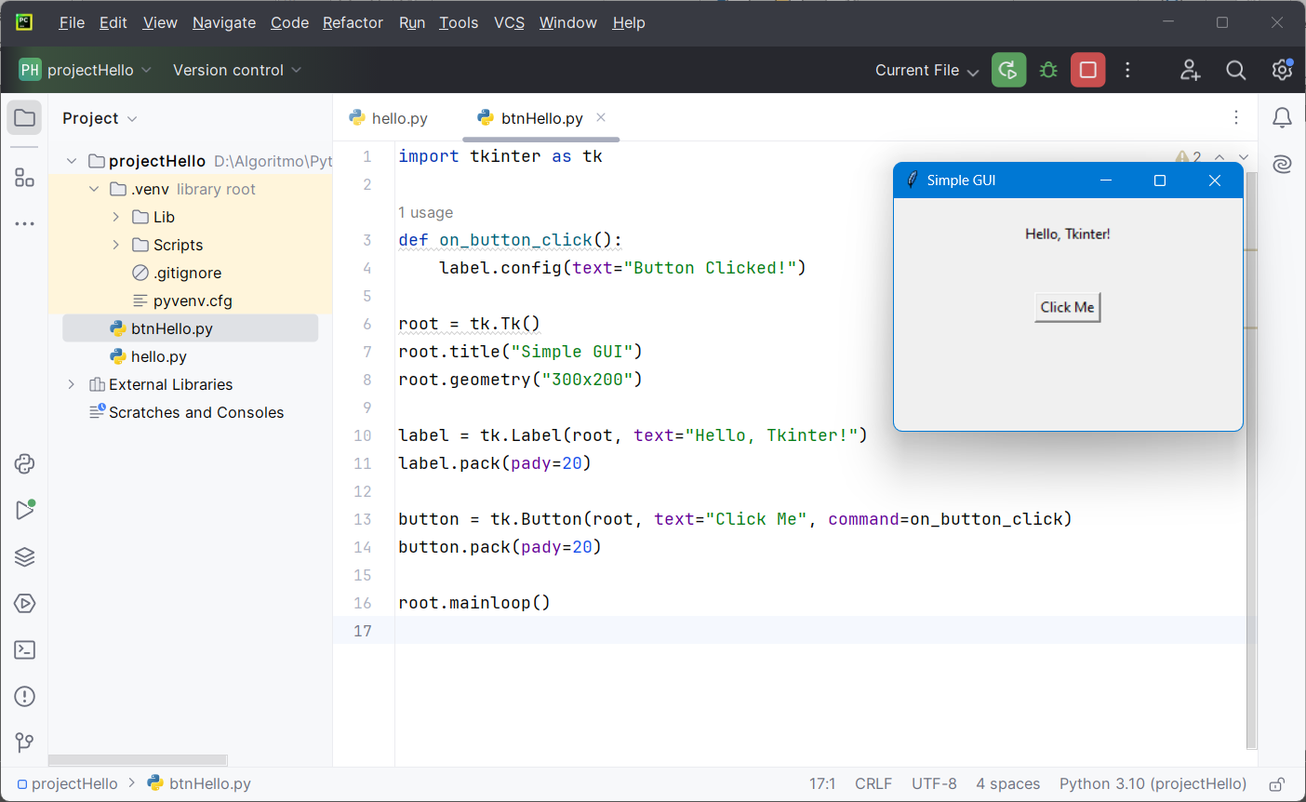
Introduction to widgets in layouts, grid layout
Adding label and button to pack layout

Slide 30
Introduction to widgets in layouts, grid layout
explanation - adding label and button to pack layout
tk.Label()
Creates a label widget.
label.pack()
Adds the label to the window.
tk.Button()
Creates a button widget.
button.pack()
Adds the button to the window.
command=on_button_click
Specifies the function to call when the button is clicked.

Slide 31
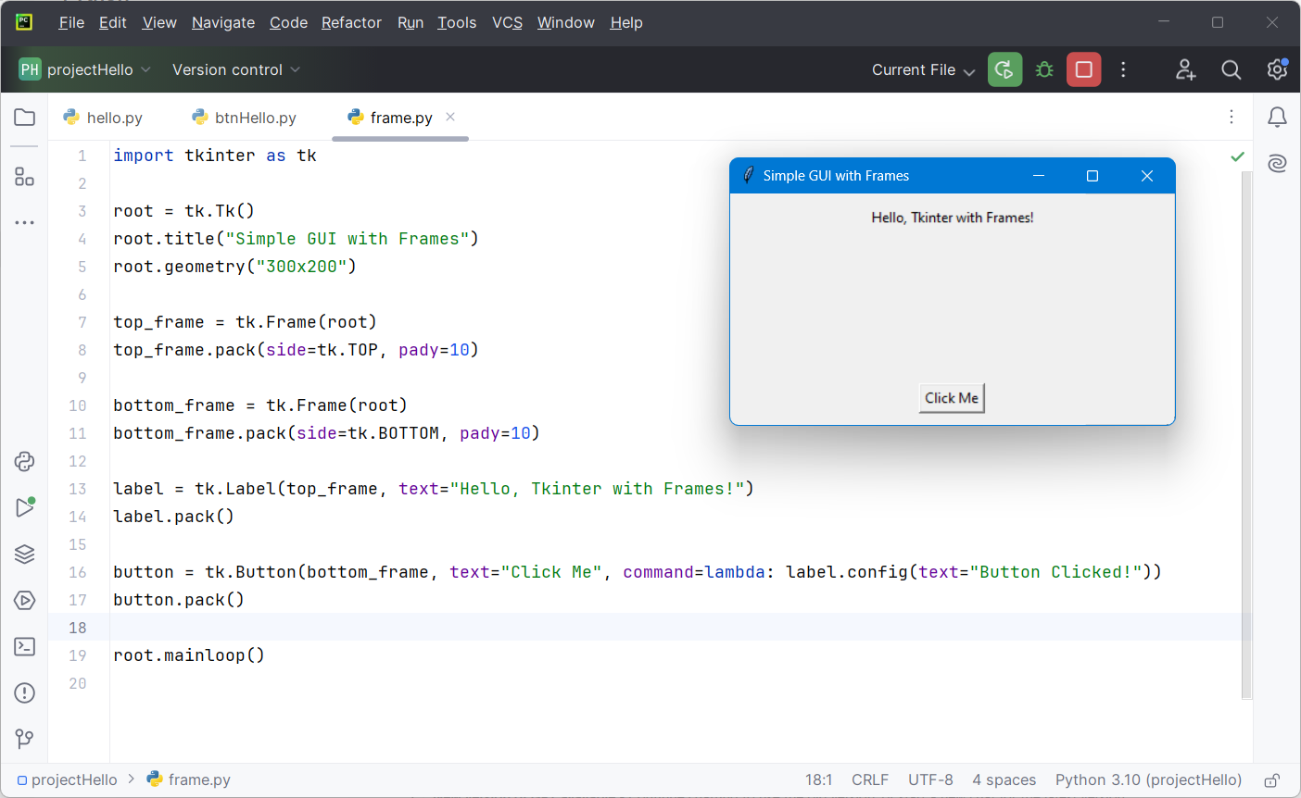
Introduction to widgets in layouts, grid layout
Organizing widgets with frame

Slide 32
Introduction to widgets in layouts, grid layout
Explanation - organizing widgets with frame
tk.Frame()
Creates a frame to group widgets.
frame.pack()
Adds the frame to the window.
Widgets can be added to specific frames for better organization.

Slide 33
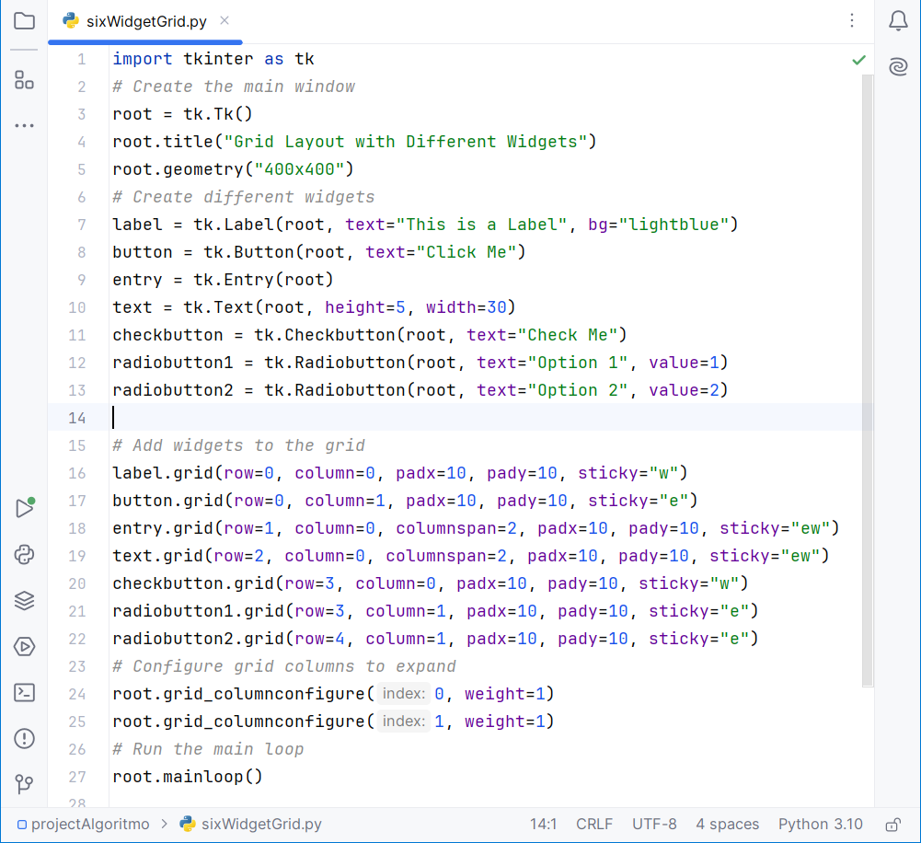
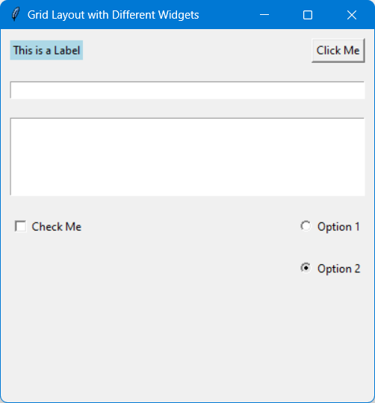
Introduction to widgets in layouts, grid layout
Adding multiple widgets to grid layout

Slide 34
Introduction to widgets in layouts, grid layout
Explanation - adding multiple widgets to grid layout
Each widget is placed in the grid using the grid method with specified row, column, padding, and sticky options.
label is placed at row 0, column 0.
button is placed at row 0, column 1.
entry is placed at row 1, column 0, spanning 2 columns.
text is placed at row 2, column 0, spanning 2 columns.
checkbutton is placed at row 3, column 0.
radiobutton1 is placed at row 3, column 1.
radiobutton2 is placed at row 4, column 1.

Slide 35
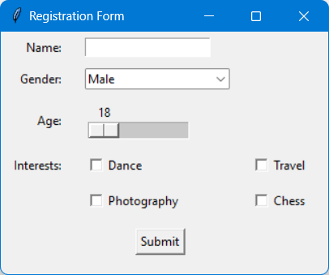
GUI Development - Introduction
Write python code using Tkinter library to design the registration form. Use grid layout.

Slide 36
6. Integration Using GUI-Designing User Interface

Slide 37
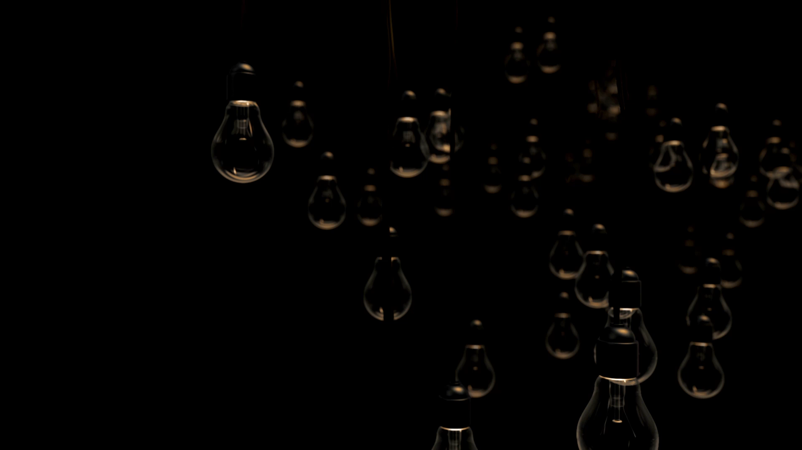
Integration using GUI-designing user interface
Explanation
Integrating GUI design involves creating a visually appealing and functional interface using a GUI toolkit, connecting UI elements to program logic, handling user input and output, and ensuring smooth interaction between the UI and back-end functionality.
In the video - whenever the bigger bulb is appearing it turns on and turns off before disappearing.
Here, GUI (i.e. the bulb) is connected with the program logic to turn on/off considering event/situation.

Slide 38
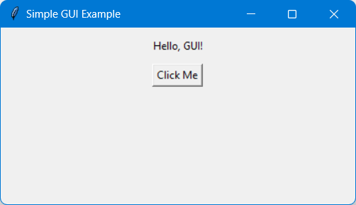
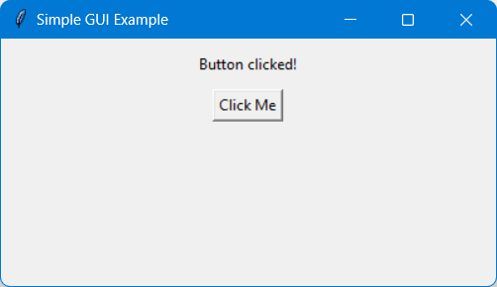
Integration using GUI-designing user interface
Example – GUI of “Click Me”
In this example, tkinter is used to create a simple window (root). A label (label) and a button (button) are added to root. Clicking the button triggers the button_click function, which updates the label's text from “Hello, GUI!” to “Button clicked”.

Slide 39
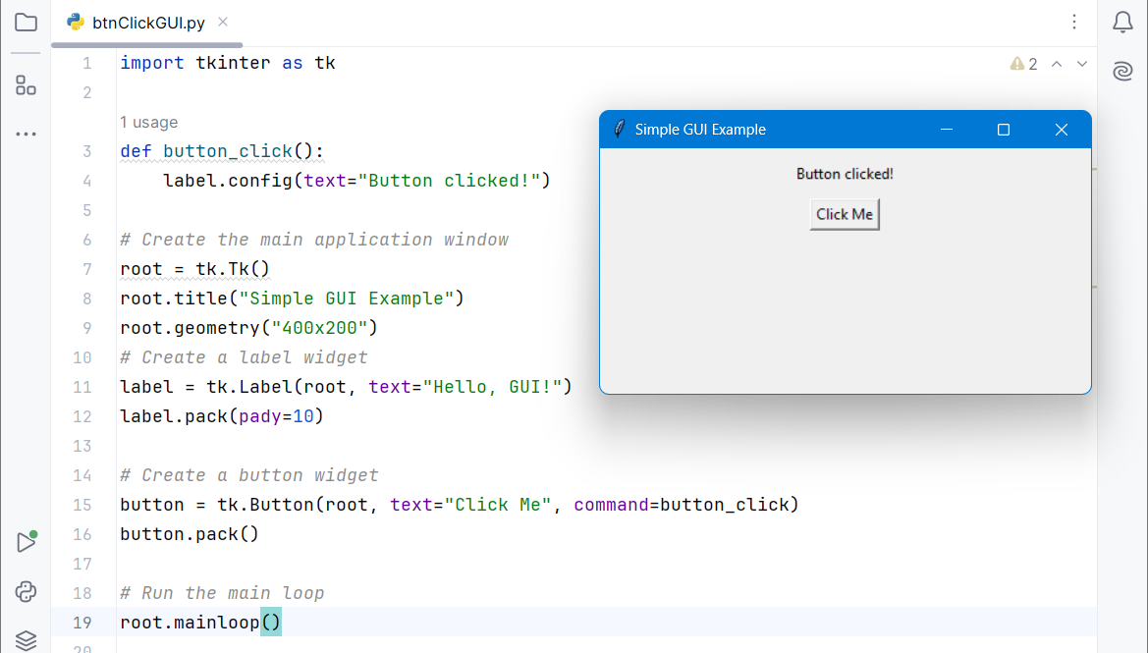
Integration using GUI-designing user interface
Example – Code of “Click Me”
Here is code for that GUI integration with program logic to change the label text on button click.

Slide 40
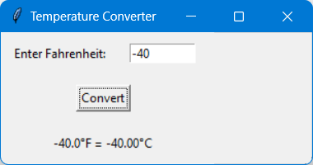
Integration using GUI-designing user interface
Example – GUI of temperature converter
This example creates a simple Fahrenheit to Celsius temperature converter. It uses an entry widget (entry) for user input, a button (convert_button) to trigger the conversion function (convert), and a label (result_label) to display the conversion result.

Slide 41
Integration using GUI-designing user interface
Question : How do we handle run time error in Python?
Answer : Using try-except-else-finally block.

Slide 42
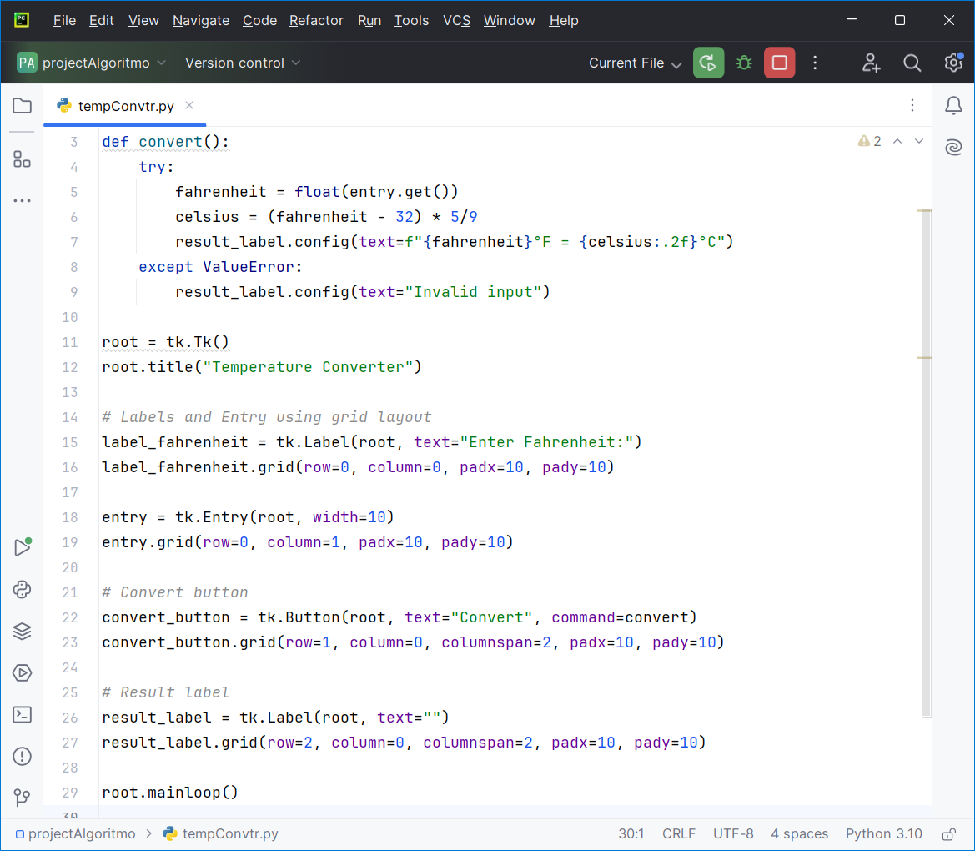
Integration using GUI-designing user interface
Example – Code of temperature converter
Defining the convert() function to convert the temperature.
Designing the GUI of converter and connecting with the convert() function.
1
2

Slide 43
Integration using GUI-designing user interface
Explanation –Temperature converter
Functionality:
The convert() function is called when the "Convert" button is clicked. It retrieves the Fahrenheit temperature from the entry widget, performs the conversion to Celsius, and updates the result_label with the converted temperature.
Grid Layout Control:
“padx” and “pady” parameters add padding around widgets to improve spacing and appearance.

Slide 44
7. Events

Slide 45
Events
Explanation
In the context of Python GUI programming, an event refers to any action or occurrence that happens within the graphical user interface, typically triggered by user interaction or system events.
These events could include clicking a button, typing in a text field, moving the mouse, resizing a window, or any other action that causes a change in the state or behavior of the GUI application.

Slide 46
Events
A button (convert_button) to trigger the conversion function (convert), and a label (result_label) to display the conversion result.

Slide 47
Events
How events work in Tkinter
Event Binding: Bind an event (such as button click) to a function (event handler). This is typically done using the command parameter for buttons or through methods like .bind() for other widgets or custom events.
Event Handlers: Event handlers (like on_button_click() in the example) are functions that execute in response to specific events. These functions can manipulate widgets, update data, or perform any action based on user interaction or system events.
Event Queue: When an event (e.g., button click) occurs, Tkinter places the event in the queue. The event loop (mainloop()) retrieves events from the queue, dispatches them to the appropriate event handlers, and executes the associated functions.

Slide 48
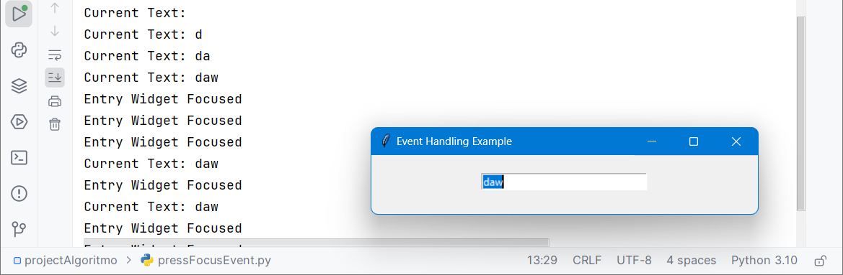
Events
Example - Handling “key” and “focus” events
We will create a Tkinter window with an Entry widget. We'll handle events such as typing in the entry field (<Key> event) and gaining focus (<FocusIn> event).

Slide 49
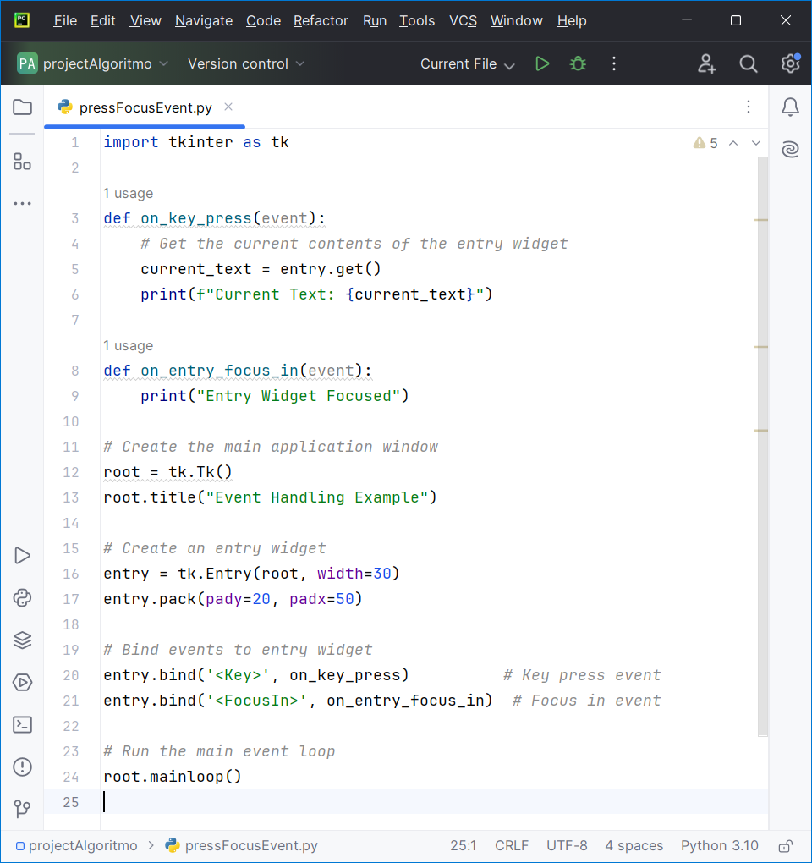
Events
Example – Code for handling “key” and “focus” events

Slide 50
Events
Example – Explanation of handling “key” and “focus” events
Event Handling Functions
on_key_press(event): This function handles the <Key> event, which occurs whenever a key is pressed while the entry widget has focus. It prints the current text in the entry widget to the console.
on_entry_focus_in(event): This function handles the <FocusIn> event, which occurs when the entry widget gains focus. It simply prints a message to indicate that the widget has been focused.

Slide 51
Events
Create a GUI with Keyboard Shortcuts
Create a Tkinter GUI application that includes a text entry widget and uses keyboard shortcuts to interact with the text.
Implement the following features:
Pressing the Enter key while typing in the text entry widget should print the current text in the entry widget to the console.
Pressing the Escape key should clear the text in the entry widget.
Requirements:
Create a main window with a title "Keyboard Shortcuts Example".
Add an Entry widget to the window where users can type text.
Implement an event handler for the Enter key that prints the current text in the entry widget to the console.
Implement an event handler for the Escape key that clears the text in the entry widget.

Slide 52
7. Functions and Layouts

Slide 53
Functions and Layouts
Functions
Functions in Tkinter are used to define the behavior and logic of your application. These functions are typically linked to events or widgets, such as button clicks, menu selections, or other user actions.
Need of function to work with Tkinter?
Event Handling : Functions allow you to define how your application should respond to specific events, such as button clicks, key presses, or mouse movements.
Modularity : Functions make your code modular by breaking it into smaller, manageable pieces. This modularity allows you to test and debug individual parts of your application separately.
State Management : Functions can help manage the state of your application. For example, you can create functions that update the content of widgets or variables based on user interactions.
Reusability : Functions promote reusability. Once you define a function, you can reuse it across different parts of your application or even in different applications.

Slide 54
Functions and Layouts
We have already used on_keypress() and on_entry_focus_in() functions to handle key press and get fucus events.

Slide 55
Functions and Layouts
Layouts
Explanation
In Tkinter, a layout refers to the way widgets (such as buttons, labels, text boxes, etc.) are organized within a window or frame.
Type of layouts
Tkinter offers several ways to place widgets in the window, the most commons are -
Pack layout
Grid layout
Place layout

Slide 56
Functions and Layouts
Layouts
Pack layout
Grid layout
Place layout

Slide 57
Functions and Layouts
Create a GUI with different layouts and functions.
Create a Tkinter GUI of Registration form. Collect data from user inputs – name, email, mobile number, age, gender, hobbies, and address, and display these into terminal.
Instructions:
1.Use functions to handle various events corresponding to widgets.
2.Use appropriate layout to organize the widgets.
3.On click of the “Submit” button all the data inputted by user should be display on terminal.
4. Use a variety of widgets.

Slide 58
Question?

Slide 59
Thank you

