Slide 1
Tkinter - Widgets

Slide 2


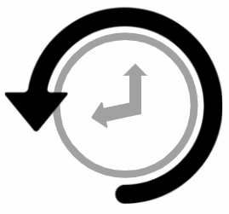

Error/ Warning
Information
Flashback
Class Exercise

Slide 3
What Tkinter is and its importance in python GUI programming
Hierarchy of widgets and how they are organized
Main components of A Tkinter application: root window, frames & widgets
Widgets using GUI - drop down menus
Toolbar
Scale widget
Spinbox widget
Messagebox
Graphics and shapes-line graphics
Graphics and shapes - box
Graphics and shapes - canvas
Graphics and shapes - images in GUI
AGENDA

Slide 4
What Tkinter Is and Its Importance in Python GUI Programming

Slide 5

What Tkinter is and its importance in python GUI programming
Tkinter
Tkinter is the standard GUI (Graphical User Interface) library for Python, providing a fast and easy way to create GUI applications.
It is a thin object-oriented layer on top of the Tcl/Tk GUI toolkit.
The name Tkinter comes from Tk interface.

Slide 6
What Tkinter is and its importance in python GUI programming
Importance
Standard library integration
Cross-platform compatibility
Ease of use
Rich widget set
Event-driven programming
Flexible layout management
Customizable appearance
Canvas widget
Extensible
Good documentation
Integration with other libraries
Stable

Slide 7
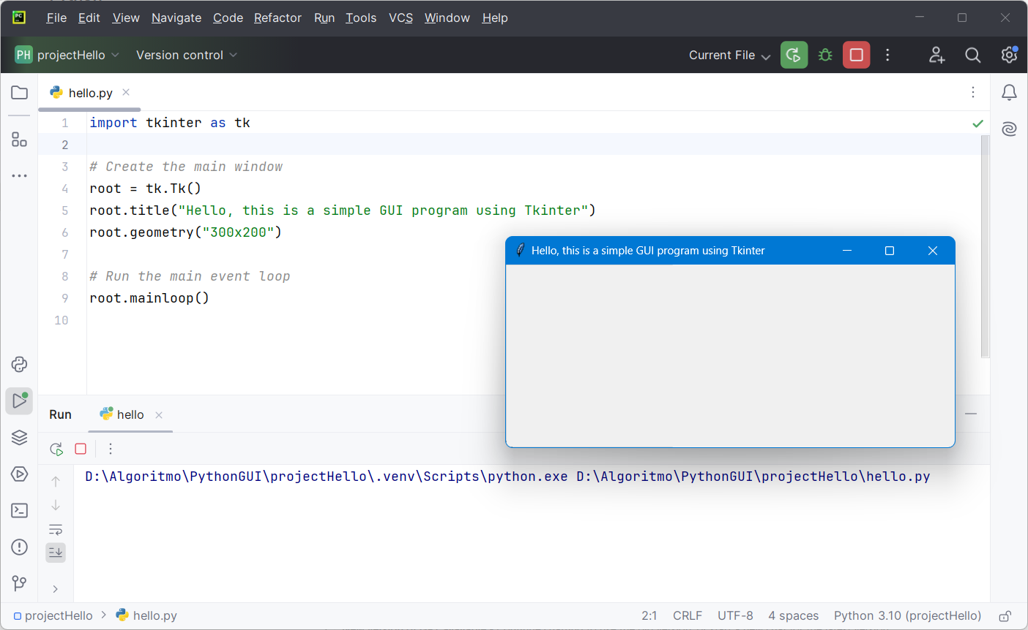
What Tkinter is and its importance in python GUI programming
Creating a Simple Window:

Slide 8
2. Hierarchy of Widgets and How They Are Organized

Slide 9
Hierarchy of widgets and how they are organized
Hierarchy of widgets
In Tkinter, widgets are organized in a hierarchical manner. The main window (or root window) is at the top of the hierarchy, and other widgets are added as children to this window or to other widgets.
Root window
Frame
Label
Entry
Radio button
Radio button

Slide 10
Hierarchy of widgets and how they are organized
How they are organized
In Tkinter, widgets are organized in a tree-like structure.
The tree-like oraganization is essential in Tkinter because it defines the parent-child relationship between widgets, influencing their placement and behavior.
Each widget can have only one parent, but a parent can have multiple child widgets.

Slide 11
Hierarchy of widgets and how they are organized
Create a Tkinter application with the following hierarchy
Root Window: The main application window.
  Frame 1: A frame inside the root window.
    Label 1: A label inside Frame 1 with the text "Label in Frame 1".
    Button 1: A button inside Frame 1 with the text "Button in Frame 1".
  Frame 2: Another frame inside the root window.
    Label 2: A label inside Frame 2 with the text "Label in Frame 2".
    Button 2: A button inside Frame 2 with the text "Button in Frame 2".

Slide 12
3. Main Components of Tkinter Application: root window, frames & widgets

Slide 13
Main components of Tkinter application: root window, frames & widgets
Main components of Tkinter application
Root Window: The main window of a Tkinter application. It is the parent container for all other widgets and frames.
Frames: Containers used to organize and group widgets within the root window. They help in structuring the layout of the application.
Widgets: The individual UI elements like buttons, labels, entry fields, etc., that are placed inside frames or directly within the root window.

Slide 14
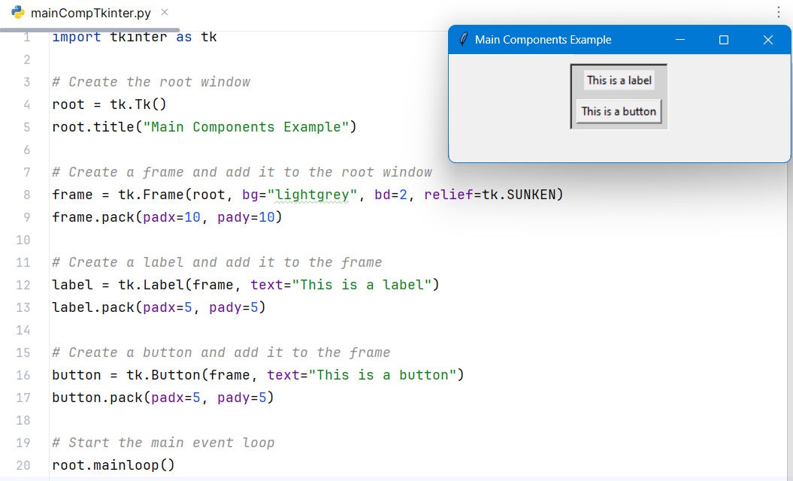
Main components of Tkinter application: root window, frames & widgets
Example - Main components of Tkinter application

Slide 15
Main components of Tkinter application: root window, frames & widgets
Explanation – Example of main components of Tkinter application
Root Window:
  Created using tk.Tk()
  The title is set using root.title("Main Components Example").
Frame:
  Created using tk.Frame(root, ...)
  Configured with background color (bg), border (bd), and relief style (relief).
  Added to the root window using frame.pack(padx=10, pady=10) which adds padding around the frame.
Label:
  Created using tk.Label(frame, text="This is a label")
  Added to the frame using label.pack(padx=5, pady=5) which adds padding around the label.

Slide 16
4. Widgets Using GUI - Dropdown Menus

Slide 17
Widgets using GUI - drop down menus
Drop-Down Menu
In Tkinter, a dropdown, often referred to as a "dropdown menu" or a "dropdown list," is a graphical control element that allows users to select one option from a list of predefined choices.
Steps to create a dropdown:
Create the Root Window: Initialize the main application window.
Create a Menu Widget: This will be the main menu bar.
Configure the Menu: Set the menu as the root window's menu.
Create Submenus: Add items to the menu bar and create submenus for drop-down functionality.
Add Commands to Submenus: Populate the submenus with commands or actions.

Slide 18
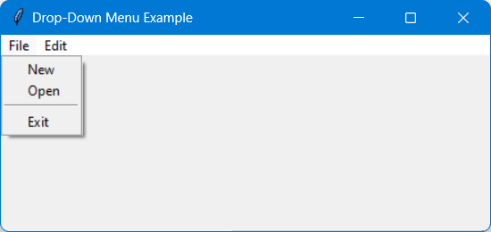
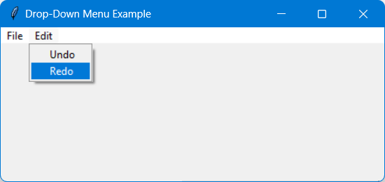
Widgets using GUI - drop down menus
Example – GUI of Drop-Down Menu
Let’s create a Tkinter application with a menu bar that contains two menus: "File" and "Edit". The "File" menu should have the options "New", "Open", and "Exit". The "Edit" menu should have the options "Undo" and "Redo". Display a message in the console when any menu item is clicked.

Slide 19
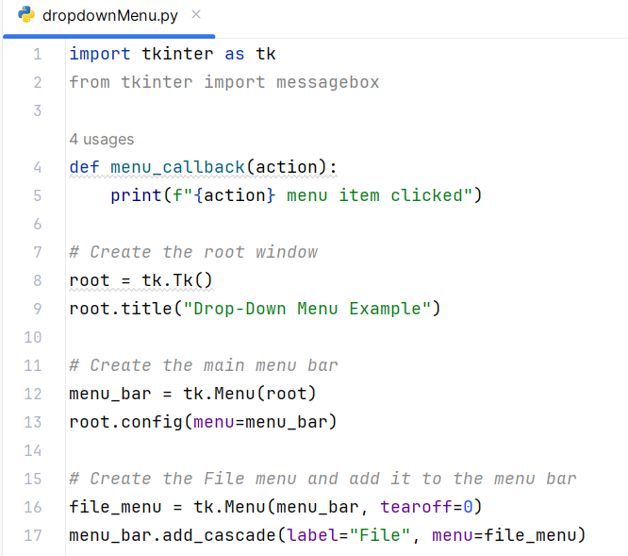
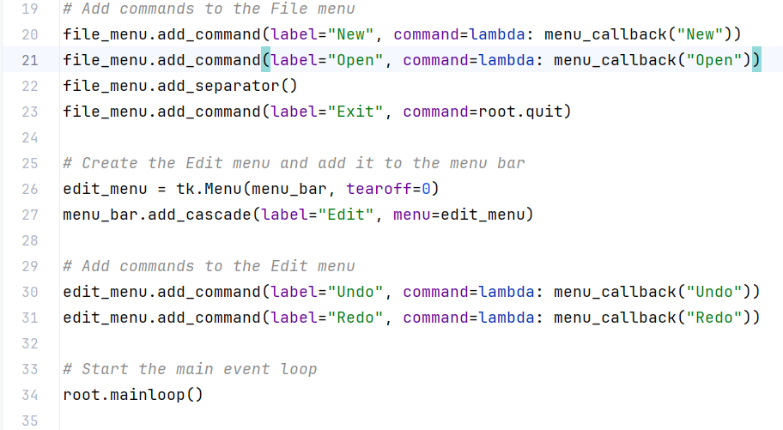
Widgets using GUI - drop down menus
Example – Code of Drop-Down Menu

Slide 20
Widgets using GUI - drop down menus
Explanation - Example of Drop-Down Menu
Menu Bar: The main menu bar is created using tk.Menu(root).
Configuring Menu Bar: The menu bar is set as the root window's menu using root.config(menu=menu_bar).
File Menu:
  Created using tk.Menu(menu_bar, tearoff=0).
  Added to the menu bar using menu_bar.add_cascade(label="File", menu=file_menu).
  Commands ("New", "Open", "Exit") are added to the file menu using file_menu.add_command(...).
  A separator is added using file_menu.add_separator().
  The "Exit" command is linked to root.quit to close the application.
Edit Menu:
  Created using tk.Menu(menu_bar, tearoff=0).
  Added to the menu bar using menu_bar.add_cascade(label="Edit", menu=edit_menu).
  Commands ("Undo", "Redo") are added to the edit menu using edit_menu.add_command(...).

Slide 21
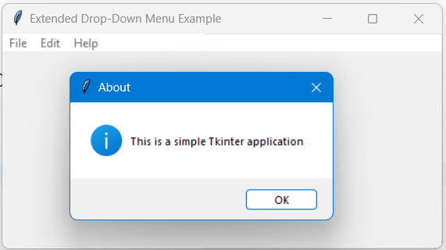
Widgets using GUI - drop down menus
Extend the previous example by adding a "Help" menu with an "About" option that shows an informational message box with the message "This is a simple Tkinter application".

Slide 22
5. Toolbar

Slide 23
Toolbar
Toolbar
A toolbar in Tkinter can be created using the Frame widget, which acts as a container for buttons or other widgets that represent tools or actions. Toolbars are typically placed at the top of the application window and provide quick access to commonly used functions.
Steps to create a Toolbar:
Create the Root Window: Initialize the main application window.
Create a Frame for the Toolbar: This frame will hold the toolbar buttons.
Add Buttons to the Toolbar: Create and add buttons to the toolbar frame.
Pack the Toolbar Frame: Place the toolbar frame at the top of the root window.

Slide 24
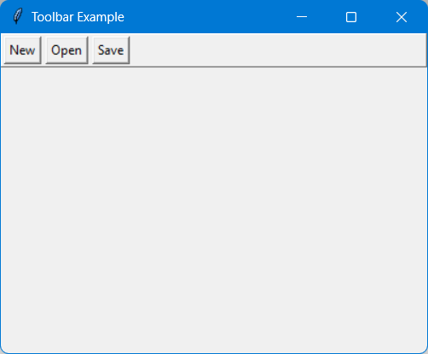
Toolbar
Example – GUI of Toolbar
Create a Tkinter application with a toolbar that contains three buttons: "New", "Open", and "Save". Each button should print a message to the console when clicked.

Slide 25
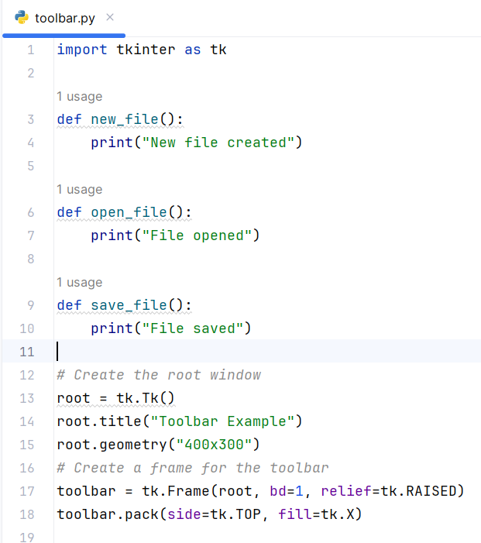
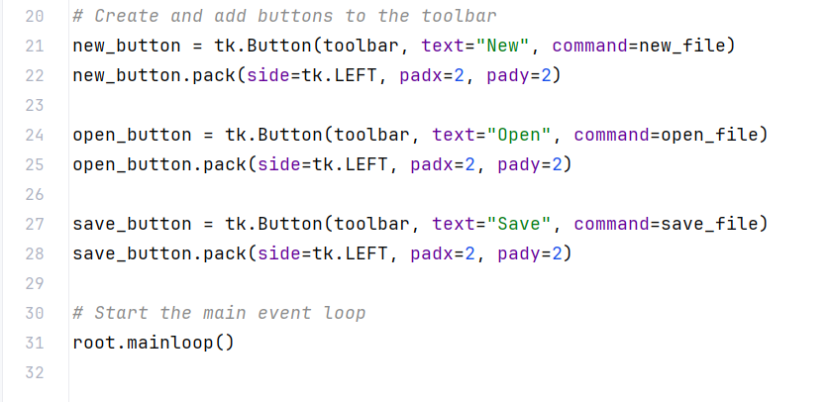
Toolbar
Example – Code of Toolbar

Slide 26
Toolbar
Explanation - Example of Toolbar
Root Window: The main application window is created using tk.Tk().
Toolbar Frame:
  Created using tk.Frame(root, bd=1, relief=tk.RAISED).
  Configured with a border (bd) and a raised relief style (relief).
  Placed at the top of the root window using toolbar.pack(side=tk.TOP, fill=tk.X).
Buttons:
  Created using tk.Button(toolbar, text="Button Text", command=command_function).
  Added to the toolbar frame using button.pack(side=tk.LEFT, padx=2, pady=2).
Button Commands: Each button is linked to a function that prints a message to the console.

Slide 27
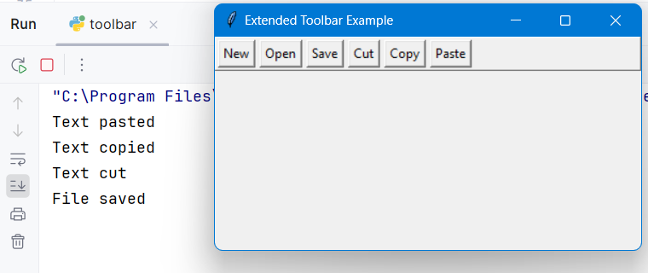
Toolbar
Extend the previous example by adding a "Cut", "Copy", and "Paste" button to the toolbar. Each button should print a corresponding message to the console when clicked.

Slide 28
6. Scale Widget

Slide 29
Scale widget
Scale widget
The scale widget in Tkinter is a graphical slider that allows users to select a value within a specified numeric range. It provides a way to interactively adjust and input numeric values using a GUI interface.
Steps to create a scale widget:
Create the Root Window: Initialize the main application window.
Create a Frame for the Toolbar: This frame will hold the scale widget.
Add the Scale Widget:
  Create the scale widget (tk.Scale) within the frame.
  Specify the parent widget (frame), the range of values (from_ and to parameters), orientation (orient parameter), and a function (command parameter) to handle value changes.
Pack the Scale Widget

Slide 30
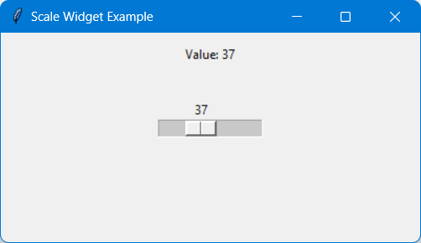
Scale widget
Example – GUI of Scale widget
Create a Tkinter application with a scale widget that scales from 0 to 100.

Slide 31
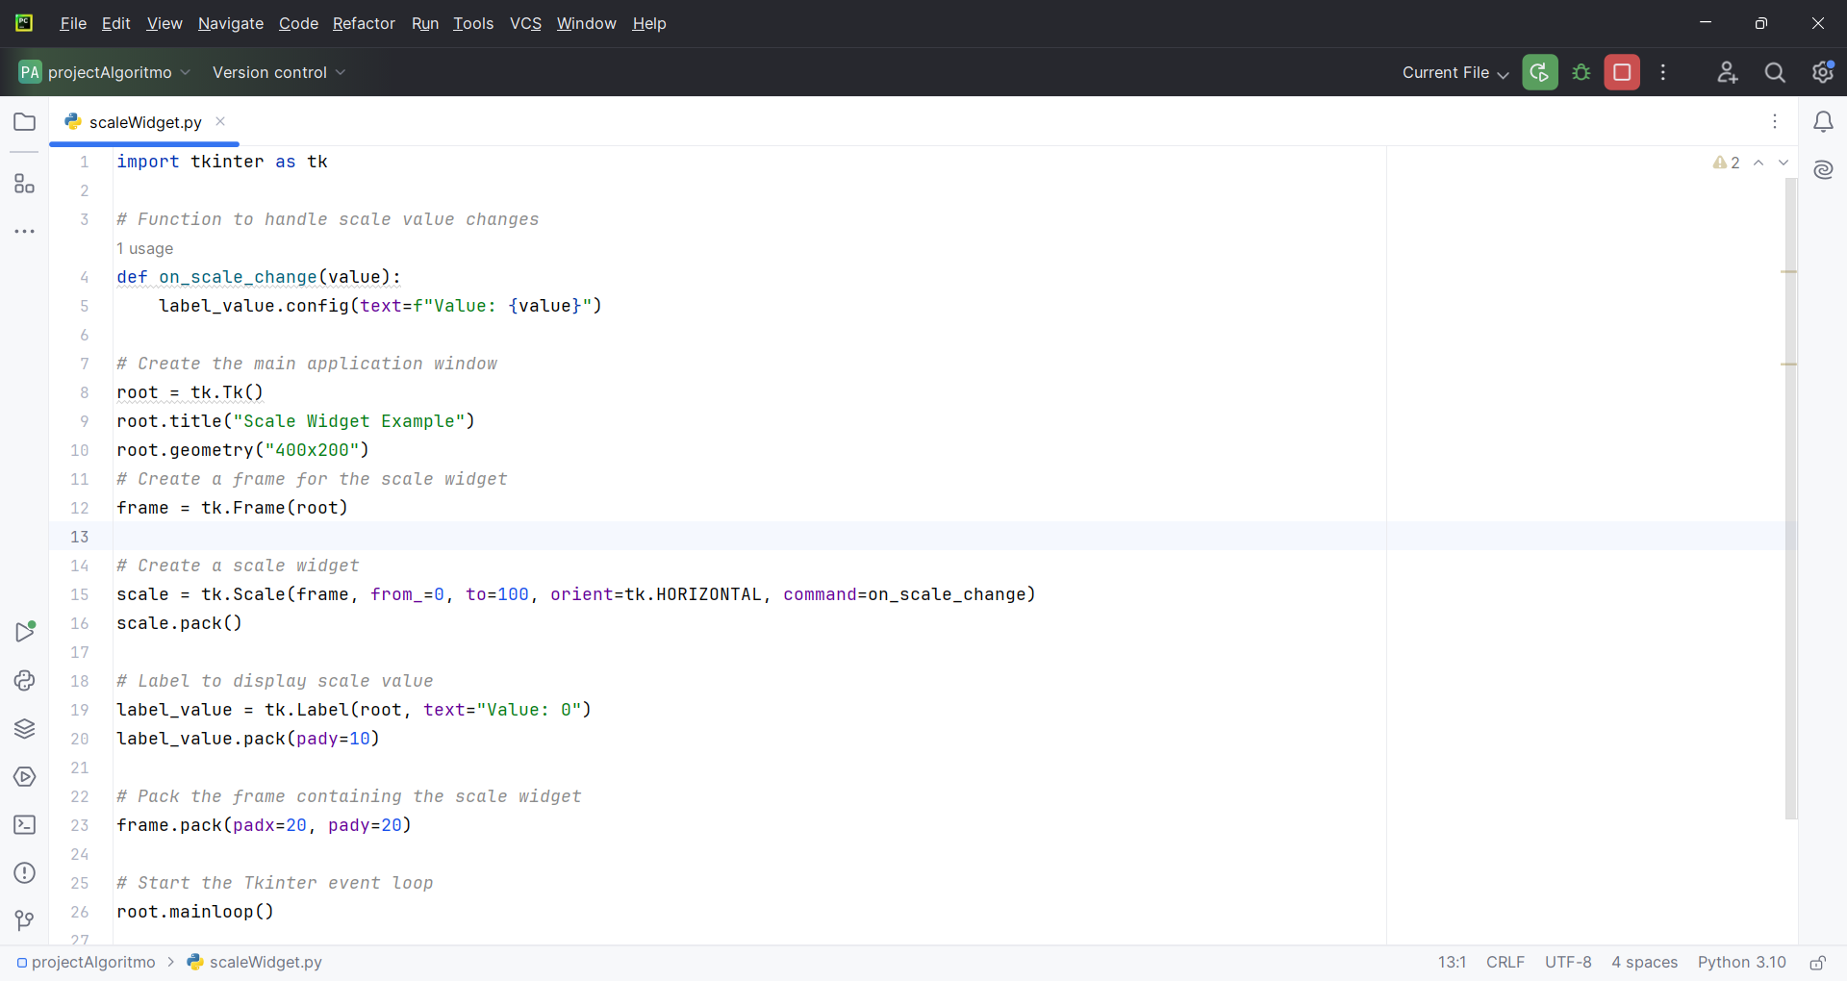
Scale widget
Example – Code of Scale widget

Slide 32
Scale widget
Explanation - Example of Scale widget
scale = tk.Scale(…): Creates a horizontal scale widget (tk.Scale) within the frame.
Parameters:
  from_=0 and to=100: Specifies the range of values for the scale widget (from 0 to 100).
  orient=tk.HORIZONTAL: Specifies the orientation of the scale widget (horizontal).
  command=on_scale_change: Specifies the function (on_scale_change) to call during scale value changes.

Slide 33
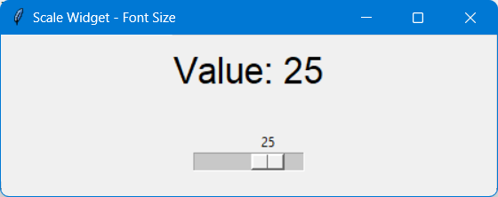
Scale widget
Enhance the scale widget example by adding a label that changes its font size based on the selected scale value.

Slide 34
7. SpinBox Widget

Slide 35
SpinBox widget
SpinBox widget
The SpinBox widget in Tkinter is a graphical control element consisting of a text box and two small arrow buttons that allow users to select a numeric value within a specified range by incrementing or decrementing.
Steps to create a SpinBox widget:
Create the Main Application Window: root = tk.Tk()
Create SpinBox Widget: spinbox = tk.Spinbox(root, from_=0, to=100)
Pack SpinBox Widget: spinbox.pack()
Handle SpinBox Value Changes: Define a function on_spinbox_change() to update based on SpinBox value.

Slide 36
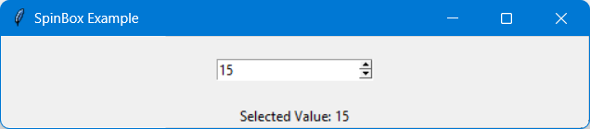
SpinBox widget
Example – GUI of SpinBox widget
Create a Tkinter application with a spinbox widget that spins from 0 to 100.

Slide 37
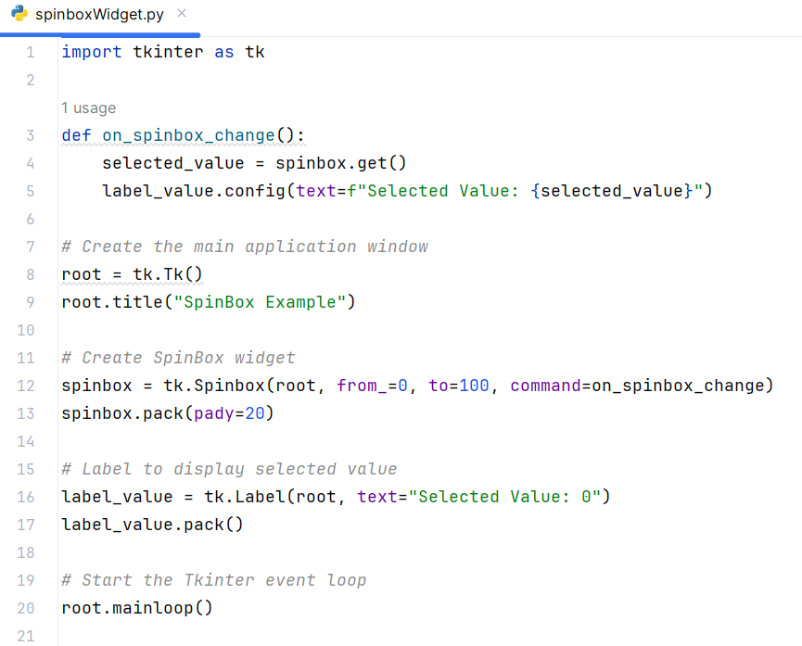
SpinBox widget
Example – Code of SpinBox widget

Slide 38
SpinBox widget
Explanation - Example of SpinBox widget
Defines a function on_spinbox_change that:
  Retrieves the current value of the SpinBox using spinbox.get().Updates the text of label_value to display the selected value.
spinbox = tk.Spinbox(root, …)
  Creates a SpinBox widget “spinbox” within the main window “root”.
  Parameters:
    from_=0 and to=100: Specifies the range of values (from 0 to 100).
    command=on_spinbox_change: Specifies the function (on_spinbox_change) to call whenever the SpinBox value changes.

Slide 39
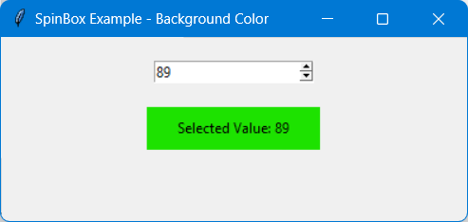
SpinBox widget
Enhance the SpinBox example to dynamically change the background color of a label based on the selected value of the SpinBox.

Slide 40
8. MessageBox

Slide 41
MessageBox
MessageBox
Tkinter Messagebox provides dialog boxes to show messages to users, including alerts, warnings, and confirmation prompts.
Step to create a messegebox widget:
import tkinter.messagebox as mb

Slide 42
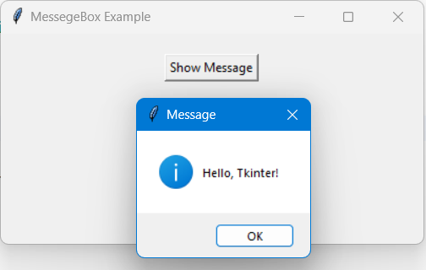
MessageBox
Example – GUI of MessageBox
Create a Tkinter application that display a prompt to user upon a button click.

Slide 43
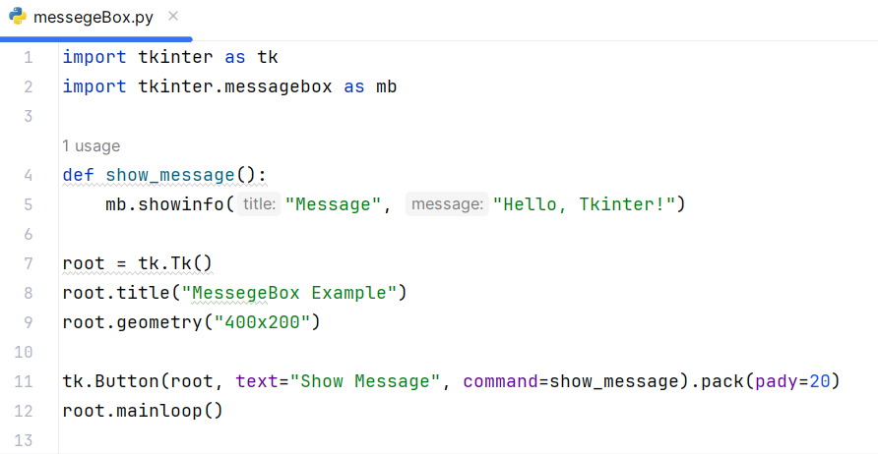
MessageBox
Example – Code of MessageBox

Slide 44
MessageBox
Explanation - Example of MessageBox
Imports:
  import tkinter.messagebox as mb – it Imports the Tkinter messagebox module as mb for convenience.
Function show_message():
  Defines a function show_message that displays an informational message box using mb.showinfo.

Slide 45
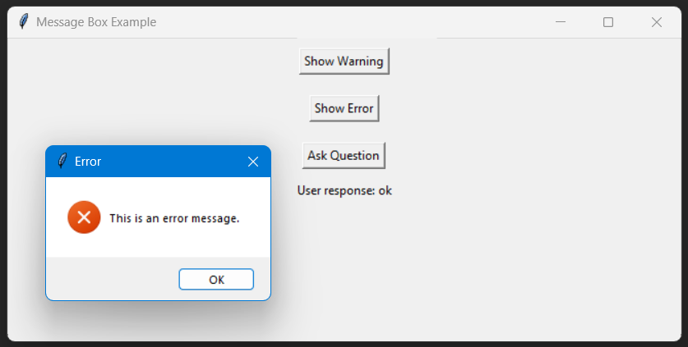
MessageBox
Enhance the example to include different types of message boxes (warning, error, question) and handle user responses (e.g., display a different message or take different actions based on user input).

Slide 46
9. Graphics and Shapes - Line Graphics

Slide 47
Graphics and shapes - line graphics
Line
Tkinter allows drawing lines between specified points using the Canvas widget.
Step to create a line:
canvas.create_line(x1, y1, x2, y2, ...)

Slide 48
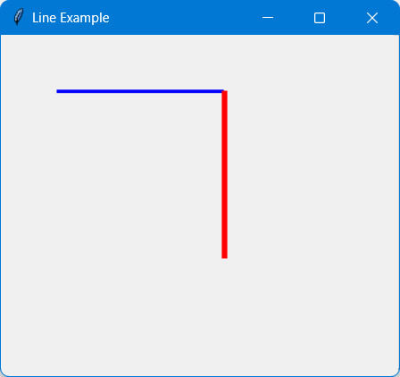
Graphics and shapes - line graphics
Example – GUI of Line
Create a Tkinter application that display a line on canvas.

Slide 49
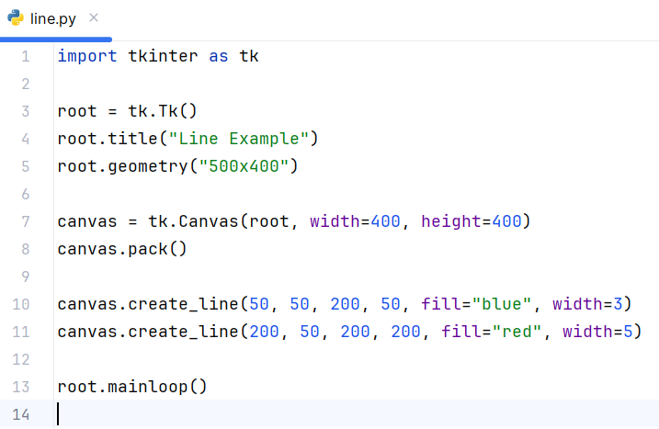
Graphics and shapes - line graphics
Example – Code of Line

Slide 50
Graphics and shapes - line graphics
Explanation - Example of Line
Canvas Widget:
  Creates a Canvas widget (canvas) within the main window (root) with specified width and height.
create_line Method:
  Uses canvas.create_line to draw lines:
    canvas.create_line(50, 50, 200, 50, fill="blue", width=3): Draws a blue line from (50, 50) to (200, 50) with a width of 3 pixels.
    canvas.create_line(200, 50, 200, 200, fill="red", width=5): Draws a red line from (200, 50) to (200, 200) with a width of 5 pixels.

Slide 51
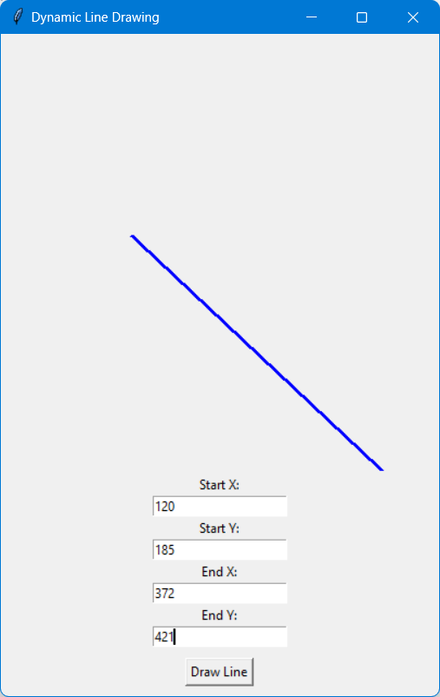
Graphics and shapes - line graphics
Extend the example by allowing users to input coordinates via entry widgets
and draw lines dynamically based on those coordinates.

Slide 52
10. Graphics and Shapes - Box Graphics

Slide 53
Graphics and shapes - box graphics
Box
Tkinter Canvas widget allows drawing rectangles or boxes with specified coordinates and attributes.
Step to create a box:
canvas.create_rectangle(x1, y1, x2, y2, ...)

Slide 54
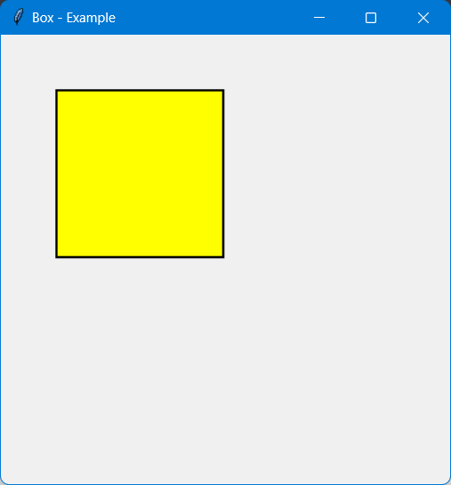
Graphics and shapes - box graphics
Example – GUI of Box
Create a Tkinter application that display a box on canvas.

Slide 55
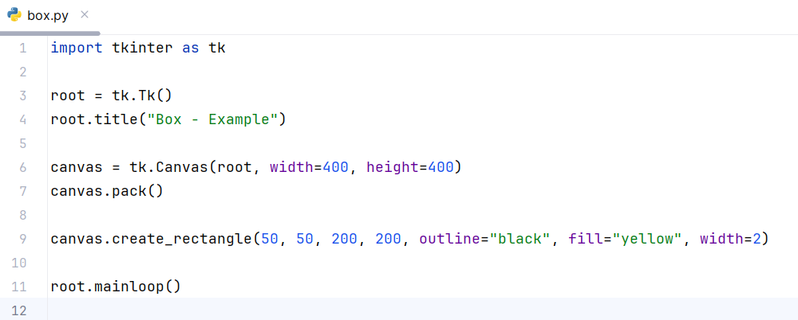
Graphics and shapes - box graphics
Example – Code of Box

Slide 56
Graphics and shapes - box graphics
Explanation - Example of Box
create_rectangle Method:
  Uses canvas.create_rectangle to draw a rectangle:
    canvas.create_rectangle(50, 50, 200, 200, outline="black", fill="yellow", width=2): Draws a rectangle with top-left corner at (50, 50) and bottom-right corner at (200, 200).
    outline="black": Sets the outline color to black.
    fill="yellow": Fills the rectangle with yellow color.
    width=2: Sets the outline width to 2 pixels.

Slide 57
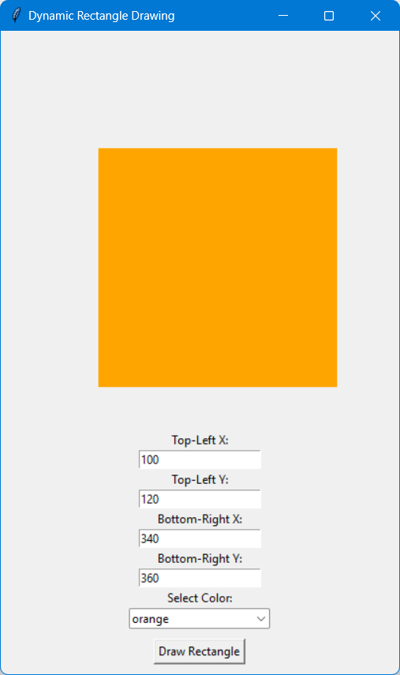
Graphics and shapes - box graphics
Enhance the example to allow users to change the size, color, and position
of the rectangle using entry widgets or dropdown menus.

Slide 58
11. Graphics and Shapes - Canvas

Slide 59
Graphics and shapes - canvas
Canvas
Tkinter Canvas widget provides a drawing space to create graphics, shapes, and images.
Step to create a canvas:
canvas = tk.Canvas(root, width=400, height=400)

Slide 60
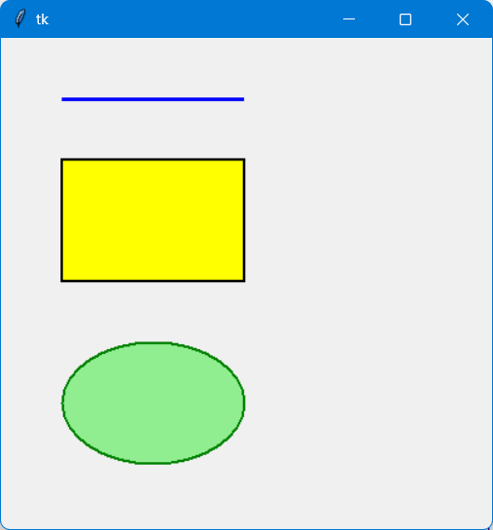
Graphics and shapes - canvas
Example – GUI of Canvas
Create a Tkinter application that makes a canvas placing some
shapes on it.

Slide 61
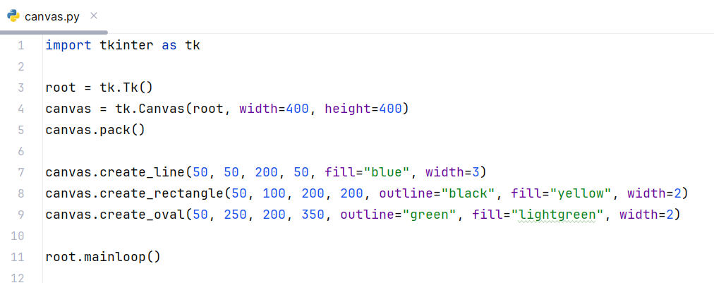
Graphics and shapes - canvas
Example – Code of Canvas

Slide 62
Graphics and shapes - canvas
Explanation - Example of Canvas
Canvas Widget:
  Creates a Canvas widget (canvas) within the main window (root) with specified width and height.
Drawing Methods:
  Uses canvas.create_line, canvas.create_rectangle, and canvas.create_oval methods to draw:
    A blue line from (50, 50) to (200, 50) with a width of 3 pixels.
    A yellow rectangle with outline in black, from (50, 100) to (200, 200) with a width of 2 pixels.
    A light green oval with outline in green, from (50, 250) to (200, 350) with a width of 2 pixels.

Slide 63
12. Graphics and Shapes - Images in GUI

Slide 64
Graphics and shapes – images in GUI
Images in GUI
Tkinter allows showing images (e.g., PNG, JPEG) within GUI applications using the PhotoImage class.
Step to add an image:
photo = tk.PhotoImage(file="image.png")

Slide 65
Graphics and shapes – images in GUI
In Tkinter some image formats are not supported by default. How can we address that issue?

Slide 66
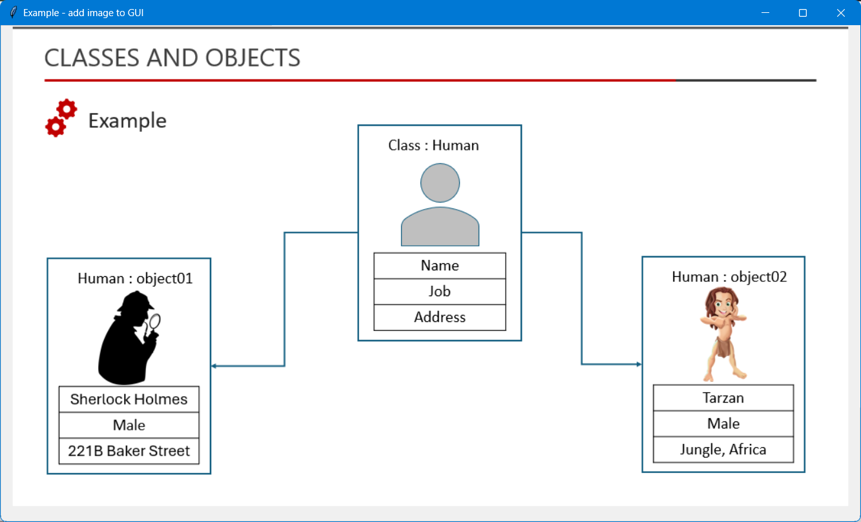
Graphics and shapes – images in GUI
Example – showing an image
Create a Tkinter application that shows an image.

Slide 67
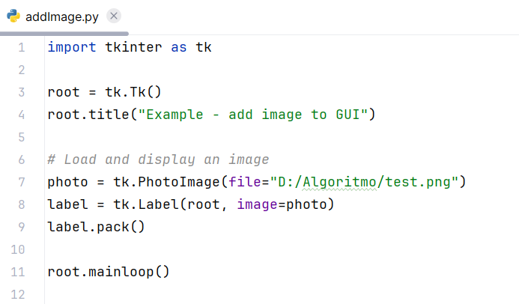
Graphics and shapes – images in GUI
Example – Code of showing an image

Slide 68
Graphics and shapes – images in GUI
Explanation - Example of Canvas
PhotoImage Class:
Uses tk.PhotoImage(file="image.png") to create a PhotoImage object (photo) from an image file (image.png).

Slide 69
Question?

Slide 70
Thank you

