Slide 1
Advanced Widgets

Slide 2




Error/ Warning
Information
Flashback
Class Exercise

Slide 3
Working with advanced widgets - Listbox
Working with advanced widgets - Combobox
Working with advanced widgets - Treeview
AGENDA

Slide 4
Working with Advanced Widgets - Listbox

Slide 5

Working with advanced widgets - listbox
Listbox
The Listbox widget in Tkinter is used to display a list of items from which a user can select one or more.
Step to Implement
  Create a Listbox by initializing it with tk.Listbox.
  Add it to the Tkinter window using the layout function.

Slide 6
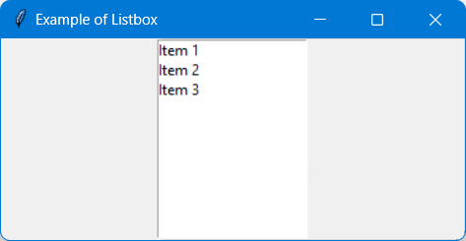
Working with advanced widgets - listbox
Example – GUI of Listbox
Create a Tkinter application that uses a listbox.

Slide 7
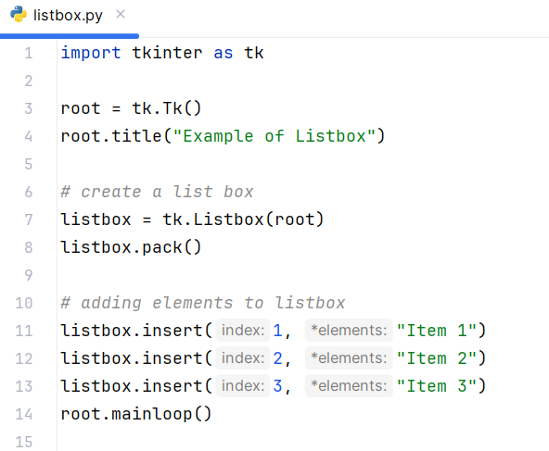
Working with advanced widgets - listbox
Example – Code of Listbox

Slide 8
Working with advanced widgets - listbox
Explanation - Example of Listbox
tk.Listbox(root): Creates a Listbox widget in the root window.
listbox.pack(): Adds the Listbox to the window using the pack layout manager.
listbox.insert(index, item): Inserts an item into the Listbox at the specified index.

Slide 9
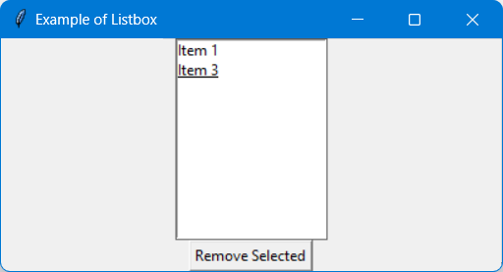
Working with advanced widgets - listbox
Extend the previous example by allowing the user to remove a selected item from the Listbox.

Slide 10
2. Working with Advanced Widgets - Combobox

Slide 11
Working with advanced widgets - combobox
Combobox
The Combobox widget in Tkinter, which is a part of the ttk module, is a drop-down list that allows the user to select one item from a list of choices.
Step to Implement
  Create a Combobox using ttk.Combobox.
  Add it to the Tkinter window with layout function.

Slide 12
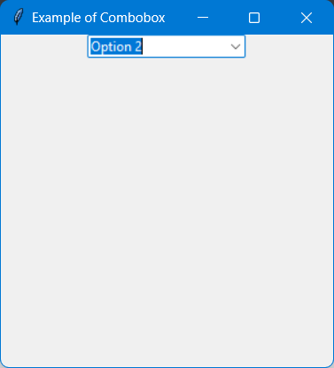
Working with advanced widgets - combobox
Example – GUI of Combobox
Create a Tkinter application that uses a combobox.

Slide 13
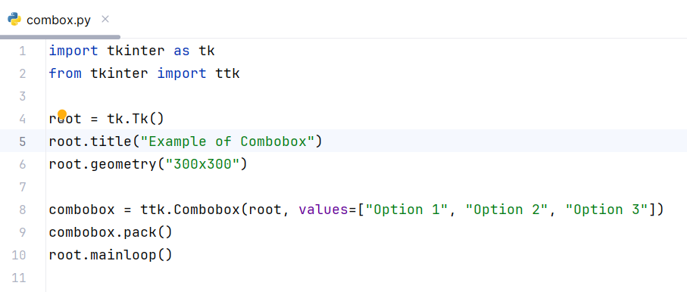
Working with advanced widgets - combobox
Example – Code of Combobox

Slide 14
Working with advanced widgets - combobox
Explanation - Example of Combobox
ttk.Combobox(root, values=[]): Creates a Combobox widget in the root window with specified options.
combobox.pack(): Adds the Combobox to the window using the pack layout manager.

Slide 15
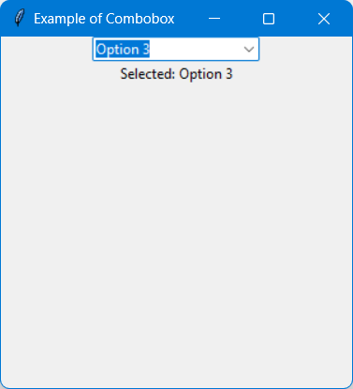
Working with advanced widgets - combobox
Extend the previous example by displaying the selected item in a label when the selection changes.

Slide 16
2. Working with Advanced Widgets - Treeview

Slide 17
Working with advanced widgets - treeview
Treeview
The Treeview widget in Tkinter, part of the ttk module, is used to display a hierarchical collection of items, such as a directory structure or an organizational chart.
Step to Implement
  Create a Treeview using ttk.Treeview.
  Add it to the Tkinter window with layout function.

Slide 18
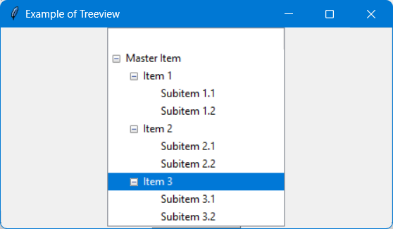
Working with advanced widgets - treeview
Example – GUI of Treeview
Create a Tkinter application that places item1, item2, and item3 under a top-level item called master_item. And each item with will have two subitems (Subitem 1.1 … Subitem 3.2).

Slide 19
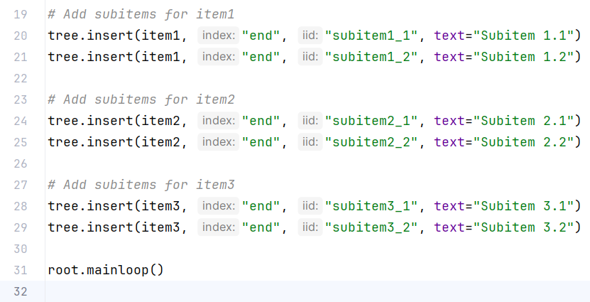
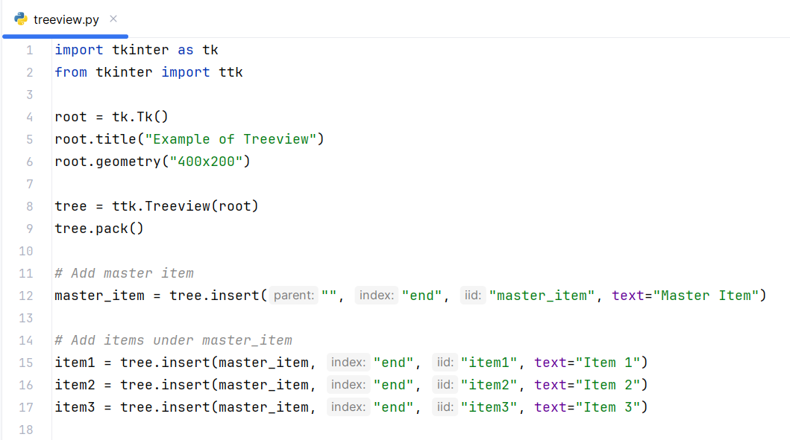
Working with advanced widgets - treeview
Example – Code of Treeview

Slide 20
Working with advanced widgets - treeview
Explanation - Example of Treeview
master_item = tree.insert("", "end", "master_item", text="Master Item"): Adds a top-level item called master_item.
tree.insert(master_item, "end", "item1", text="Item 1"): Adds item1 under master_item.
Similar lines add item2 and item3 under master_item.

Slide 21
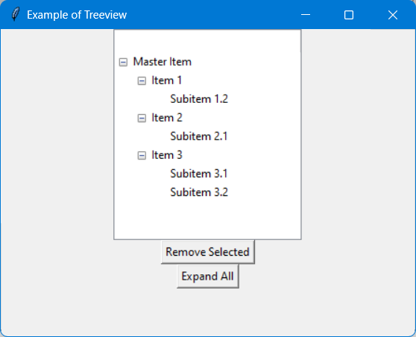
Working with advanced widgets - treeview
Extend the previous example by adding two buttons to remove the selected item ad expand the entire tree accordingly.

Slide 22
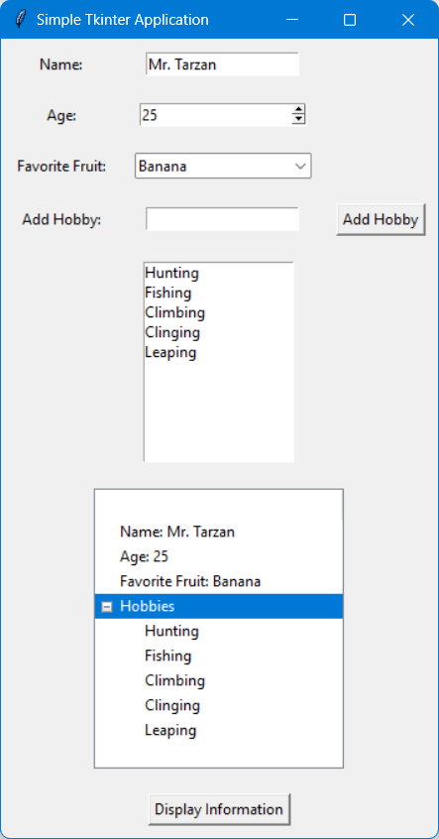
Advanced widgets
Case Study: Building a Simple Tkinter Application with Spinbox
Objective:
Build an application where users can input their name and age, select their favorite fruit from a combobox, add their favorite hobbies to a listbox, and display a hierarchical view of their input in a treeview.
Instructions:
Create the main window.
Add a Label and Entry for the user to input their name.
Add a Label and Spinbox for the user to select their age.
Add a Label and Combobox for the user to select their favorite fruit.
Add a Label, Entry, Button, and Listbox for the user to add and display their hobbies.
Add a Button to display the collected information in a Treeview.

Slide 23
Question?

Slide 24
Thank you

