Slide 1

April 2023
FPGA IMPLEMENTATION OF MULTIPLIER TOPOLOGIES
ECE 382N – High Speed Computer Arithmetic - I
Course Project Presentation
SHREYAS RAVISHANKAR (SR48925)
SAMARTH BONTHALA (SB63389)
TEJAS BHAGWAT (TB34454)
ATHARVA KARAGUPPi (AVK529)
The University of Texas at Austin

Slide 2
Motivation
Multipliers are basic building blocks of processors.
Field-Programmable Gate Arrays – Highly reconfigurable and used for many applications for HW acceleration and prototyping
There is a need for efficient and fast multiplier architectures for FPGA applications
Notes:
Learnt different multipliers in class and chose to implement them on a hardware platform.
Implemented using verilog
Wanted to know hardware resources required for each multiplier

Slide 3
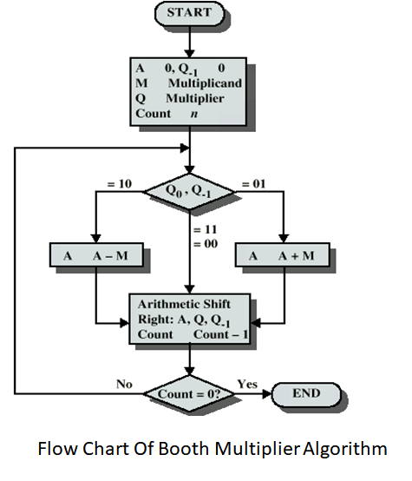
Background
Radix-2 Booth Multiplier
Iterative approach

Slide 4
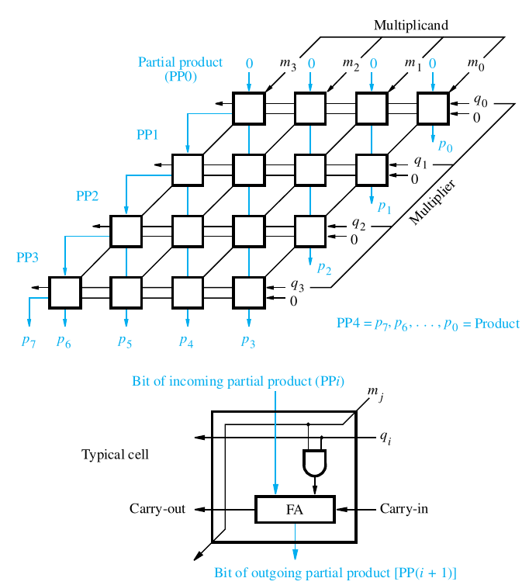
Array Multiplier
Parallel sum reduction

Slide 5
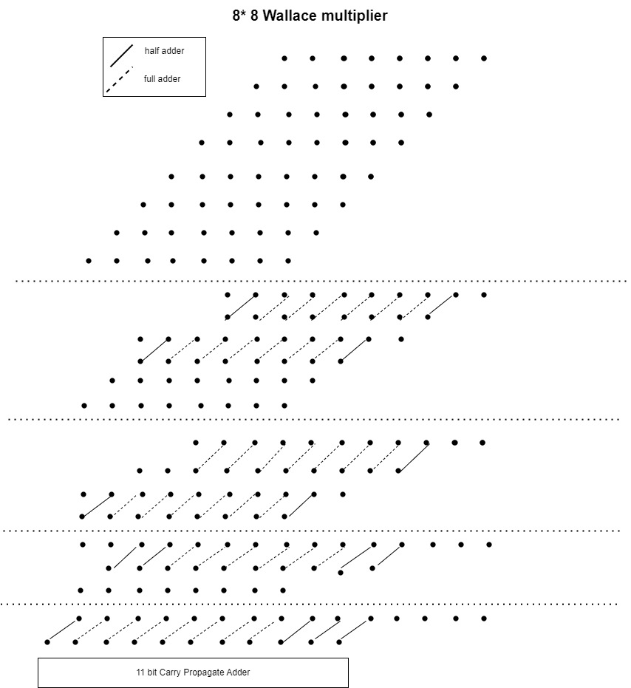
Wallace Multiplier
Fast Multiplier
Lesser resources than array multiplier
Partial Product reduction
Notes:
Uses maximum number of full adders and half adders for reduction after grouping into sets of 3

Slide 6
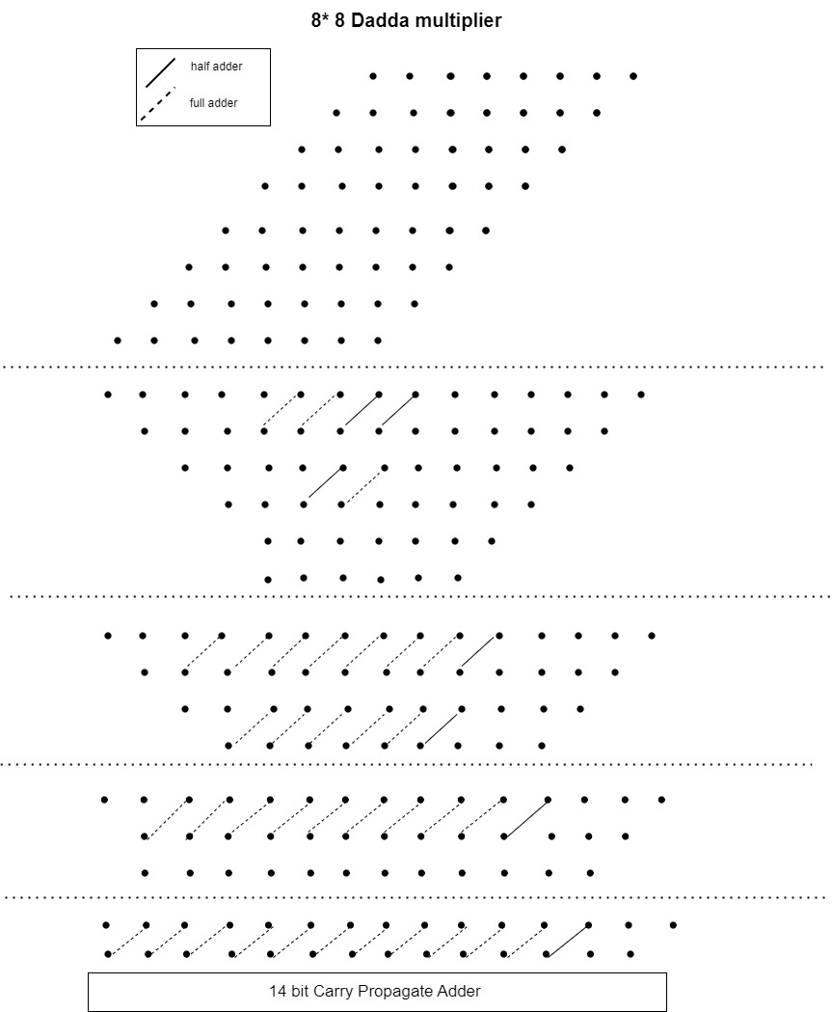
Dadda Multiplier
More resource efficient compared to Wallace
Different reduction technique
Significantly smaller half adder requirement
Notes:
Describe the levels and we use minimum number of half adders and full adders to satisfy the level requirement

Slide 7
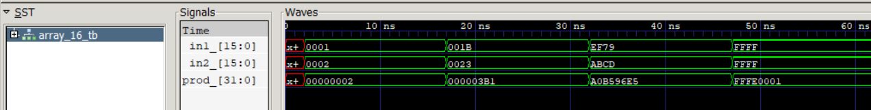
Approach
Verilog Implementation
Structural code
Simulation using Icarus Verilog
Simulation Results for 16x16 Array Multiplier
Notes:
Elaborate on our project implementation
Explain that various multiplier topologies were written in RTL and how they were implemented on FPGA (Avnet Ultra96)

Slide 8
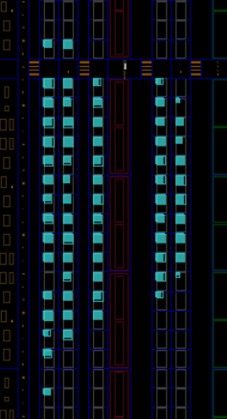

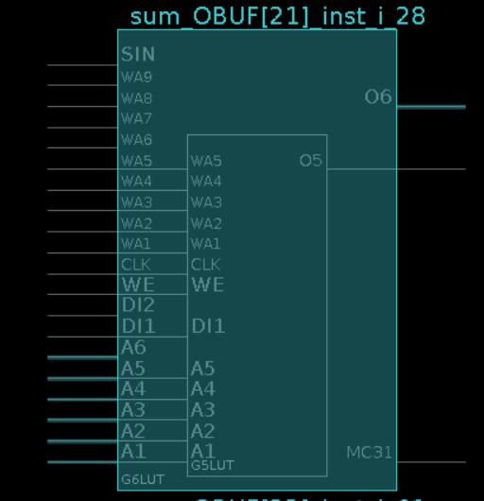
Approach
Synthesis and FPGA implementation
Notes:
Elaborate on our project implementation
Explain that various multiplier topologies were written in RTL and how they were implemented on FPGA (Avnet Ultra96)

Slide 9
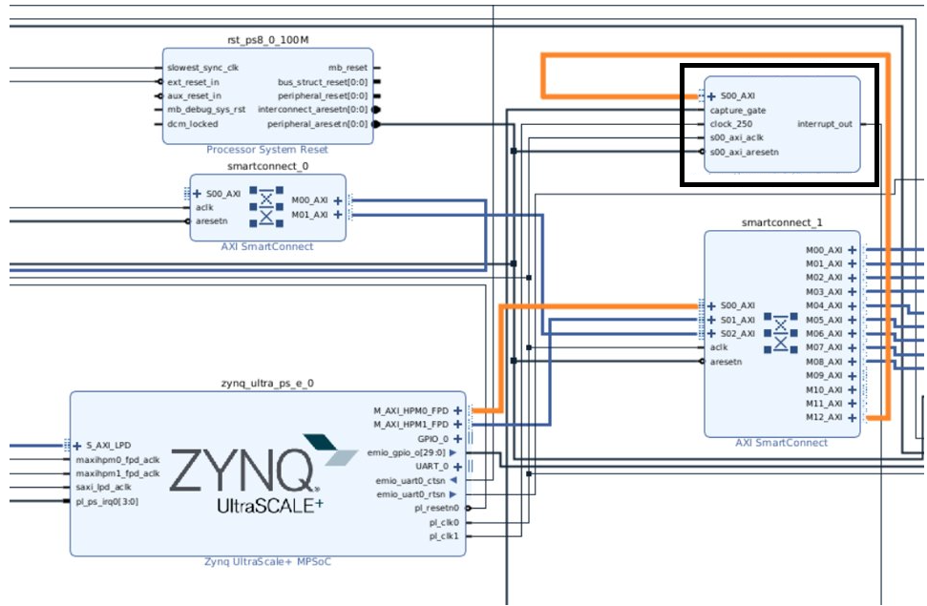
Approach
FPGA Design
Notes:
Elaborate on our project implementation
Explain that various multiplier topologies were written in RTL and how they were implemented on FPGA (Avnet Ultra96)

Slide 10
Results

Slide 11
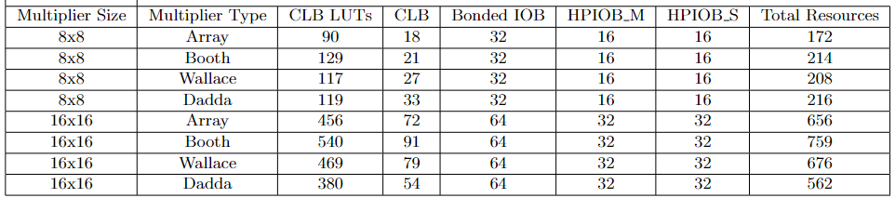


Resource Utilization Comparison

Slide 12
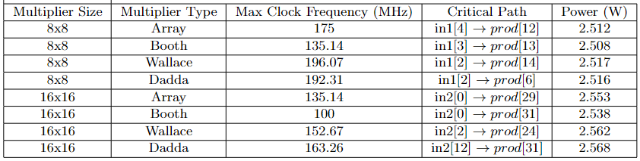


Timing Results
Notes:
Explain best and worst timing
Explain that critical path is not as expected

Slide 13
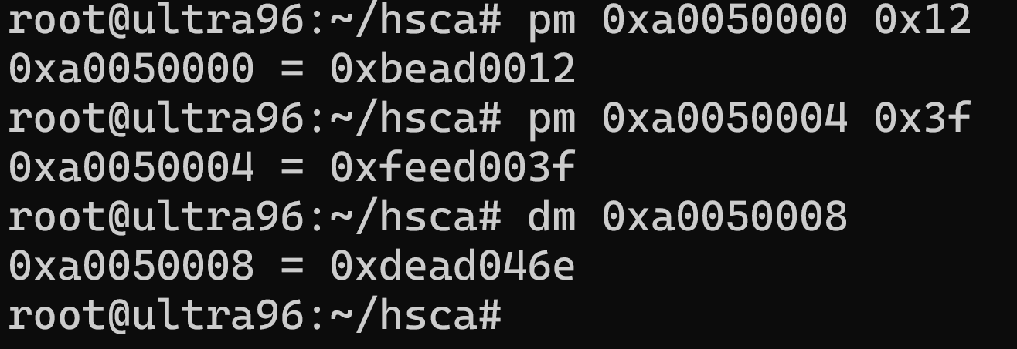
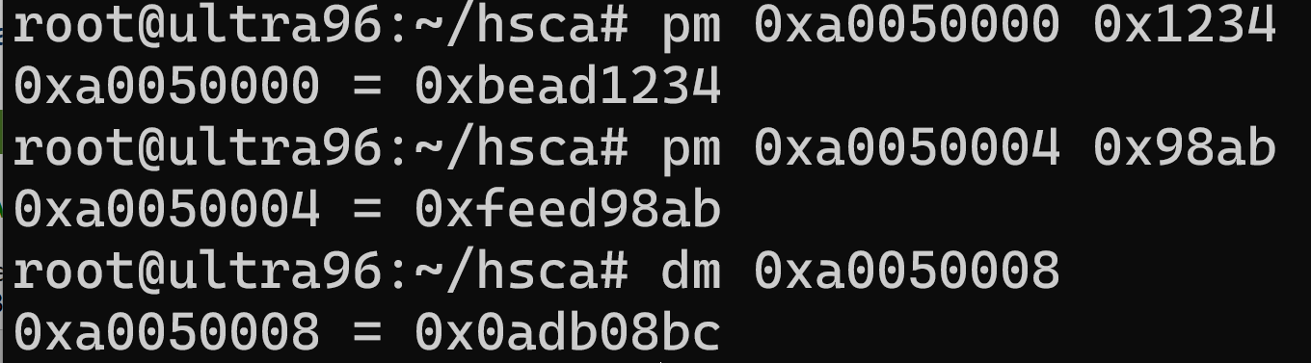







FPGA Deployment
FPGA deployment results for 8x8 Wallace Multiplier: 0x12 * 0x3f= 0x46e
FPGA deployment results for 16x16 Wallace Multiplier: 0x1234 * 0x98ab= 0x0adb08bc
Notes:
Need to do fpga dmeo

Slide 14
Thank You
Notes:
Need to do fpga dmeo

