Slide 1

A Project on "NSS Connect Platform: Digitalizing Community Service & Volunteer Management"
Under Guidance of Prof.
Manisha P. Navale
NBN Sinhgad School of Engineering
2025-2026 Sem VIII

Slide 2
Group Members
Abhijeet Indrjeet Bhosle
Aniket Vijay Chandan
Pratham Prashant Dhakate
Rajendra Narendra Patil
NBN Sinhgad School of Engineering
2025-2026 Sem VIII
Group 20

Slide 3
INDEX
INTRODUCTION
PROBLEM STATEMENT
THE SOLUTION: NSS CONNECT
STUDENT & VOLUNTEER PORTAL
COORDINATOR (PROFESSOR) DASHBOARD
SYSTEM ARCHITECTURE
FRONT-END & DESIGN HIGHLIGHTS
TECHNOLOGY STACK & INTEGRATION
IMPACT & FUTURE SCOPE
CONCLUSION

Slide 4
INTRODUCTION
Concept – A unified web portal connecting volunteers, coordinators, and administrators in a single digital ecosystem.
Purpose – Automate tracking of volunteer hours, streamline camp/event organization, and simplify certificate issuance.
Design Goal – Premium, responsive user interface featuring dynamic elements and interactive animations to increase service engagement.
Modern Stack – Built using React, Tailwind CSS v4, and Supabase Backend-as-a-Service.

Slide 5
PROBLEM STATEMENT
Inefficient Records – Traditional logs are paper-based, making hours tracking slow, tedious, and prone to calculations errors.
Communication Delays – No direct digital communication channel between volunteers and coordinators for emergency blood requests or camp notices.
Approval Bottlenecks – Manual verification of camp participation causes long delays in issuing certificates and recognitions.
Data Silos – Information is not shared seamlessly between student profiles, coordinator logs, and administrative portals.

Slide 6
THE SOLUTION: NSS CONNECT
Unified Hub – Replacing fragmented manual processes with a centralized, secure web application.
Role-Based Workspaces:
• Student Workspace – Profile setup, hour tracking progress bar, activity signups, and digital certificate downloads.
• Coordinator Workspace – Review registrations, approve service hours, schedule camps, and track logs.
• Admin Workspace – Platform analytics, program approvals, and coordinator verification.

Slide 7
STUDENT & VOLUNTEER PORTAL
Self-Service Portal – Clean personal dashboard showing active progress toward volunteer hours targets.
Hour Tracker Progress Bar – Visual progress indicator of hours completed (towards the 120-hour certificate requirement).
Activity Signups – Single-click registration for blood camps, environmental cleanups, and literacy campaigns.
Live Announcements – Real-time notification banners for urgent blood requests and camp schedules.

Slide 8
COORDINATOR (PROFESSOR) DASHBOARD
Streamlined Approvals – Scrollable log of pending hours submitted by students, approved/rejected in bulk.
Event Scheduler – Create upcoming activities, specify volunteer limits, and log description metrics.
QR/Live Attendance – Take and register student attendance directly in the field for real-time verification.
Automated Reports – Generate university-level attendance and performance logs instantly in standard formats.

Slide 9
SYSTEM ARCHITECTURE
Client-Server Architecture – Secure APIs separating user client screens from backend data logic.
Frontend (Client) – React SPA running in Vite, Tailwind CSS v4 styling, custom double-rotation animations.
Database & Auth (Supabase) – Real-time PostgreSQL database, secure Row-Level Security (RLS) policies, and email-based authentication.
Data Flow – Secure read/write API requests driven by modular service modules.

Slide 10
FRONT-END & DESIGN HIGHLIGHTS
Double-Rotation Background – Concentric orbit lines with rotating service badges. Counter-rotation ensures text remains upright and readable as they spin.
Sliding Underline Navbar – Navigation link indicator highlights active pages with a smooth sliding micro-animation.
Mixed-Media Gallery – Horizontal marquee grid showing photos/videos with lightbox controls.
SVG Logo – Clean, vector-based, high-fidelity Konark chariot wheel.

Slide 11
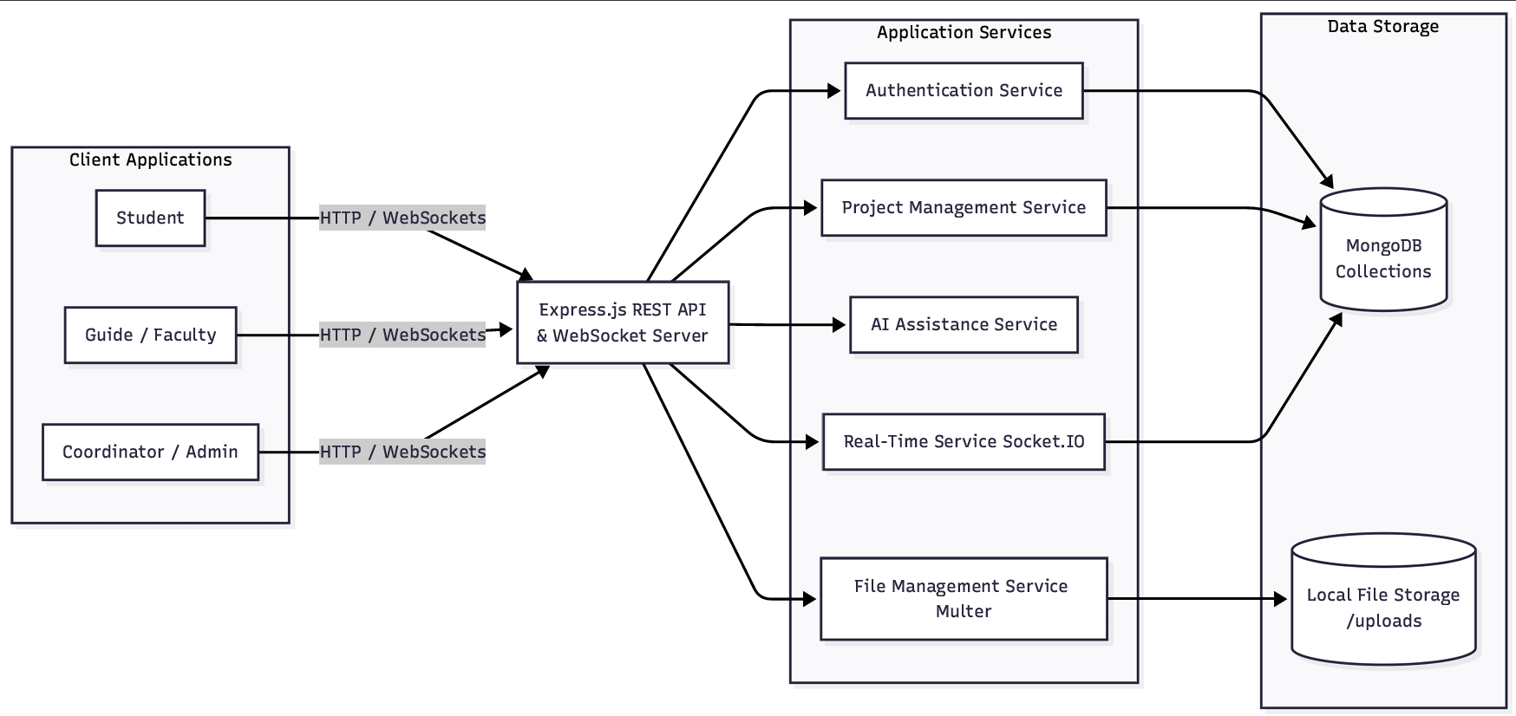
FUTURE SCOPE & IMPACT
Mobile App – Native Android/iOS applications with push notifications for urgent local blood requests.
GPS Attendance – Geofenced check-ins to verify volunteer presence in field camps.
Gamification – Awarding digital badges and milestones for students completing extra community hours.
Inter-College Leaderboard – Visual ranking to encourage friendly service competitions.

Slide 12
CONCLUSION
Centralizes volunteer management, saving coordinators hours of administrative work.
Enhances volunteer engagement using modern visual cues and responsive design features.
Promotes the core values of the National Service Scheme ('Not Me But You').
Ready for scaling to include more college units across the region.

Slide 13
THANK YOU
NBN Sinhgad School of Engineering
Academic Year: 2025-2026 (Sem VIII)
Project Group: Group 20
Under Guidance of: Prof. Manisha P. Navale

