Slide 1

A Project on "NSS Connect Platform: Digitalizing Community Service & Volunteer Management"
Under Guidance of Prof.
Manisha P. Navale
NBN Sinhgad School of Engineering
2025-2026 Sem VIII

Slide 2
Group Members
Abhijeet Indrjeet Bhosle
Aniket Vijay Chandan
Pratham Prashant Dhakate
Rajendra Narendra Patil
NBN Sinhgad School of Engineering
2025-2026 Sem VIII
Group 20

Slide 3
INDEX
1. INTRODUCTION & SCOPE – Overview of the NSS portal objectives and core concept.
2. PROBLEM STATEMENT – Inefficiencies in paper-based operations and verification delays.
3. THE SOLUTION: NSS CONNECT – Centralized, secure, and role-based web workspaces.
4. STUDENT & VOLUNTEER PORTAL – Tracking progress, event signups, and live announcements.
5. COORDINATOR (PROFESSOR) DASHBOARD – Approval engines, schedulers, and report utilities.
6. SYSTEM ARCHITECTURE – Separation of concerns, API routes, and database client layers.
7. FRONT-END DESIGN HIGHLIGHTS – Premium sliding headers, rotating orbits, and SVG assets.
8. TECHNOLOGY STACK – Frontend modules, backend configuration, and database security.
9. METHODOLOGY – Steps followed in development from gathering to deployment.
10. IMPACT & FUTURE SCOPE – Location geofencing, native mobile apps, and gamified statistics.
11. CONCLUSION & LESSONS LEARNED – Platform summary, motto integration, and future scaling.

Slide 4
INTRODUCTION
Unified Digital Ecosystem – A secure web portal designed to seamlessly connect volunteers, professor-coordinators, and system administrators, digitizing all operational aspects of the National Service Scheme.
Core Project Objective – Automate the tedious manual log entries of volunteering hours, streamline camp scheduling/blood donation drives, and fast-track evaluation approvals.
Modern Visual Language – Designed with a focus on high-fidelity user experiences, incorporating fluid sliding navigations and interactive background orbits to maximize volunteer engagement.
Robust Technical Foundation – Built with a React.js single-page application framework (SPA), styled with Tailwind CSS, and fully backed by a real-time Supabase cloud database instance.

Slide 5
PROBLEM STATEMENT
Manual Logging Inefficiencies – Traditional paper logs for tracking student volunteer hours are labor-intensive, slow, and highly prone to calculation errors and log disputes.
Communication Delays – Absence of an instant broadcast channel prevents coordinators from pushing urgent announcements (e.g., emergency blood requests or schedule changes) to students.
Verification Bottlenecks – Coordinators face administrative stress verifying attendance logs across multiple campuses, causing massive delays in issuing student certificates.
Lack of Real-Time Analytics – Higher administration lacks centralized dashboards to evaluate active campaigns, count aggregate volunteer contributions, or track engagement trends.

Slide 6
THE SOLUTION: NSS CONNECT
Centralized Service Hub – Replaces fragmented physical workflows with a modern, secure, and collaborative cloud-hosted portal.
Role-Based Workspaces:
• Student Workspace – Self-onboarding, real-time hour progress indicators, single-click activity signups, and immediate certificate generation.
• Professor/Coordinator Dashboard – Manage student rosters, approve/reject hour logs with comments, generate reports, and schedules events.
• System Admin Console – Approve professor applications, configure university divisions, audit activity metrics, and manage databases.

Slide 7
STUDENT & VOLUNTEER PORTAL
User-Centric Landing Hub – Displays a visual timeline of enrolled activities, active tasks, and upcoming camp details upon logging in.
Hour Tracker Progress Rings – Features dynamic visual progress components showing total verified hours and remaining targets toward the 120-hour certificate goal.
Campaign Registration – Students can browse open cleanup camps, health drives, or collection drives, and enroll instantly with automatic slot validation.
Live Announcement Banners – Integrates real-time Socket/Database listeners that display flash banners for critical notices, such as urgent local blood bank requests.

Slide 8
COORDINATOR (PROFESSOR) DASHBOARD
Batch Verification Engine – Allows coordinators to view, audit, and approve/reject volunteer hour claims submitted by students with descriptive feedback.
Campaign Scheduler – Create events by specifying dates, target domains (health, environment), student capacity limits, locations, and directions.
On-Field Attendance Register – Allows coordinators to mark student attendance live on-site (supports mobile check-ins), syncing data directly with backend logs.
Exportable Analytics Reports – Generates university-grade reports detailing volunteer achievements, total hours completed, and camp statistics in CSV/PDF formats.

Slide 9
SYSTEM ARCHITECTURE
Separation of Concerns – Standard multi-tier model separating presentation logic, application server logic, and persistent storage layers.
Frontend Client Tier – React.js single-page app running on Vite, integrating state providers and secure HTTP router guards.
Backend Database Tier (Supabase) – Leverages Supabase Backend-as-a-Service for authentication, persistent storage (PostgreSQL), and real-time database subscription features.
Security Framework – Implements strict Row-Level Security (RLS) policies at the database layer to ensure students, coordinators, and admins can only modify authorized data rows.

Slide 10
FRONT-END & DESIGN HIGHLIGHTS
Double-Rotation Background – Concentric orbit lines with rotating service badges. Clockwise container spins, while counter-clockwise badge spins keep labels upright.
Sliding Underline Navbar – Navigation link indicator highlights active pages with a smooth sliding micro-animation.
Mixed-Media Gallery – Horizontal marquee grid showing photos/videos with lightbox controls.
SVG Logo – Clean, vector-based, high-fidelity Konark chariot wheel.

Slide 11
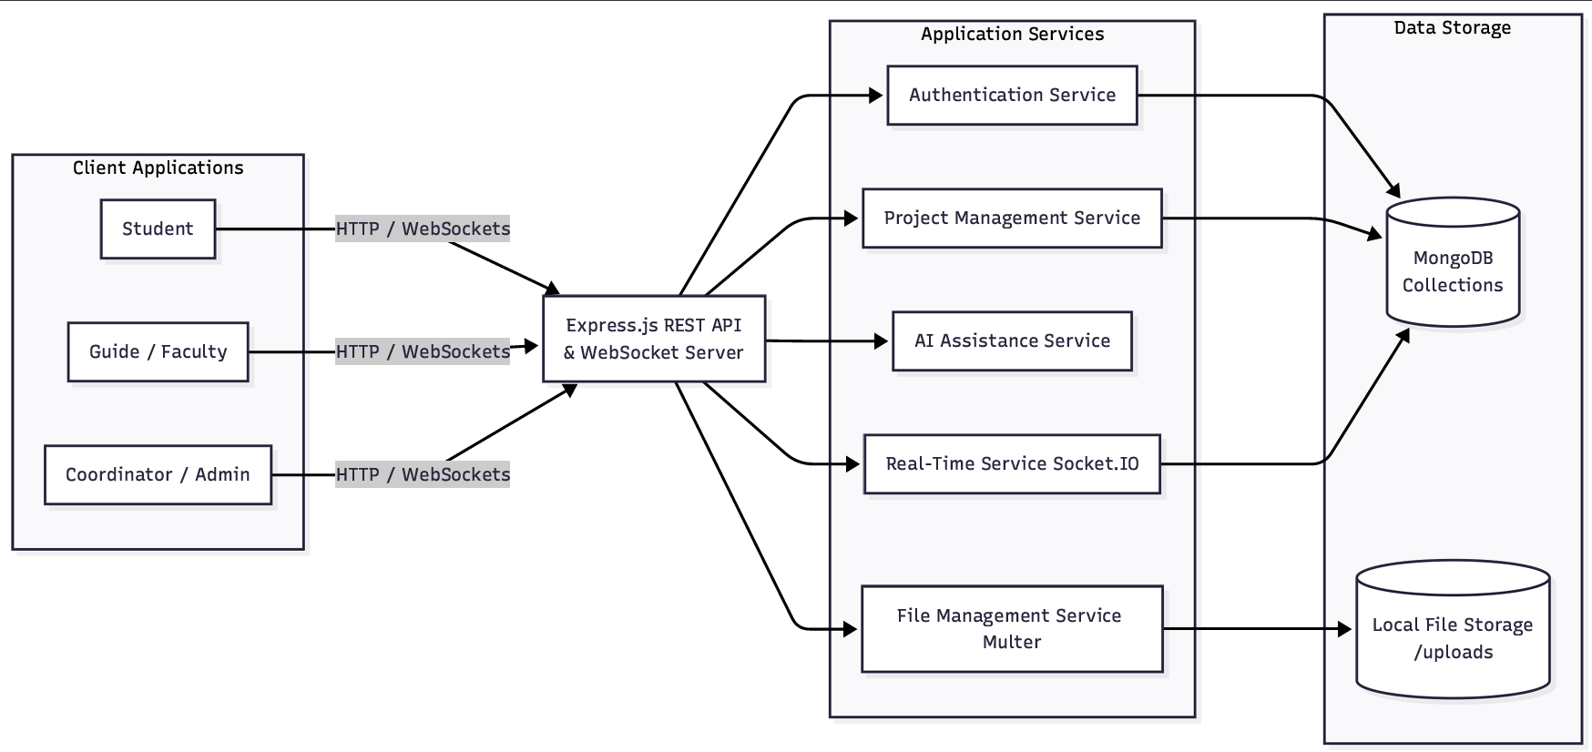
FUTURE SCOPE & IMPACT
Native Mobile Application – Geolocation-enabled apps for Android and iOS, allowing coordinators to push nearby volunteer alerts during emergencies.
Geofenced GPS Check-ins – Automatic coordinate verification to ensure students are physically present at the volunteer camp site to log hours.
Gamified Achievements – Awarding digital badges and milestones for students completing extra community hours.
Inter-College Leaderboard – Visual ranking to encourage friendly service competitions.

Slide 12
METHODOLOGY
Requirement Gathering – Identify stakeholders, functional needs (hours tracking), and non-functional specifications.
System Design – Design user flows, database schemas, and custom dashboard layouts.
Technology Selection – Choose React.js, Tailwind CSS, PostgreSQL, and Supabase services.
Implementation – Develop volunteer trackers, coordinator approval panels, and media galleries.
Database & Sync Integration – Implement Supabase Auth, Row-Level Security, and WebSocket notification systems.
Testing & Validation – Conduct routing checks, security audits, and responsive layout testing.
Deployment & Maintenance – Deploy web client on static hosts and monitor database performance.

Slide 13
CONCLUSION
Operational Efficiency – Significantly reduces the administrative workload on professor-coordinators by automating approvals and reports.
Enhanced Motivation – Increases student engagement through real-time feedback, visual trackers, and modern interface interactions.
Motto Alignment – Facilitates the core objective of the National Service Scheme ('Not Me But You') using digital collaboration.
Scalable Foundation – Designed with modular React components and scalable backend logic to support future feature expansions.

Slide 14
THANK YOU
NBN Sinhgad School of Engineering
Academic Year: 2025-2026 (Sem VIII)
Project Group: Group 20
Under Guidance of: Prof. Manisha P. Navale

