Slide 1
Jain College of Engineering and Technology, Hubballi
Dept. of Electronics & Communication Engineering · Academic Year 2025–26
AUTOMATED SLIDING WINDOW
ESP32
SMART VENTILATION
for Ambient Air Quality
SYSTEM
Design, Development and Validation of an
ESP32-Based Smart Ventilation System
ENGINEERING TEAM
Samarth G. Ichageri — Electronics & Systems Lead
Sayed Rimaz Ahmed — Software & Hardware Engineer
Guide: Dr. Mahendra M. K.

Slide 2
PROJECT AT A GLANCE
ESP32-Based Smart Ventilation System
CONTROLLER
SENSOR
MOTOR DRIVER
ACTUATOR
ESP32
MQ Gas
L298N
12V DC
240 MHz Dual-Core
Analog 0–5V Output
Dual H-Bridge, 2A/ch
Geared Motor, 30 RPM
MECHANISM
GAS THRESHOLD
1900 ADC
RACK LENGTH
11 inches
LED INDICATORS
Rack & Pinion
GPIO 18 — Window Open
TRAVEL TIME
6500 ms
MOTOR SPEED
30 RPM
11" rack · 3 cm pinion
GPIO 19 — Window Closed
STABILITY DELAY
10 sec
PINION DIA.
3 cm
Total BOM Cost: ₹1,200 – ₹1,500

Slide 3
PROBLEM STATEMENT
Why Manual Windows Fail
💨
Polluted Air Ingress
😴
No Overnight Response
Open window during outdoor pollution events degrades indoor AQI within minutes
Manual operation impossible during sleep — prolonged unmanaged exposure
🔒
Poor Ventilation
⚕️
Health Risks
Closed window during clean conditions leads to CO₂ accumulation indoors
WHO identifies household air pollution as a leading global health risk
Existing commercial solutions cost ₹30,000–₹5,00,000 and are not designed for single-window residential or classroom use.

Slide 4

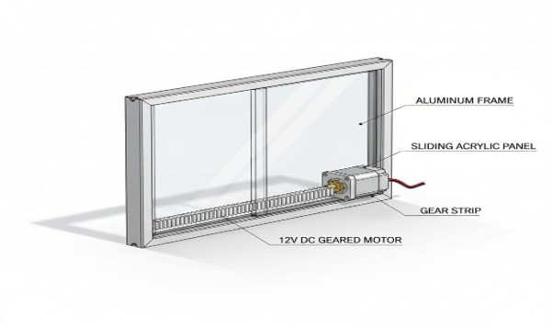
PROPOSED SOLUTION
Sense → Decide → Act
A fully autonomous ventilation system that continuously monitors ambient air quality and physically actuates a sliding window — no human intervention required.
Real-Time Sensing:
MQ Gas Sensor feeds live ADC readings to ESP32
Smart Threshold Logic:
1900 ADC threshold with 10s stability gate — no false trips
Mechanical Actuation:
Rack & pinion converts motor torque to window displacement
Visual Feedback:
Blue/Red LED indicators confirm system state instantly
Low Cost:
Full BOM under ₹1,500 — residential & classroom scale
System Design Render — Exploded View

Slide 5
SYSTEM ARCHITECTURE
Signal Flow — Sensor to Window
MQ GAS
SENSOR
ESP32
ADC
THRESHOLD
LOGIC
L298N
DRIVER
12V DC
MOTOR
RACK &
PINION
0–5V Analog
GPIO 34 / 12-bit
1900 ADC / 10s Gate
H-Bridge, 12V
30 RPM Geared
11" Linear Drive
✅ CLEAN AIR (ADC < 1900, sustained 10s) → Window OPENS
🚨 POLLUTED AIR (ADC ≥ 1900, sustained 10s) → Window CLOSES
Sensing
Processing
Control & Actuation
Mechanical
5V Logic Supply (ESP32, Sensor, LEDs) ↔ 12V Motor Supply (L298N + Motor) | Common GND

Slide 6
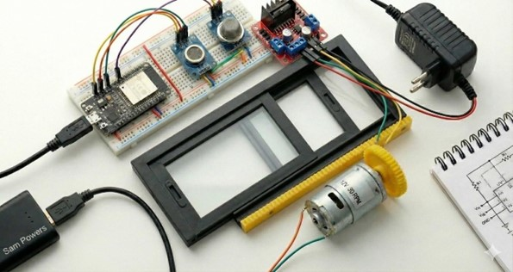
HARDWARE COMPONENTS
Bill of Materials
ESP32 Dev Board
240 MHz · 12-bit ADC · Wi-Fi/BT
MQ Gas Sensor
Analog 0–5V · DO/AO outputs
L298N Motor Driver
Dual H-bridge · 2A/ch · 12V
12V DC Geared Motor
30 RPM · High torque
Blue LED (GPIO 18)
Window-open indicator · 220Ω
Red LED (GPIO 19)
Window-closed indicator · 220Ω
Hardware Prototype Setup
5V USB Power Supply
GPIO ASSIGNMENTS
Logic rail — ESP32, sensor, LEDs
GPIO 34
MQ Sensor AO
Analog In
12V DC Adapter (≥1A)
GPIO 26/27
L298N IN1/IN2
Dir Control
Motor rail — isolated from logic
GPIO 25
L298N ENA
PWM Speed
GPIO 18/19
Blue / Red LED
Status Out

Slide 7
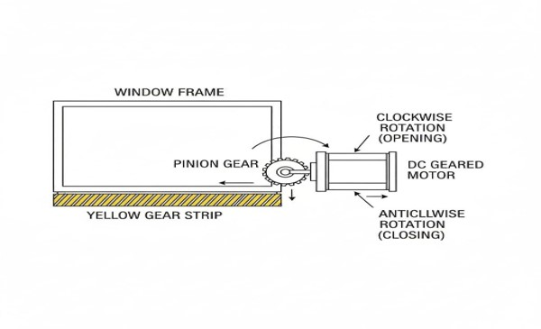
MECHANICAL DESIGN
Rack & Pinion Linear Actuation
Rack Length
11 inches
279.4 mm full stroke
Pinion Diameter
3 cm
30 mm / 94.25 mm circumference
Motor Speed
30 RPM
0.5 rev/s output shaft
Travel Time
6500 ms
+10% margin over 5.93s theory

Slide 8
ENGINEERING CALCULATIONS
Transmission & Threshold Derivation
MECHANICAL TRANSMISSION
THRESHOLD CALIBRATION
Pinion Circumference
Clean Air Baseline
π × d = π × 30 mm
= 94.25 mm/rev
1100–1400
Linear Speed @ 30 RPM
Mild Pollution
94.25 mm × 0.5 rev/s
= 47.12 mm/s
1700–1900
Theoretical Travel Time
Dense Smoke (10cm)
279.4 mm ÷ 47.12 mm/s
= 5.93 s
2100–2800
Firmware Travel Time
Threshold Set Point
5.93 s × 1.10 margin
= 6.5 s → 6500 ms
1900 ADC
Threshold = clean-air mean + 500 ADC · Protocol: 5-min baseline read then set point
Rack Length = 27.94 cm · Pinion Circumference = 9.425 cm · Rotations Required = 2.965 rev

Slide 9
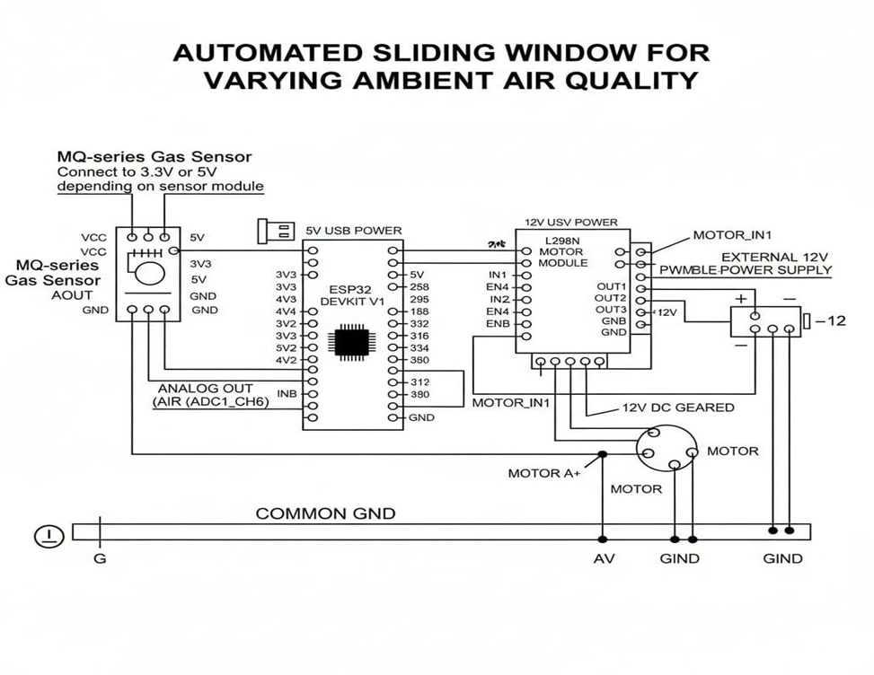
CIRCUIT & WIRING ARCHITECTURE
Split-Supply Design
5V Logic Rail
· ESP32 VIN
· MQ Sensor VCC
· Blue LED (220Ω)
· Red LED (220Ω)
· L298N Logic (5V pin)
12V Motor Rail
· L298N VS (motor power)
· 12V DC Geared Motor
· Isolated from logic rail
⚠ Separate 5V/12V supplies with shared GND eliminated ESP32 reset on motor inrush
Common GND
· 5V GND → Breadboard rail
· 12V GND → Breadboard rail
· GND rails tied together
· Critical: shared ref only

Slide 10
CONTROL LOGIC
Firmware State Machine (FSM)
POWER ON — Setup()
60s Sensor Warm-Up
ADC Read ( gasValue )
NO
gasValue ≥ 1900?
YES
Wait 10s → Re-read
Open Window (6500ms)
Wait 10s → Re-read
Close Window (6500ms)
Blue LED ON (GPIO 18)
Red LED ON (GPIO 19)
Wait 1s → Loop

Slide 11
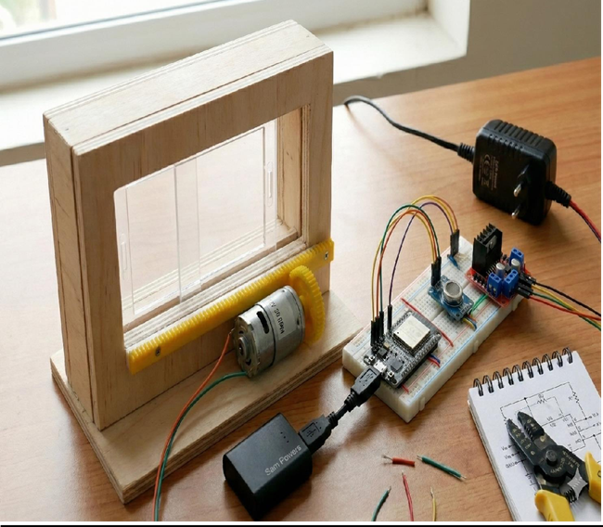
IMPLEMENTATION
5-Phase Development Journey
01
Problem Analysis & Component Selection
ESP32 chosen for 12-bit ADC (4096 levels vs Arduino's 1024)
02
Circuit Assembly & Power Fix
Split 5V/12V supply resolved ESP32 reset on motor inrush
03
Firmware Development & Calibration
Threshold raised 1800→1900; stability delay extended 3s→10s
04
Mechanical Assembly & Alignment
Rigid Al side-bracing eliminated rack skip under load
Hardware Prototype · Final Integrated Assembly
05
System Integration & Validation
Full test under incense smoke — all scenarios passed

Slide 12
RESULTS & VALIDATION
Laboratory Testing — All Scenarios Passed
Test Scenario
Reading
Expected
Observed
Clean Ambient Air
< 1900 ADC
Window Opens
✅ Pass
Incense Smoke Introduced
> 1900 ADC
Window Closes
✅ Pass
MECHANICAL PERFORMANCE
Brief Spike (< 10s)
> 1900, then drops
No Actuation
✅ Stable
Full Stroke Time:
6.2 – 6.4 s
Rack Skip Events:
0 (after bracing)
Sustained Pollution (> 10s)
> 1900 sustained
Window Closes
✅ Pass
False Actuations:
0 observed
Clean Air Baseline:
1100–1400 ADC
Fluctuation Near Threshold
~1850–1950 ADC
No Actuation
✅ Stable
Extended Ambient Monitor
< 1900 throughout
No Change
✅ No False Act.
ESP32
MQ Gas Sensor
L298N
12V Motor
1900 ADC
6500 ms
10s Delay
₹1,500 BOM

Slide 13
CHALLENGES & SOLUTIONS
Engineering Problems Encountered & Resolved
01
Single-Supply Voltage Collapse
02
MQ Sensor Warm-Up Drift
⚠ Motor inrush current caused ESP32 to reset on every motor start
⚠ Elevated startup ADC readings triggered immediate window close on boot
✅ Separated 5V logic rail from 12V motor rail — shared GND only
✅ Added 60s blocking warm-up delay in setup() before control loop
03
Rack Skip Under Load
04
Threshold Under Unit Variation
⚠ Flexible motor bracket allowed pinion disengagement from rack under resistance
⚠ MQ sensor unit-to-unit variation made datasheet 1800 ADC estimate unreliable
✅ Rigid aluminum side-bracing on motor body — zero skip events after fix
✅ Calibration protocol: 5-min baseline read → threshold = mean + 500 ADC

Slide 14
APPLICATIONS
Deployment Environments
🏠
🏥
🏫
Residential
Hospitals
Classrooms
Bedroom & Kitchen
Patient Ward Ventilation
School Ventilation
Passive overnight air quality management
Reduced pollutant exposure for vulnerable occupants
Maintains acceptable CO₂ & AQI for learning
🔬
🏢
🏭
Laboratories
Office Buildings
Industrial
Fume-Aware Ventilation
Multi-Zone Ventilation
Worker Safety Zones
Auto-closure during chemical or fume events
Integration with building management systems
Supplemental actuation during process events
Scalable: One ESP32 per window. Multi-window: central sensor → multiple ESP32 units via I2C or Wi-Fi

Slide 15
FUTURE SCOPE
Version 2.0 Roadmap
HIGH PRIORITY
MEDIUM
FUTURE
IoT Dashboard
Remote Override
Multi-Gas Sensing
Area AQI Integration
Solar Power Supply
OTA Firmware Updates
Adaptive Threshold
ESP32 Wi-Fi + MQTT → Node-RED / Home Assistant
Mobile app control via Blynk or custom interface
BME688 — PM2.5, CO₂, VOC, Temp, Humidity
Supplement with AQICN / OpenAQ API live data
PV panel with Li-ion buffer for off-grid use
ArduinoOTA — threshold adjustment without reflash
Rolling baseline model — auto-adjusts to site conditions
Architecture Principle: Actuation loop stays local & deterministic regardless of cloud connectivity

Slide 16
CONCLUSION
Design Objectives Achieved
✅
Functional Prototype Delivered
Full sensing-to-actuation loop operational on ESP32 with L298N and 12V rack-and-pinion
✅
Reliable Threshold Logic
1900 ADC threshold with 10s stability gate — zero false actuations in all test scenarios
✅
Precision Mechanical Drive
6500 ms firmware drive completes 11-inch rack stroke reliably across repeated cycles
✅
Low-Cost & Accessible
Full BOM under ₹1,500 — suitable for residential, classroom, and institutional deployment
✅
Extensible Architecture
Modular design supports IoT, multi-gas sensing, and remote control in Version 2.0

Slide 17

THANK YOU
Automated Sliding Window for Ambient Air Quality
Samarth G. Ichageri · Satvik Pandurangi
Guide: Dr. Mahendra M. K. · Dept. Electronics & Communication Engineering
Jain College of Engineering and Technology, Hubballi · 2025–26

