Slide 1

Supply Chain
Black Box
AI-powered hidden supplier dependency discovery, cascading risk prediction and intelligent supply chain recovery
Advanced Machine Learning for Business Transformation
PGDM Big Data Analytics · Goa Institute of Management
Shraddha Shete (B2026102) · Shirsodeep Biswas (B2026100) · Jayant Kumawat (B2026078)
FMCG: chocolate & malt-based beverages

Slide 2
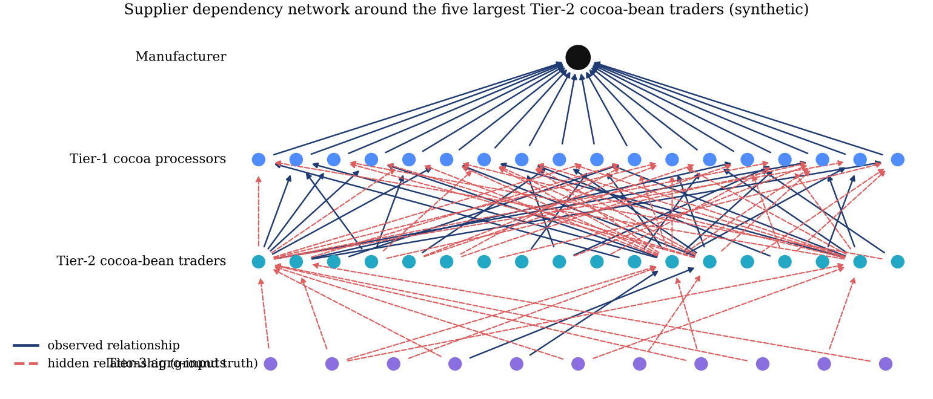
The business problem
synthetic + real data, labelled
A manufacturer sees its Tier-1 suppliers — not the Tier-2/3 suppliers they quietly share
• A malt-beverage jar needs malt extract, milk powder, cocoa, sugar, vitamin premix and PET jars; each Tier-1 input depends on Tier-2 commodity traders.
• One hidden cocoa-bean trader can starve several 'independent' cocoa processors at once — a ripple effect through invisible links.
• Disruptions destroy value: announced supply chain disruptions are followed by lower long-run returns and higher equity risk (Hendricks & Singhal, 2005).
• Decision supported: each month, which mitigation action per supplier? If a shock hits, which alternates get which quantity, by which mode?

Slide 3
Research gap, objectives and contributions
synthetic + real data, labelled
• Gap: discovery (link prediction), risk prediction and recovery optimisation are studied separately; few works report calibrated, leakage-controlled, policy-level business outcomes.
• Objectives: discover candidate hidden links · predict calibrated 30-day disruption risk · simulate cascades · quantify inventory/production/₹ exposure · optimise recovery · explain.
• Contribution 1: an executable, traceable pipeline from prediction → exposure → cost-optimal action → MILP plan.
• Contribution 2: leakage-audited evaluation (prediction timestamp, embargoed chronological splits, calibration-only split, test edges removed).
• Contribution 3: quantification of the 'black-box gap' between observed and true network exposure.
• Contribution 4: predefined nine-scenario policy evaluation with 500 common-random-number replications and explicit economics.
• Not claimed: novelty of GNNs, calibration or MILP individually.

Slide 4
Literature review
synthetic + real data, labelled
Work | Contribution | Relevance / gap
Baryannis et al. 2019 | AI for SCRM review | few studies close the loop to response
Brintrup et al. 2018 | hidden-link prediction (automotive) | discovery only
Kosasih & Brintrup 2022 | GNN link prediction | no risk/recovery integration
Wasi et al. 2024 (SupplyGraph) | real FMCG GNN benchmark | product graph, no suppliers
Platt 1999; Zadrozny & Elkan 2002; Niculescu-Mizil & Caruana 2005 | probability calibration | used for decision thresholds
Kipf 2017; Hamilton 2017; Veličković 2018; Grover 2016 | GCN, GraphSAGE, GAT, node2vec | comparators
Snyder et al. 2016; Ivanov et al. 2019 | disruption OR models, ripple effect | recovery & propagation

Slide 5
Data and provenance
synthetic + real data, labelled
Real and synthetic data are kept separate and labelled everywhere
Dataset | Provenance | Size | Use
DataCo Smart Supply Chain | REAL (CC BY 4.0, Mendeley DOI; GitHub mirror, SHA-256) | 180,519 order lines → 172,765 after removing cancelled | Exp 3 shipment delay
SupplyGraph | REAL FMCG (LGPL-2.1, pinned commit) | 40 products, 684 edges, 221 days (1 duplicate node removed) | Exp 2B real graph
Cocoa & Malt Foods (fictional) | SYNTHETIC (seed 42) | 500 suppliers · 1,500 links (461 observed) · 1,048 disruptions · 9,579 shipments | Exps 1, 2, 4, 5, app
• Hidden edges are ground truth for the simulator and evaluation only — never model features.
• 196 validation checks pass (keys, foreign keys, dates, ranges, logical quantity rules); outliers flagged, not deleted.
• AnonNet, SynDelay, UN Comtrade, NOAA investigated: not verifiable / not reachable — not used.

Slide 6
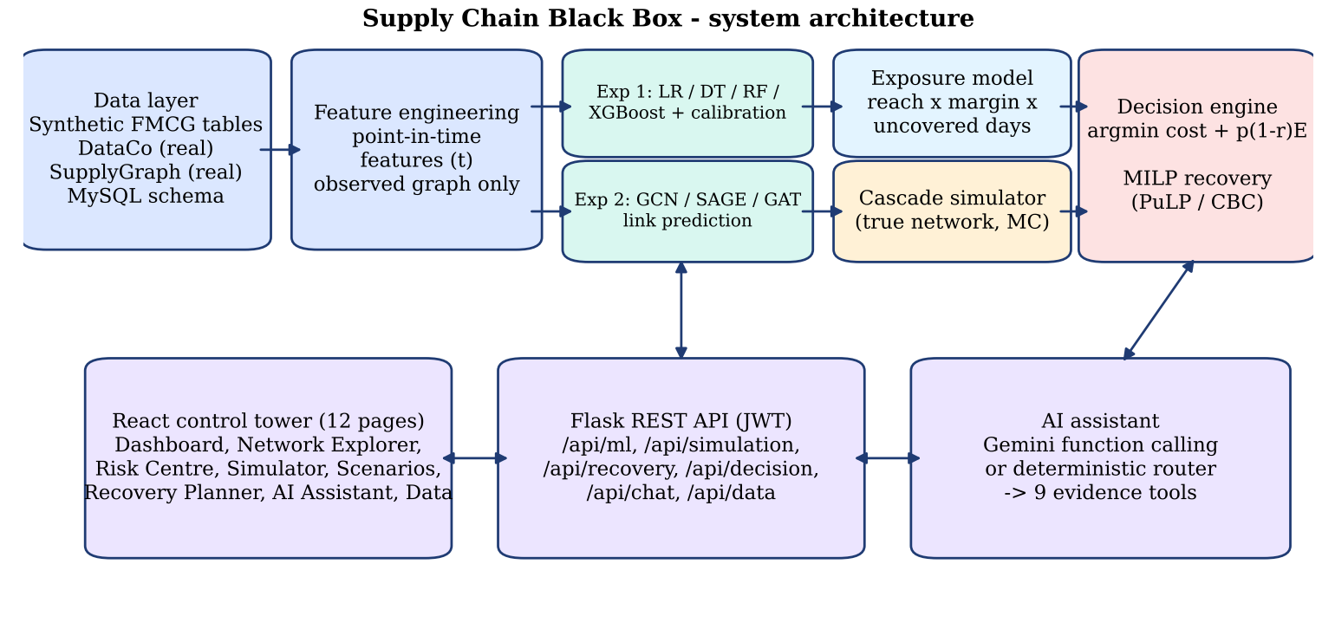
System architecture
synthetic + real data, labelled

Slide 7
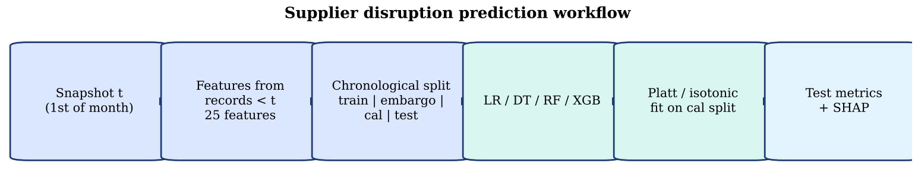
Methodology: prediction timestamp and leakage control
synthetic + real data, labelled
• Prediction timestamp t = 00:00 on the 1st of each month; label = qualifying disruption (≥25 % capacity loss, ≥3 days) starting in (t, t+30 d].
• Features use disruptions with reported_date < t, deliveries completed before t, the monthly risk forecast, and OBSERVED edges only (25 features).
• Chronological split: train 2024-04…2025-02 (5,500) · embargo 2025-03 · calibration 2025-04…06 (1,500) · test 2025-07…12 (3,000).
• Calibrators (Platt, isotonic) fitted on the calibration split only; method chosen by 5-fold CV Brier inside that split.
• Unit tests tamper with future records and hidden edges and assert features do not change.

Slide 8
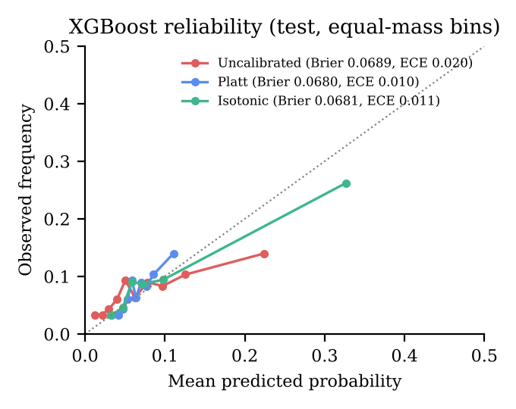
Experiment 1 — supplier disruption prediction
synthetic + real data, labelled
Test: 3,000 supplier-months, prevalence 7.4 %
Model | Calibration | ROC-AUC | PR-AUC | Brier | ECE
Logistic Regression | none | 0.666 | 0.150 | 0.0669 | 0.0066
Logistic Regression | platt | 0.666 | 0.150 | 0.0670 | 0.0059
Decision Tree | none | 0.571 | 0.098 | 0.0704 | 0.0366
Decision Tree | platt | 0.571 | 0.098 | 0.0689 | 0.0111
Random Forest | none | 0.657 | 0.140 | 0.0672 | 0.0046
Random Forest | platt | 0.657 | 0.140 | 0.0675 | 0.0081
XGBoost | none | 0.626 | 0.122 | 0.0689 | 0.0197
XGBoost | platt | 0.626 | 0.122 | 0.0680 | 0.0104
Modest discrimination for rare, contagion-driven events; LR significantly beats XGBoost (ROC +0.040, p=0.008); Platt ECE gain not significant.

Slide 9
From probability to action: cost-based decision rule
synthetic + real data, labelled
• a* = argmin_a C_a + q·(1 − ρ_a)·E_i (Bayes-optimal when q is calibrated)
• Actions: routine monitoring (₹0, 0 %) · enhanced monitoring (₹5k, 15 %) · contingency review (₹20k, 45 %) · escalate & recover (₹60k, 70 %)
• E_i = network exposure: Σ_m reach × contribution margin × E[severity × uncovered days]
• Test months: 5 contingency alerts; realised cost ₹118.3 L vs ₹116.9 L monitor-only, ₹120.4 L uncalibrated, ₹664.3 L review-all.
• Honest finding: 3–4 weeks of inventory absorb most single-supplier events → value concentrates in network-level shocks.

Slide 10
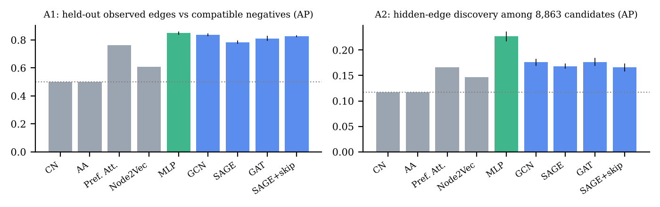
Experiment 2A — the black-box gap and hidden-link discovery
synthetic + real data, labelled
Observed graph understates mean exposure of Tier-2 suppliers 2.1× and Tier-3 suppliers 10.8×.
Discovery: 8,863 compatible unobserved pairs, 1,039 hidden edges (base rate 0.117).
Validation-selected model: MLP (AP 0.227); GraphSAGE AP 0.168; CN/Adamic-Adar uninformative on layered networks.
Outputs are candidate links for supplier verification — never confirmed relationships.

Slide 11
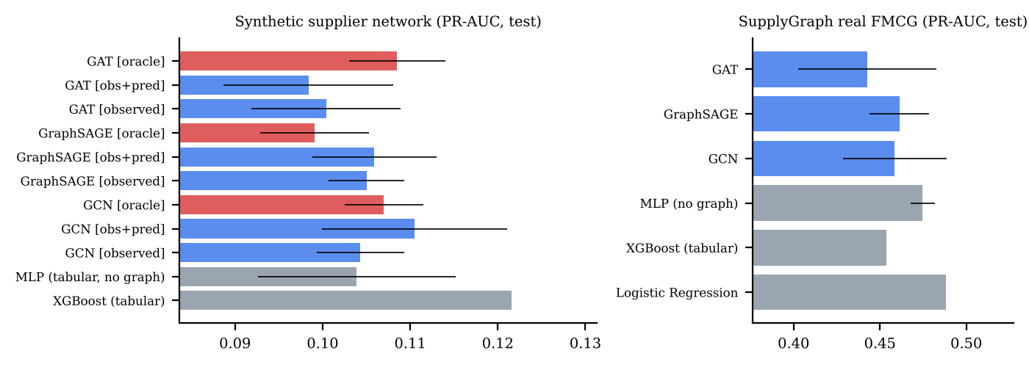
Experiment 2B — graph vs tabular risk models
synthetic + real data, labelled
PR-AUC on the test split, mean ± sd over 5 seeds (Platt-calibrated)
Negative result, reported transparently: GNNs did not beat tabular models on synthetic data (even with the oracle graph) or on real SupplyGraph, where logistic regression is best.

Slide 12
Experiment 3 — real shipment delays (DataCo)
Chronological test: 34,554 order lines, late rate 57.3 %
Model | ROC-AUC | PR-AUC | F1 | Brier
Logistic Regression | 0.749 | 0.839 | 0.682 | 0.1878
Random Forest | 0.777 | 0.855 | 0.710 | 0.1768
XGBoost | 0.780 | 0.858 | 0.713 | 0.1768
Baseline: shipping-mode late rate | 0.744 | 0.785 | 0.670 | 0.1881
• Order-time features only; outcome columns (real shipping days, delivery status) excluded.
• XGBoost beats the shipping-mode baseline on ranking; delay-days regression adds nothing beyond shipping mode.
Delay regression | MAE | RMSE | R²
Baseline: training mean | 1.202 | 1.491 | -0.000
Baseline: shipping-mode mean | 0.978 | 1.264 | 0.280
Linear Regression | 0.990 | 1.265 | 0.279
Random Forest | 0.978 | 1.274 | 0.269
XGBoost | 0.992 | 1.273 | 0.270

Slide 13
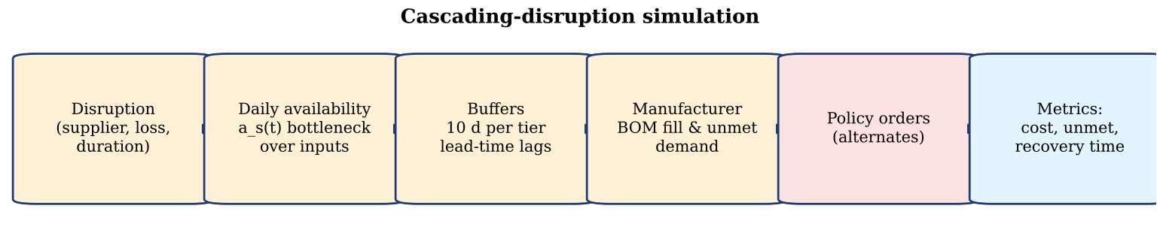
Experiment 4 — cascading-disruption simulator
synthetic + real data, labelled
Daily availability over the TRUE network; buffers, lead-time lags and BOM bottlenecks
Disruption (no intervention) | Affected suppliers | Unmet | Impact (₹) | Recovery (d)
Direct Tier-1 failure (highest exposure, 100%, 45d) | 1.0 | 167.6k | 95.4 L | 82
Tier-2 failure (highest exposure, 100%, 45d) | 6.4 | 0.8k | 28.0 L | 108
Tier-3 failure (highest exposure, 100%, 45d) | 9.8 | 0.0k | 24.1 L | 95
Transportation / port disruption (imports via sea, 60%, 30d) | 56.3 | 138.9k | 87.8 L | 146
Weather: Kerala monsoon flood (all suppliers in region, 70%, 21d) | 10.3 | 0.0k | 11.4 L | 44
Capacity reduction (top-exposure Tier-1, 50%, 60d) | 1.0 | 18.8k | 34.7 L | 99
Multiple simultaneous failures (3 highest-risk suppliers, 100%, 30d) | 4.0 | 0.0k | 22.4 L | 88

Slide 14
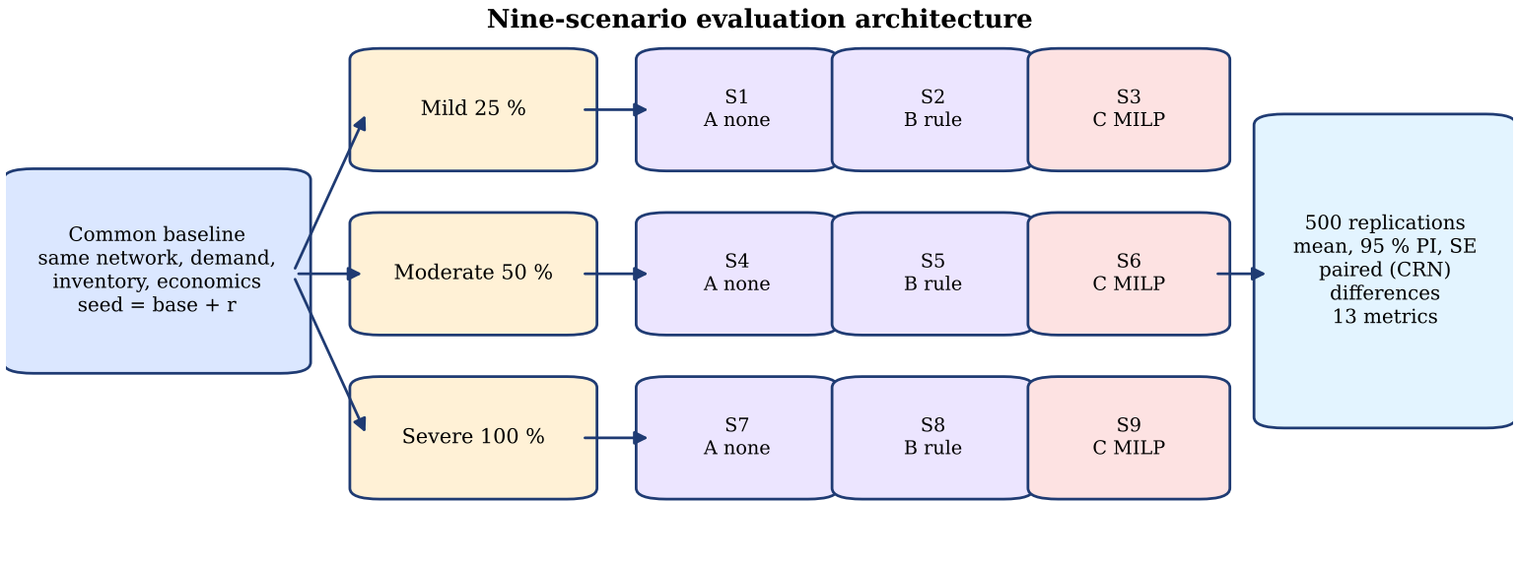
Nine-scenario evaluation design
synthetic + real data, labelled
• Shock: five largest Tier-2 cocoa-bean traders (19 observed + 25 hidden outgoing links) lose 25 / 50 / 100 % capacity for a nominal 60 days.
• A: no intervention · B: rule-based (observed graph, same material, reliability-ranked, standard freight, reactive) · C: MILP (observed + predicted graph, derated availability, substitutes, expedited option).
• 500 replications per scenario with common random numbers; 180-day horizon; illustrative INR economics documented.

Slide 15
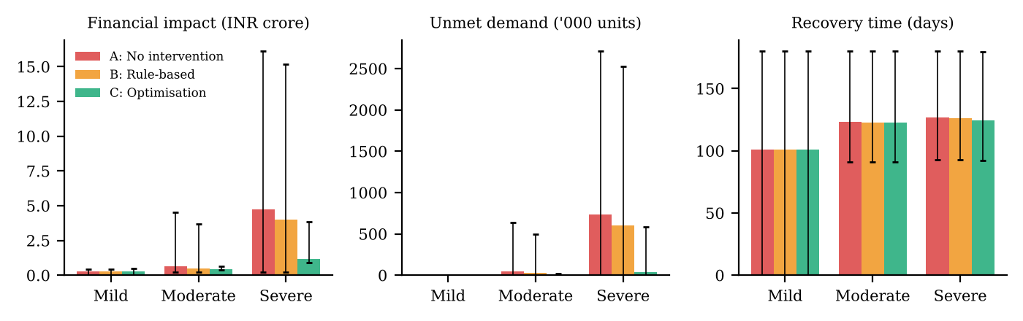
Nine-scenario results
synthetic + real data, labelled
Means and 95 % percentile intervals; simulated INR on synthetic data
Scen. | Severity | Policy | Unmet (k) | Impact (₹ Cr) | Recovery (d)
S1 | Mild | A: No intervention | 0.0 | 0.26 | 101
S2 | Mild | B: Rule-based | 0.0 | 0.26 | 101
S3 | Mild | C: Optimisation | 0.0 | 0.26 | 101
S4 | Moderate | A: No intervention | 47.6 | 0.61 | 123
S5 | Moderate | B: Rule-based | 29.8 | 0.51 | 123
S6 | Moderate | C: Optimisation | 2.6 | 0.45 | 123
S7 | Severe | A: No intervention | 734.1 | 4.72 | 127
S8 | Severe | B: Rule-based | 605.3 | 3.98 | 126
S9 | Severe | C: Optimisation | 39.2 | 1.16 | 125

Slide 16
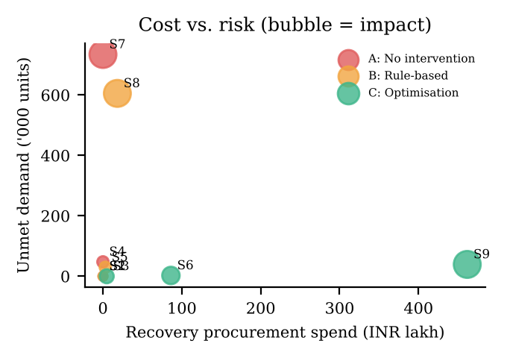
Business impact
synthetic + real data, labelled
• Severe shock: optimisation saves ₹3.56 Cr vs no intervention (95 % CI 3.25–3.87) and ₹2.82 Cr vs rule-based.
• Moderate shock: ₹16.7 L mean saving — tail protection; doing nothing is cheapest in most individual replications.
• Mild shock: buffers suffice; optimisation over-hedges (small extra cost) → use a tiered policy.
• Every number is reproducible from experiments/scenario_results.csv and checked by the verification script (61/61 checks).
• Financial values are simulated on synthetic data with illustrative assumptions — not observed company losses.

Slide 17
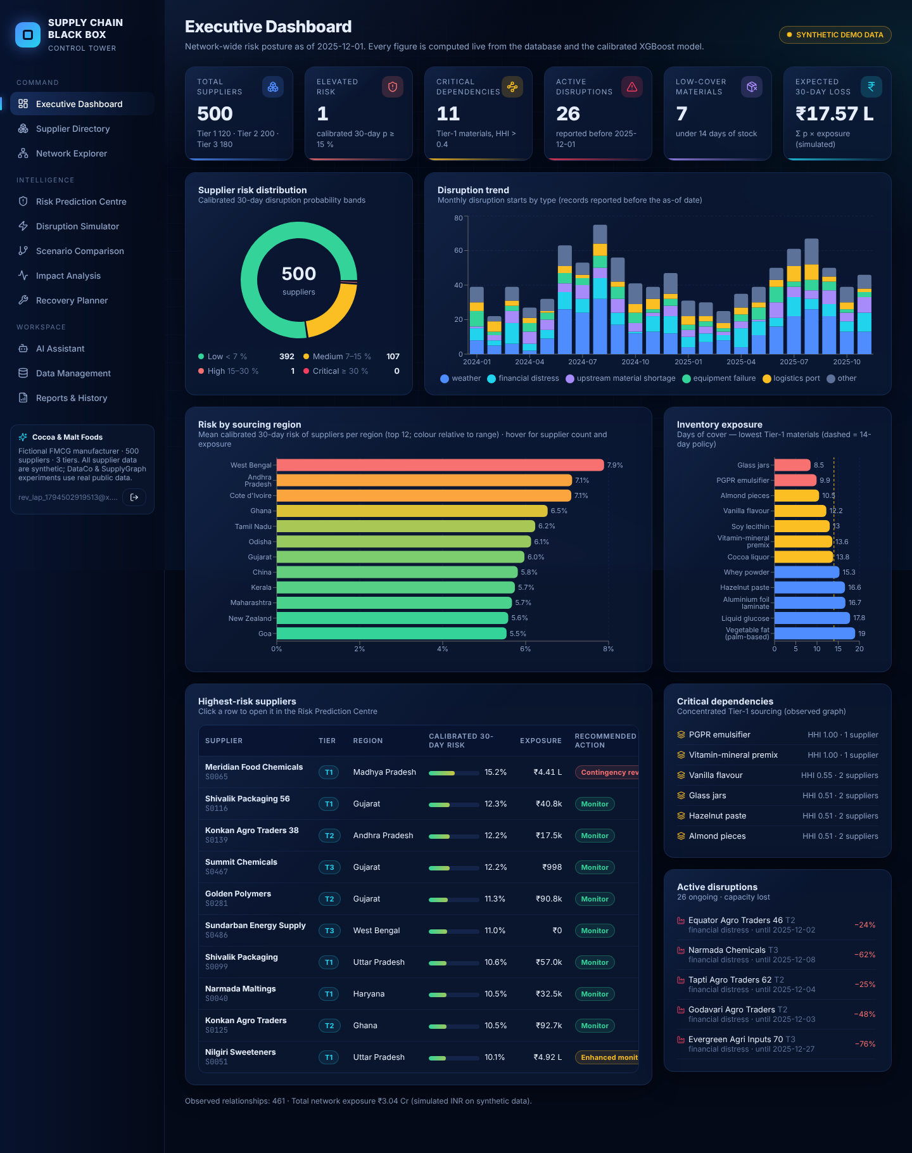
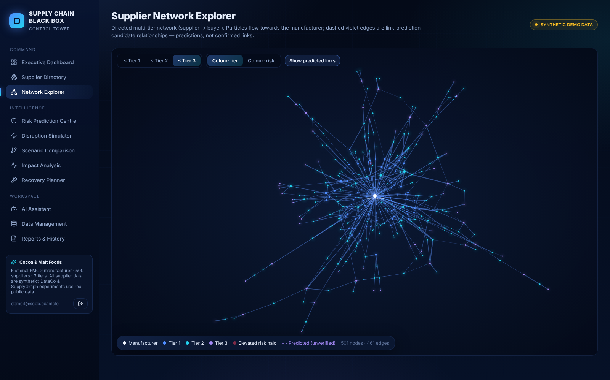
Application demo — control tower
synthetic + real data, labelled
React 18 + Vite · Flask (JWT) · MySQL/SQLite · every value computed live from the database, models and solvers

Slide 18
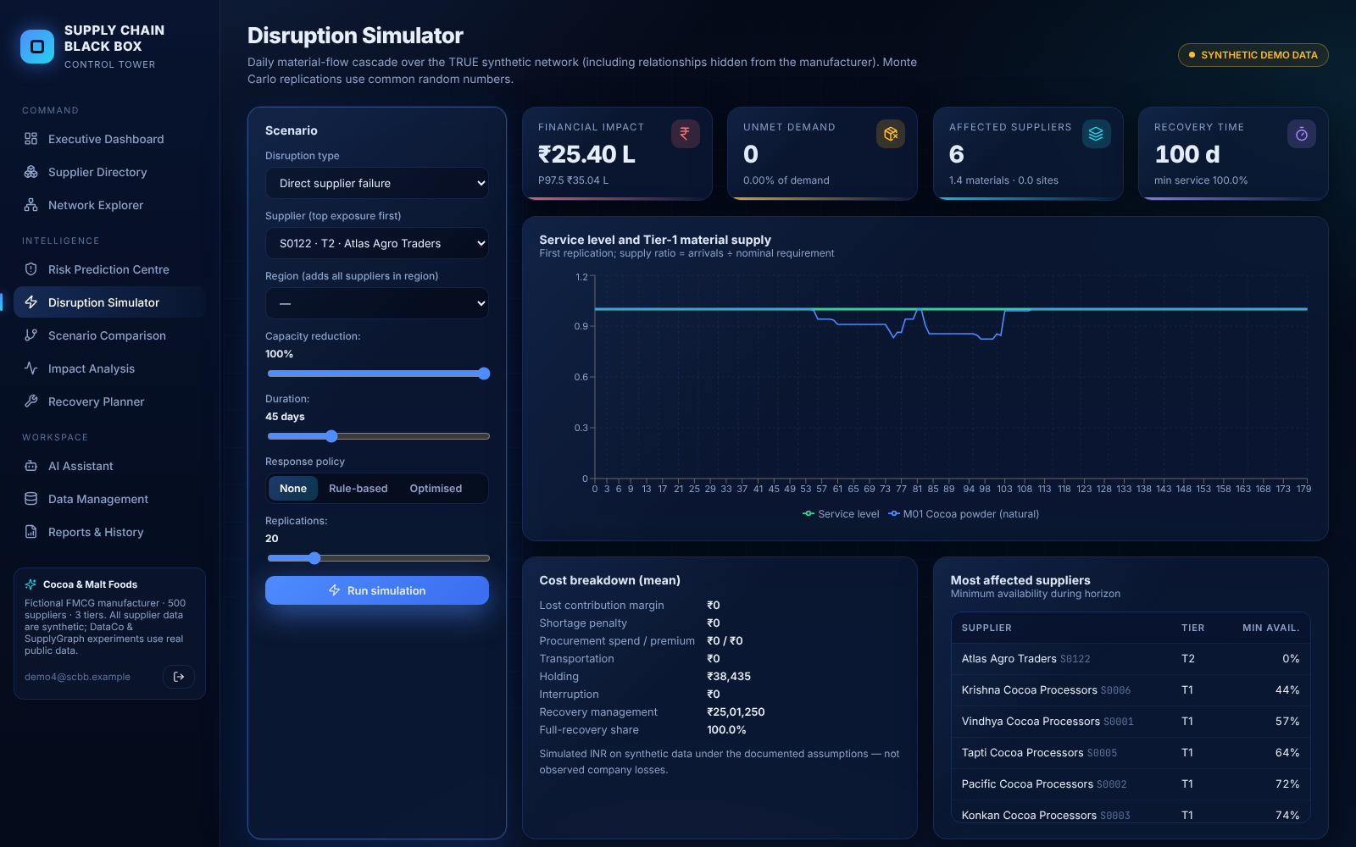
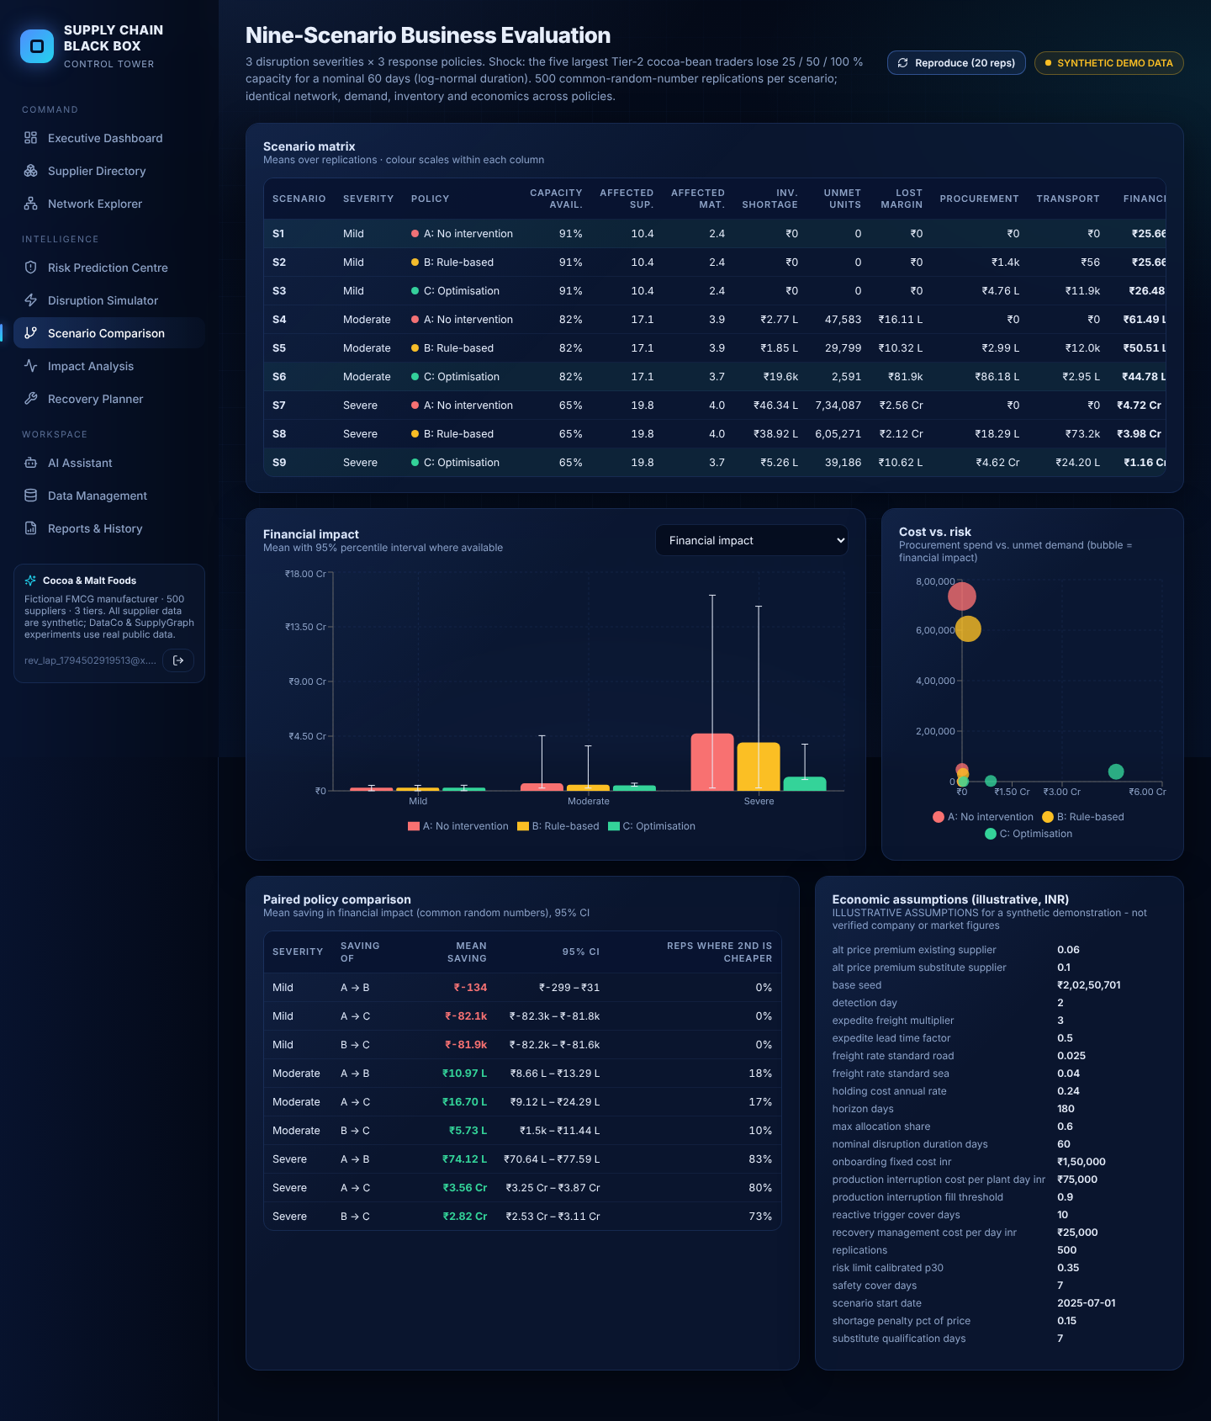
Application demo — simulation, scenarios, recovery
synthetic + real data, labelled
React 18 + Vite · Flask (JWT) · MySQL/SQLite · every value computed live from the database, models and solvers

Slide 19
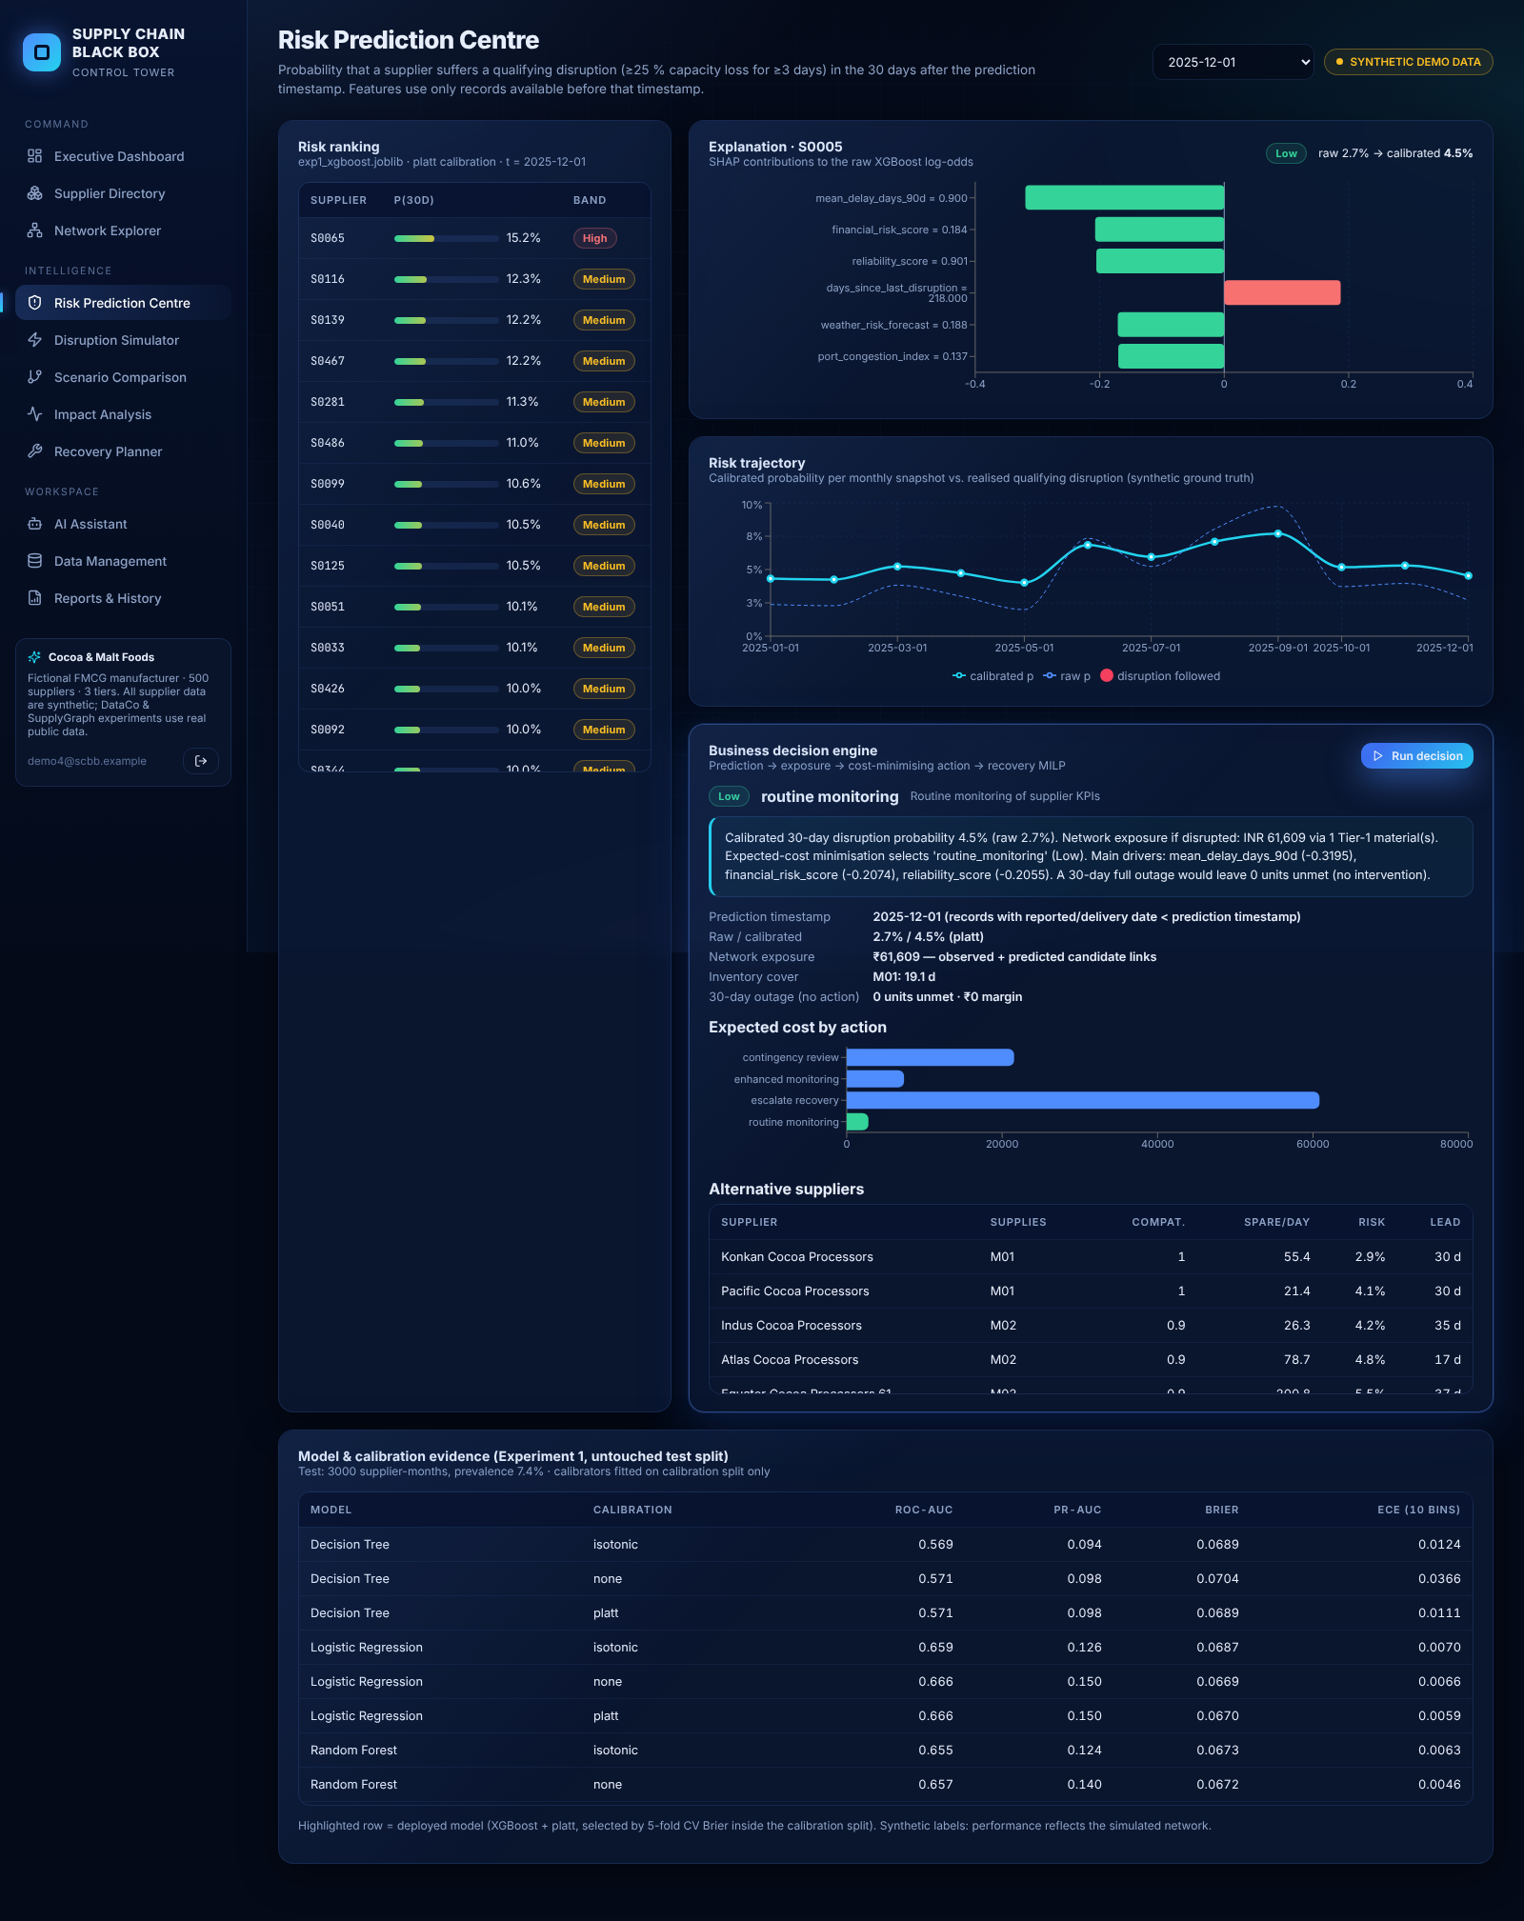
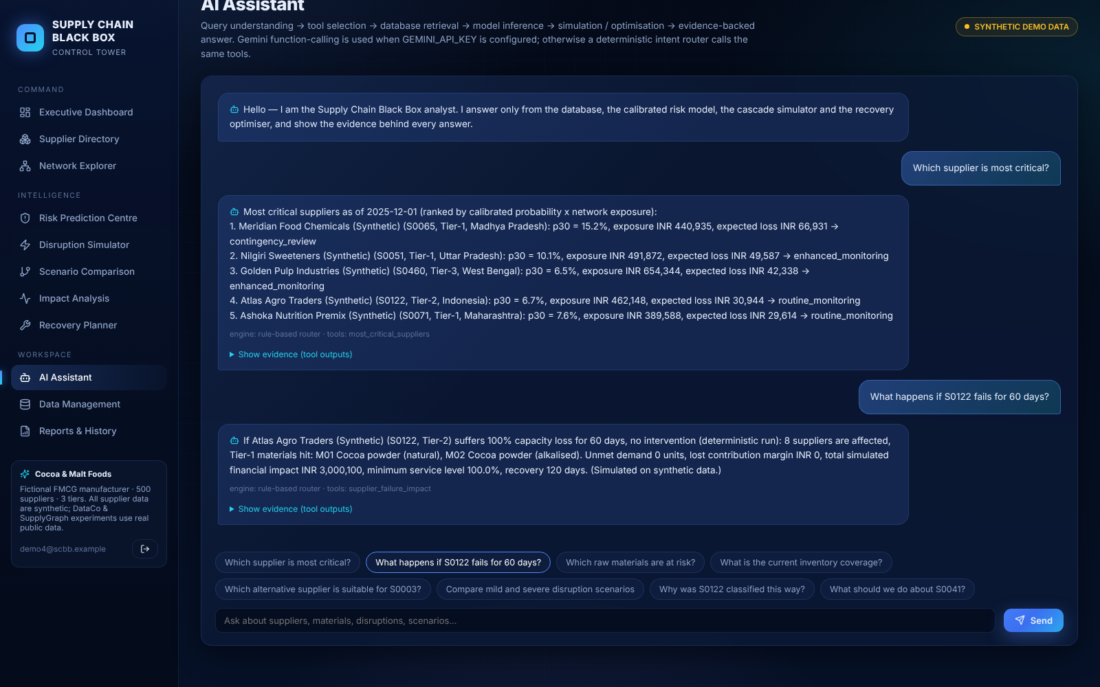
Application demo — decision engine and AI assistant
synthetic + real data, labelled
React 18 + Vite · Flask (JWT) · MySQL/SQLite · every value computed live from the database, models and solvers

Slide 20
Reproducibility and testing
synthetic + real data, labelled
• bash run_all.sh: pinned, hash-verified downloads → data generation (seed 42) → Exps 1–5 → verification → figures → database → tests.
• Experiment registry (run.json per experiment): dataset hash, seeds, features, split counts, class balance, hyper-parameters, metrics, timestamps.
• verify_results.py: 61/61 checks — confusion matrices sum to test size, metrics recomputed from predictions, prevalence, CRN integrity, impact components.
• pytest: 35 tests pass (leakage, metrics, policy, simulator, MILP, validation, 20 API end-to-end); API suite also passes on MySQL (MariaDB 10.11).
• Browser check: all 12 pages rendered with live data and zero console errors (Playwright); deployed on Render.
• Gemini function calling executed with a live key; free-tier throttling falls back to the tested deterministic router.

Slide 21
Limitations and future work
synthetic + real data, labelled
• Supplier-level results rest on a synthetic generator we designed; real-world supplier-network performance is not established.
• Economic parameters are illustrative; conclusions are about relative policy performance.
• Link prediction quality is moderate (AP ≈ 2× base rate); predicted links need supplier verification.
• Optimisation over-hedges under mild shocks; future: risk-aware / stochastic programming policies.
• Future data: bills of lading, UN Comtrade cocoa flows, supplier surveys to label hidden links.

Slide 22
Conclusion
synthetic + real data, labelled
• Calibrated prediction makes thresholds defensible but rarely justifies supplier-level action when buffers are healthy.
• The decisive value lies in exposing hidden dependencies and optimising recovery under severe network shocks (≈75 % lower simulated impact).
• Every recommendation is traceable to a model output, an exposure calculation and a solver result — delivered in a tested, working application.

