Slide 1









eriFyn
01
03
User Experience (UX) and Engagement
Accessibility and Inclusivity
Creating an intuitive, engaging user interface that guides users smoothly through the KYC process with clear instructions and feedback.
Making the KYC process easy and accessible for users of all backgrounds, abilities, and languages, ensuring no one is left behind.
02
04
Security and Compliance
Technology and Innovation
Ensuring the highest standards of data security and regulatory compliance, including protection against fraud and adherence to privacy laws.
Leveraging advanced technologies and innovative approaches for efficient and effective KYC verification, including AI, ML, and real-time video communication.

Slide 2




TECHSTACK
Frontend
React.js
WebRTC
Bootstrap
Backend
Node.js with Expres.js
MongoDB
ML/ DL
TensorFlow
OpenCV
RASA
Keras
DevOps & Infrastructure
Docker
Jenkins
AWS
Twilio

Slide 3
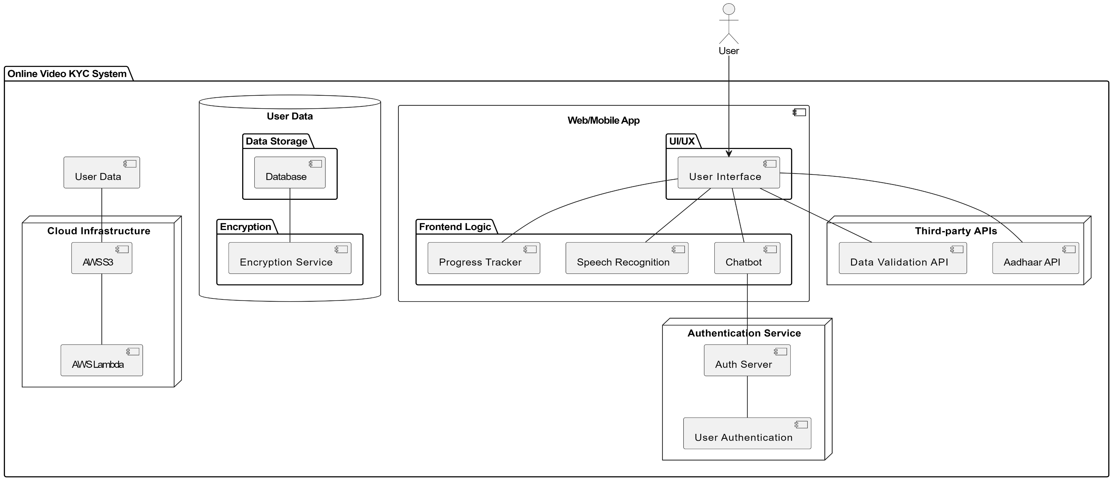
PROPOSED FRAMEWORK

Slide 4
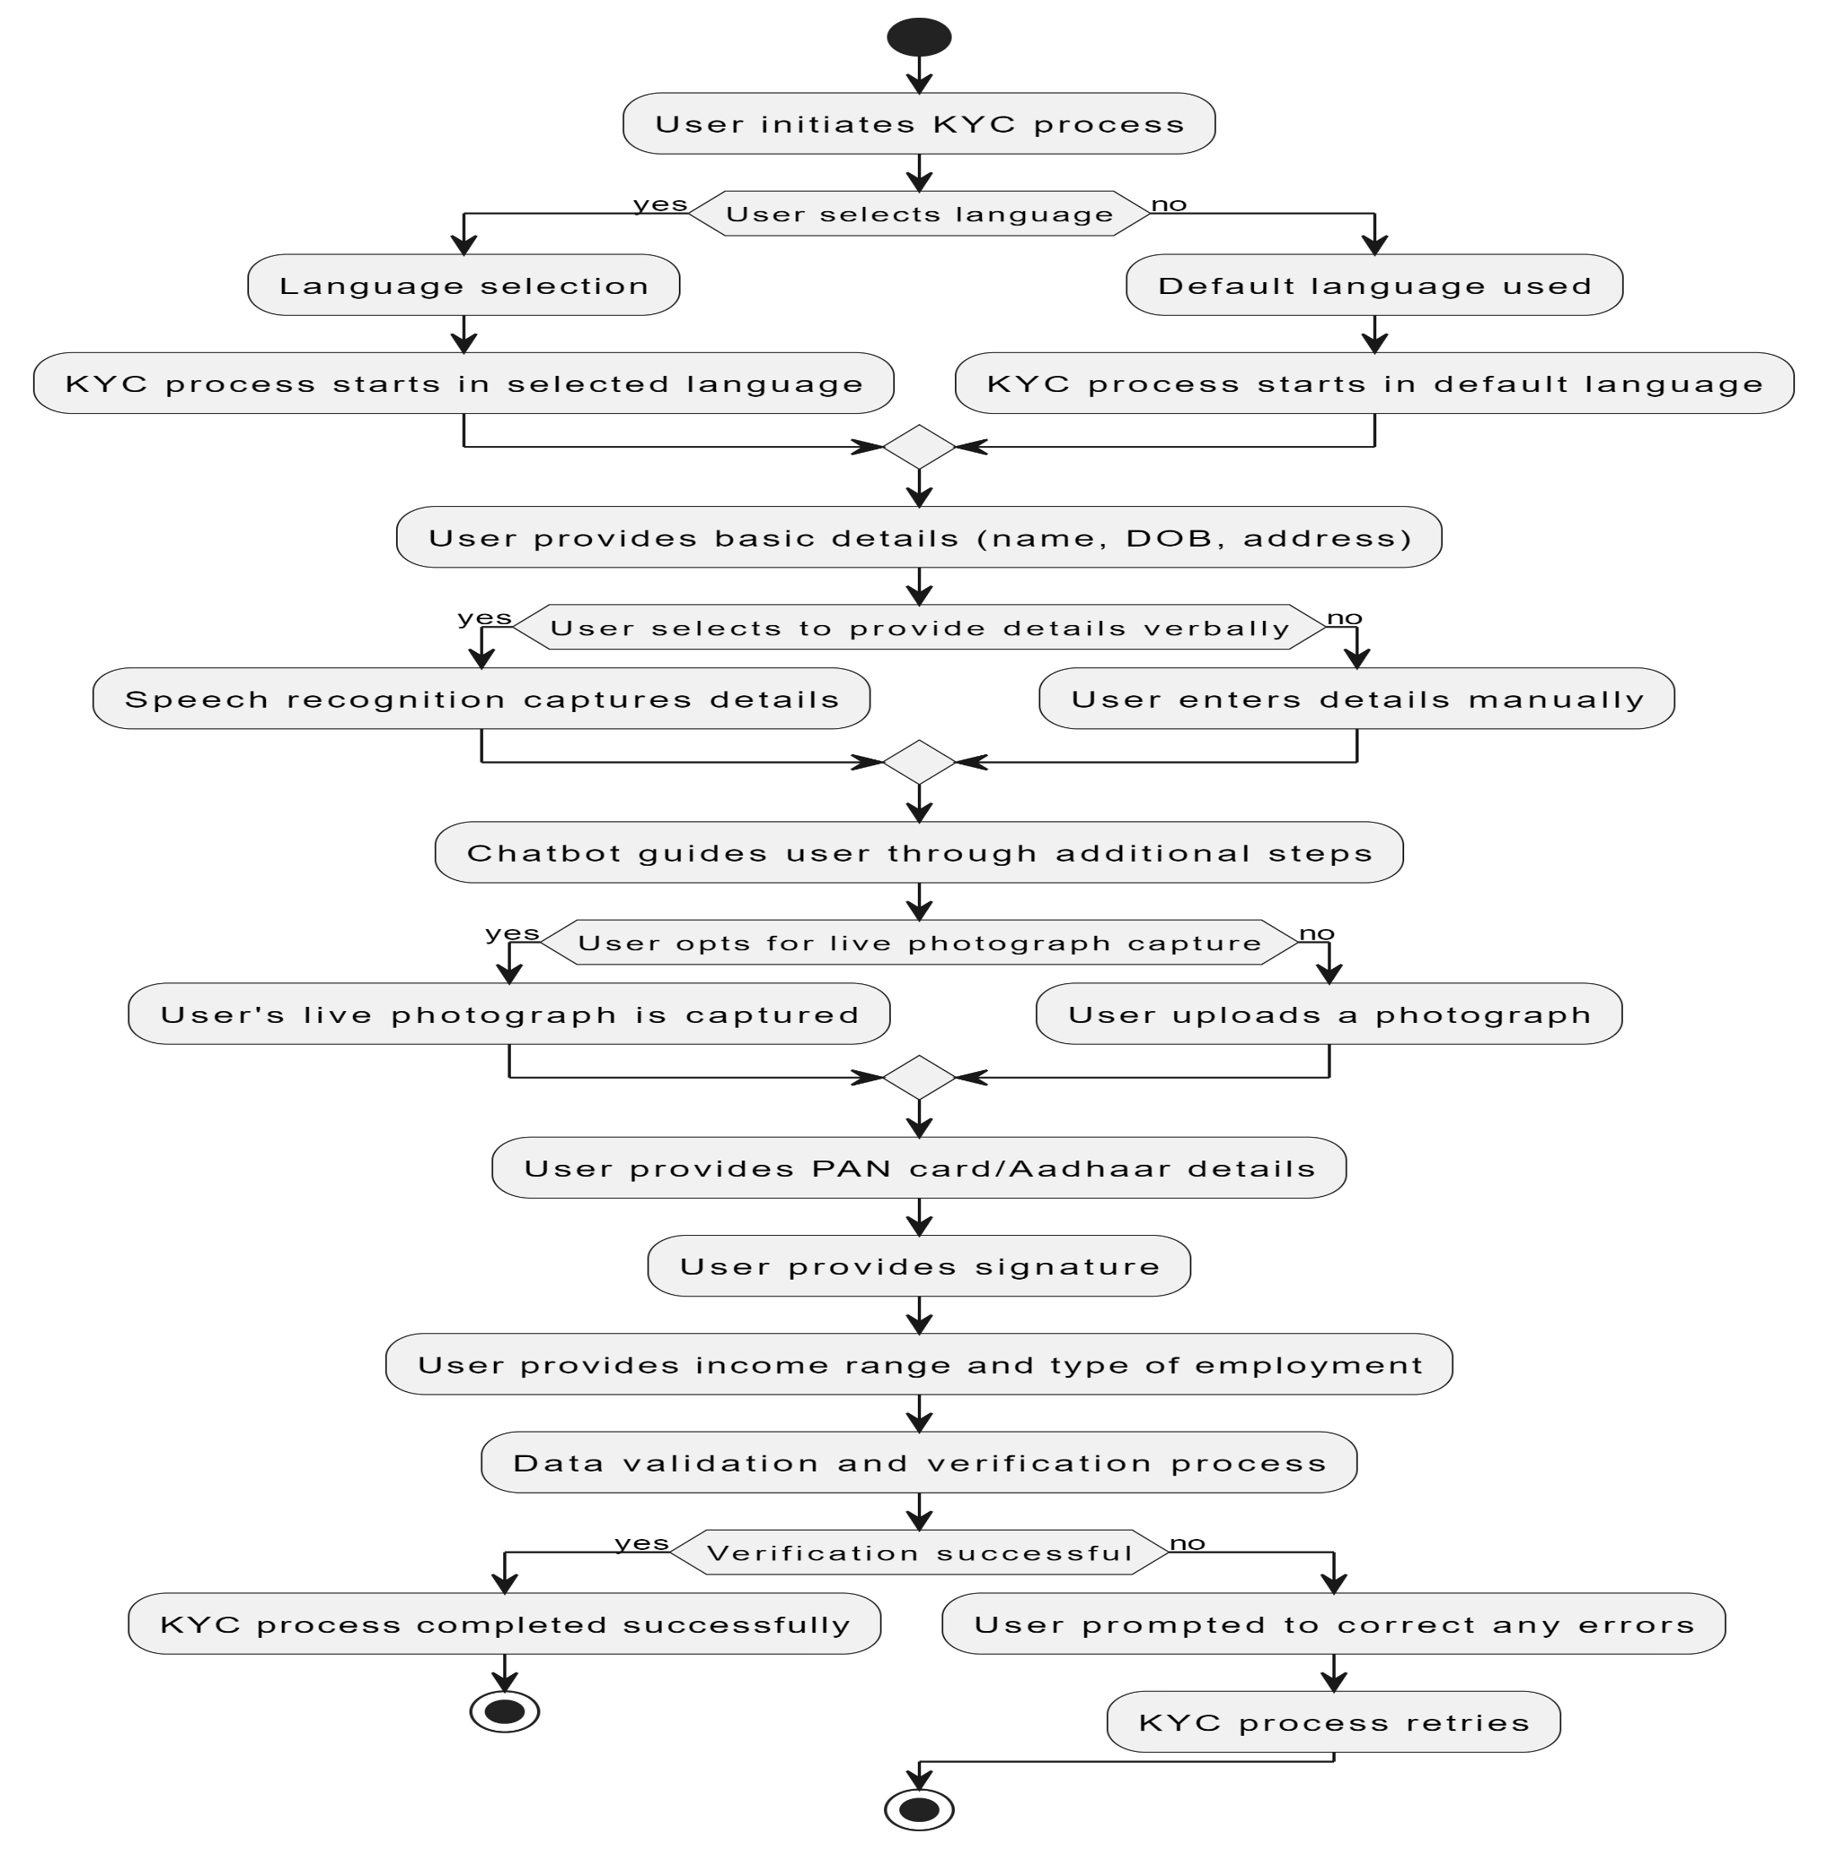
WORKFLOW

Slide 5
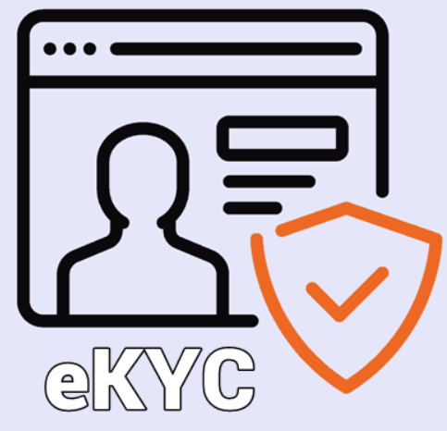



CHATBOT
Initiating KYC Process
Document Uploading
(ID proof, address proof, signature specimen) and detailed instructions on how to capture and upload them properly to ensure high-quality images suitable for verification.
During document uploads, the chatbot provides real-time advice on image quality, while ML algorithms assess and prompt re-upload if issues are detected.
01
03
Automated Verification via ML
Final Review and KYC Completion
Facial recognition and OCR extract and verify personal data from documents, while liveness checks confirm user presence.
02
04
The chatbot presents a summary for review, allowing corrections before confirming KYC completion or explaining further steps if needed

Slide 6
Why Choose eriFyn ?
01
03
05
Secure and Compliant
Conversational and User-Friendly
Scalable and Future-Proof
02
04
Our methodology integrates top-tier encryption and follows global data privacy laws, ensuring user information is always protected and compliant with regulations.
Utilizing conversational AI, our system offers an intuitive chatbot-guided KYC process, making complex verification steps accessible and engaging for all users.
It would help if you were comfortable delegating, but there's still much work involved.
It would help if you were comfortable delegating, but there's still much work involved.
Robust Against Deepfakes and Fraud
Inclusive Video Solution
Advanced facial recognition and liveness detection techniques are employed to effectively counteract deepfakes and other fraud, guaranteeing authentic user verification.
It would help if you were comfortable delegating, but there's still much work involved.
It would help if you were comfortable delegating, but there's still much work involved.

Slide 7
DOCUMENTATION
GITHUB:
VIDEO EXPLANATION:
01
03
https://github.com/SamarthKumar3/Standard-Chartered
SURVEY against DEEPFAKE’s:
KYC COMPLETE TOOLKIT:
02
04
https://docs.google.com/document/d/1cAzkqANrLsjt9VVmWeZFgGViZtu9G6-EFIoe79Cmyzc/edit

Slide 8
THANK YOU

