Slide 1




Implementation of Chatbot Using NLP and Machine Learning

Slide 2

Learning Objectives
Understand how chatbots process user input, classify intents, and generate responses.
Utilize tokenization, vectorization, and preprocessing to analyze textual data.
Train and evaluate machine learning models for intent classification.
Optimize model performance using hyperparameter tuning and cross-validation.
Deploy an interactive chatbot using Streamlit.
GOAL

Slide 3
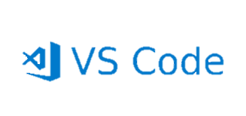


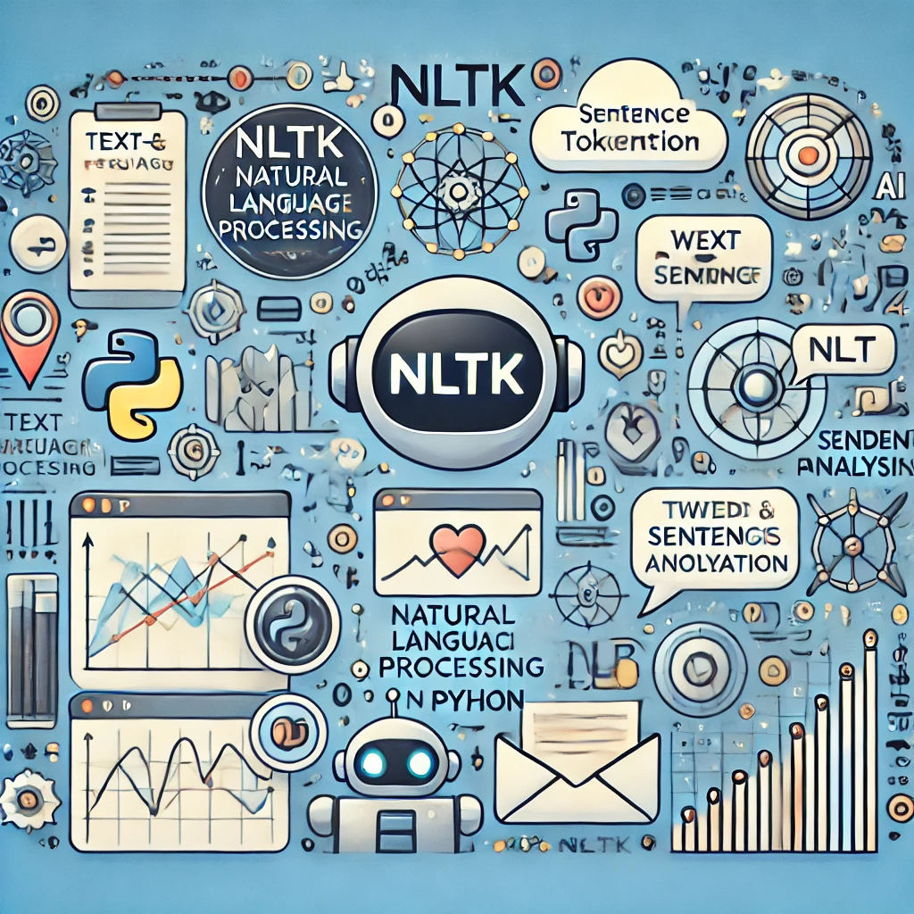
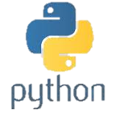
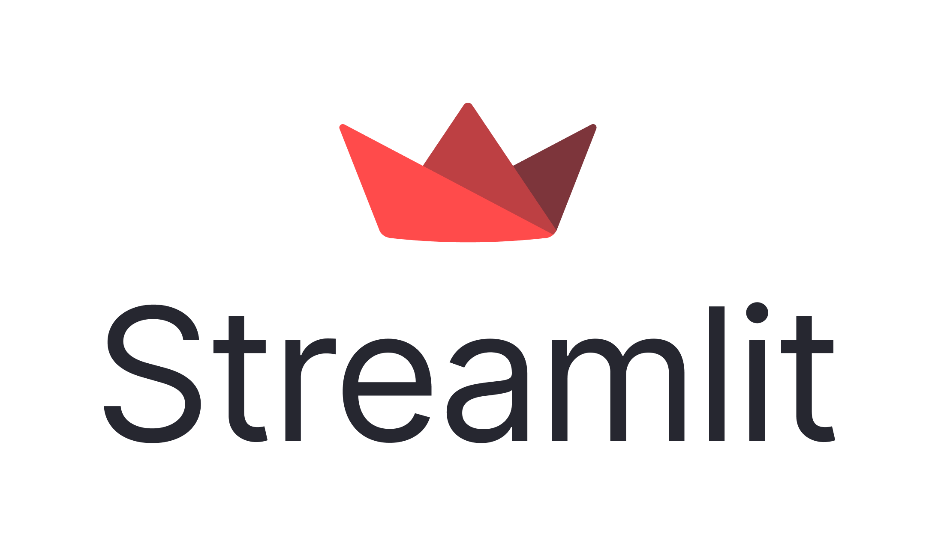
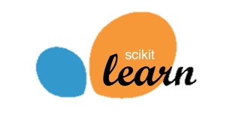
Tools and Technology used
Programming Language: Python
Libraries:
NLTK: Tokenization, preprocessing user input.
Scikit-learn: TF-IDF vectorization, machine learning models, and evaluation metrics.
Streamlit: Web-based deployment interface for the chatbot.
Development Environment: VS Code, GitHub, Google Colab.

Slide 4
Methodology
Data Preparation
Data Preparation:
Loaded and preprocessed intent.json
Tokenized and vectorized text using TF-IDF.
Model Selection:
Baseline model: Logistic Regression.
Advanced models: Random Forest, SVM.
Training:
Trained models on labeled intent patterns.
Applied 5-fold cross-validation for reliability.
Optimization:
Hyperparameter tuning using GridSearchCV.
Regularization for performance improvement.
Deployment:
Saved the best model and vectorizer for real-time interaction.
Deployed using Streamlit for a user-friendly interface.
Model Selection
Training
Optimization
Deployment

Slide 5
Problem Statement:
Challenge
In today's digital world, there is an increasing need for efficient, scalable, and cost-effective ways to handle frequent queries and interactions. Manual response systems are time-consuming, error-prone, and resource-intensive, creating a need for automation to enhance user experience and streamline operations.
Problem Statement
Develop a generic chatbot capable of understanding user inputs, classifying them into predefined intents, and providing accurate, context-aware responses. The chatbot should leverage Natural Language Processing (NLP) techniques and machine learning models to ensure adaptability, scalability, and relevance across multiple domains.

Slide 6

Solution:
Proposed Chatbot:
Core Features:
Understands user input using Natural Language Processing (NLP).
Matches user input patterns to predefined intents.
Generates accurate and context-aware responses.
Technologies:
Machine learning models for intent classification.
Streamlit-based interface for seamless user interaction.
Benefits:
Generic Functionality: Suitable for various domains (e.g., customer support, FAQs).
Operates 24/7 for uninterrupted user assistance.
Scalable to include more intents and responses as needed.

Slide 7
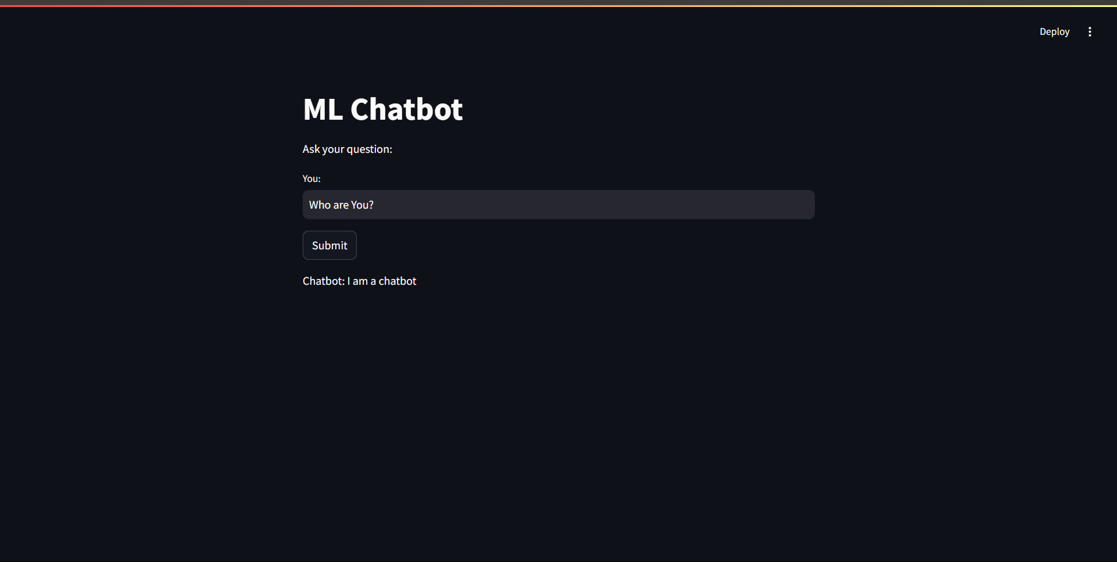
Screenshots:

Slide 8

Conclusion:
Successfully developed and deployed a functional chatbot capable of understanding and responding to user queries.
Leveraged NLP and machine learning models for intent classification with high accuracy.
Streamlit provided a seamless user interface for real-time chatbot interaction.
Future Scope:
Expand dataset for more diverse intents.
Integrate deep learning models like RNNs for improved understanding.
Enable dynamic conversational flows for more complex interactions.

