Slide 1
+
ClinicFlow
A clinic appointment system, taken from a git commit to a monitored, autoscaled Kubernetes deployment
Samarth Deshpande · DevOps Final Capstone · github.com/SamarthPD-21/clinicflow
Notes:
Hi, I'm Samarth. My capstone is ClinicFlow, a front-desk appointment system for small clinics. The app is small on purpose; the focus is the path it takes from a commit on my laptop to a monitored, autoscaled deployment on Kubernetes, with AWS infrastructure built by Terraform.

Slide 2
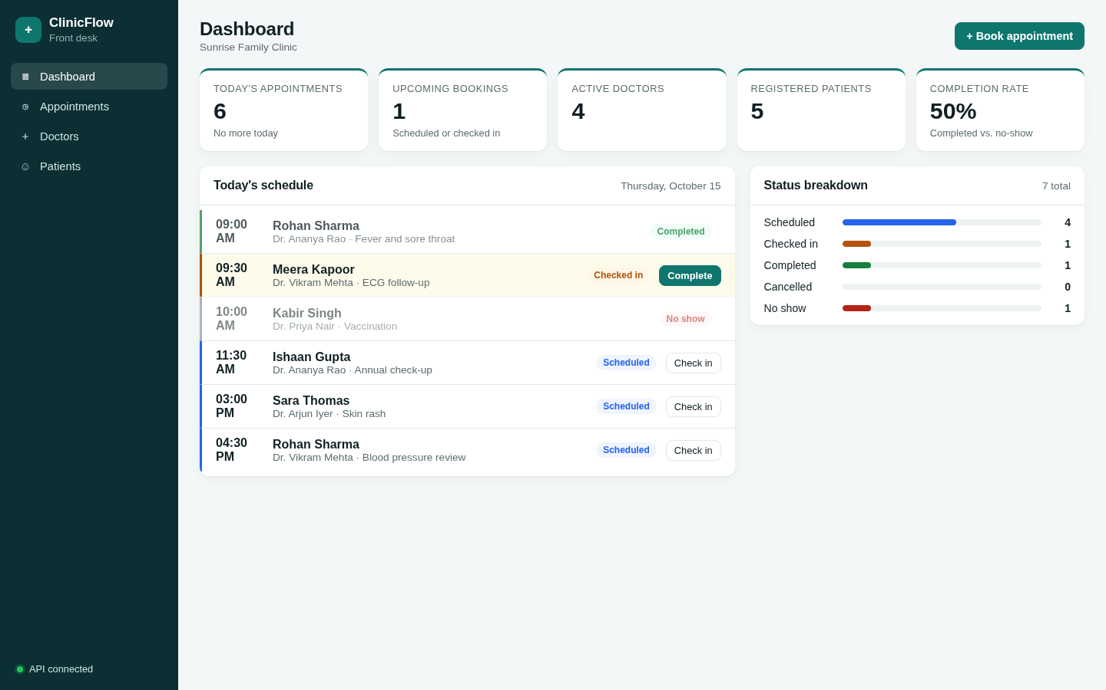
The app: front desk for a small clinic
Register patients and manage doctors on duty
Book appointments; the API refuses to double-book a doctor in the same 30-minute slot (HTTP 409)
Move each visit through the day: scheduled → checked in → completed / no-show
React + Vite frontend, FastAPI backend, PostgreSQL with Alembic migrations
15 REST endpoints, plus /health, /ready and /metrics
Notes:
Reception staff register patients, manage doctors, and book appointments. The key business rule is that a doctor can't be double-booked within the same 30-minute slot; the API returns 409. The frontend is React, the backend FastAPI with SQLAlchemy and Alembic, the database PostgreSQL.

Slide 3
From commit to production
1
2
3
4
→
→
→
git push
Test
Build
Scan
GitHub
ruff + pytest
Docker images
Trivy gate
5
6
7
8
→
→
→
Publish
Deploy
Run
Observe
GHCR :sha
Helm upgrade
K8s + HPA
Prometheus
Terraform builds the AWS VPC + EKS cluster the same chart deploys to
Notes:
This is the whole flow. A push to main runs lint and tests, builds both images, scans them with Trivy, and only if the scan passes pushes them to GitHub Container Registry tagged with the commit SHA. The CI then writes that SHA into the Helm values, and a helm upgrade rolls it out to Kubernetes, where the HPA scales it and Prometheus scrapes it.

Slide 4
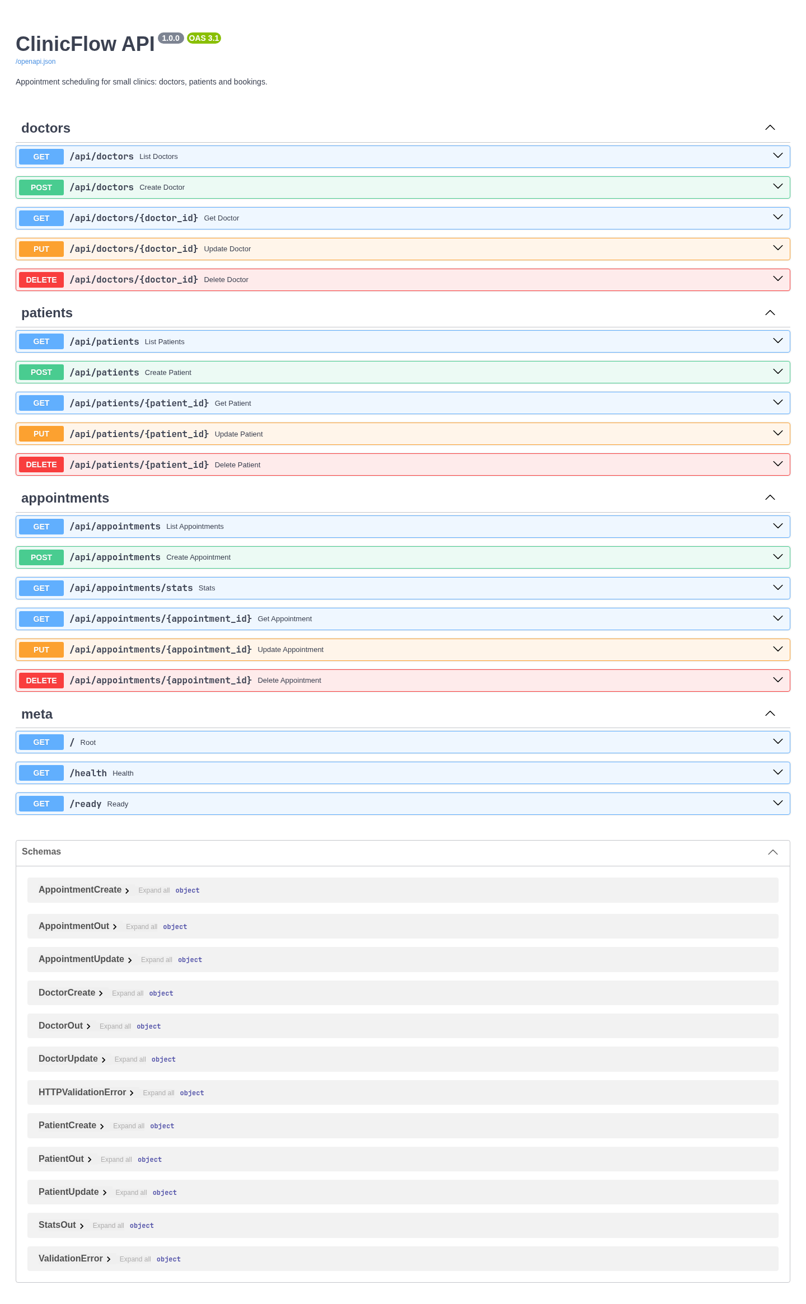
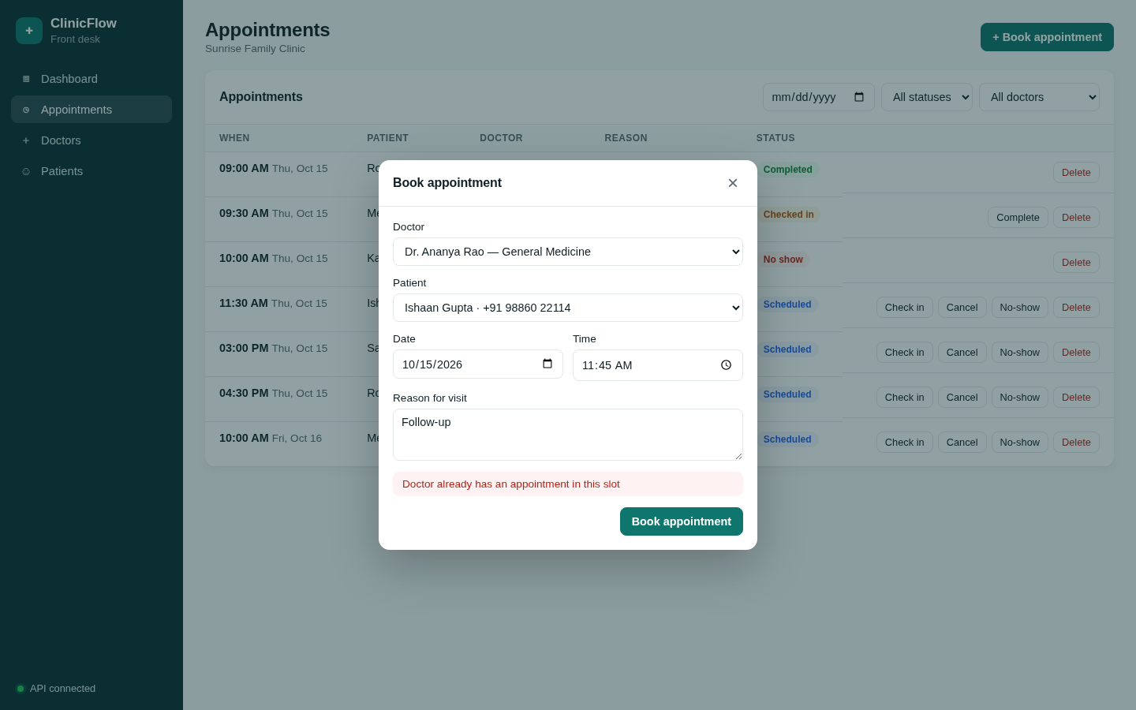
API, database and the double-booking rule
Booking a taken slot is rejected with 409 and shown in the UI
Notes:
Swagger shows the full API: CRUD for doctors, patients and appointments, plus stats. On the right, trying to book Dr. Rao into a slot that's already taken returns 409 and the form shows the clash.

Slide 5
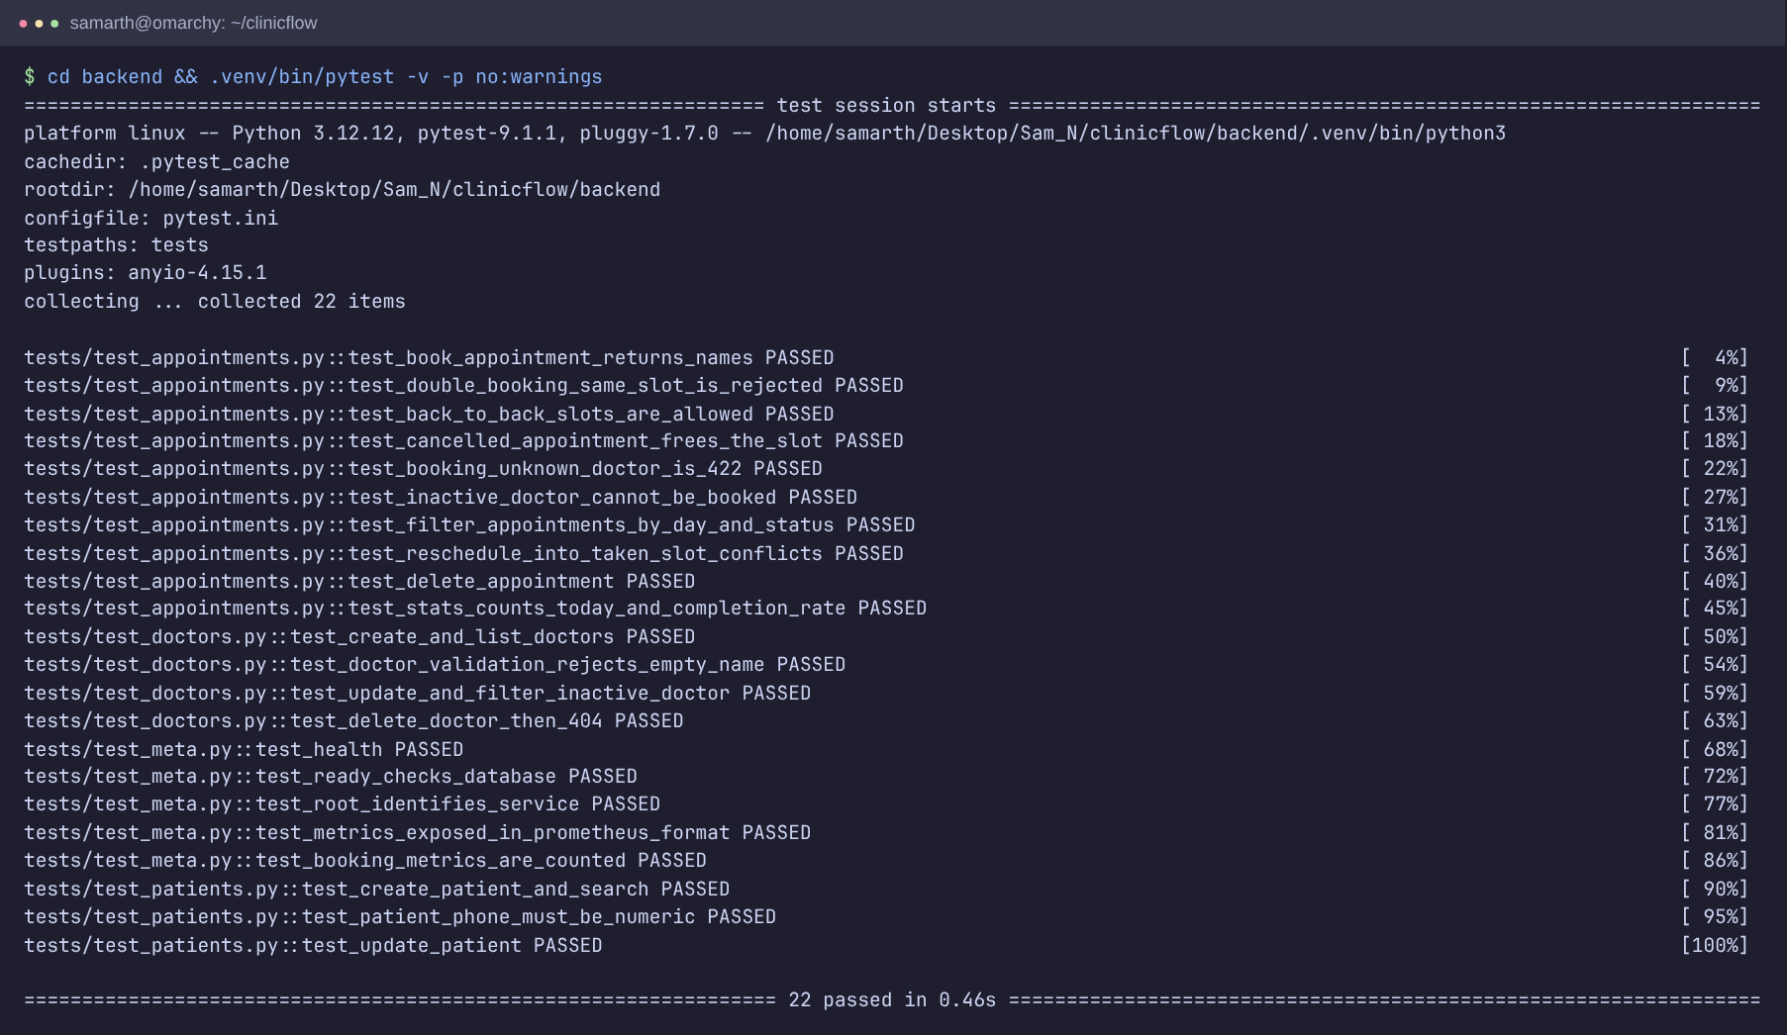
Tests and version control
22
pytest tests, all passing
SQLite
in-memory test DB, never prod
27
commits on main
Notes:
There are 22 pytest tests covering CRUD, validation and the double-booking edge cases. conftest swaps the database dependency for in-memory SQLite, so tests never touch Postgres. The repo has a proper .gitignore and short, meaningful commits.

Slide 6
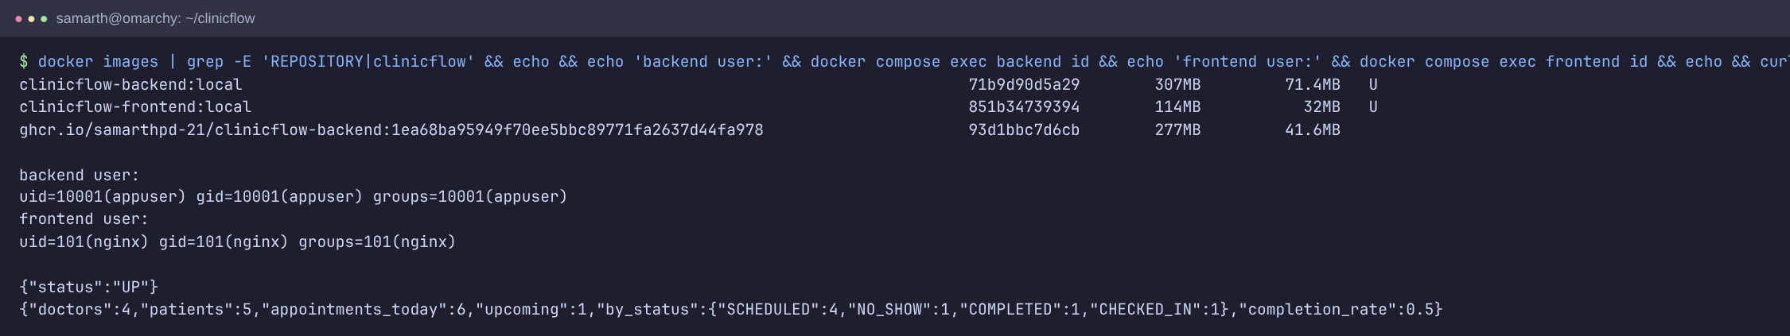
Docker: small, non-root images
Backend: python:3.12-slim, runs as uid 10001, healthcheck, migrations then uvicorn
Frontend: multi-stage, node build → nginx-unprivileged (uid 101, port 8080)
docker compose up --build: Postgres → backend → frontend, health-gated
Notes:
Both images run as non-root users. The frontend is a multi-stage build so node and the source never ship. Compose starts Postgres, waits for it to be healthy, then the backend runs migrations, then the frontend.

Slide 7
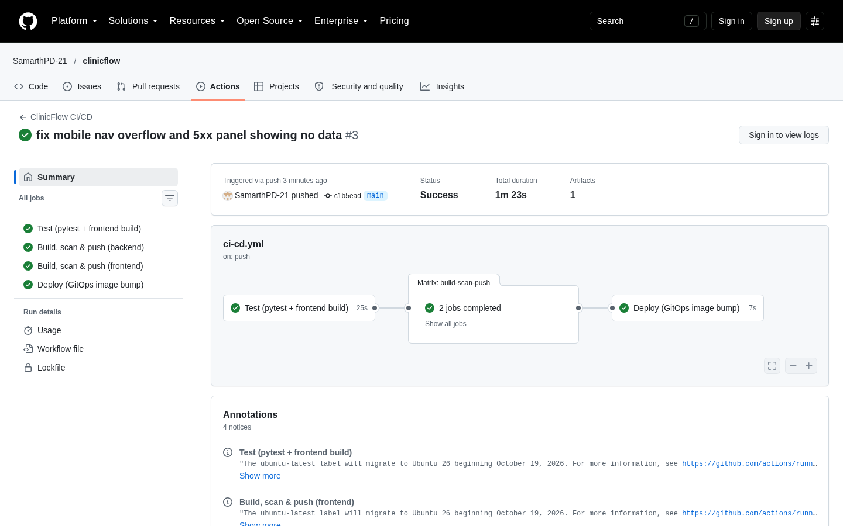
GitHub Actions: test, build, scan, push
test
build-scan-push ×2
deploy
Images tagged with the commit SHA, never latest
PRs build and scan but never push
Deploy job writes the SHA into values.yaml
Notes:
The workflow has three jobs. Test runs ruff, pytest and the frontend build. build-scan-push runs once per image. Deploy writes the new SHA into the Helm values so main always describes what should be running.

Slide 8
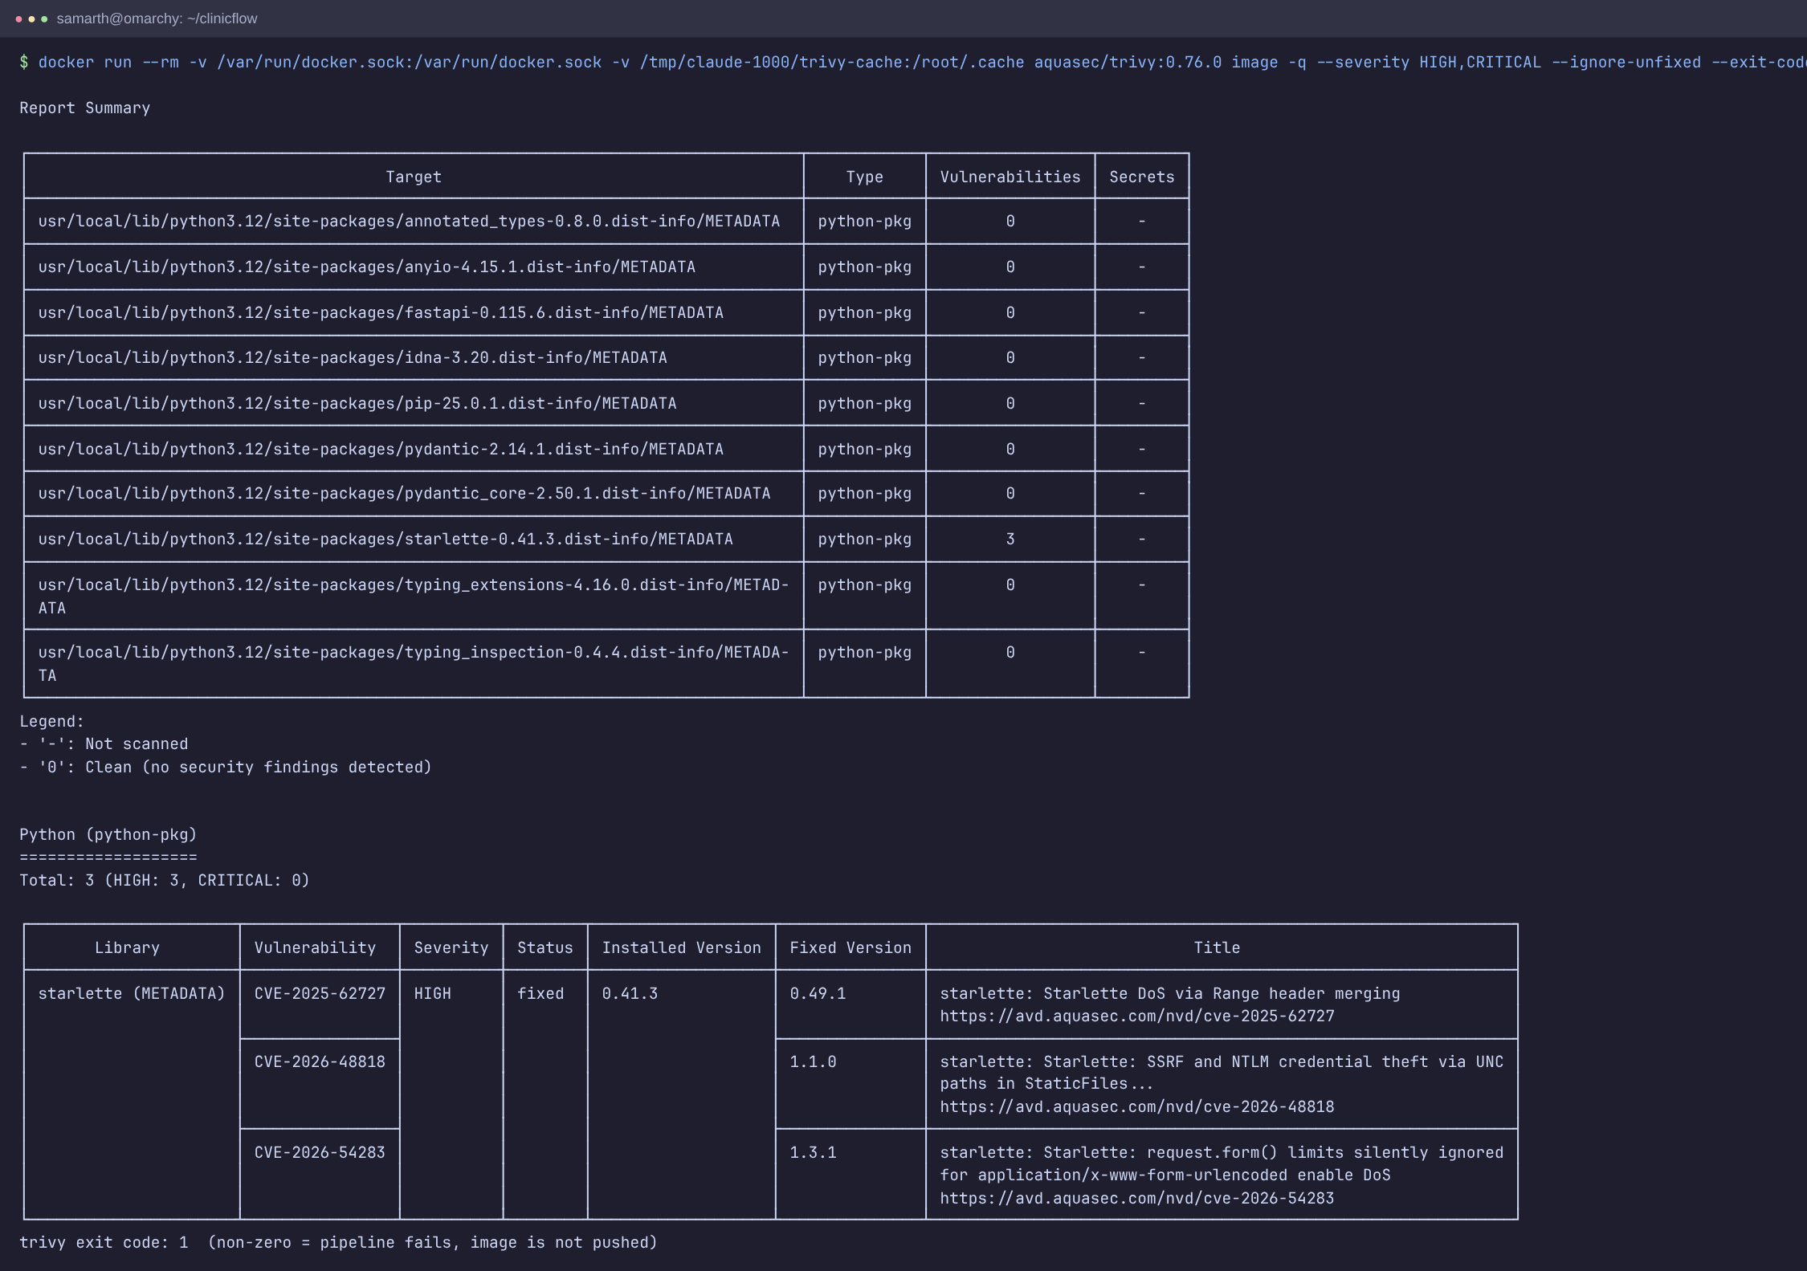
Trivy caught a real CVE
CVE-2025-62727
Starlette Range-header DoS
43 → 0
fixable HIGH CVEs in the nginx base
The scan fails the build on fixable HIGH/CRITICAL, so nothing vulnerable reaches GHCR
Notes:
Trivy scans OS packages and Python packages. It blocked my first build: Starlette 0.41.3 had CVE-2025-62727, a denial of service through crafted Range headers, so I upgraded FastAPI. The Alpine nginx base also had 43 fixable HIGH CVEs, fixed with apk upgrade.

Slide 9
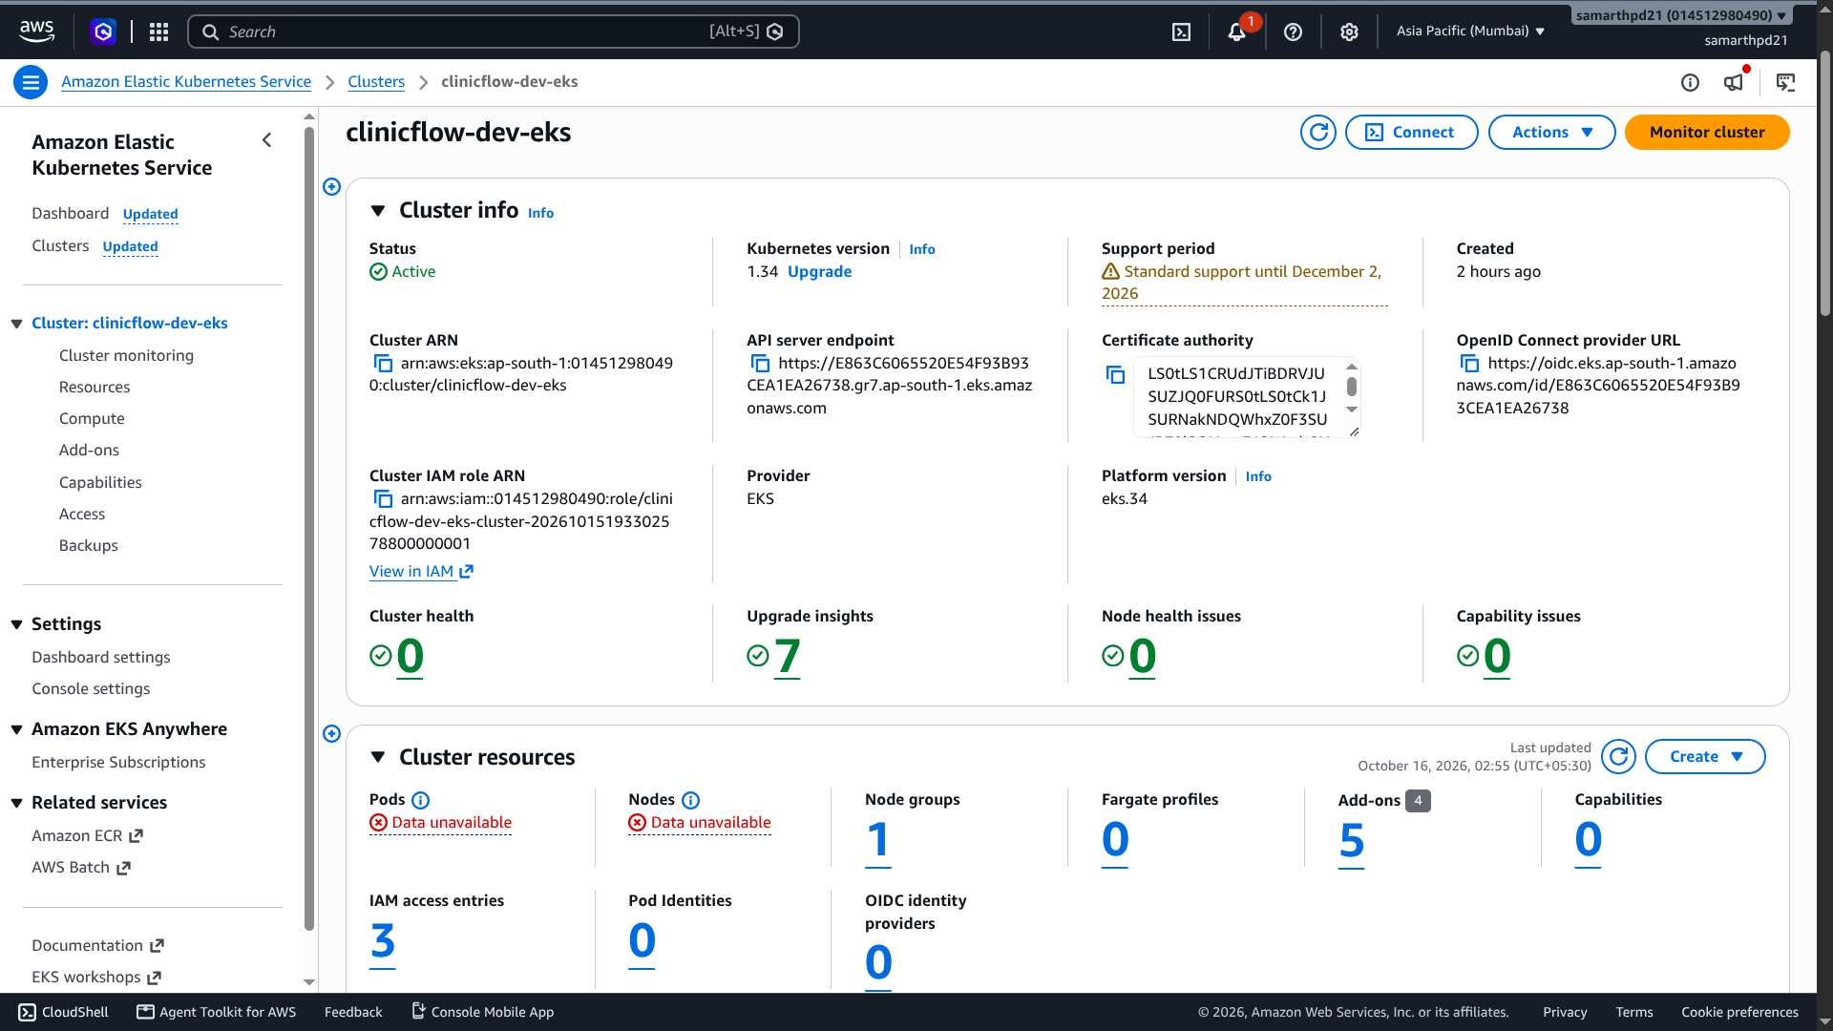
Terraform: AWS VPC + EKS
60
resources from one terraform apply
VPC: 2 public + 2 private subnets, NAT gateway
EKS 1.34, 2 × c7i-flex.large, EBS CSI add-on
Free plan blocked t3.medium; found it in CloudTrail and switched type
terraform destroy: 0 resources left
Notes:
Terraform builds the VPC and an EKS cluster in Mumbai. My account is on the AWS Free plan: the first apply hung because t3.medium isn't allowed. CloudTrail showed the RunInstances error, so I switched to c7i-flex.large. I deployed the same Helm chart there, then destroyed everything and confirmed nothing was left running.

Slide 10
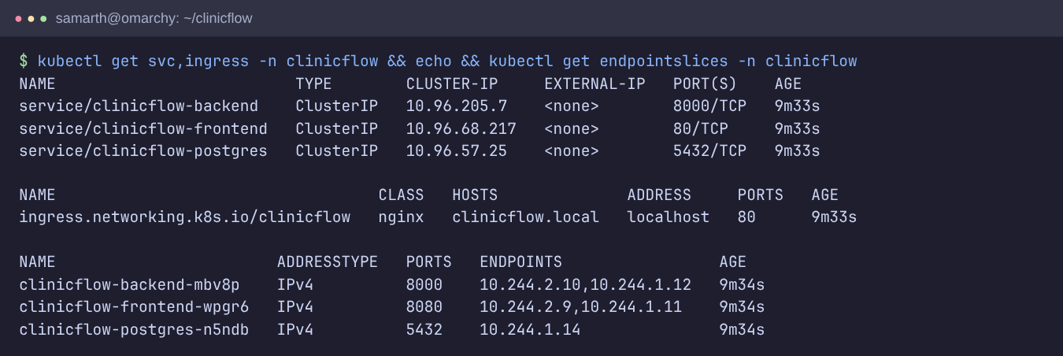
Kubernetes + Helm
One Helm chart: Deployments, StatefulSet Postgres, ClusterIP Services, Ingress, HPA, ServiceMonitor
Ingress: / → frontend, /api → backend
Readiness checks the DB, liveness only the process
Notes:
Everything is one Helm chart. Two replicas each of frontend and backend, Postgres as a StatefulSet with a PVC. The Ingress sends / to the frontend and /api to the backend. Readiness checks the database, so a DB outage takes pods out of rotation instead of restart-looping them.

Slide 11
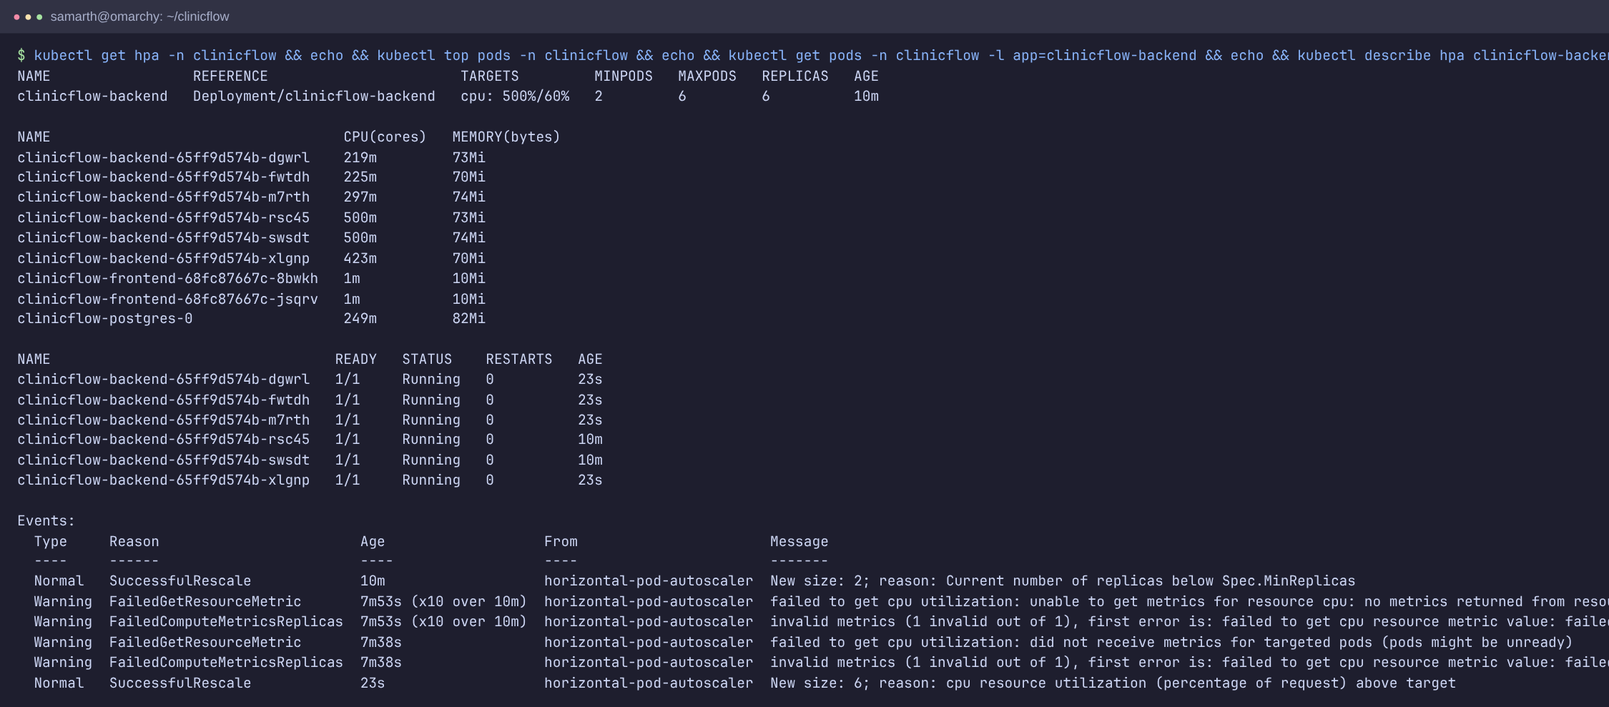
Autoscaling under load
2 → 6
backend pods under load
60%
CPU target
Scaled back down once the load test stopped
Notes:
With a load generator against the API, the HPA saw CPU climb past the 60% target and scaled the backend from 2 to 6 pods, then back down when the load stopped.

Slide 12
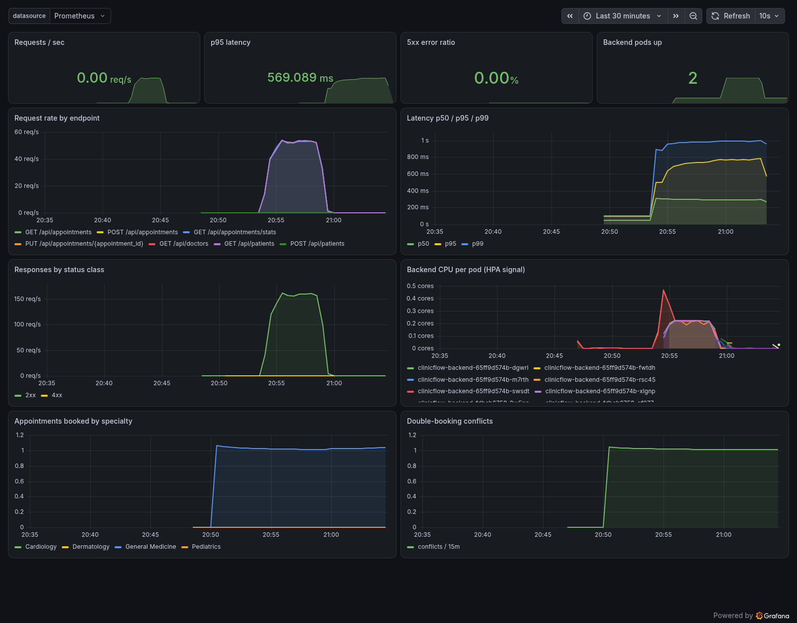
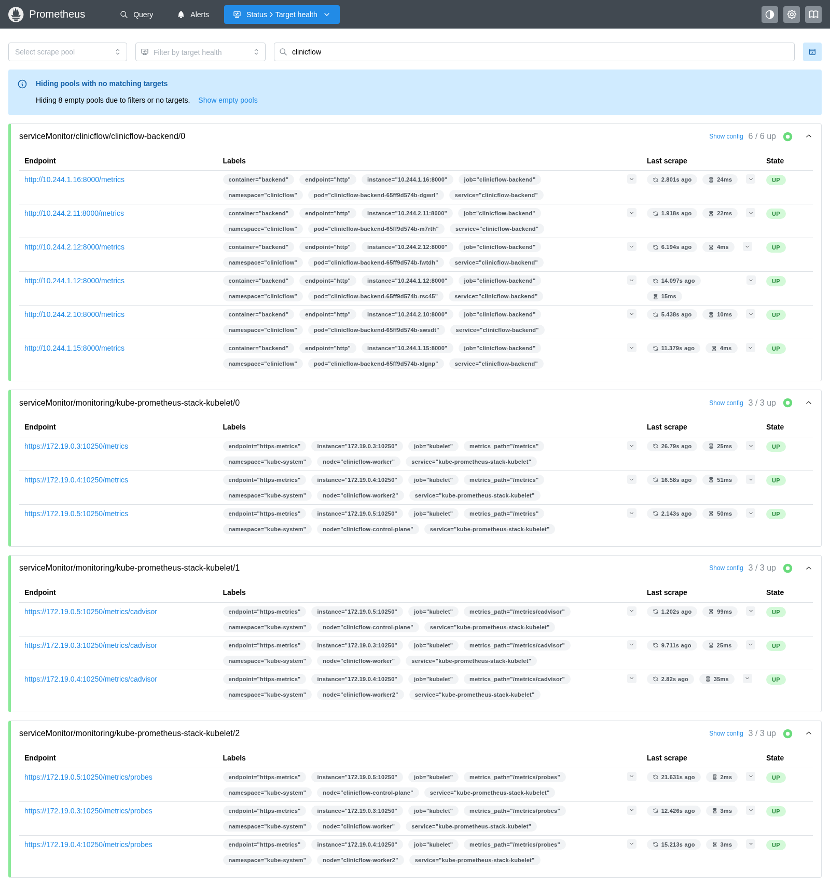
Prometheus + Grafana
ServiceMonitor scrapes /metrics every 15 s
Custom metrics: bookings by specialty, booking conflicts
Dashboard ships inside the Helm chart
Notes:
The backend exposes request rate and latency per route plus two domain metrics: bookings by specialty and booking conflicts. A ServiceMonitor makes Prometheus scrape every pod; all targets are UP. The Grafana dashboard is shipped as a ConfigMap in the chart.

Slide 13
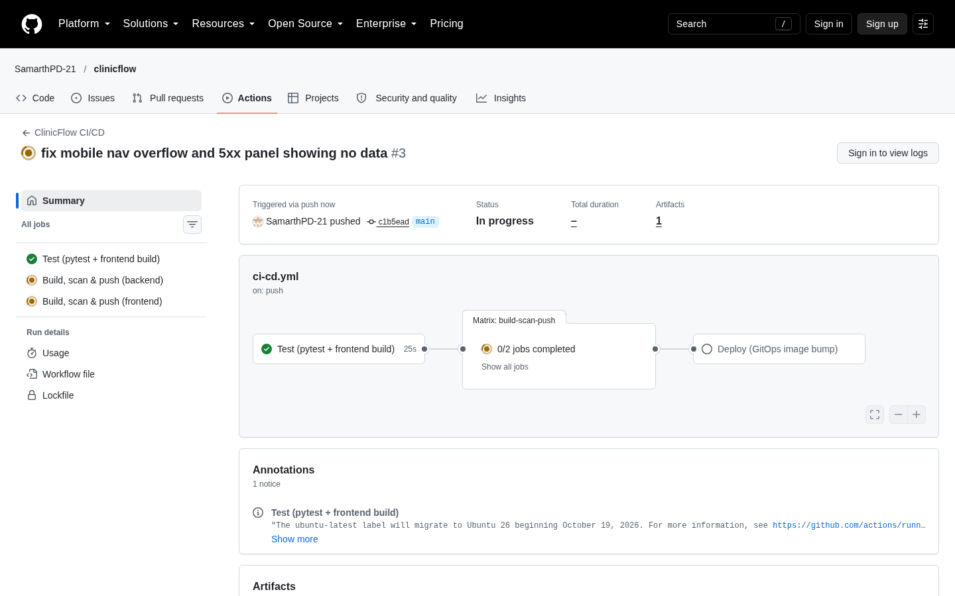
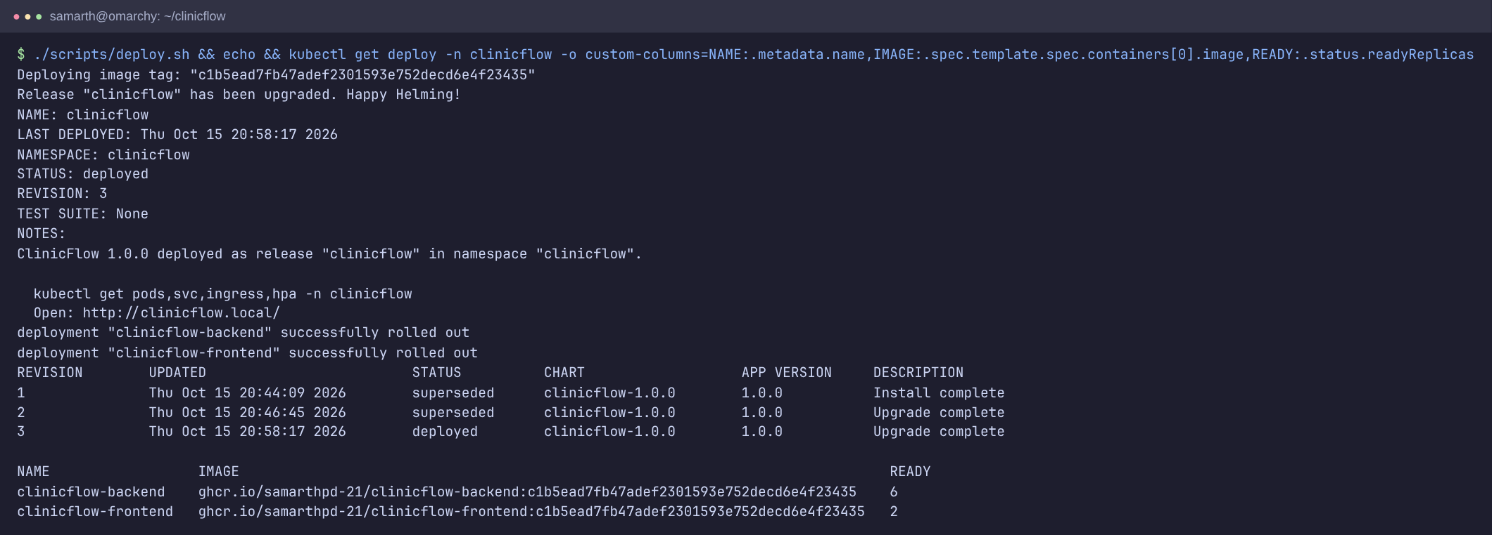
Demo: commit → pipeline → deployment
1 Commit a mobile-nav fix and push
2 Pipeline goes green; images tagged with the new SHA
3 scripts/deploy.sh → helm upgrade; pods roll to the new tag
4 The fix is live in the app
Notes:
For the end-to-end demo I committed a small UI fix, watched the pipeline test, scan and push the new images, then ran the deploy script, which pulls main and runs helm upgrade. Both deployments rolled to the new SHA and the fix was visible in the app.

Slide 14
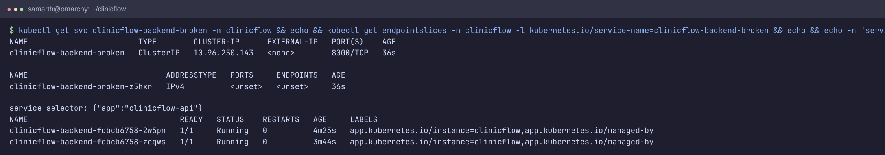
Troubleshooting lab
Broken | Symptom | Found with | Fix
Image tag | ImagePullBackOff | kubectl describe pod | Correct the tag
Service selector | No endpoints, 503 | kubectl get endpoints | Match pod labels
DB password | Running, never Ready | logs + /ready → 503 | Fix the secret
Notes:
I broke the deployment three ways on purpose: a bad image tag, a Service selector that matches no pods, and a wrong database password that keeps pods running but never ready. Each one has a diagnose and fix walkthrough in the troubleshooting folder.

Slide 15
What I learned
1
Security gates catch real bugs
Trivy blocked a live CVE before it shipped
2
Readiness ≠ liveness
a DB outage should drain traffic, not restart pods
3
Read the cloud's logs
CloudTrail explained a node group that never came up
4
Always destroy
terraform destroy and verify: 0 resources, ~$1 spent
Thank you · github.com/SamarthPD-21/clinicflow
Notes:
To close: the Trivy gate caught a real vulnerability; separating readiness from liveness matters; the cloud's own logs explain failures; and always destroy and verify. Thank you.

