Slide 1

Reading Analog Gauges from Oblique Photographs
A controlled comparison of tilt-correction strategies
Samarth Pyati
1RVU23CSE400
Pranathi Manalithara
1RVU23CSE343
Amit Narendra
1RVU23CSE042
Rishab A.V
1RVU23CSE375
CS4231 Fundamentals of Computer Vision
School of Computer Science and Engineering (SoCSE), RV University, Bengaluru
Guided by Prof. Dr. Ramakrishnan Varadharajan
Notes:
Introduce the team and the course. One sentence: we read analog gauges from phone photos and measure how camera tilt affects the reading, comparing four ways to correct for it.

Slide 2
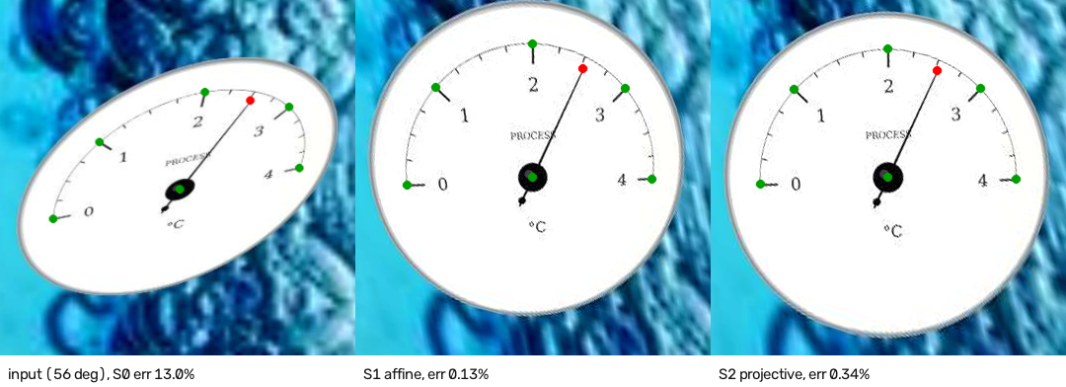
Camera tilt changes what the needle says
13.0 %FS
error at 56° when the angle is measured straight from the photo
0.13 %FS
after correcting the dial back to a circle (S1)
A dial is a flat plane. When the camera is not square to it, equal steps on the scale no longer look equal, so the needle angle measured in the photo is wrong.
Our question: how much does tilt hurt, and which correction works best, under one protocol?
Notes:
Left: the same synthetic dial seen at 56 degrees, then corrected with S1 and S2. Measured directly, the reading is off by 13 percent of full scale; after correction it is within 0.13 to 0.34 percent. %FS = percent of full scale, our error unit.

Slide 3




What we built and measured
Synthetic gauge generator
One pipeline, four strategies
Exact labels for the reading, 7 keypoints and camera tilt. Each nuisance can be switched on or off on its own.
Shared detector, crop and keypoints. Only the way tilt is handled differs (S0–S3).
Error per tilt angle
Real photographs
E1 with perfect keypoints and E2 with trained models, with 95 % bootstrap intervals.
A transfer test on 298 web photos, and a protocol for a labelled real test set (future work).
Notes:
Four contributions. The research contribution is the evaluation itself: reading error per camera-tilt bin and a fair comparison of tilt corrections.

Slide 4
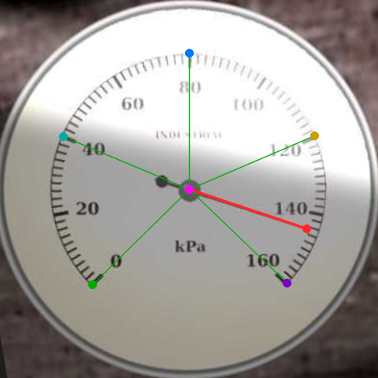
How a reading is defined
Reading f
Needle position as a fraction of full scale, clockwise from the min mark (0 = min, 1 = max). Value = min + f × (max − min).
Error
|f̂ − f| × 100, in % of full scale (%FS). The printed numbers never need to be read.
7 keypoints
K0 pivot, K1 needle tip, K2–K6 points on the scale at 0, 25, 50, 75 and 100 %.
Obliquity
Angle between the dial's normal and the camera ray to its centre. Bins: 0–15°, 15–30°, 30–45°, 45–65°.
Corrected dial with its 7 keypoints
Notes:
f is what every strategy outputs. Measuring error as a fraction of full scale means no OCR is needed in the experiments. Obliquity is computed from the camera pose for synthetic data and from a marker for real photos.

Slide 5
Method
Pipeline · four strategies · synthetic data

Slide 6
One pipeline, four ways to handle tilt
7 keypoints
YOLO26n-pose
S0 / S1 / S2
geometry
Photo
any angle
Detect + segment
YOLO26n-seg, 640 px
Square crop
384 px + face mask
Regression
ResNet-18 on the crop
S3
learned
Each strategy outputs the reading f
Everything except the tilt handling is shared, so differences between S0–S3 come from the strategy alone.
A strategy that fails is recorded as a failure, never quietly replaced by another one.
Notes:
The detector finds and segments the dial; a square crop goes to the keypoint model and the regression network. S0, S1 and S2 read f from the keypoints after their correction; S3 predicts f directly.

Slide 7
The four strategies
S0
S1
S2
S3
No correction
Ellipse fit
Conic + pivot
Direct regression
Measure needle angles directly in the photo.
Fit an ellipse to the dial face and map it back to a circle (affine).
Fit a conic through the 5 scale points; the pivot's polar line is the horizon; full projective correction.
A ResNet-18 predicts the reading from the crop. No geometry.
Exact when
the camera faces the dial
Exact when
the dial is small or far away
Exact when
keypoints are exact and the pivot lies on the dial face
Exact when
test angles are covered by training
Notes:
S1 is exact under weak perspective. S2 uses the fact that the scale points lie on a circle centred at the pivot: the polar of the pivot with respect to the fitted conic is the vanishing line, which gives a full projective rectification. S3 has no geometry at all.

Slide 8
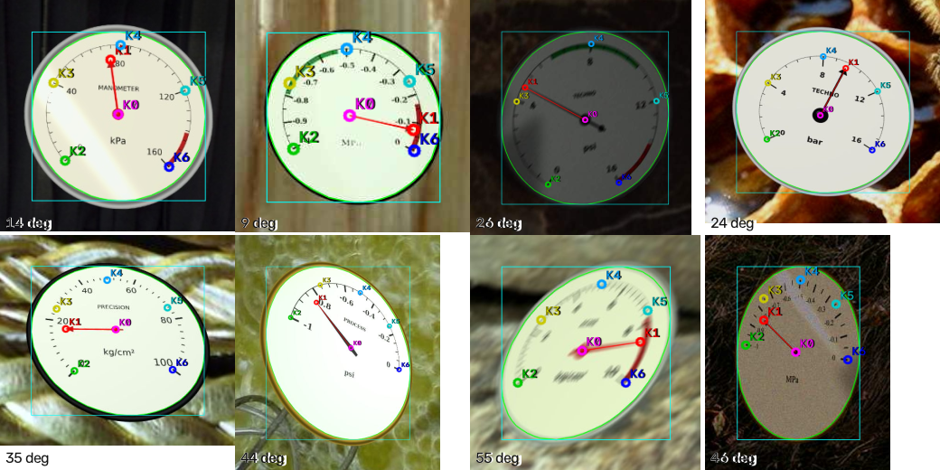
Synthetic gauges with exact labels
Faces, bezels, fonts, 4 sweep angles, 6 scale ranges, 3 needle styles
Camera tilt 0–65°, roll, field of view and framing
Needle 2–5 % of the radius above the face (parallax)
Glare, shadows, low light with sensor noise, blur, JPEG
5,640 real texture photos as backgrounds (DTD)
Test images with their ground-truth keypoints, two per tilt bin
Every label is exact, and each nuisance can be switched off without changing anything else in the image: the basis for the E4 ablation.
Notes:
All training data is synthetic, so the reading and camera pose are known exactly. The needle is drawn on a plane slightly above the face, like a real gauge, which creates parallax.

Slide 9
Data splits and training
20,000
2,000
2,000
training images
validation images
test images, 500 per tilt bin
Model | Architecture | Input | Epochs | Training time
Detector + segmenter | YOLO26n-seg | full image, 640 px | 60 | 6.8 h on one T4
Keypoints | YOLO26n-pose | dial crop, 384 px | 100 | 4.7 h on one T4
Direct regression (S3) | ResNet-18 (ImageNet) | dial crop, 384 px | 30 | after keypoints
Trained on Kaggle with two NVIDIA T4 GPUs, one model per GPU at a time. No horizontal flips for the keypoint and regression models: a mirror image swaps min and max.
Notes:
Models start from pretrained weights and are fine-tuned on synthetic data only. The real photos are kept strictly for testing.

Slide 10
Results
E1 perfect keypoints · E2 trained models · synthetic test set, n = 2,000

Slide 11
E1: perfect keypoints, most tilt error removed
0.000 %FS
S2 error when the needle lies flat on the face (400 dials): projective correction is exact
0.35 vs 0.36
overall MAE of S2 and S1 once the needle sits above the face: parallax erases S2's edge
38 / 2,000
images S2 rejects with 2 px keypoint noise: five scale points leave no redundancy
Notes:
Without correction, error grows from 0.27 to 4.01 %FS. S1 and S2 cut it to about 0.35 overall. On a flat needle S2 is exact to machine precision; with realistic needle parallax it matches S1. With keypoint noise S1 is slightly better and S2 rejects more images.

Slide 12
E2: the trained system stays near 1 %FS up to 65°
S0
1.86 %FS
overall, 95 % CI [1.75, 1.97]
S1
0.57 %FS
overall, 95 % CI [0.53, 0.62]
S2
0.61 %FS
overall, 95 % CI [0.57, 0.66]
S3
0.72 %FS
overall, 95 % CI [0.65, 0.81]
Without correction the error grows 9× from frontal to steep views.
Notes:
Same picture with trained models: S0 grows from 0.45 to 4.16 %FS; all three corrections stay at or below 1.12 %FS in every bin. 86 % (S1) and 84 % (S2) of readings are within 1 %FS. The whole pipeline runs in about 0.1 s per image on a laptop CPU.

Slide 13
Which correction wins, and why
Paired comparison on the same 2,000 test images
Why S2 does not win
S1 beats S2 by 0.04 %FS
95 % CI [0.02, 0.05]: small, but not chance
A real needle sits a few mm above the face, so the pivot is not on the dial plane: S2's key assumption.
S2 fits a conic through exactly five keypoints: no redundancy against keypoint error.
S1 fits the many points of the face outline, so it is less sensitive to keypoint error.
S1
S1
S1 beats S3 by 0.15 %FS
95 % CI [0.10, 0.21]: small, but not chance
S2
S2 beats S3 by 0.11 %FS
95 % CI [0.06, 0.17]: small, but not chance
Keypoint error (median, % of dial radius)
pivot 0.9 · needle tip 1.6 · scale points 1.0–1.3
Notes:
Strategies are compared image by image with a paired bootstrap. The differences are statistically clear but small compared with the uncorrected error. The simple affine correction is slightly the most accurate.

Slide 14
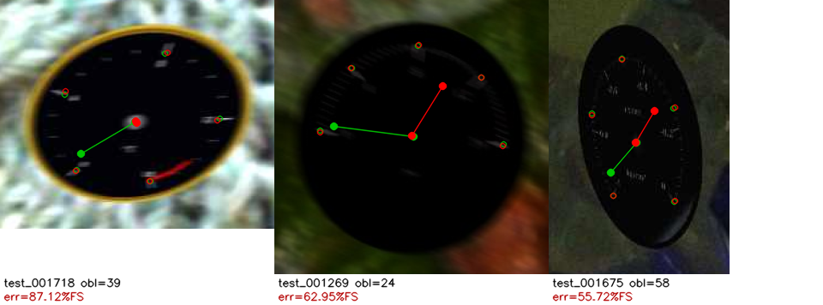
The evaluation caught a bug in our data
29 of 30
largest errors in the first run were black needles on dark faces
11.6 vs 0.6 %FS
error for that group vs every other face and needle colour
First E2 run: green lines are the true needle positions; the black needles are practically invisible
Fix: the generator never draws a black needle on a dark face (or white on light). Re-evaluated on corrected test data, every strategy's error roughly halved and the outliers vanished. The current models were still trained on the old data (6.7 % of images affected), so retraining is planned.
Notes:
A good example of why per-image analysis matters: the mean error was dominated by 30 images that no method could read, all caused by our own renderer.

Slide 15
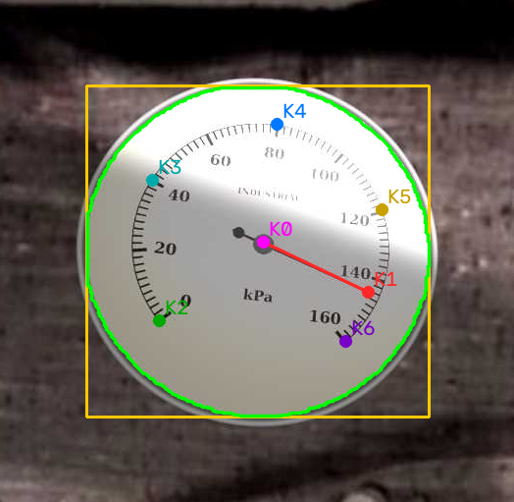
Live demo
python -m scripts.demo
Upload, take or paste (Ctrl/⌘+V) a photo
Shows the keypoints, the corrected dial and all four readings
Value from the scale range: typed, or read from the dial numerals (experimental)
About 0.1 s per photo on a laptop CPU
Synthetic test photo at 16.5°, 0–160 scale: S2 reads 145.1, true value 144.2
Notes:
Run the demo live if time allows: photograph a gauge head-on, then at 30 and 50 degrees, and watch S0 drift while S1 and S2 hold. Reading the scale range with OCR is experimental and often fails on real photos; typing the range always works.

Slide 16
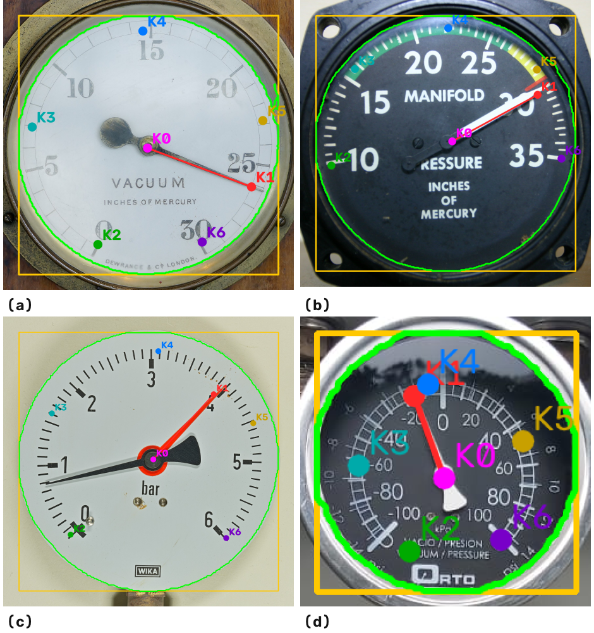


Real photographs, and what comes next
185 / 298
No labels
web photos where the dial was found (62 %)
so this test shows what transfers, not accuracy
Works: close-up, single-scale gauges are read plausibly (a, b).
Fails: a red set-point marker taken for the needle (c); dual-scale gauges (d).
Future work
Labelled real photos: calibrated phones, ArUco marker, ~350 photos, tooling ready
Nuisance ablation: five training sets ready for retraining
Generator: add marker pointers and dual scales
Photos via Wikimedia Commons: Sasha Taylor (CC BY-SA 4.0), Chopper (public domain), Hannes Grobe (CC BY 3.0), VeRdUgO PY (CC BY-SA 4.0)
Notes:
We ran the trained system on 298 openly licensed gauge photos from Wikimedia Commons. They have no ground-truth readings, so this is a qualitative check: the dial is found in 62 percent of photos, close-up single-scale gauges are read plausibly, and the failures come from things our generator never draws: secondary marker pointers and dual scales. A labelled real-photo test with marker-based tilt labels, and the nuisance ablation, are future work; the tooling for both is ready.

Slide 17
Takeaways
1
Tilt matters: without correction, error grows about 9× from frontal to steep views, to about 4 %FS.
2
Every correction keeps error near 1 %FS up to 65°; simple ellipse fitting (S1) is slightly the most accurate.
3
Projective correction is exact in theory, but needle parallax and five-point fits erase its edge in practice.
Thank you. Questions?
Samarth Pyati · Amit Narendra · Pranathi Manalithara · Rishab A.V — CS4231, Prof. Dr. Ramakrishnan Varadharajan
Notes:
Close with the three findings, then mention that the real-photo evaluation will test whether the ranking holds outside synthetic data.

