Slide 1

Barcode Item Scanner System
BY: NIKHIL SWAMI, SAMARTH KV

Slide 2
Barcode Item Scanner System - Purpose
Scanning Inventory
Having Itemized List of every item
Quantity of each item
Problem of overstocking
Problem of understocking
Perishable goods (optional)

Slide 3
Requirements
Raspberry Pi
Wifi router
Barcode Scanner Camera
Image Processing
MQTT Publisher and subscriber

Slide 4
Security
CA will issue certificates
Publisher certificates
Client certificates
Username Password
Encrypted Key
Encryption of message to be sent (future/optional)
Decryption of message at subscriber side (future/optional)
Restrict Access to a finite set of Ips (future/optional)
Filter user input (future/optional)

Slide 5
Problems Faced
MQTT certificate
Username and password authentication
Image processing and obtaining data
Raspberry Pi camera not working
Processing data at subscriber side

Slide 6
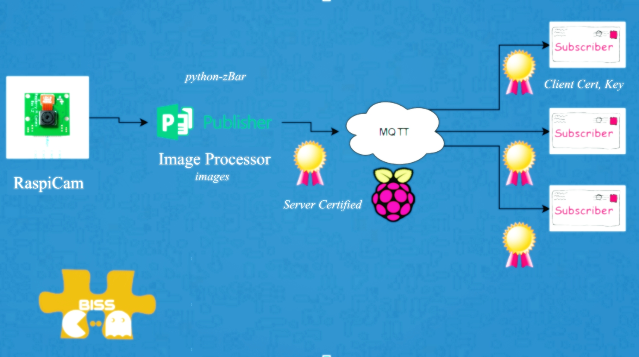
BISS:

Slide 7

Thank you

