Slide 1
Multi-core Processors and Caching - A Survey
Under guidance of,
Mrs . Renukha.
Submitted by,
LAKSHMEESHA P
1st Sem, CSE( M.Tech)
VIAT, Muddenahalli

Slide 2
Contents
Abstract
Introduction
Background
Uses
Previous Work
Conclusions

Slide 3
Abstract
What brought about this changes from single processer architecture to having multiple processor on a single die and some of the hurdles and technologies.
Having each processor or core on a single die allows much greater communication between the processors among other benefits.
The pushes for multi-core processors have been the need for multi-threading and multitasking, security and virtualization, and physical restraints such as heat generation and die size.

Slide 4
Processor cache, the memory between the main memory and the CPU registers, is the performance bottleneck in most current architectures, and as such, can have vast improvements to the overall system.
These caching methods are complex - multi-core processor caches are even more so.

Slide 5
Introduction
Traditional processor architectures have pushed the transistor count well into the hundreds of millions.
These transistors, Nano-scale electronic switches, can switch between on and off (1 and 0) states billions of times in a second.
On a single core processor running multiple applications, the operating system acts as a scheduler - switching contexts between the applications.

Slide 6
Introduction Cont..
In order for applications to reap the greatest benefits from multiple cores, the programmer must divide the application into simultaneous thread or be done by the OS for multitasking.
A thread is a lightweight sub-program that shares the same memory space as other threads under the same program process.

Slide 7
Background
Computer Architectures
Past architectures have included multiple physically separate processors.
Those architectures fall far behind the multiple on-chip processors due mainly to wire delay and caching techniques

Slide 8
2. Cache
Computer cache is intermediary role between main memory and the processor.
Cache is made from static RAM(SRAM),built from static flip-flops, to provide faster access times.
SRAM is a up to four times larger than an equivalent DDR SDRAM module.
Caches are several issues to be dealt with initial placement, identification, replacement, and write strategies.

Slide 9
These have to deal with the fundamental cache element ,a block (Block size 4 to 32kilobytes).
While a bigger block size decreases the miss rate, the miss penalty goes up.
Primary aspects of Caches is the type of mapping strategy:
Direct
Fully associative
Set associative

Slide 10
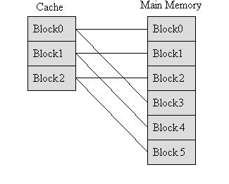
Direct mapping is Each block in main memory has exactly one and only one location in cache it can be copied to.
Fig :Direct mapped cache.
Fully associative is the opposite of direct mapping in that main memory block can stored in anywhere in the cache.
In this mapping, the entire cache must be searched for each memory access.

Slide 11
Set associative is combination of two extremes, direct and fully associative. Cache is broken up into separate sets. Each set is made up of two or more blocks.
This allows the cache some flexibility and which goes through the cache. The cache must limits the amount of thrashing that could occur.

Slide 12
Uses
1.Servers
Servers have a direct application for multicore processors. A server can potentially have many simultaneous connections to many users.
To accept these connections, the server will either spawn a new process or fork off a new thread
2.Consumers
The consumer market has adopted these new processors, banking on the multi-tasking parallelism granted by the multiple cores

Slide 13
3. Virtualization
A system administrator can configure the computer to “virtualize" its devices, or operating system, to allow one or more simultaneous virtual machine(s) to use the computer. If each virtual machine (VM) was its own computer.
4. Analysis Techniques
In the theoretical design of an architecture, one uses mathematical equations to verify the performance.
the average memory access time (AMAT) in seconds or clock cycles can be found by,
AMAT = Hit time + (Miss rate * Miss penalty)

Slide 14
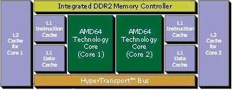
Previous work
1. AMD Athlon 64 FX Architecture
Fig: AMD Athlon 64 FX Architecture
The AMD Athlon 64 FX dual-core processor has two L1 caches, data and instruction, and L2 cache, unified, for each core.

Slide 15
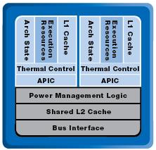
2. Intel Core Duo Architecture
Fig: Intel core Duo Architecture
Intel uses a shared L2 cache in what is referred to as the “Advanced Smart Cache”.
Reducing cache misses and increasing the performance.

Slide 16
Conclusions
Parallel programming and operating system collaboration remain key in the proper fulfilment of a multicore processor's usefulness.
Further caching schemes, both specialized and general, will continue to be honed, narrowing the performance gap between the processor and main memory.

Slide 17
THANK YOU….

