Slide 1

Sri Venkateshwara College of Engineering Vidyanagar, Kempegowda International Airport Road, Bengaluru 562157 Department of Computer Science and Engineering
PRESENTATION ON
Modern Home Automation System Using
Raspberry Pi
Under the guidance of
Mr.Srinivasa G,
Asst.professor
Dept. of CS&E, SVCE
Presented By
POOJA HEGDE
2nd sem M.Tech (CS&E)

Slide 2
CONTENTS
Introduction
What is raspberry Pi
Related work
Disadvantages of Existing System
Proposed System
Advantages
Conclusion
References

Slide 3
INTRODUCTION
The home automation refers to domestic environment that improves the quality of the resident’s life.
Most home automation systems use different wireless communication standard to exchange data between their components.
The remote controlling and monitoring of a house using internet requires computer, it is large in size and heavy to carry around.

Slide 4
What is Raspberry Pi
The Raspberry pi is a low cost, credit-card sized
computer that plugs into a computer monitor or
TV and uses a standard keyboard and mouse.
It’s capable of doing everything you would expect a desktop computer to do - spreadsheet, word processing, playing games.

Slide 5
Raspberry Pi continued…
It was created with the intension of providing kids all over the world to learn programming and understand how computers work.
It is highly affordable programming computer that they can buy easily by kids and can break it without the fear of an angry parent.
Raspberry Pi has the ability to interact with the outside world, and has been used in many projects.

Slide 6
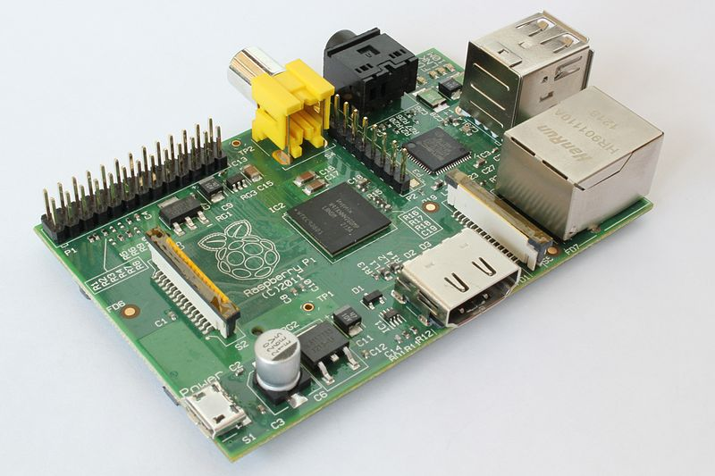
Raspberry Pi
Audio
Video
USB
GPIO
Ethernet
SD
HDMI
Power
CPU

Slide 7
Types of Raspberry pi
 | Model A | Model A+ | Model B | Model B+
Developer | Raspberry pi foundation | Raspberry pi foundation | Raspberry pi foundation | Raspberry pi foundation
Introductory price | US$25 | US$20 | US$35 | US$35
Operating system | Linux | Linux | Linux | Linux
Power | 2.5 W | 1.0 W | 3.5 W | 3.0 W
CPU | Arm processor 700 MHz | Arm processor 700 MHz | Arm processor 700 MHz | Arm processor 700 MHz
Memory | 256 MB | 256MB | 512MB | 512MB
Size | 85.60 mm × 56.5 mm | 65.00 mm × 56.5 mm | 85.60 mm × 56.5 mm | 85.60 mm × 56.5 mm
Weight | 45 gm | 23 gm | 45 gm | 45 gm

Slide 8
RELATED WORK
Home automation systems are available in a
number of varieties. A few have been discussed
here.
Home Automation using GSM.
SMS based Home automation.
Java-Based Home Automation System.

Slide 9
Home automation using GSM
The entire system depends on a 8 bit microcontroller named PIC (Peripheral Interface Controller) in this work.
Microcontroller communicates with each and every node presents in system.
GSM (global system for mobile communications) communicates between user and microcontroller.

Slide 10
SMS based Home automation
Here communication interface between the home automation system and the user through SMS technology .
System security based on user authentication of each SMS being exchange, as each SMS contains user name and password.

Slide 11
JAVA based home automation
Java-based automation system can monitor and control home appliances via the World Wide Web.
The design is based on a stand alone embedded system board integrated into a PC-based server at home.
The home appliances are connected to the input/output ports of the embedded system board and their status are passed to the server.

Slide 12
EXISTING SYSTEM
Currently systems are implemented with a large amount of hardware.
very poor in bandwidth utilization.
It also imposes a huge installation cost on the user. SMS based and GSM based home automation is costly .
Current systems are inefficient in security. Java based home automation is very poor in security.

Slide 13
PROPOSED SYSTEM
The proposed system supports more flexibility, comfort ability and security.
The new kind of system brought android and raspberry-pi into home automation implementation.
The main objectives of the proposed system is to design and implement a low cost and open source home automation system.

Slide 14
Modern home automation system using Raspberry pi
Home automation is required to be without new wiring and to be very easy installation.
It is having mainly three components :
User interface
Wi-Fi Router Configuration
Raspberry-PI

Slide 15
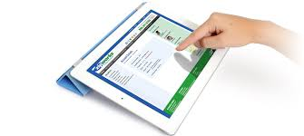
User interface
User interface is everything that the user can see and interact with.
Android provides a variety of pre-build UI components .
The Android will allow user to view device status and to control device.

Slide 16
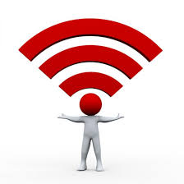
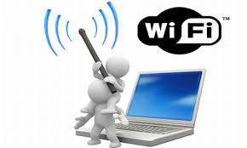
Wi-Fi Router Configuration
The Wi-Fi unit provides the medium for communication .
It can be also configured to make security services.

Slide 17
Raspberry-pi
The core of the home automation system is this mini computer.
Here model B ,700 MHz ARM processor with 512 MB RAM used.
The raspberry pi board is configured according to the home system and it will enable the adjust as per user request.

Slide 18
Advantages proposed system
The new system will provide the following
Features :
It allows more flexibility through android device.
It allows a good range of scalability.
It provides security and authentication.
Additional vendors can be easily added.

Slide 19
CONCLUSION
It makes the system more flexible and provides attractive user interface compared to other home automation systems.
In this system integrate mobile devices into home automation systems which is more popular.
Here complexity of the home automation system is reduced by including them into a simple, but comprehensive set of related concepts.

Slide 20
REFERENCES
[1].Sharma, Rupam Kumar, et al. "Android interface based GSM home security system." Issues and Challenges in Intelligent Computing Techniques ICICT), 2014NInternational Conference on. IEEE, 2014.
[2]. De Luca, Gabriele, et al. "The use of NFC and Android technologies to enable a KNX-based smart home." Software, Telecommunications and Computer Networks (SoftCOM), 2013 21st international Conference on. IEEE, 2013.
[3].Gu, Yi, et al. "Design and Implementation of UPnP-Based Surveillance Camera System for Home Security." Information Science and Applications (ICISA), 2013 International Conference on. IEEE, 2013.
[4].Van Thanh Trung, Bui, and Nguyen Van Cuong. "Monitoring and controlling devices system by GPRS on FPGA platform." Advanced Technologies for Communications (ATC), 2013 International Conference on. IEEE, 2013.
[5].Karia, Deepak, et al. "Performance analysis of ZigBee based Load Control and power monitoring system." Advances in Computing, Communications and Informatics (ICACCI), 2013 International Conference on. IEEE, 2013.

Slide 21


