Slide 1


DATA SCIENCE TOOLBOX: PYTHON PROGRAMMING - COVID-19 Analysis by ZIP Code
This project analyzes a COVID-19 dataset containing weekly cases, deaths, tests, and case rates across ZIP codes. The aim is to uncover temporal trends, regional severity, correlations, and anomalies using Python tools like Pandas, NumPy, Matplotlib, and Seaborn. The analysis is structured into six objectives, providing actionable findings for public health stakeholders.
by Samarth Garg

Slide 2
Data Cleaning and Handling Missing Values
Data Quality
Specific Functions
Ensuring data quality by addressing duplicates, missing values, and incorrect data types is foundational for reliable analysis. The dataset was processed to remove duplicate rows and impute missing values in numeric columns using medians to maintain central tendency.
df.drop_duplicates(): Removes duplicate rows.
df.astype(str), pd.to_datetime(): Converts ZIP Code to string, Week Start and Week End to datetime.

Slide 3
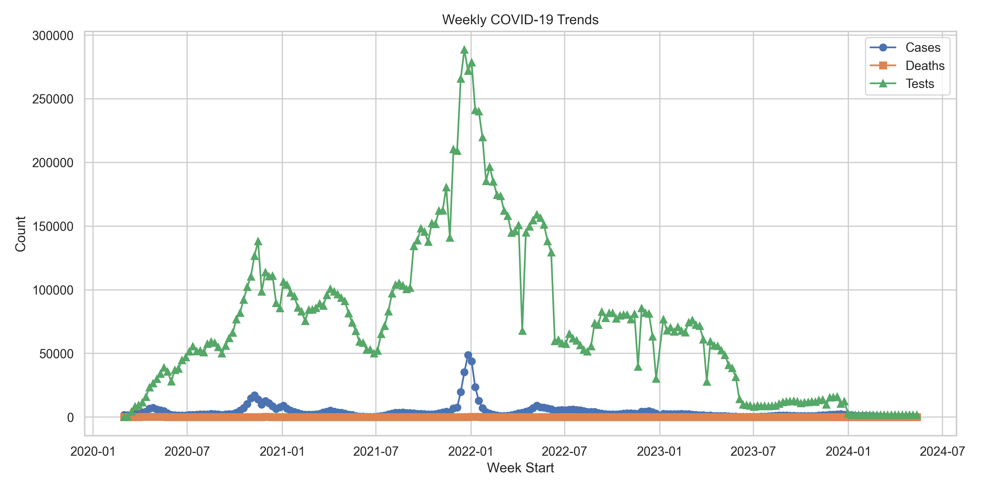
Weekly COVID-19 Trend Analysis
1
Data Aggregation
Data was aggregated by week across all ZIP codes to compute total Cases - Weekly, Deaths - Weekly, and Tests - Weekly.
2
Trend Visualization
Trends were visualized using a line plot to show temporal progression and a stacked area chart to show cumulative contribution.
3
Peak Identification
Cases - Weekly peaked around late 2020 and early 2022, indicating two major waves. Deaths - Weekly followed a similar pattern.

Slide 4
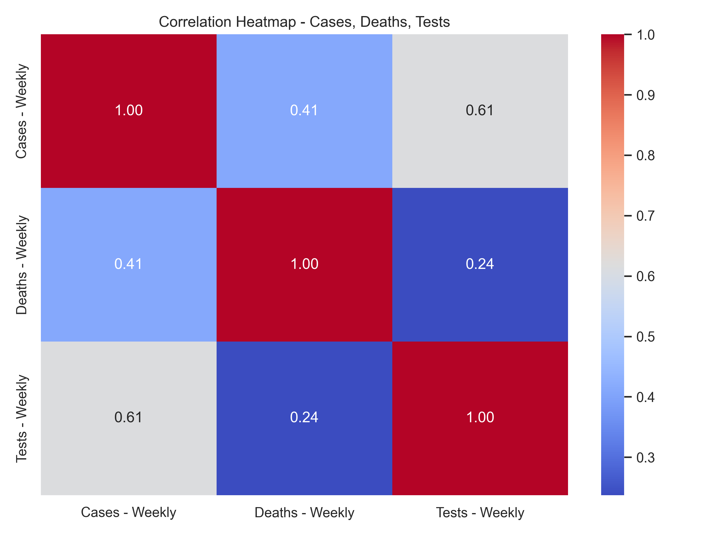
Correlation Analysis Between Cases, Deaths, and Tests
Correlation Matrix
Case-Test Correlation
Computed the Pearson correlation matrix for Cases - Weekly, Deaths - Weekly, and Tests - Weekly. Cases - Weekly and Deaths - Weekly have a strong positive correlation of 0.65.
Cases - Weekly and Tests - Weekly have a moderate correlation of 0.49, suggesting testing increased with case surges but not proportionally.
Death-Test Correlation
Deaths - Weekly and Tests - Weekly have a weaker correlation of 0.33, reflecting a less direct relationship.

Slide 5


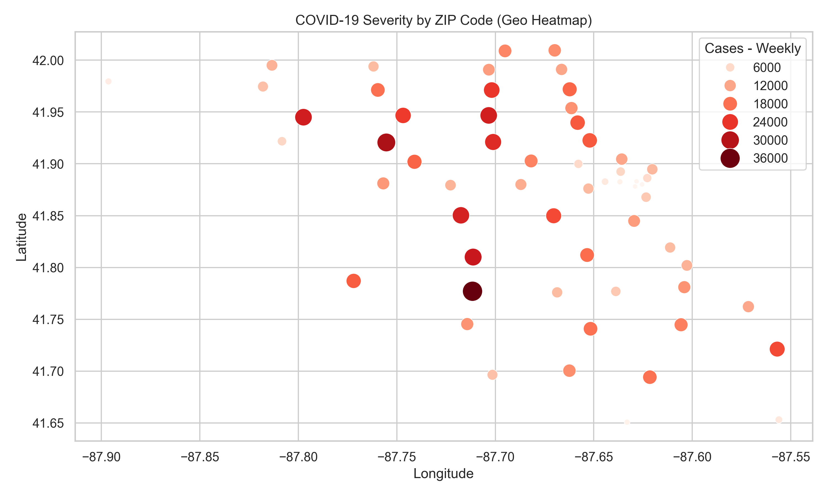
ZIP Code Wise COVID-19 Severity Analysis
Geographic Variation
Severity Visualization
Geographic variation in COVID-19 impact highlights areas needing attention. Data was aggregated by ZIP code to compute total Cases - Weekly, Deaths - Weekly, and Tests - Weekly.
Severity was visualized using three bar plots (top 10 ZIP codes per metric) and a heatmap (all ZIP codes).
ZIP code 60629 was identified as the highest in cases, deaths and tests. Urban ZIP codes dominate due to population size, with 60629 being the most affected across all metrics.

Slide 6

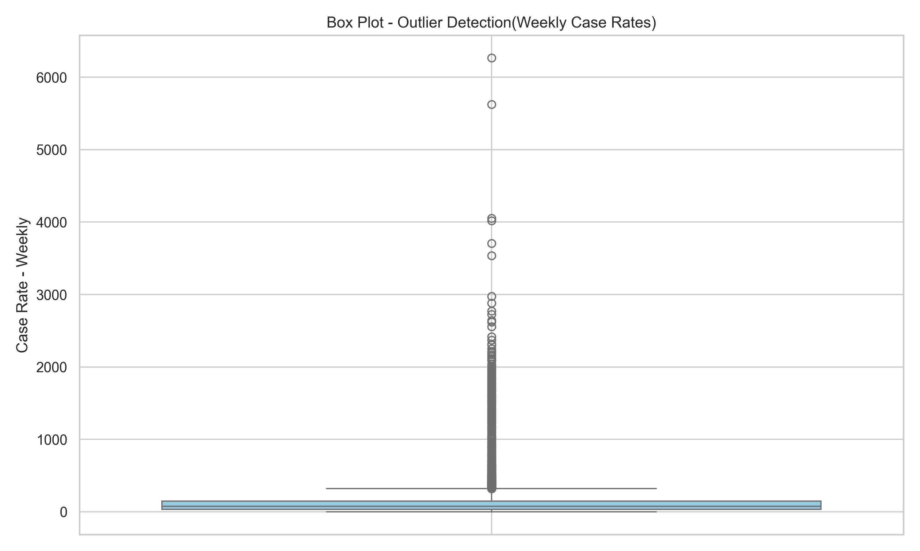


Outlier Detection in Case Rates
Outlier Identification
Outliers in case rates indicate unusual patterns, such as localized outbreaks. A boxplot was used to visualize the distribution of Case Rate - Weekly.
IQR Method
The IQR method was applied to identify outliers numerically. Outliers indicate potential data anomalies or significant public health events.
ZIP Code 60666
ZIP code 60666 (O’Hare Airport) showed extreme rates, suggesting a need to exclude or adjust for low-population areas in rate calculations.

Slide 7
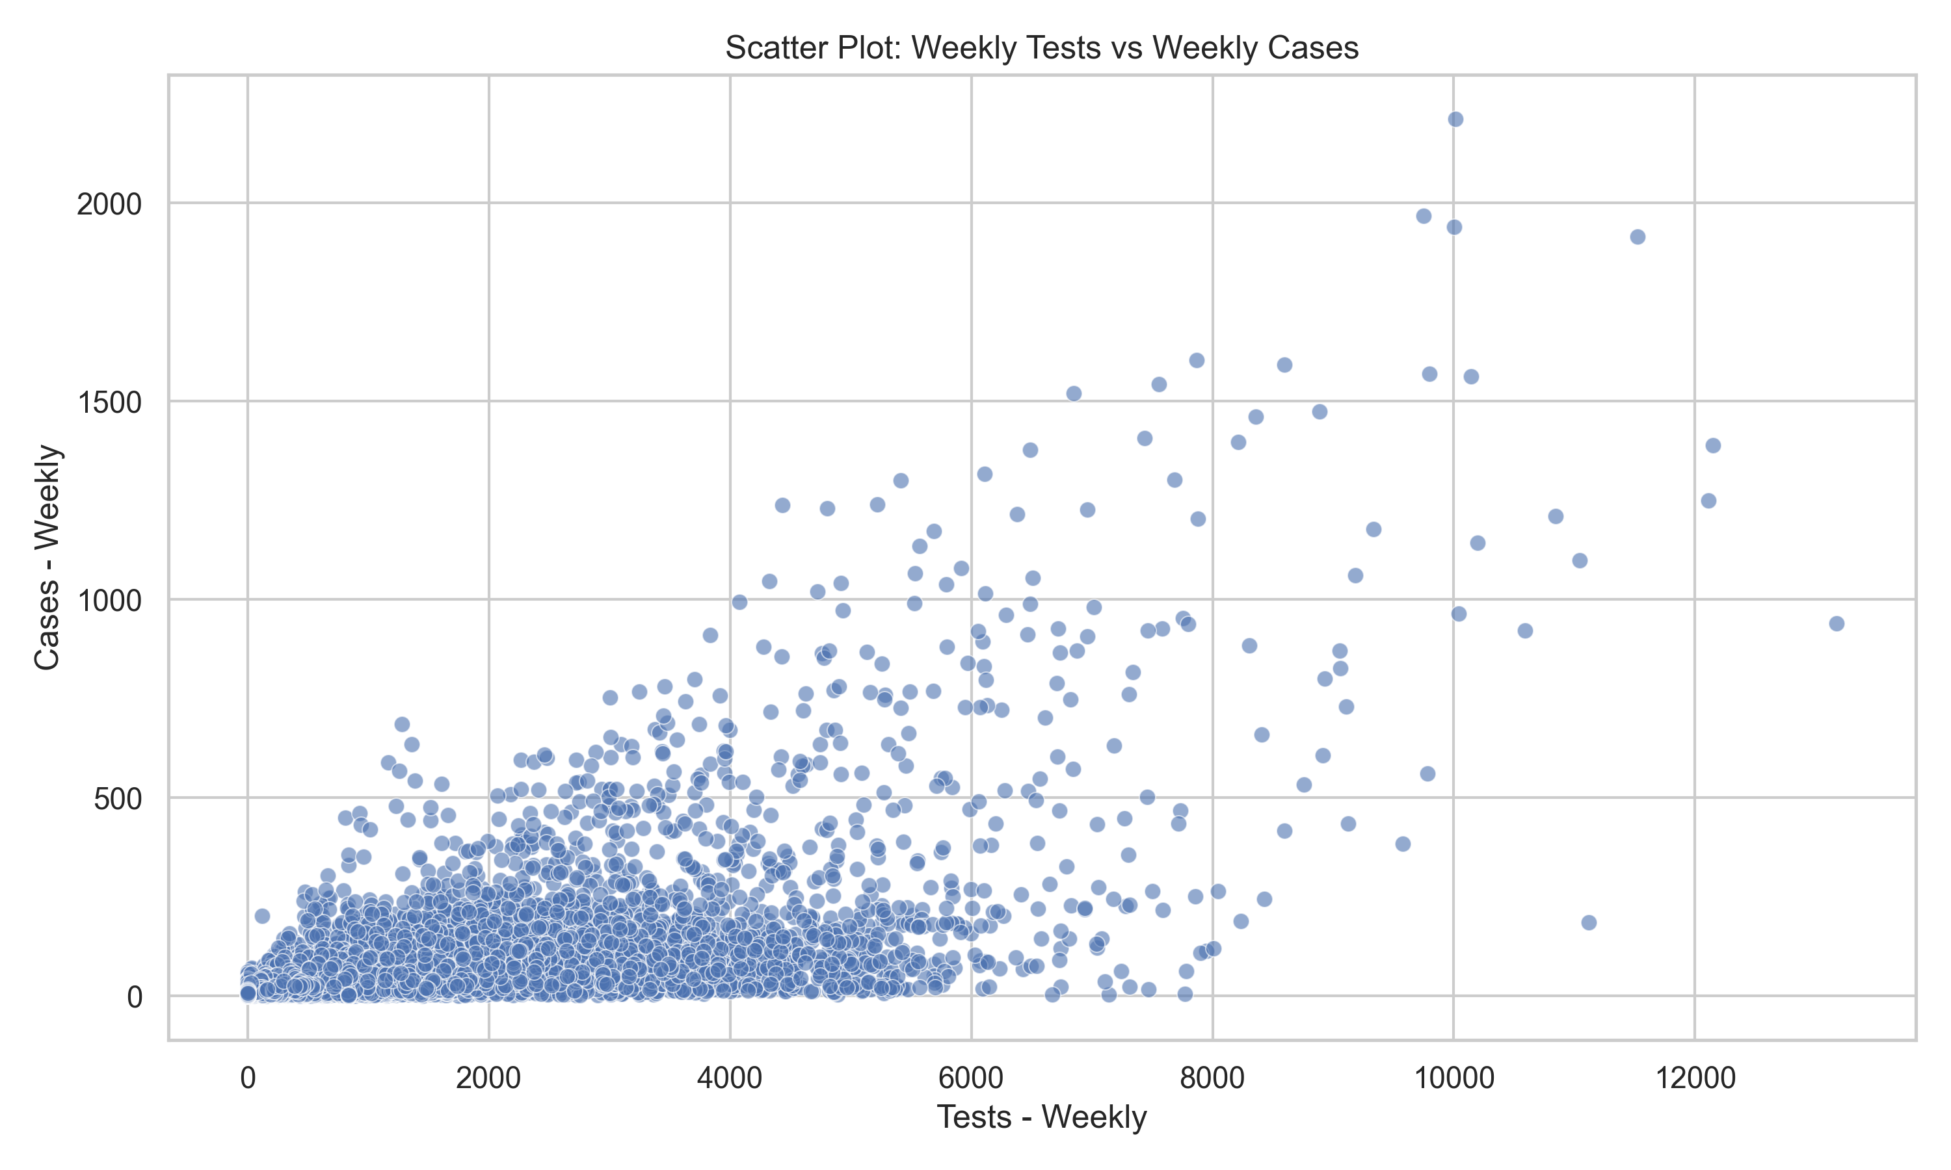
Exploratory Data Analysis (EDA) with Advanced Visualizations
EDA uncovers hidden patterns through diverse visualizations. Summary statistics were computed, and a histogram (cases), scatter plot (cases vs. tests), and density plot (case rates) were generated to examine data characteristics. The histogram for Cases - Weekly is right-skewed, with most weeks showing fewer than 100 cases.

Slide 8

Conclusion and Future Scope
Key Findings
The analysis provided comprehensive insights into COVID-19 dynamics, including identifying waves, confirming a strong case-death correlation, and highlighting high-severity ZIP codes.
Future Directions
Future scope includes advanced modeling, demographic analysis, geospatial mapping, robust outlier handling, real-time analysis, and policy impact assessment.
The findings underscore the importance of targeted interventions in high-severity areas and robust data validation for outliers. Advanced modeling and integration of live data feeds can enhance ongoing monitoring and predictive capabilities.

Slide 9
Enhancements and Inclusions
Advanced Modeling
Demographic Analysis
Geospatial Mapping
Time series analysis and regression models can forecast trends. Models help predict future cases and deaths.
Integrating demographic data enhances insights. Factors include age, income, and race/ethnicity.
Mapping with tools like GIS identifies spatial clusters. It helps visualize geographic patterns.

Slide 10

Thank You
Thank you for your time and attention.
We hope this analysis provides useful insights.
1
Insights
2
Findings
Comprehensive analysis of COVID-19 trends.
Key patterns and insights on case severity.
3
Predictions
Advanced modeling can help predict future outbreaks.

