Slide 1

Project Title –Seasonal Agricultural Performance Analysis
Student Name – Samarth Iranna Kurle
College Name - Nagesh Karajagi Orchid College of Engineering and Technology, Solapur
AICTE STU ID : STU6a6c7e5bef5271785495131

Slide 2

PROBLEM STATEMENT
Agricultural performance changes across seasons due to variations in environmental conditions, farming practices, resource usage, and market conditions. The problem is to analyze agricultural data and identify seasonal differences in crop performance, resource utilization, and economic outcomes using data analytics, visualization, and statistical techniques.

Slide 3
Project Description
Seasonal Agriculture Performance Analysis is a data analytics project that studies agricultural performance across different seasons. The project analyzes factors such as crop yield, production, rainfall, soil moisture, irrigation, water usage, revenue, and profit.
The raw agricultural data is cleaned and processed before performing exploratory data analysis. Statistical techniques and data visualizations are used to compare seasons, identify trends, relationships, and variations in agricultural performance.
The project aims to generate meaningful, data-driven insights that can help in better resource management, seasonal planning, and agricultural decision-making.

Slide 4

WHO ARE THE END USERS?
Farmers – To understand seasonal crop performance and improve farming decisions.
Agricultural Planners – To support seasonal planning and resource management.
Agricultural Researchers – To study seasonal trends and agricultural patterns.
Government & Agricultural Departments – For data-driven agricultural planning and policy decisions.
Agribusinesses – To analyze crop production, resource usage, and economic performance.
Data Analysts – To analyze and visualize agricultural performance data.

Slide 5

Technology Used
  Python – Data analysis and processing
  Jupyter Notebook – Project development and analysis
  Pandas & NumPy – Data cleaning and manipulation
  Matplotlib & Seaborn – Data visualization-
  SciPy – Statistical analysis
  Machine Learning Techniques – Pattern and relationship analysis
  CSV Dataset – Agricultural performance data

Slide 6
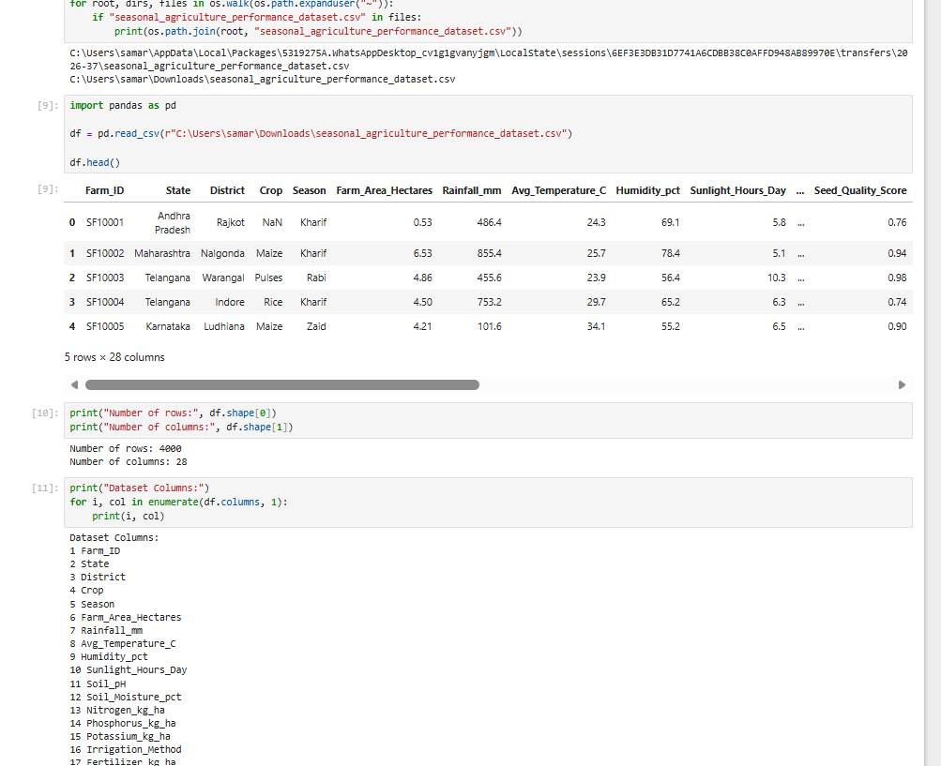
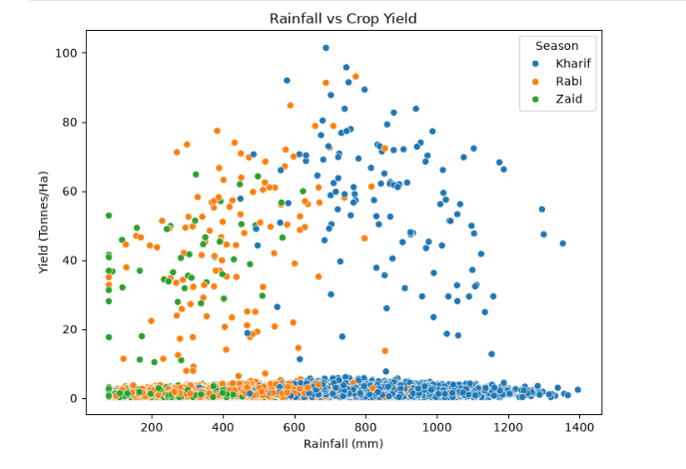
RESULTS

Slide 7
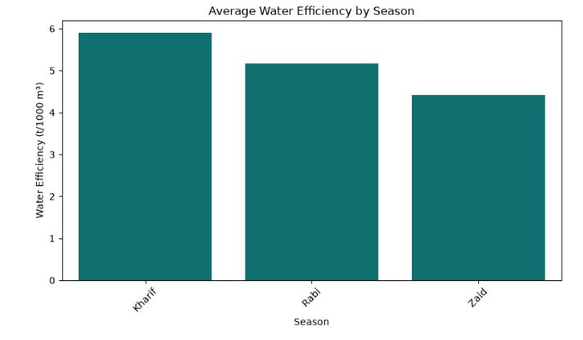
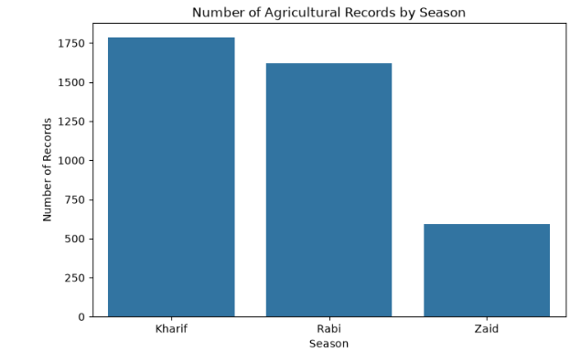

Slide 8
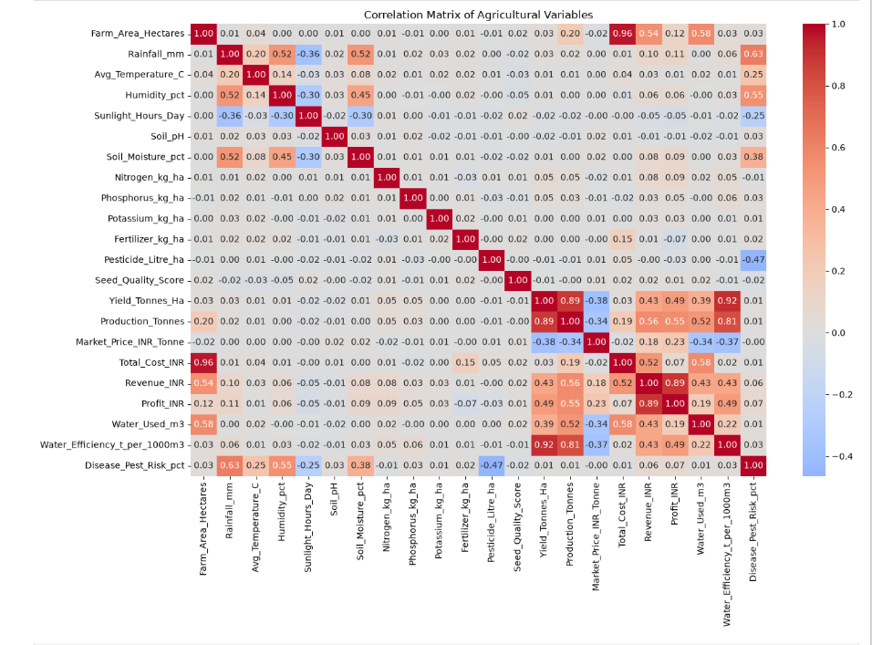
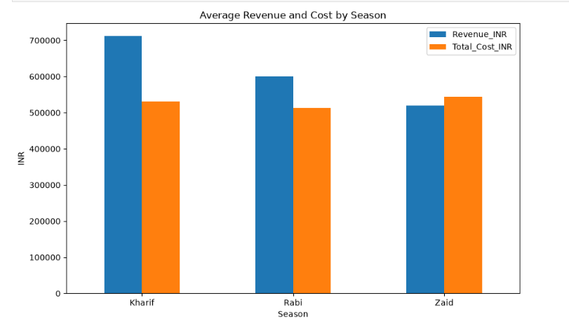
RESULTS

Slide 9
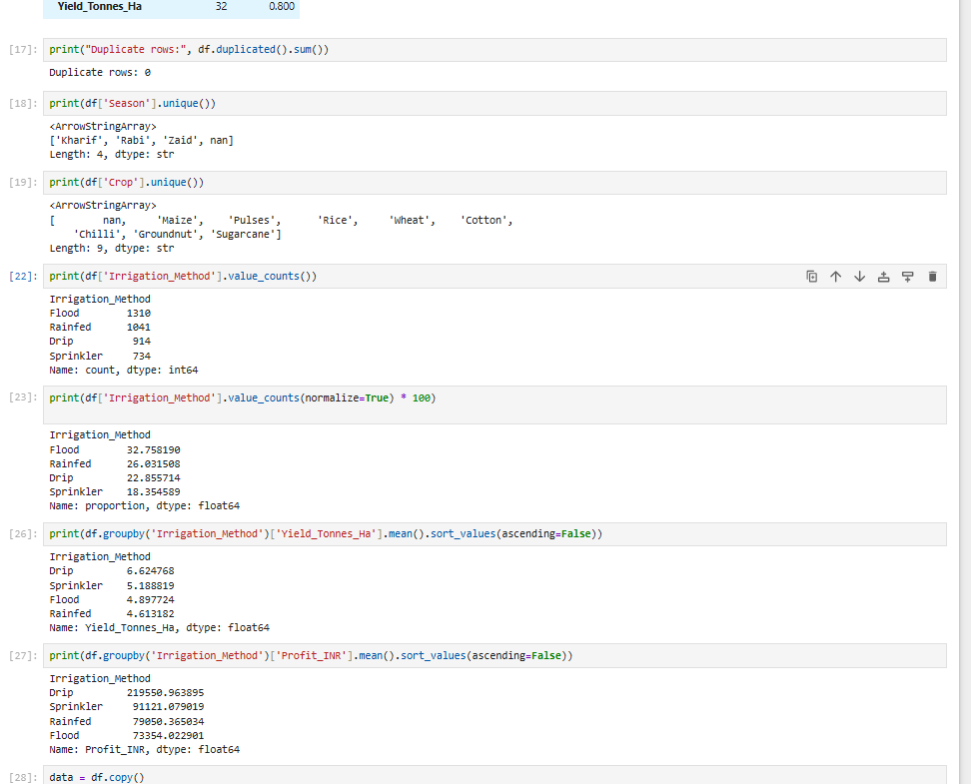
RESULTS
[Add screen shots of your code ]

Slide 10
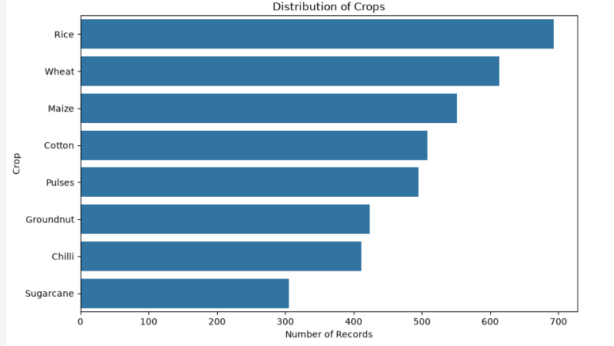
RESULTS
[Add screen shots of your code ]

Slide 11
Future scope
Develop AI/ML models to predict crop yield and seasonal performance.
Add real-time weather and soil data for better analysis.
Develop a dashboard for farmers and agricultural planners.
Provide crop and irrigation recommendations based on seasonal conditions.
Integrate IoT sensors and satellite data for real-time monitoring
Extend the system to support more crops and regions.

Slide 12
GitHub Link
https://github.com/Samarthk22/seasonal-agriculture-performance-analysis.git

Slide 13
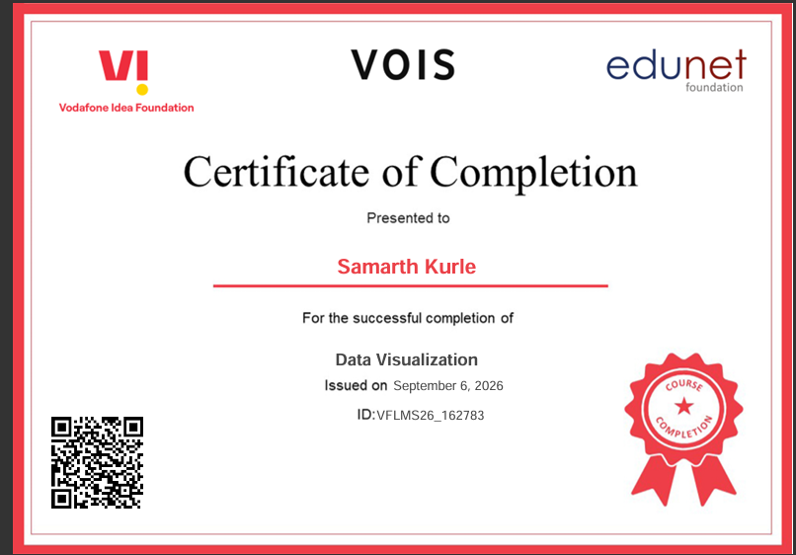
VOIS Course completion certificate -
Course name- Data Visualization

Slide 14
Thank you
.
.

