Slide 1
E-Bay Shopping Website
By :- Samarth kumar yadav
under the guidance of Mrs. Vaishali Sonawane Mam

Slide 2
INTRODUCTION
eBay is one of the world’s largest online marketplaces, connecting millions of buyers and sellers globally. It provides a platform where users can list, buy, and sell products through both auctions and fixed-price listings.
eBay enables individuals as well as businesses to showcase their products to a worldwide audience, making it a key player in the e-commerce ecosystem.

Slide 3
OVERVIEW
What is eBay?
eBay is a global e-commerce marketplace that allows users to buy and sell products and services online. It connects millions of buyers and sellers worldwide through both auction-style listings and fixed-price sales.
eBay provides a platform where individuals and businesses can showcase their products to a global audience.
Users can search, bid, and purchase items across multiple categories such as electronics, fashion, collectibles, and more.
👉 eBay serves as a real-world example of an online store, making it ideal for practicing and demonstrating e-commerce automation testing.

Slide 4
Modules
📦 eBay Modules for Testing
Module 1 : Sign in Page
Checked all the functionalities on Sign in page, including:
Email address input field
Sign in button
Forgot password link
Create account link
Module 2 : Electronics Page
Checked all functionalities on Electronics category page, including:
Item details (title, price, seller info)

Slide 5
Filters (Brand, Condition, Price range, Delivery options)
Compare button
Add to Cart button
Module 3 : Fashion Page
Checked all functionalities on Fashion category page, including:
Item details (size, color, price)
Quantity selection
Filters (Size, Brand, Material, Price)
Grid/List view buttons
Module 4 :- Order History Module
Checked past orders, invoice download
return/replacement options, and tracking link.

Slide 6
Module 5 : Cart & Checkout Page
Verified functionalities on Cart & Checkout page, including:
Add/Remove items
Update quantity
Apply coupons (if available)
Proceed to checkout
Payment options (Card, PayPal, etc.)
Module 6 :- Profile & Settings Module
Checked editing personal info, changing password,
managing addresses, and payment preferences.

Slide 7
DEFECTS
While executing my assigned test cases on the eBay website, I observed that at certain points, some fields and functionalities were not working as expected. Since this is considered a defect, I created a Defect Report to log and track the issues.

Slide 8
Defect 1
Defect Identifier : EBAY_002
Defect Summary : Search filter Price Range not- working – products outside the selected price range are displayed.
Test ID : TC_210
Test Case Name : TC_search_filter_price_validation
Module Name : Search Page
Reproducible : Yes
Severity : Medium
Priority : High
Raised By : Samarth Yadav (Tester)
Assigned To : Developer
Status : Pending
Snapshots : Shown in next slide

Slide 9
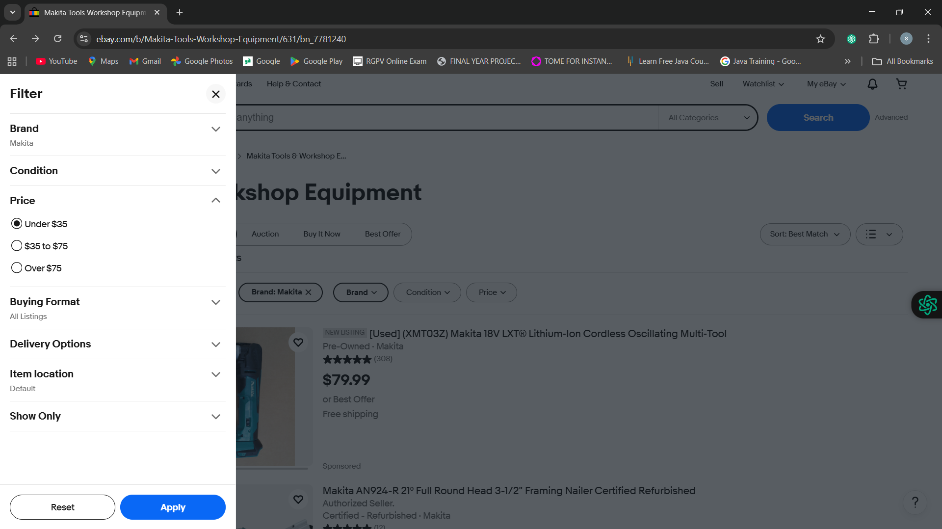
When applying filters (such as Price Range, Condition, or Brand) on the eBay search results page, products outside the selected criteria are still displayed. This leads to irrelevant results and affects the accuracy of search functionality.

Slide 10
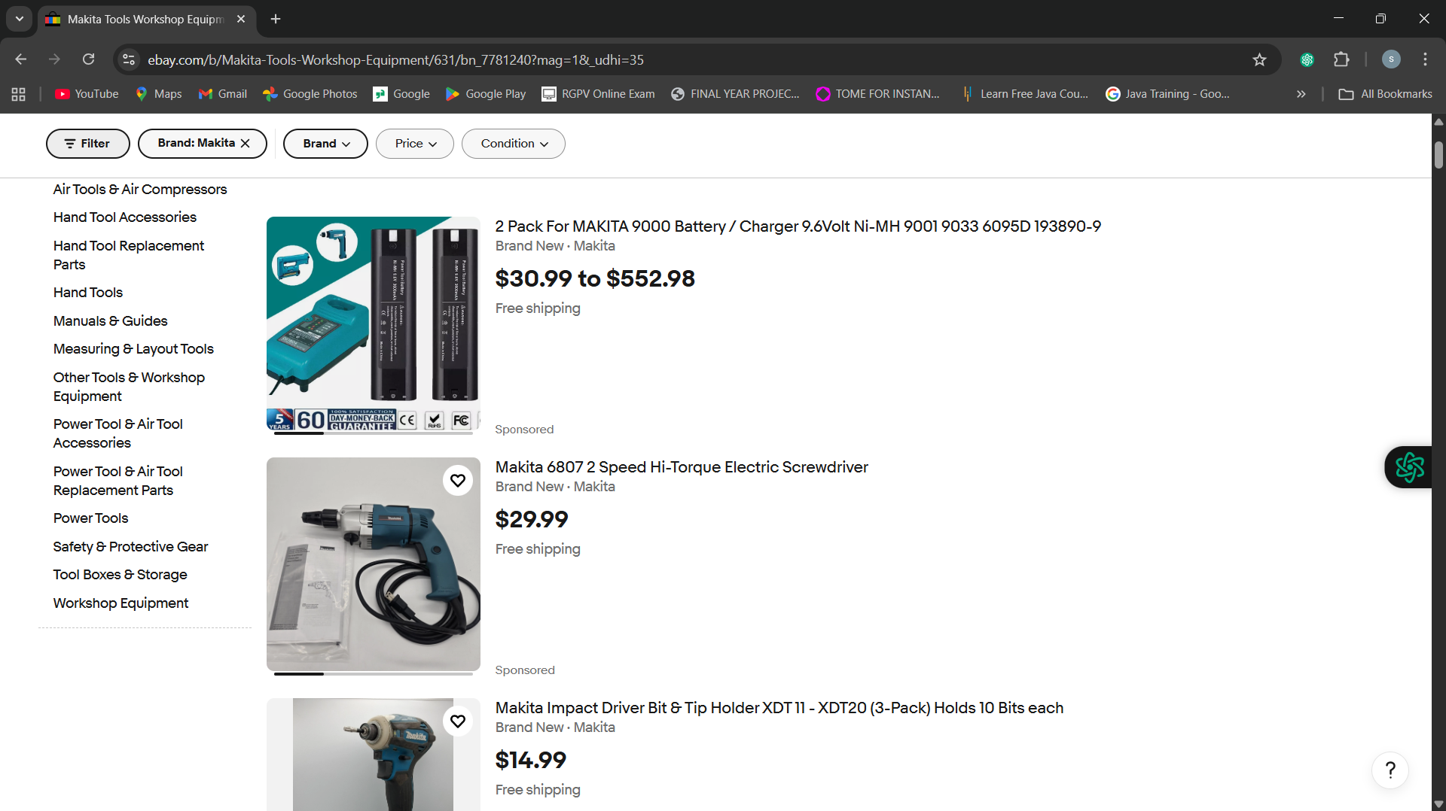



Slide 11
Challenges
Cross-Browser Compatibility
Certain functionalities behaved differently in Chrome vs. Firefox (like UI alignment or button clicks).
Performance Issues
Some pages took longer to load

Slide 12
EXPERIENCED GAINED
1) Module-wise Testing
Got exposure to breaking down an application into modules (Login, Product Page, Checkout, etc.) and testing them individually.
2) Problem-Solving Skills
Learned how to handle dynamic elements, synchronization issues, and browser compatibility challenges.
3) Defect Reporting
Learned how to identify, log, and track defects properly in a defect report format.

Slide 13
THANK YOU

