Slide 1

Problem Statement ID : SIH1683
Problem Statement Title : Development of AI/ML based solution for detection of face-swap based deep fake videos.
Theme : Miscellaneous
PS Category : Software
Team Name (Registered on portal) : DATA DRAGONS
Team Members : EDWIN JOEL P
DIVIYA V
SUBESH S
RADHIKA V

Slide 2
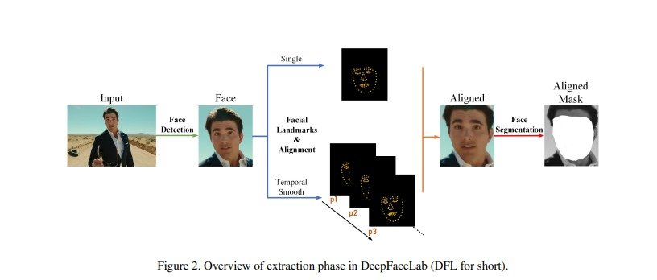
Idea Title : AI-Based Deepfake Detection System
Proposed Solution
Innovation and Uniqueness
An AI/ML-based system that detects deepfakes, particularly face swaps, in uploaded videos and images.
If the content is identified as fake, the system separates the video, audio, images, and subtitles into real and fake components.
Users can directly file a complaint with cybersecurity authorities through an integrated reporting feature.
Identifies if content is created by AI or is animated
Includes a browser extension and automatic checks.
Analyzes both visual and audio components.
Enhances global usability by accommodating various languages
Allows users to help improve accuracy and shows a visual timeline of fake content

Slide 3
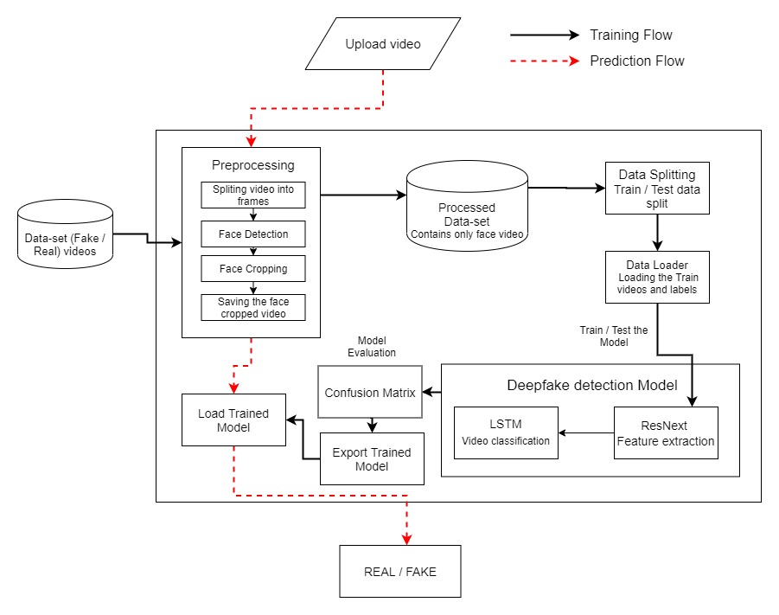
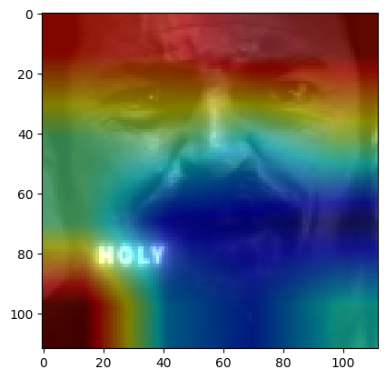
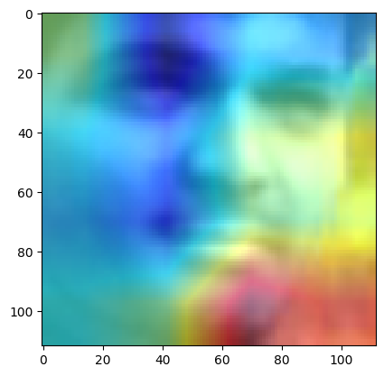
Technical Approach
Data Collection and Data Preprocessing
Deepfake Detection Model
Training and Validation
Component Separation
Model Optimization
System Scalability
User Interface (UI) Design
Reporting and Compliance
Security and Privacy
Continuous Learning and Updates
REAL
FAKE

Slide 4
Potential challenges and risks
Data Quality : Poor quality or limited training data can reduce the effectiveness of AI/ML models in detecting face swaps.
Evolving Techniques : Deepfake technology is constantly improving, making it harder for detection systems to keep up.
Complexity in Multimodal Content : Detecting deepfakes in videos where audio, facial expressions, and lip movements are synchronized can be more complex than in static images.
Strategies for overcoming these challenges
Evolving Techniques : Regularly update and adapt our detection system with diverse data and feedback to keep up with evolving deepfake techniques.
Data Quality : Enhance data quality by collecting more varied and detailed examples of deepfakes and real content to train our models better.
Complexity in Multimodal Content : We used a multi-layered approach that analyzes audio, facial expressions, and lip movements together for better detection of complex deepfakes.
Analysis of the feasibility of the idea
Computational Complexity: Requires high processing power; optimize models and use specialized hardware for real-time detection.
Scalability and User Demand: Needs scalable infrastructure; utilize cloud services and distributed processing to handle large volumes effectively.

Slide 5
Potential impact on the target audience
Enhanced Trust in Digital Media: Our solution helps users discern between real and fake content, thereby restoring trust in digital media, which is crucial in an age of misinformation.
Protection Against Misinformation: By detecting and exposing deepfakes, Our platform can significantly reduce the spread of false information, particularly in sensitive areas like politics, news, and social media.
Improvement of Online Safety: The browser extension automatically checks for deepfakes while you browse, making online experiences safer
Benefits of the solution
Accurate Deepfake Detection: Users can trust our platform to accurately differentiate between real and fake content, giving them confidence in their media consumption.
User-Friendly Experience: Uploading videos or images is easy, and users get clear results with visual timelines and feedback, making it simple for everyone to use
Comprehensive Analysis: Our solution breaks videos into audio and images, showing the original and altered content for a clear analysis of any changes.

Slide 6
References and Research
Dataset & Research :
paperswithcode.com
References :
FaceForensics++
References and Deepfake Detection Challenge :
www.kaggle.com
complete process for deepfake detection :
deepfakeforensics
References video
Video dataset & ML :
open weaver
Deepfake detection process :
kite

