Slide 1

Vel Tech Rangarajan Dr. Sagunthala R&D Institute of Science and Technology
School of Computing
Department of Computer Science and Engineering
10211CS224 / FULL STACK APPLICATION DEVELOPMENT (JAVA)
PROJECT REVIEW : MILESTONE PROJECT – 2
Date: 20-04-2026
Smart Event Ticket Booking System using React JS
SDG 9: Industry, Innovation, and Infrastructure
Presented By:
BHUMIREDDY SAMATHA REDDY
– VTU26586 – 23UECS1025
Courses Handling Faculty:
Dr . HAFIZUR RAHMAN

Slide 2
INTRODUCTION
1
Event management in educational institutions often relies on manual processes or basic tools, which can lead to inefficiencies and errors in ticket booking. Students and faculty may face difficulties in accessing event details and registering on time. With the increasing number of departmental events, there is a growing need for a streamlined and automated solution. This project is important as it simplifies the booking process and improves user experience. It also helps organizers manage event data efficiently and avoid issues like overbooking. In real-world scenarios, such systems are widely used for concerts, seminars, and conferences. The proposed system is a React JS-based web application that allows users to view event details and book tickets online. It ensures accuracy, transparency, and ease of use for both users and administrators.
2
3
4
5
6
7
8
9

Slide 3
PROBLEM STATEMENT
1
In many educational institutions, event ticket booking is handled manually or through unstructured systems, leading to inefficiencies and errors. Students and faculty often face difficulties in accessing event details and booking tickets on time. Manual tracking of ticket availability can result in overbooking or data inconsistency. There is also a lack of a centralized platform to manage event information and user registrations. This creates confusion, delays, and poor user experience. Therefore, there is a need for a simple, efficient, and automated web-based system. The system should allow users to view event details and book tickets easily. It should also ensure accuracy, transparency, and better management of event data.
2
3
4
5
6
7
8
9

Slide 4
OBJECTIVE(S)
1
To design and develop a React JS-based web application for efficient event ticket booking and management: The objective is to create a responsive and interactive web platform where users can easily view event details such as name, date, venue, and ticket availability. The system should allow seamless ticket booking, store user information securely, and provide real-time updates on ticket availability. It should also support organizers in managing event data effectively through a centralized interface.
To implement a user-friendly system that improves booking accuracy, reduces manual errors, and enhances user experience: This objective focuses on building an intuitive interface that simplifies the booking process for students and faculty. The system should minimize errors like duplicate bookings or incorrect data entry by validating user inputs. It should also provide instant confirmation and clear navigation, ensuring a smooth and efficient experience while improving overall system reliability and performance.
2
3
4
5
6
7
8
9

Slide 5
PROPOSED SYSTEM
The proposed system is a React JS-based web application designed to automate event ticket booking for internal department events.
It provides a centralized platform where users can view event details such as name, date, venue, and ticket availability.
Users can easily book tickets online by entering their details, reducing the need for manual registration.
The system maintains real-time updates of ticket availability, preventing overbooking issues.
Input validation and structured data storage help reduce errors and improve data accuracy.
It offers a user-friendly interface that ensures smooth navigation and quick booking.
Organizers can efficiently manage event information and monitor bookings through the system.
Compared to manual or basic systems, it improves efficiency, transparency, speed, and overall user experience.
1
2
3
4
5
6
7
8
9

Slide 6
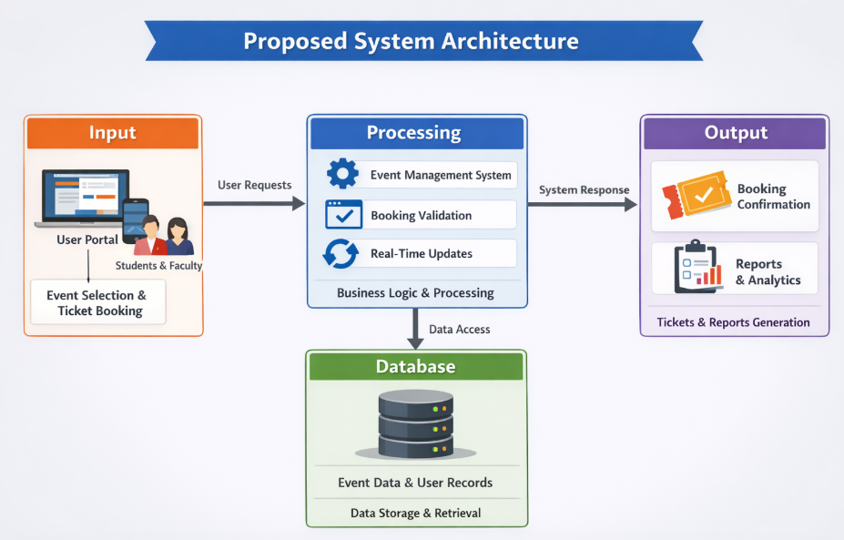
PROPOSED SYSTEM ARCHITECTURE
1
2
3
4
5
6
7
8
9

Slide 7
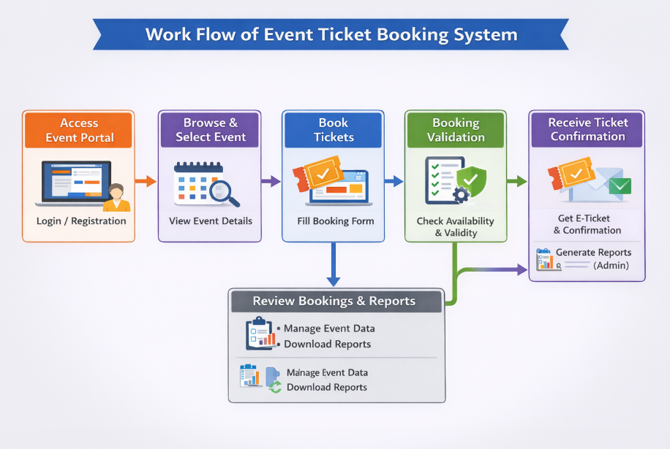
WORKFLOW
1
2
3
4
5
6
7
8
9

Slide 8
TECHNOLOGIES USED
Frontend:
React JS (for building dynamic and responsive user interface)
HTML5, CSS3 (for structure and styling)
JavaScript (for interactivity and logic)
Backend:
Node.js (server-side runtime environment)
Express.js (for handling API requests and routing)
Database:
MySQL / MongoDB (for storing user data, event details, and booking information)
Tools:
VS Code (code editor)
Git & GitHub (version control)
Postman (API testing)
XAMPP (for local server and database management, if using MySQL)
Hardware/Software Requirements:
System with minimum 4GB RAM and internet connectivity
Operating System: Windows / Linux / macOS
Web Browser: Chrome / Edge / Firefox
Node.js and npm installed for running the application
1
2
3
4
5
6
7
8
9

Slide 9
MODULE DESCRIPTION
Module 1: User Management Handles user registration and login for students and faculty. It collects basic details like name, email, and department during booking. Ensures secure authentication and manages user sessions. Provides a simple interface for users to access the system easily.
Module 2: Event Management & Booking Displays event details such as event name, date, venue, ticket price, and availability. Allows users to select events and book tickets by filling out a booking form. Handles ticket availability and prevents overbooking. Ensures smooth and quick booking process.
Module 3: Database Management Stores all event details, user information, and booking records in the database. Handles data insertion, retrieval, and updates efficiently. Maintains data accuracy and consistency. Supports real-time updates for ticket availability.
Module 4: Reporting & Confirmation Generates booking confirmation for users in the form of e-tickets. Provides organizers with reports on total bookings and event participation. Helps in analyzing event success and managing future events. Ensures transparency and proper record-keeping.
1
2
3
4
5
6
7
8
9

Slide 10
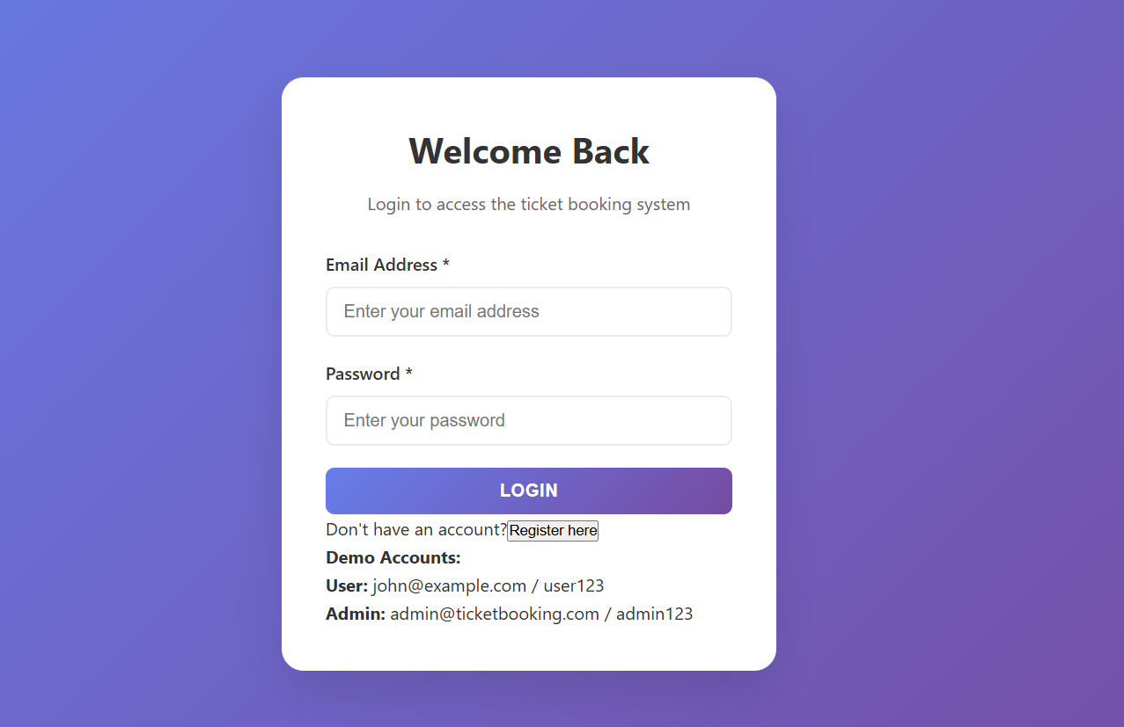
IMPLEMENTATION SCREENSHOTS
1
2
3
4
5
6
7
8
9

Slide 11
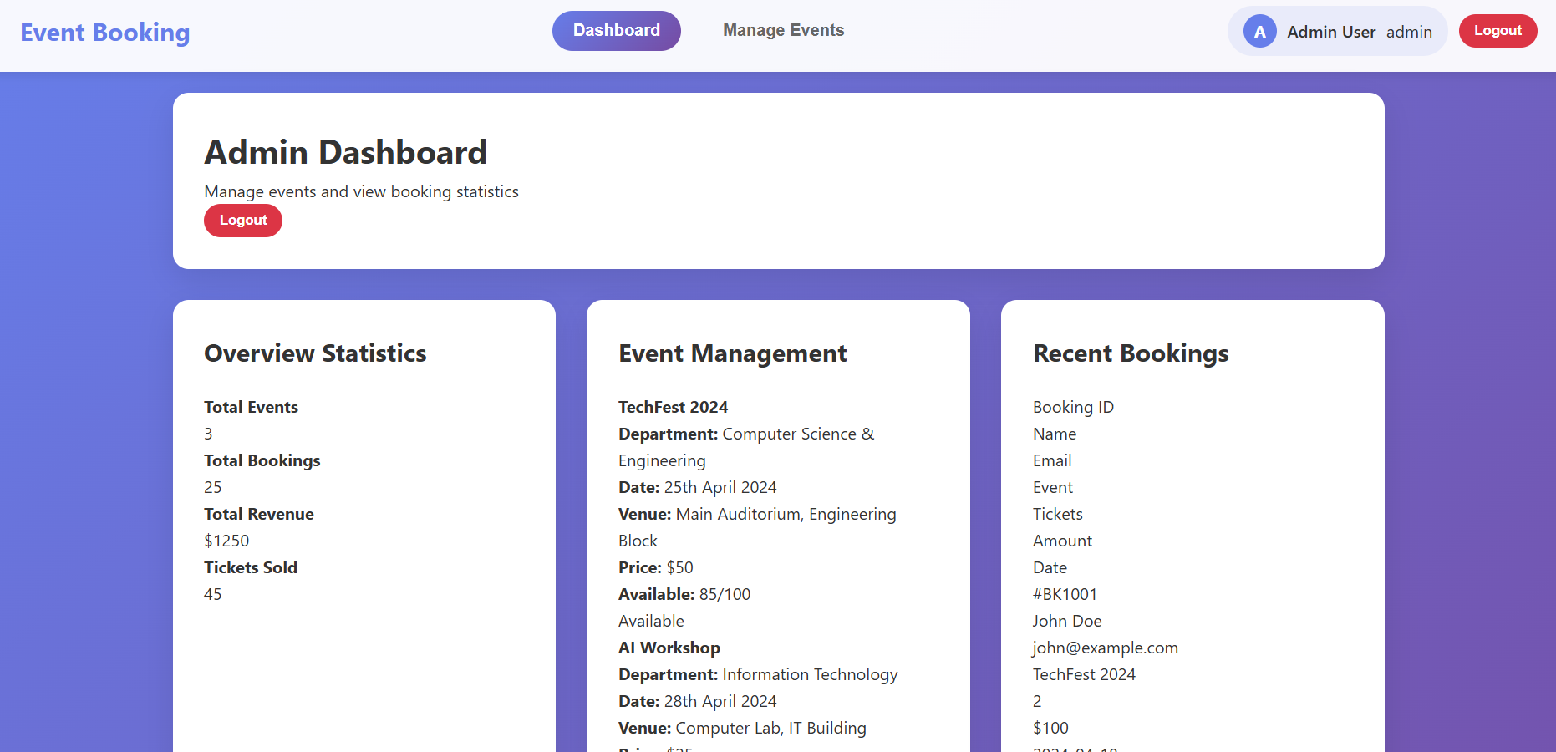
IMPLEMENTATION SCREENSHOTS
1
2
3
4
5
6
7
8(A)
9

Slide 12
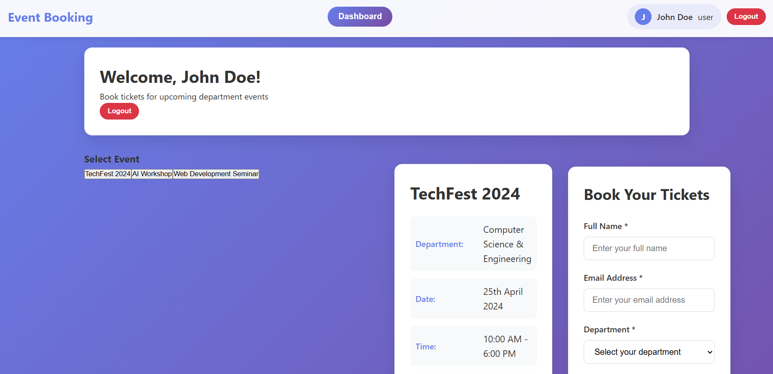
IMPLEMENTATION SCREENSHOTS
1
2
3
4
5
6
7
8(B)
9

Slide 13
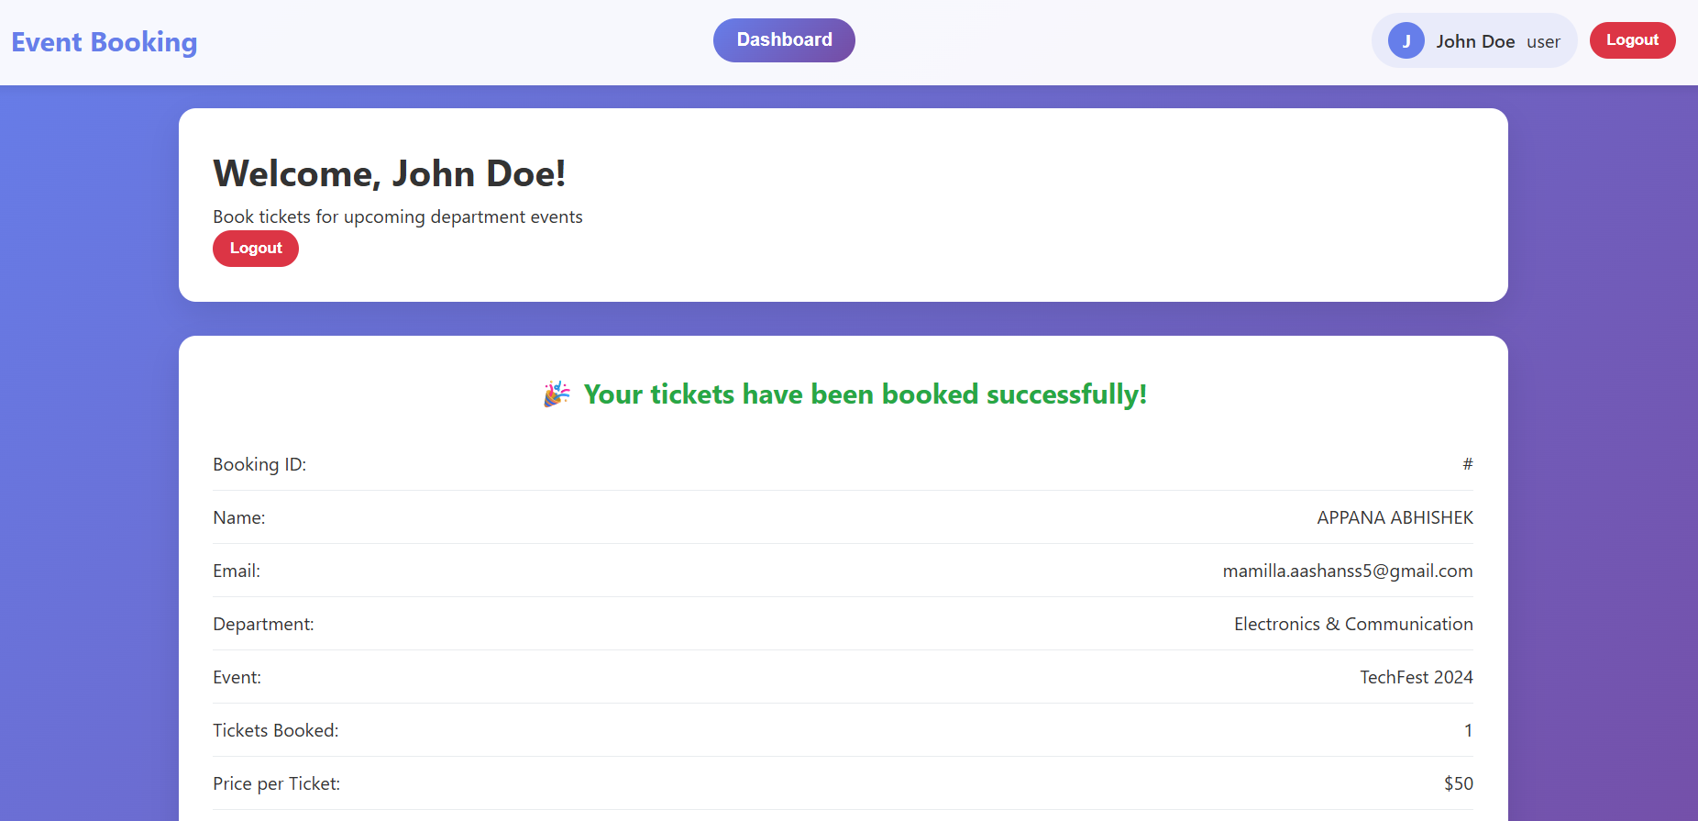
IMPLEMENTATION SCREENSHOTS
1
2
3
4
5
6
7
8(C)
9

Slide 14
ADVANTAGES & LIMITATIONS
1
Advantages
Provides a fast and automated ticket booking system, reducing manual work.
User-friendly interface makes it easy for students and faculty to use.
Real-time ticket availability prevents overbooking issues.
Improves data accuracy and reduces human errors.
Centralized system helps organizers manage events efficiently.
Saves time and provides instant booking confirmation (e-ticket).
Limitations
Requires internet connection to access the application.
Initial setup and development may take time and technical effort.
System may face performance issues with a large number of users if not optimized.
Security risks if proper authentication and data protection are not implemented.
Depends on server availability; downtime can affect booking process.
2
3
4
5
6
7
8
9

Slide 15
Thank you

