Slide 1
RxJS: The Big Picture
INTRODUCTION TO REACTIVE PROGRAMMING AND RXJS

Slide 2
OBJECTIVE
What is RxJS
What problems it solves,
The benefits of using RxJS,
RxJs relationship to other libraries and frameworks,
Building blocks of RxJS

Slide 3
Exit Criteria:
By the end of the course, you'll have a solid understanding of the role RxJS plays in client-side web development and the features it provides to help you manage data.
You'll also feel confident deciding if it's the right tool for your project.

Slide 4
PreRequisite:
Before beginning this course, you should be familiar with the basics of JavaScript,

Slide 5
What is RxJS?

Slide 6
The rx stands for the Reactive Extensions API and the js refers to JavaScript.
RxJS is the JavaScript implementation of the Reactive Extensions API.
https://reactivex.io
The reactive extensions are often simply referred to as ReactiveX, or even more simply than that, just rx.

Slide 7
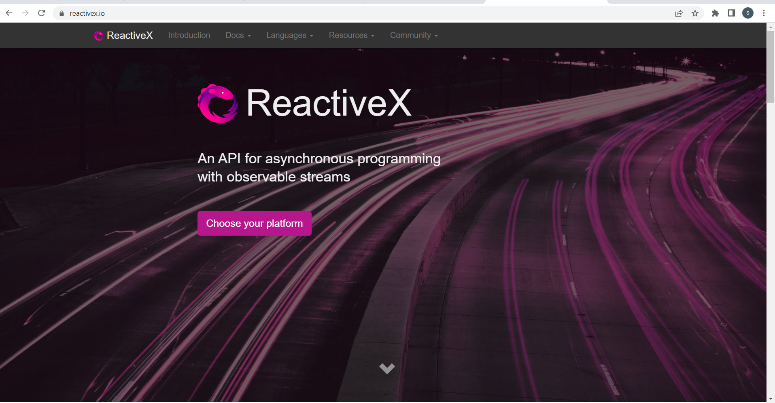

Slide 8
Definition on the home page, that it's an API for asynchronous programming with observable streams.
The stream here really refers to the data that flows into your app like the water in a stream.
The background image on the page appears to show the flow of traffic on a highway, which I suppose is also intended to symbolize the flow of data.
The ReactiveX API is meant to help you manage the flow of data into your application. Much of the API is designed to work with data asynchronously, but there are some synchronous bits as well

Slide 9
ReactiveX is a combination of the best ideas from the observer pattern and the iterator pattern.
Describing streams as observable means their streams design to follow the observer pattern.
When you click on the button labeled Choose your platform and it takes you to another page that links to different ReactiveX implementations.
RxJS is right on the top, And clearly RxJS is a popular API that's been implemented in lots of different languages.

Slide 10
What Problems Does RxJS Solve?

Slide 11

Streams of Data
Synchronous data
Asynchronous data Application data from a server User-provided data
Client-side event data Function return values

Slide 12
RxJS helps you process data
It provides a single API that facilitates and simplifies the processing of data from multiple sources. When those sources produce data over time, it's helpful to think of them as streams of data gradually flowing into your application.

Slide 13
Those streams can take lots of different forms,
It can be synchronous data or asynchronous data,
It might be application data returned from an HTTP request to your server,
It might be data generated by the user using your client application.
As it relates to RxJS, data can be just about anything. It isn't limited to domain data specific to your application.
DOM events in the browser are also data. They occur over time and contain information you may need to process.
Even a simple function return value is data that can be thought of as a stream, a stream with only one value.

Slide 14
The problem with so many different types of streams is that they're all processed a little differently in plain JavaScript.
You can process your asynchronous data with callback functions or promises.
In the case of events, it's common to write functions dedicated to handling each type of event,
if you're processing arrays or some other list of data, you'll likely iterate over it with a loop of some sort.
Finally, in the case of a function return value, you'll probably just assign the value to a new variable.

Slide 15

Processing Streams of Data
Callback functions
Promises Event handlers Loops
Variable assignment

Slide 16
RxJS helps you deal with these disparate data sources and the multiple ways they might be processed by giving you a single clean API you can use with all of them.
At the heart of the API is the observable data type.
It lets you observe the data flowing into your application and then react to it using a clearly defined set of functions.
Its named observable because the reactive extensions get their conceptual foundation from the observer software development pattern.

Slide 17
The Observer Pattern

Slide 18
The observer pattern is a common software development pattern that really forms the foundation of the Reactive Extensions API and RxJS.
It was documented, along with lots of other patterns, in a well-known book titled Design Patterns written by the so-called gang of four authors.

Slide 19
Design Patterns: Elements of Reusable Object-Oriented Software
Erich Gamma, Richard Helm, Ralph Johnson, John Vlissides

Slide 20
The general idea behind the observer pattern is that
you have an object known as a subject which will produce values and notify other objects that are interested in receiving those values.
The subject maintains a list of the objects that want to observe those new values. Those objects are the observers.
The subject pushes values to the observers over time and each observer may then react to those values by executing some bit of code specific to that observer.

Slide 21
The Observer Pattern

Slide 22
The Observer Pattern
Subject

Slide 23
The Observer Pattern
Observer
Subject
Observer
Observer

Slide 24
The Observer Pattern
Observer
Subject
Observer
Observer

Slide 25
The Observer Pattern
Observer
[ 3, 6, 9 ]
Subject
Observer
Observer

Slide 26
Let's imagine for a minute that we have a simple array of numbers this subject will produce.
Since the subject maintains a list of the observers that want to receive those values, it will push the first item in the array to all of them.
Each observer can then react to the value independent of the other observers.
At some point, the subject will produce the next value in the array and it will also be pushed out to all of the registered observers.
RxJS supports this pattern where a single subject broadcast values to multiple observers and I'll talk more about that later in the course.

Slide 27
The Observer Pattern
3
Observer
3
[ 3, 6, 9 ]
Subject
Observer
3
Observer

Slide 28
The Observer Pattern
Observer
[ 3, 6, 9 ]
Subject
Observer
Observer

Slide 29
The Observer Pattern
6
Observer
6
[ 3, 6, 9 ]
Subject
Observer
6
Observer

Slide 30
Observables and Observers

Slide 31
However, the more common scenario in RxJS is that a slightly different object, the observable, pushes values to a single observer.
Let’s understand how this is similar to the more generic example of the observer pattern we have seen earlier on the last slide, but this one is more specific to RxJS and show you some of the methods you'll call on the objects.
It starts with the observable.
You register an observer to receive the values from an observable by calling a method on the observable named subscribe.
The observer that should receive the values is passed as a parameter to the subscribe method.

Slide 32
The observable sends values and a couple of other messages to the observer by calling methods on the observer object itself.
It calls the next method to send it a new value.
If an error occurs somewhere, it can inform the observer by calling its error method.
Finally, the observable can inform the observer that it's done sending values by calling the complete method.

Slide 33
Let's imagine again that we want to produce some numbers from an array.
Once the observer is subscribed to the observable, the first value can be pushed to the observer by calling next and passing the first value as a parameter.
When the second value is ready, the observable just calls next again with the second value.
Assuming there are no errors along the way, it would also eventually call next with the last value in the array.
Once the last value has been sent, it would then call the complete method to let the observer know it was done.

Slide 34
Example explained in previous slide is an array of numbers. but again, that could be just about any type of data, a series of DOM events, an HTTP response, whatever.
In RxJS, you'll write the code for the next , error and complete methods to react to those messages from the observable in whatever way is most appropriate for your app.

Slide 35
Observables and Observers
Observable

Slide 36
Observables and Observers
Observable
subscribe()

Slide 37
Observables and Observers
Observable
Observer
subscribe()

Slide 38
Observables and Observers
Observable
subscribe()
Observer
next()

Slide 39
Observables and Observers
Observable
subscribe()
Observer
next() error()

Slide 40
Observables and Observers
Observable
subscribe()
Observer
next() error() complete()

Slide 41
Observables and Observers
Observable
Observer
next() error() complete()
[ 3, 6, 9 ]
subscribe()

Slide 42
Observables and Observers
Observable
Observer
next(3)
next() error() complete()
[ 3, 6, 9 ]
subscribe()

Slide 43
Observables and Observers
Observable
Observer
next() error() complete()
[ 3, 6, 9 ]
subscribe()

Slide 44
Observables and Observers
Observable
Observer
next(6)
next() error() complete()
[ 3, 6, 9 ]
subscribe()

Slide 45
Observables and Observers
Observable
Observer
next() error() complete()
[ 3, 6, 9 ]
subscribe()

Slide 46
Observables and Observers
Observable
Observer
next(9)
next() error() complete()
[ 3, 6, 9 ]
subscribe()

Slide 47
Observables and Observers
Observable
Observer
next() error() complete()
[ 3, 6, 9 ]
subscribe()

Slide 48
Observables and Observers
Observable
Observer
complete()
next() error() complete()
[ 3, 6, 9 ]
subscribe()

