Slide 1

DataBase Project Presentation
GID-43
Presented To:
Mr. Nazeef Ul Haq
Presented By:
Samawia Ijaz 2020-CS-124
Wasfa Nasir 2020-CS-145
Aiemen Altaf 2020-CS-148

Slide 2

Dura Group Of Companies

Slide 3
Introduction:
This company deals with production of plastic goods. This project aims to monitor all processes in the company, like order receiving, purchase of raw materials, production of goods, sales ,transfer from branch to branch, Transport and details of staff.

Slide 4
Client Detail:
Name :
Sharjeel Iftikhar
RegNo:
2020-CS-139

Slide 5
Case Study Requirements:
Manage Person(Vendor, Worker, Buyer)
Manage Company’s Goods
Manage Stock Ledger
Manage Sales
Manage Gate Pass
Manage Branch and its Stores

Slide 6
Case Study Reports:
Sale Return
Stock Ledger
GatePass
Branch To
Branch

Slide 7
Motivation:
Main target is to fulfill the requirements of the client to develop a desktop application for Dura Group of Companies.

Slide 8
Technology Stack:
Language | SQL server, C #
IDEs | SSMS(SQL Server Management Studio), VS(Visual Studio) 2019
Platform | Desktop Application

Slide 9
Objectives:
Enhance the current manual system
ER Diagram & DataBase Design
Implement all the given requirements.
Generate Crystal Reports

Slide 10
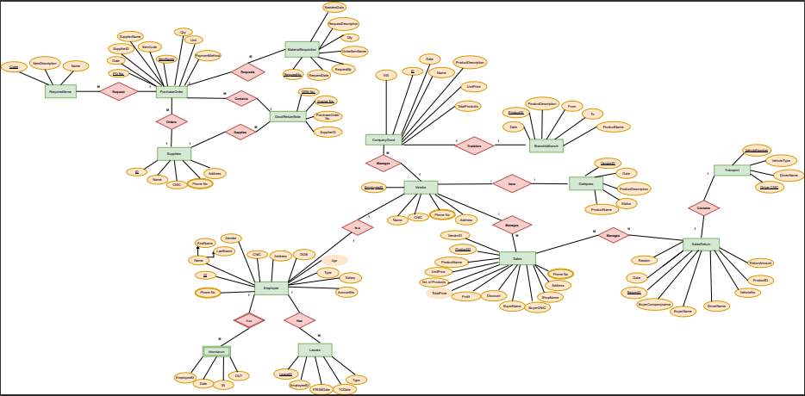
ER Diagram:

Slide 11
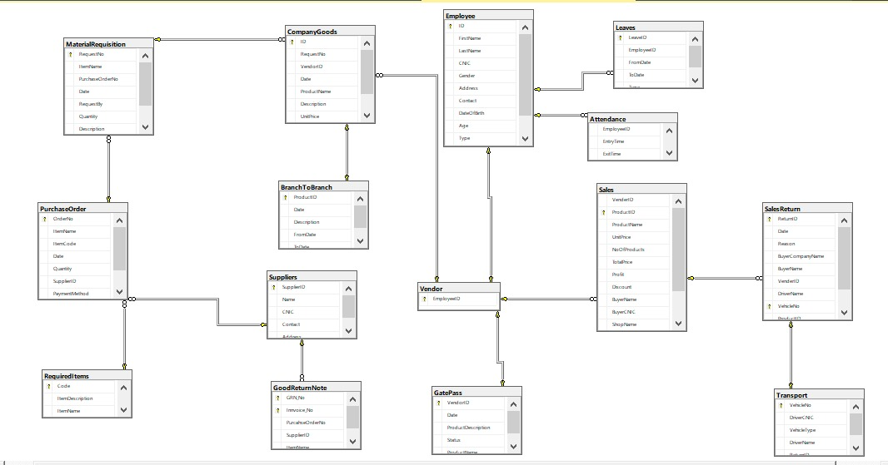
DataBase Design:

Slide 12
Implementation:
Implemented Features

Slide 13
Production Management
GatePass Management
Transport Management
Stock Management
Sales Management
Staff Management

Slide 14
Reports:
Sale
Sale Return
Attendance
GatePass
Leave

Slide 15
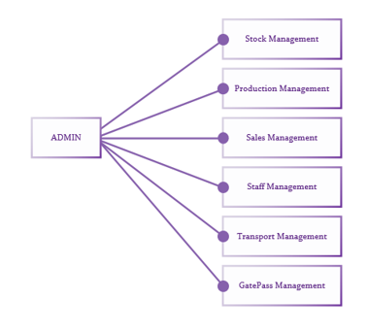
Use Case Diagram:

Slide 16
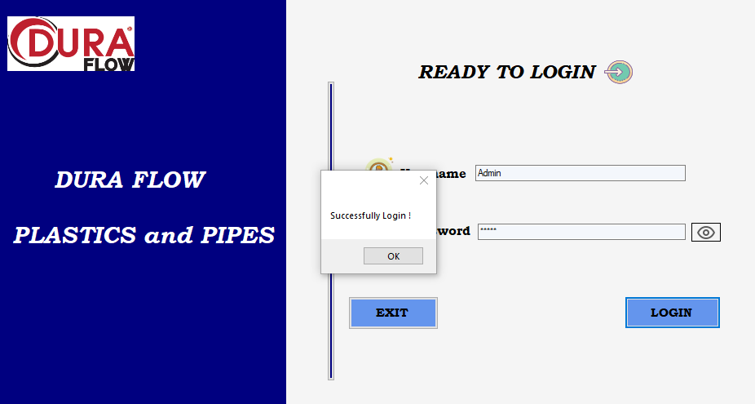
Snapshots :
Login :

Slide 17
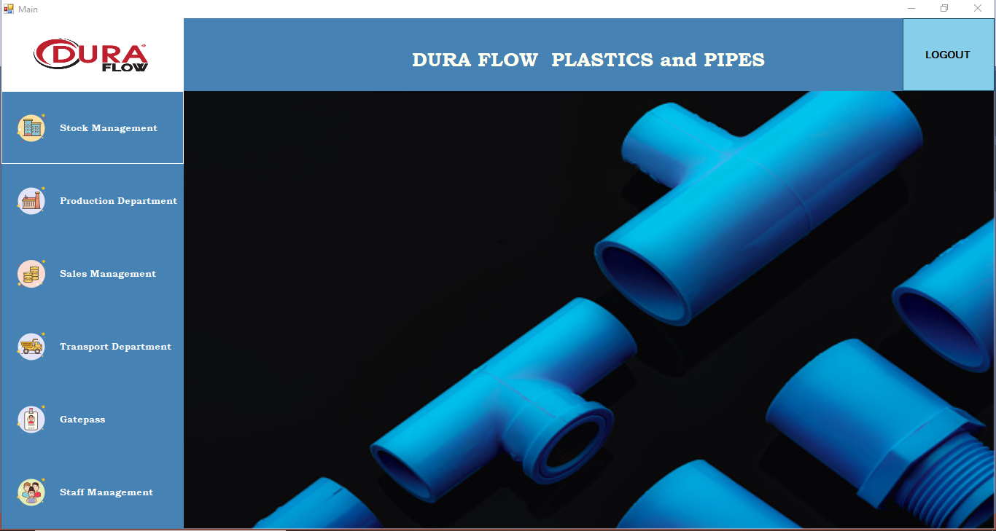
Dashboard:

Slide 18
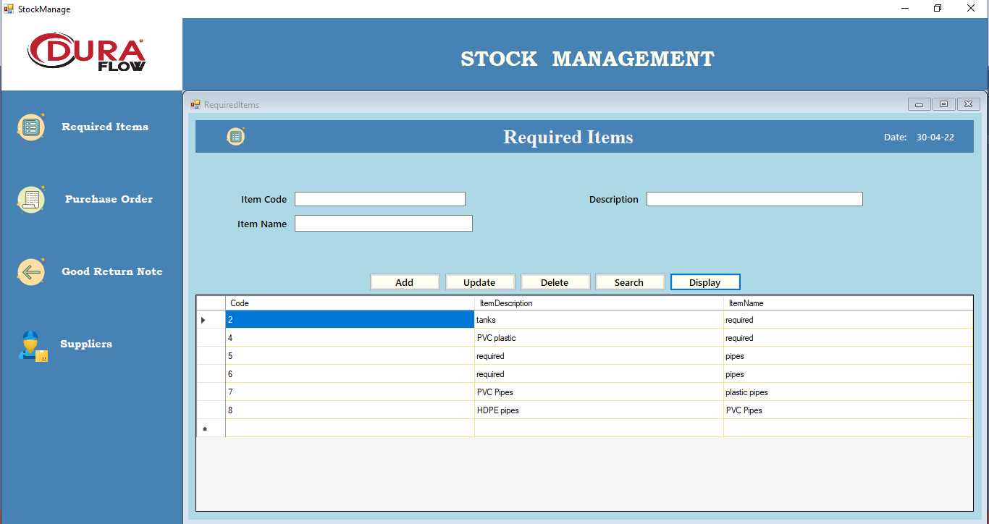
Stock Management:

Slide 19
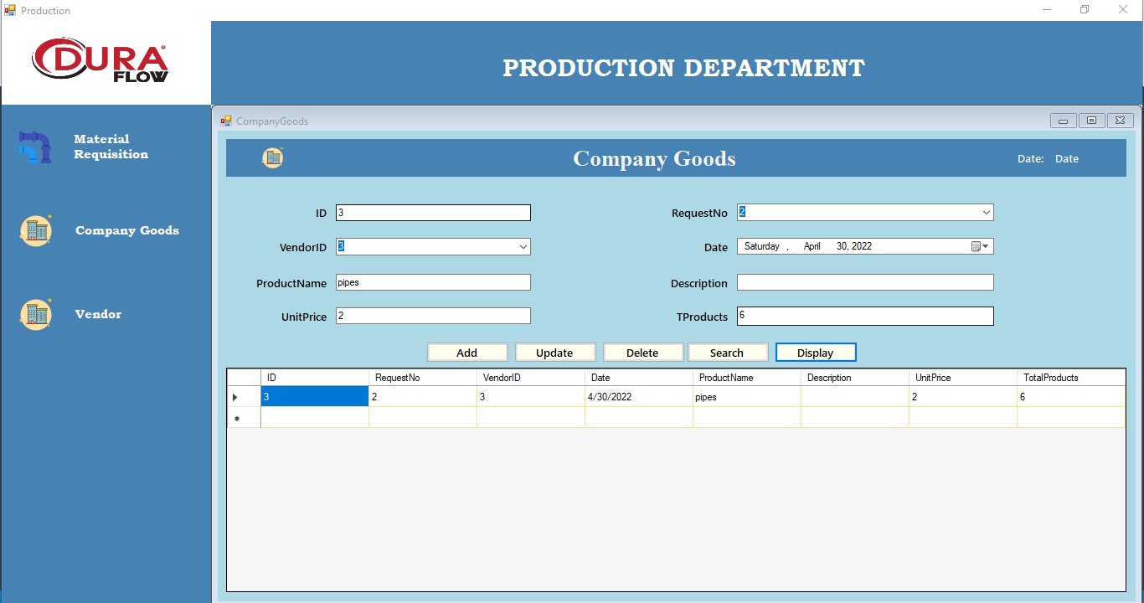
Production Department:

Slide 20
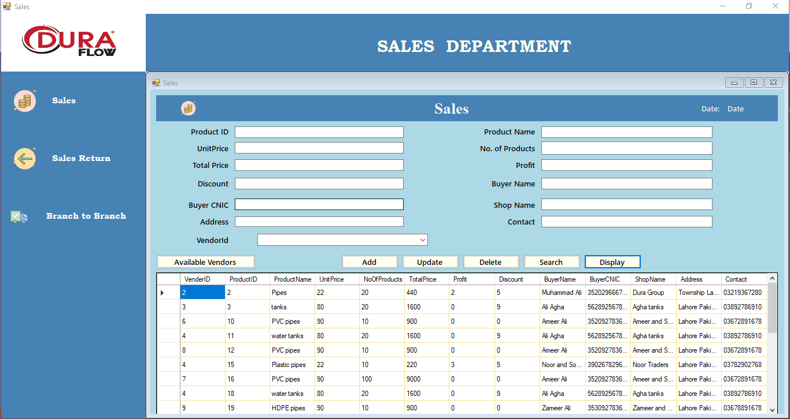
Sales Department:

Slide 21
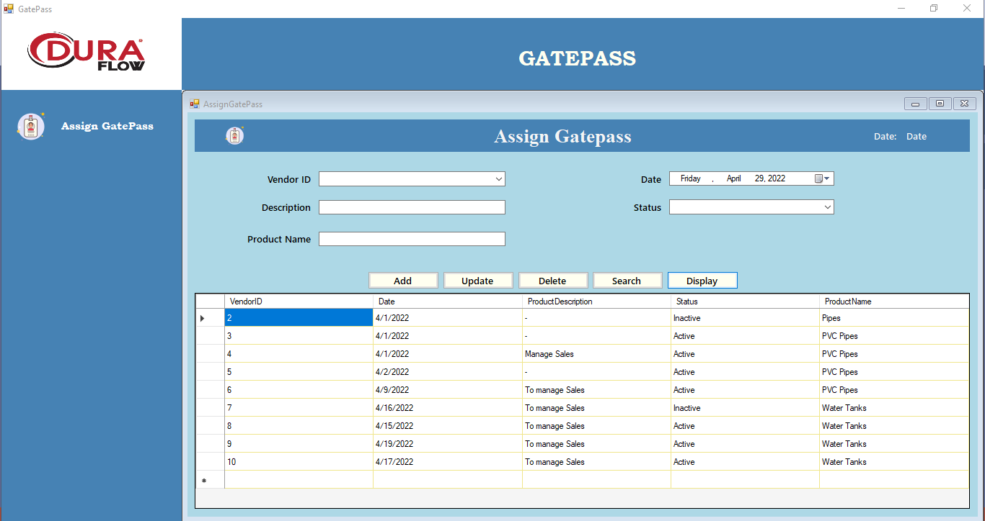
GatePass Management:

Slide 22
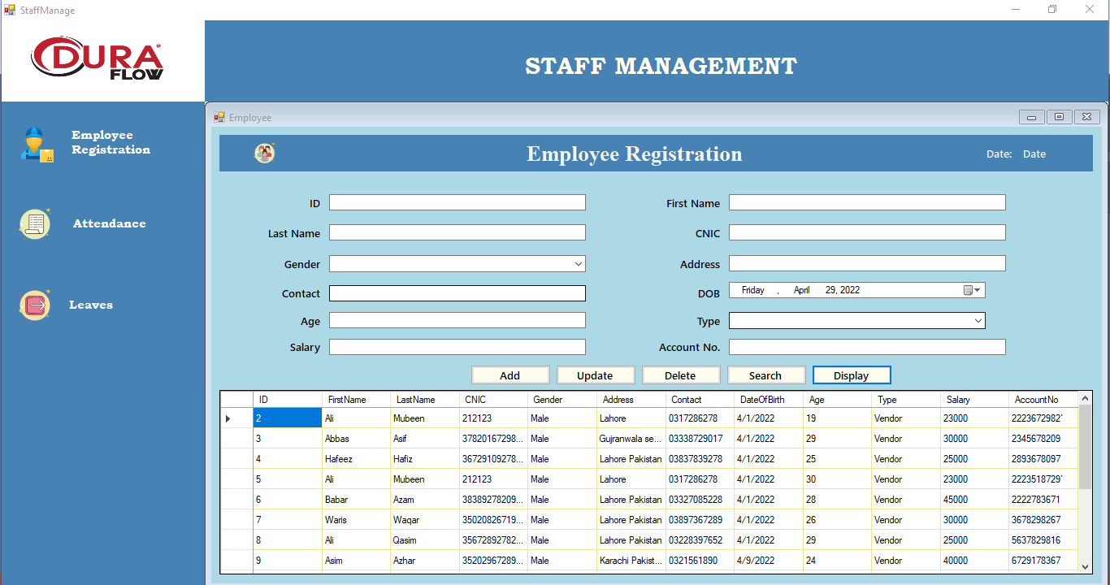
Staff Management:

Slide 23
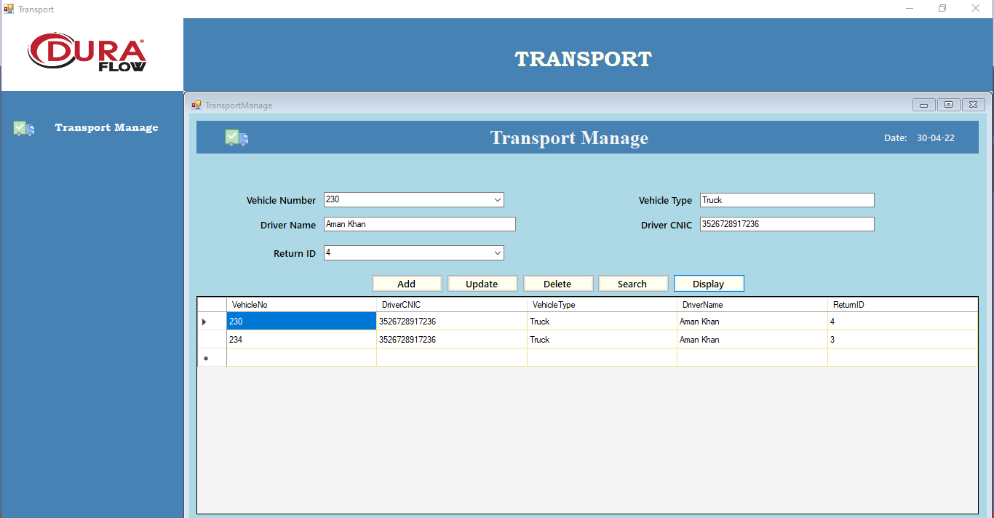
Transport Management:

Slide 24
Conclusion:
In this project we have created a desktop application which is easy to access and user friendly. The application keeps a record of the company management data which includes their details. User can view all data and analyze them for better management of the system. It provides all necessary information about the system. The user can simply sit in front of the system and login using name and password to monitor each and every query related to the company without any physical movement.

Slide 25
Thank You

