Slide 1

Db2020-CS-124 Presentation
CS 262L- Database Systems
Project Supervisor : Mr. Nazeef Ul Haq
Submitted by: Samawia Ijaz
2020-CS-124(C)

Slide 2
Project Title: FYP MANAGEMENT System
Business Case:
Our target is Students For their FYP Projects.
Motivation:
The motivation of this project is to deliver source of knowledge in a convenient way. A system by which Person have an easy access for Enroll in FYP Project. To give full facility to the Students and Advisors so they can rely easily.

Slide 3
Technology Stack:
Language | CSharp
Platform | Desktop Application
IDEs | Visual Studio AND Microsoft SQL SERVER
Objective of the Project:
For Admin to manage the details of Person who enroll as a student, Advisor, also manage Groups, Group Students, Projects, Evaluations.

Slide 4
Algebraic Query Language used in Project:
Projection
• Selection
• Cartesian Product
• Joins(Natural , Outer, left, Right , Full, Theta)
• Aggregation Operators

Slide 5
Project Features :
Manage Students
Manage Advisors
Manage Projects
Formation of Student Group and its management
Assignment of project to a group of students
Assignment of multiple advisors to the project
Manage Evaluations
Mark the evaluations against a group
List of projects along with advisory board and list of students
Marks sheet of projects that shows the marks in each evaluation against each student and project and any other reports that you can help the committee to streamline the process.

Slide 6
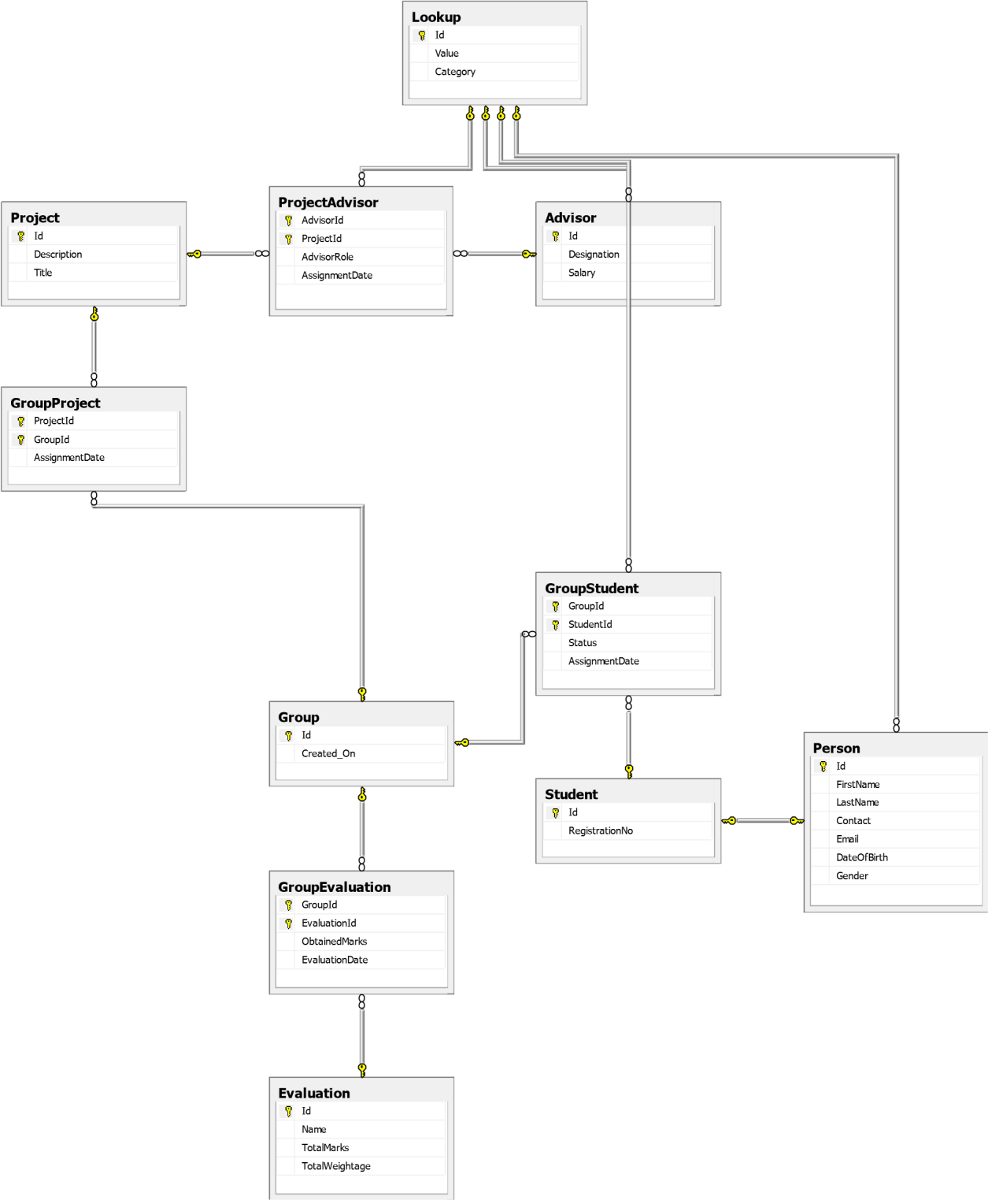
DataBase Design

Slide 7
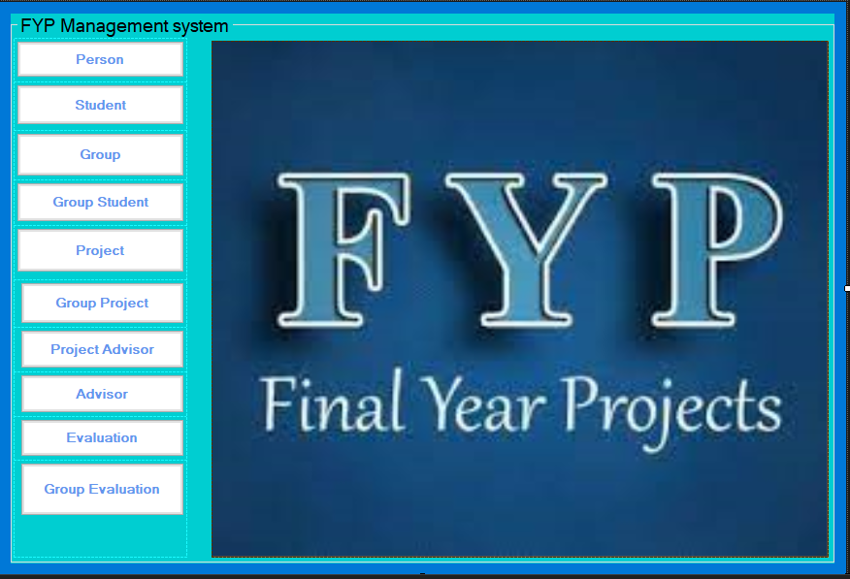
Screenshots of GUI: (MAIN)

Slide 8
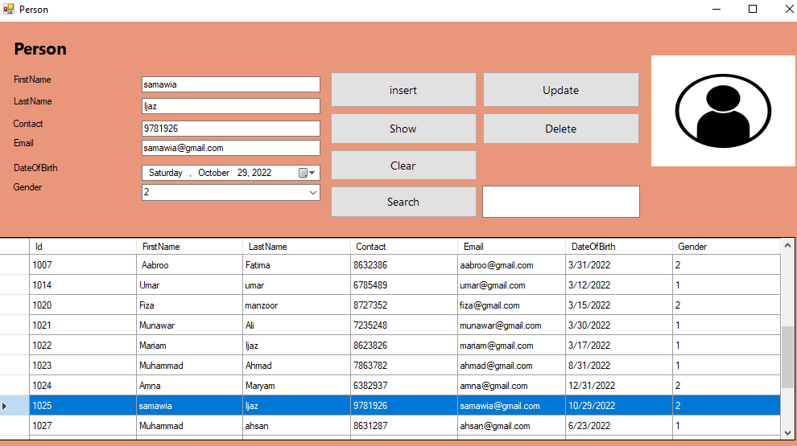
PERSON:

Slide 9
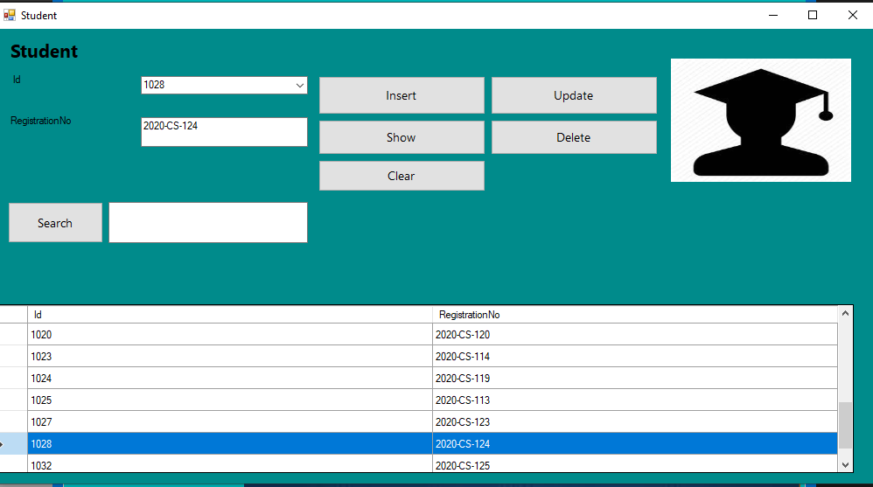
STUDENT:

Slide 10
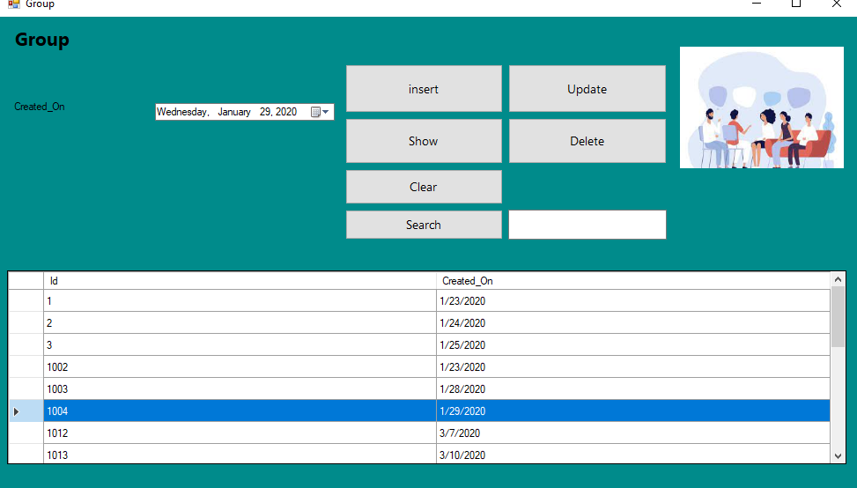
GROUP:

Slide 11
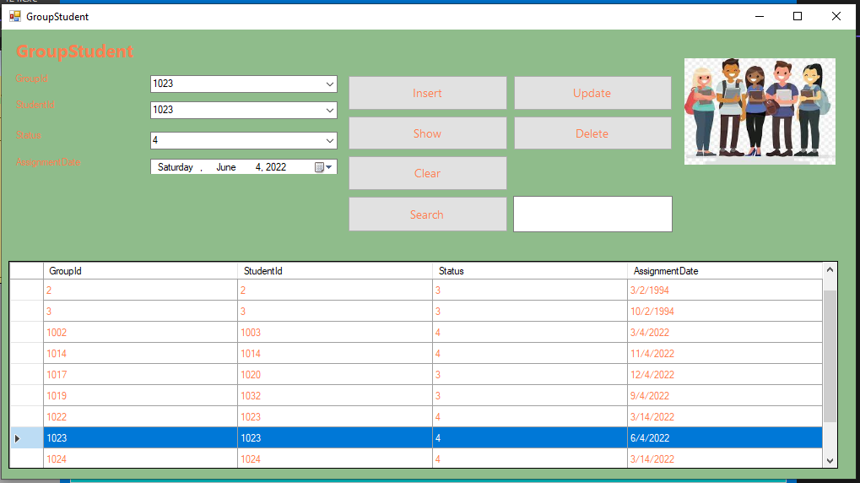
GROUP STUDENT:

Slide 12
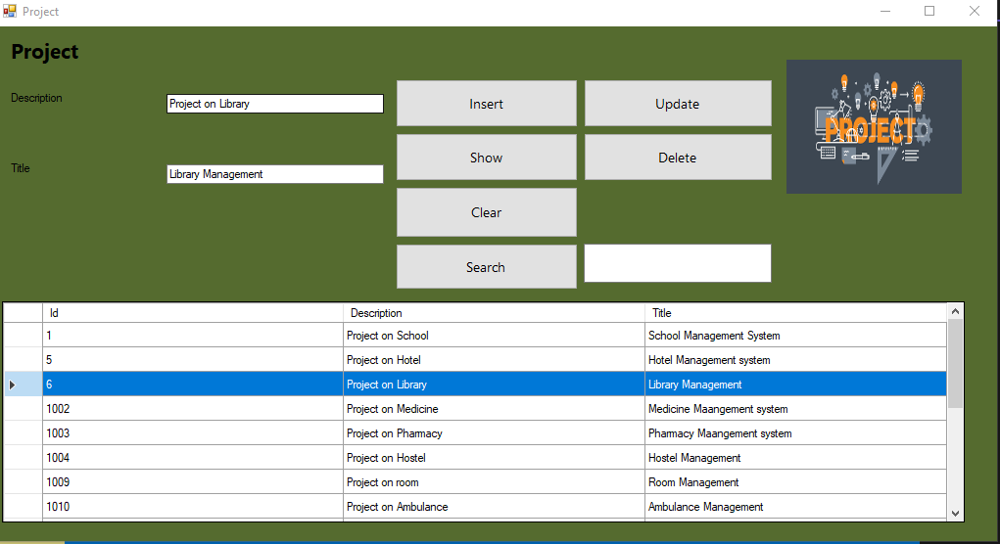
PROJECT:

Slide 13
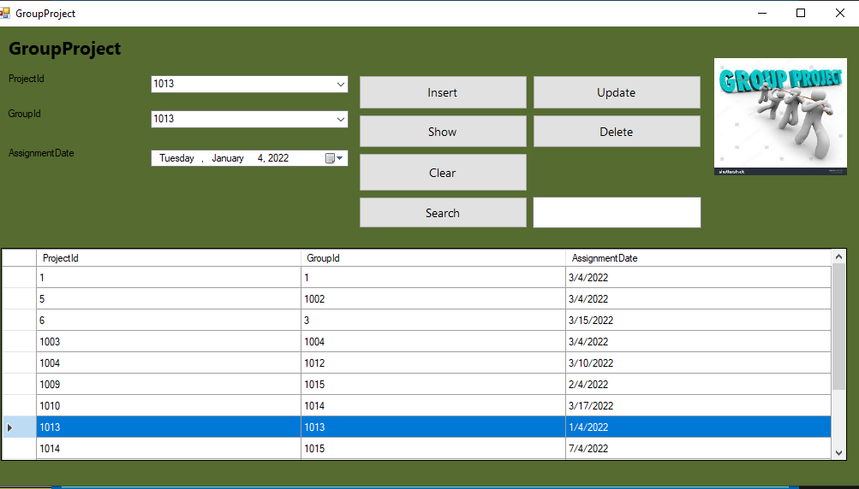
GROUP PROJECT:

Slide 14
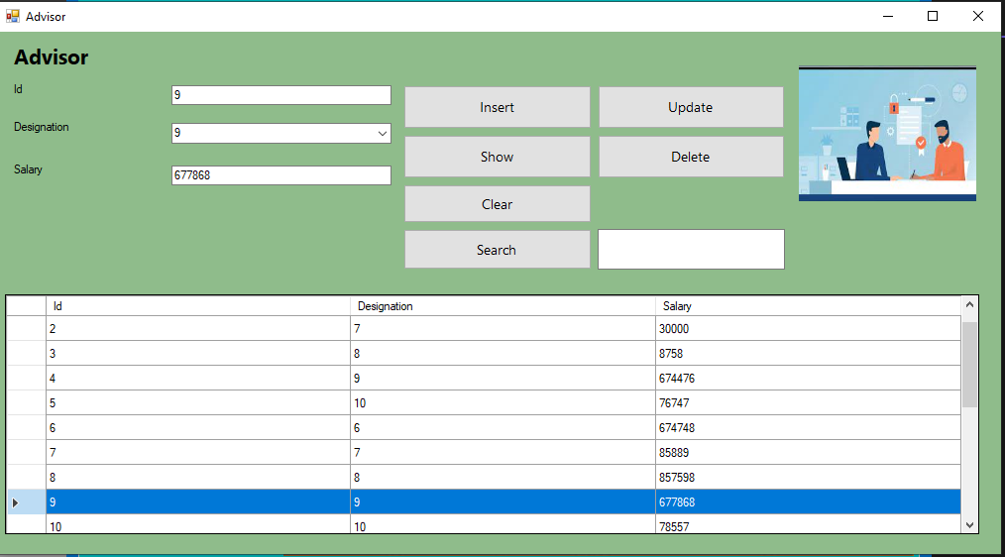
ADVISOR:

Slide 15
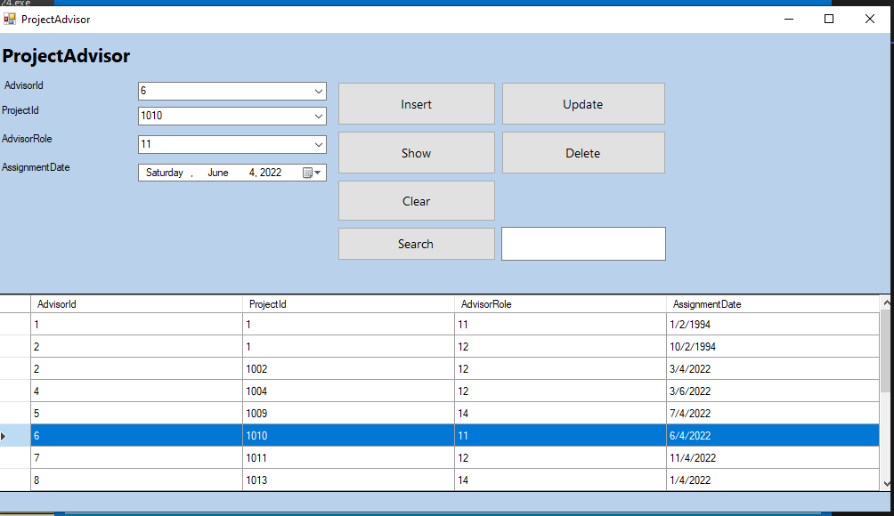
PROJECT ADVISOR:

Slide 16
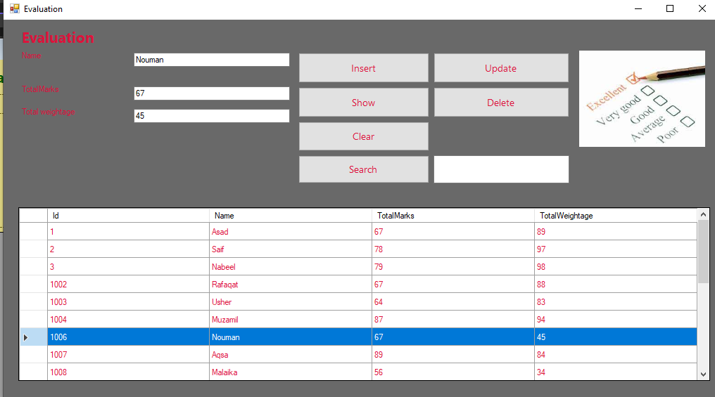
EVALUATION:

Slide 17
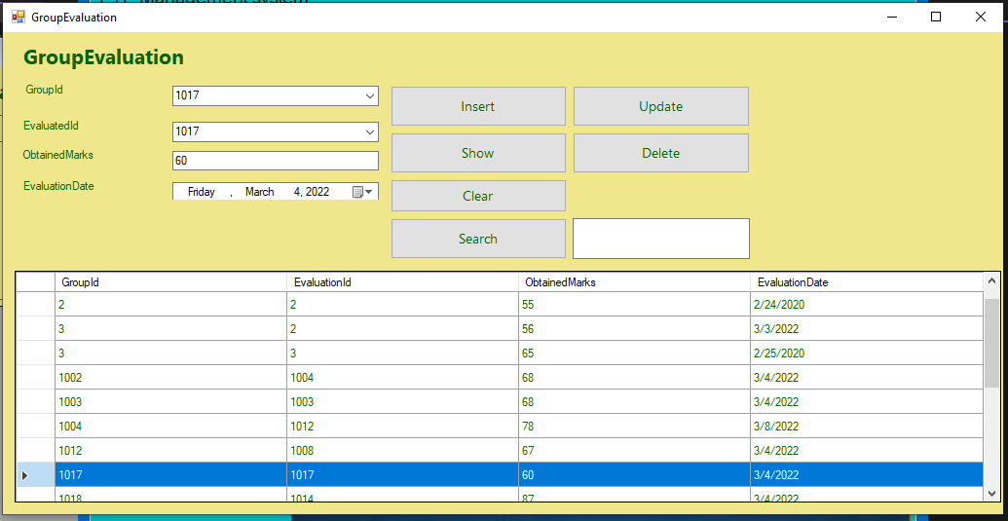
GROUP EVALUATION:

Slide 18
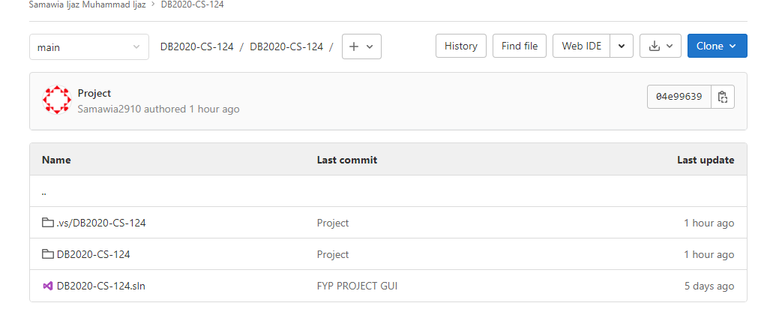
Final Commit:

Slide 19
Final Words:
This project seems an experience in which I learnt a lot. Yes, I was put a lot of effort in it. I was manage every milestone according to supervisor’s expectations sincerely. I was explore much and think more! And I believe that fruits of human labor do come. INSHAALLAH.
Future Works:
This project will try to create an online website which make possible the final year projects (FYP) for person. The FYP is a year-long process involving groups of students and their advisors to accomplish project. It is very necessary to allow different parties to communicate more efficiently. Therefore, i will design and create a desktop application to better support by three users; FYP Committee Organization, project advisors and the project group members. The system is therefore helpful for CO to arrange project selection as well as helping the students to submit their group members information. During the year, the system would provide different purpose for the CO to collect student’s assignments and marks via the submission. Project advisors will also be able check the progress of the projects. Both the students and advisors will be rewarded from these reasons, Project group members are providing communication tools to allow for discussion on project issues among group members. Moreover, they can exchange about the project including code and files using our online repository.”

Slide 20


