Slide 1
BIG DATA ANALYSIS
IMAGE CLASSIFICATION USING CNN & PYSPARK

Slide 2
IMAGE CLASSIFICATION USING CNN & PYSPARK
SUPERVISED BY :
MISS AQBA
GROUP MEMBERS:
SAMAWIA IJAZ (2020-CS-124)
WASFA NASIR(2020-CS-145)
AIEMEN ALTAF(2020-CS-148)

Slide 3
INTRODUCTION
A machine learning algorithm for machines to understand the features of the image with foresight and remember the features to guess whether the name of the new image is fed to the machine

Slide 4
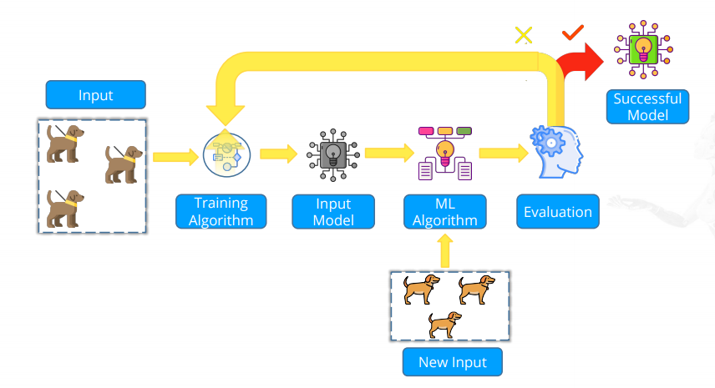
CNN Modeling and Machine Learning

Slide 5
CNN(Convolutional Neural Network )
CNN is a type of deep learning model for processing data that has a grid pattern, such as images, designed to automatically and adaptively learn spatial hierarchies of features, from low- to high-level patterns.

Slide 6
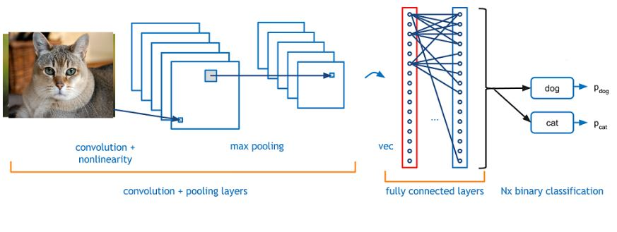
How image classification is done using CNN

Slide 7
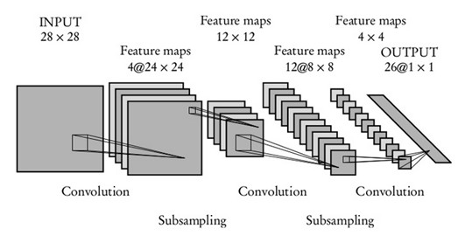
SIX LAYER Convolutional Neural Network (CNN)

Slide 8
BACKGROUND
The Convolutional Neural Network (CNN or ConvNet) is a subtype of Neural Networks that is mainly used for applications in image and speech recognition. Its built-in convolutional layer reduces the high dimensionality of images without losing its information. That is why CNNs are especially suited for this use case.

Slide 9
MOTIVATION
Finding good internal representations of images objects and features has been the main goal since the beginning of computer vision. Therefore many tools have been invented to deal with images. Many of these are based on a mathematical operation, called convolution.

Slide 10
Scope
Problem Statement
image classification are the large number of images, the high dimensionality of the data, and the lack of labeled data. Images can be very large, containing many pixels.
Image classification applications are used in many areas, such as medical imaging, object identification in satellite images, traffic control systems, and more.

Slide 11
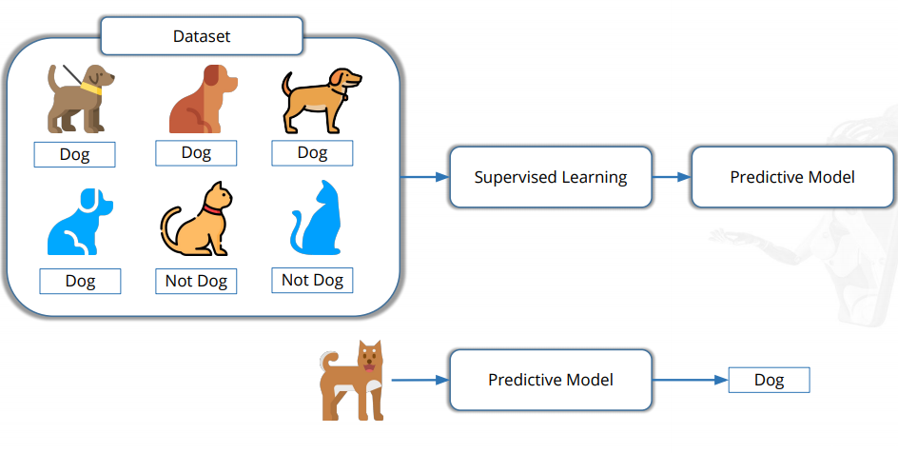
Supervised Learning

Slide 12
PYSPARK
PySpark is the Python API for Apache Spark, an open source, distributed computing framework and set of libraries for real-time, large-scale data processing. If you're already familiar with Python and libraries such as Pandas, then PySpark is a good language to learn to create more scalable analyses and pipelines.

Slide 13
Key Features of PySpark
Polyglot: The PySpark framework is compatible with various languages such as Scala, Java, Python, and R, which makes it one of the most preferable frameworks for processing huge datasets. Caching and disk persistence: This framework provides powerful caching and great disk persistence.

Slide 14
Why we use PySpark over pandas?
Pandas run operations on a single machine whereas PySpark runs on multiple machines. If you are working on a Machine Learning application where you are dealing with larger datasets, PySpark is a best fit which could processes operations many times(100x) faster than Pandas..

Slide 15
RDD(Resilient Distributed Dataset)
the elements that run and operate on multiple nodes to do parallel processing on a cluster. RDDs are immutable elements, which means once you create an RDD you cannot change it.

Slide 16
Why do we need RDD?
Resilient: means it is fault tolerant by using RDD lineage graph (DAG). Hence, it makes it possible to do recomputation in case of node failure

Slide 17
How we create RDD in PySpark?
loading an external dataset
distributing a set of collection of objects

Slide 18
THANKS❤

