Slide 1
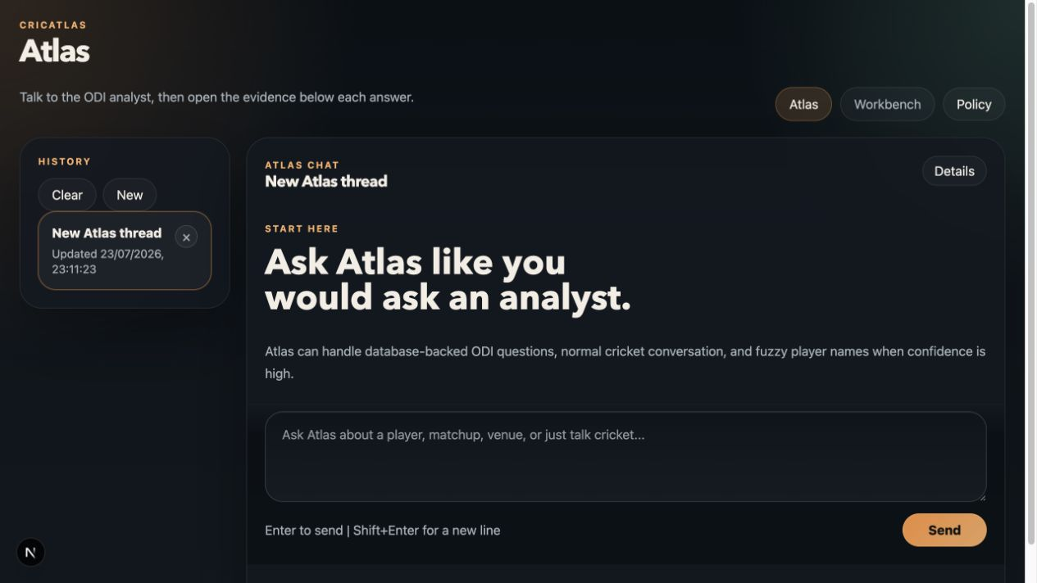
DEEP LEARNING FOR NLP MINI-PROJECT
CricAtlas
Natural Language to Structured Cricket Queries
Gemini API, Qwen 3.5 4B/9B, and QLoRA fine-tuning
CricAtlas analyst interface
Samay | Hanny | Parimal
Team presentation | July 2026
Notes:
Samay | 35-40 seconds
- Task: cricket question -> JSON query plan -> DuckDB answer.
- Four model settings: Gemini, Qwen 4B, Qwen 9B, and QLoRA Qwen 9B.
- Goal: compare the models using one pipeline and one test set.
- The research question is whether a smaller open-source model can learn this structured cricket task.

Slide 2
SAMAY | PROJECT TASK
02
Project Task: Convert Cricket Questions into Query Plans
NATURAL-LANGUAGE QUESTION
STRUCTURED QUERY PLAN
DATABASE RESULT
How many ODI runs has Virat Kohli scored in this database?
{
"operation": "aggregate",
"entity": "batter",
"metric": "runs_scored",
"group_by": ["batter"],
"filters": {
"batter": "Virat Kohli"
}
}
13,950
runs scored
14,918 balls faced
284 matches
The model predicts the query plan. CricAtlas executes that plan on DuckDB to calculate the answer.
Example from the CricAtlas ODI evaluation database.
CRICATLAS | DL4NLP
Notes:
Samay | 55-60 seconds
- Input: a natural-language cricket question.
- The model does not answer the cricket statistic directly.
- It predicts the complete JSON query plan.
- DuckDB calculates the numerical answer.
- Example: Kohli ODI runs -> 13,950.

Slide 3
SAMAY | SYSTEM DESIGN
03
CricAtlas Processing Pipeline
1
2
3
4
5
6
Question
Language model
Normalize
Validation
SQL + DuckDB
Answer
User asks an ODI cricket question
Gemini or Qwen generates JSON
Names and metric terms are standardized
Schema and cricket rules are checked
The validated plan is executed
Number or table is returned
Model comparison rule
Only the language model in Step 2 changes. Every model uses the same normalization, validation, SQL, database, and scoring.
Implemented in the CricAtlas backend.
CRICATLAS | DL4NLP
Notes:
Samay | 55-60 seconds
- Question goes to the language model.
- The model returns a JSON query plan.
- CricAtlas standardizes names and cricket terms.
- Invalid plans receive one repair attempt.
- Valid plans are converted to SQL and executed on DuckDB.
- Only the language model changes in the comparison.

Slide 4
SAMAY | DEVELOPMENT
04
How CricAtlas Developed
1
2
3
4
Direct SQL prompt
Rule-based router
AI-first JSON
Semantic V2
A long schema prompt asked the LLM to write SQL. Small wording or SQL mistakes could break the result.
Keywords selected one of five question classes. It worked for known wording but was too rigid.
Gemini extracted the question class, players, and filters. This improved language understanding.
A complete JSON query plan is normalized, validated, repaired, and executed by fixed code.
Each version was changed after we found a real failure in the previous version.
CRICATLAS | DL4NLP
Notes:
Samay | 65-75 seconds
- Version 1: the LLM generated SQL directly from a long prompt.
- Problem: small SQL mistakes could break the answer.
- Version 2: keyword rules made the system more controlled but too rigid.
- Version 3: Gemini returned a small JSON interpretation.
- Version 4: the full JSON plan, validation, repair, and fixed SQL were added.
- Each version solved a failure we found during testing.

Slide 5
SAMAY | IMPLEMENTATION
05
What We Improved in the Current System
01
Planner prompt
02
Metric catalogue
JSON-only output, the plan schema, supported cricket terms, and explicit interpretation rules.
Fixed formulas, owners, sort direction, units, and minimum sample sizes.
03
Normalization
04
Guardrails
Standardize player names, metric aliases, dimensions, phases, and bowling styles.
Correct common role and operation mistakes before SQL is generated.
05
Validation + repair
06
Fixed execution
Reject invalid plans and give the model one chance to correct the listed errors.
SQL builders and result checks calculate the answer without asking the LLM for statistics.
The LLM interprets the question; CricAtlas code controls the cricket calculations.
CRICATLAS | DL4NLP
Notes:
Samay | 60-70 seconds
- The prompt now requests strict JSON instead of SQL.
- The metric catalogue stores the cricket formulas and correct player role.
- Normalization handles aliases, spelling, phases, and bowling styles.
- Guardrails correct common role and operation mistakes.
- Invalid plans are rejected and repaired once.
- Fixed SQL code calculates the final statistics.

Slide 6
SAMAY | DATASET
06
Evaluation Dataset: 100 ODI Analyst Questions
100
test questions
Reference query plan
The complete executable JSON plan is stored for every question.
Correct database answer
That plan is executed on DuckDB to create the answer.
Test-only set
None of these 100 questions is used for fine-tuning.
Source: dl4nlp_cricket_analyst_supported_100.yaml.
CRICATLAS | DL4NLP
Notes:
Samay | 55-60 seconds
- We first created 100 realistic, answerable ODI analyst questions without looking at whether CricAtlas would pass them.
- Six types: metrics, leaderboards, breakdowns, player comparisons, splits, matchups.
- For every question, we defined the intended core query plan.
- A script executed that reference plan on DuckDB to generate the database answer.
- This avoids asking an LLM to invent the answer key.
- Test questions are separate from fine-tuning data.
- The same file is used for Gemini, both base Qwen models, and fine-tuned Qwen.

Slide 7
SAMAY | EVALUATION
07
Evaluation: Exact Match of the Full Query Plan
REFERENCE PLAN
MODEL PLAN
Scoring rule
operation + entity
=
operation + entity
metric + grouping
=
metric + grouping
1 point
only when both complete plans match
all filters
=
all filters
0 points
when any query field differs
sorting + limit
=
sorting + limit
split / comparison
=
split / comparison
sample-size settings
=
sample-size settings
59 correct plans
÷
100 questions
=
59% accuracy
JSON key order and spacing are ignored. No keyword or partial-match points are used.
One reported score: full JSON exact match of the complete executable plan.
CRICATLAS | DL4NLP
Notes:
Samay | 55-65 seconds
- We use full JSON exact-match accuracy.
- Put both plans into the same standard JSON format.
- Compare every field that controls query execution.
- A complete match gives one point; any difference gives zero.
- Spaces and JSON key order do not matter.
- There is no keyword matching and no partial credit.
- We still execute plans on DuckDB to inspect the complete system.
- If the stricter scorer changes 59, update the result before the final submission.

Slide 8
SAMAY | CURRENT RESULT
08
CricAtlas + Gemini Performance
59 / 100
structured query plans correct
Current result on the 100-question ODI analyst benchmark.
CURRENT RESULT
Main weakness
Player comparisons and batter-bowler matchups.
Current presentation result: 59/100.
CRICATLAS | DL4NLP
Notes:
Samay | 50-55 seconds
- CricAtlas + Gemini: 59 of 100 query plans matched exactly in the current run.
- Stronger categories: direct metrics, leaderboards, and breakdowns.
- Weakest categories: player comparisons and matchups.
- A comparison can fail by choosing aggregate instead of player_compare, confusing batter and bowler roles, or omitting one player.
- A matchup can fail when the model treats two players as a general comparison instead of a batter-bowler pair.
- The benchmark exposes real failures instead of making the system look perfect.

Slide 9
HANNY | BASE MODEL
09
Hanny: Zero-Shot Qwen Model Comparison
Qwen 3.5 9B
Qwen 3.5 4B
Main open-source baseline
Smaller comparison model
Larger model with stronger language understanding.
Lower memory use and faster local inference.
Training
Quantization
Test set
Output
None
4-bit
Same 100 questions
One JSON plan
Testing two sizes shows how much model capacity matters for this task.
CRICATLAS | DL4NLP
Notes:
Hanny | 45-50 seconds
- Tested Qwen 3.5 9B and the smaller Qwen 3.5 4B.
- Both models use 4-bit quantization and no fine-tuning.
- Both receive the same 100 questions and JSON instructions.
- The comparison shows the effect of model size.

Slide 10
HANNY | BASE MODEL
10
Base Qwen: Steps Performed
Models
Qwen 3.5 9B and 4B
Quantization
4-bit for both
Temperature
0.0
Maximum output
512 tokens
Test set
100 untouched questions
Main score
Full-plan exact match
1
2
3
4
5
Generate plan
Validate JSON
Execute SQL
Save answer
Score 100 cases
All downstream CricAtlas components remain unchanged.
CRICATLAS | DL4NLP
Notes:
Hanny | 55-60 seconds
- Two model sizes; temperature 0 and 512 output tokens.
- Generate one JSON plan for every question.
- Validate plan -> execute SQL -> save answer.
- Compare each plan with the correct reference plan.
- Keep the rest of CricAtlas unchanged.

Slide 11
HANNY | BASE MODEL
11
Zero-Shot Qwen Results
WORKING SCORES FOR PRESENTATION
43 / 100
Qwen 3.5 9B plans correct
34 / 100
Qwen 3.5 4B plans correct
+9
more correct plans from the 9B model
The 9B model handled more varied wording. The 4B model made more metric and filter mistakes.
Working values chosen for the presentation.
CRICATLAS | DL4NLP
Notes:
Hanny | 50-55 seconds
- Working comparison: 9B scored 43/100; 4B scored 34/100.
- The larger model produced nine more correct plans.
- The 4B model made more mistakes with metrics and filters.
- Replace these working values if the scorer output differs.
Questions Hanny may be asked:
Q: Why test two Qwen sizes?
A: To measure the effect of model size while keeping everything else the same.
Q: Was base Qwen trained on cricket examples?
A: No. It was tested zero-shot using instructions and the JSON format.
Q: What stayed unchanged?
A: Questions, prompt task, validation, SQL, database, and scoring.
Q: Why did 9B perform better?
A: It has more capacity to understand varied wording and follow JSON instructions.
Q: What mistakes did Qwen make?
A: Wrong operation, metric, role, filter, or invalid JSON.

Slide 12
PARIMAL | FINE-TUNED MODEL
12
How We Fine-Tuned Qwen 3.5 9B
Same base model
Task-specific QLoRA training
Qwen 3.5 9B Instruct
Train adapters on cricket questions paired with the correct CricAtlas JSON plans.
Unchanged
Base model, JSON format, validation, SQL, database, and test set.
Added
800 synthetic training examples and 100 validation examples.
Learning target
The complete executable CricAtlas JSON plan.
CRICATLAS | DL4NLP
Notes:
Parimal | 45-50 seconds
- Same Qwen 3.5 9B base model.
- Added task-specific QLoRA adapters.
- Trained on cricket questions paired with correct JSON plans.
- Validation, SQL, database, and test set remain unchanged.

Slide 13
PARIMAL | FINE-TUNED MODEL
13
How We Created the Fine-Tuning Data
800
100
0
training examples
validation examples
test questions used in training
1
2
3
4
Choose a question type
Vary the wording
Create the JSON plan
Check and split
Metric, leaderboard, breakdown, comparison, split, or matchup.
Change players, metrics, filters, and the way the question is asked.
Store the complete executable plan for the question.
Validate every plan, then separate training and validation examples.
The final 100 test questions were kept separate from these examples.
CRICATLAS | DL4NLP
Notes:
Parimal | 55-60 seconds
- Started with the six question types.
- Varied players, metrics, filters, and wording.
- Paired each question with the correct JSON plan.
- Checked every plan before adding it to the dataset.
- Used 800 for training and 100 for validation; test set stayed separate.

Slide 14
PARIMAL | FINE-TUNED MODEL
14
QLoRA Configuration
Adapter settings
Training settings
Quantization
4-bit NF4
Epochs
3
Target layers
q_proj, k_proj, v_proj, o_proj
Learning rate
2 × 10⁻⁴
Maximum length
1,024 tokens
LoRA rank
16
Effective batch
16
LoRA alpha
32
Optimizer
Paged AdamW 8-bit
LoRA dropout
0.05
Warmup / seed
5% / 42
Checkpoint selection: best JSON-plan score on the 100-example validation set.
CRICATLAS | DL4NLP
Notes:
Parimal | 60-65 seconds
- 4-bit NF4 QLoRA; base weights remain frozen.
- Target layers: q, k, v, and output projections.
- Rank 16, alpha 32, dropout 0.05.
- Three epochs; learning rate 2e-4; effective batch 16.
- Select the best validation exact-match checkpoint.

Slide 15
PARIMAL | FINE-TUNED MODEL
15
Fine-Tuned Qwen Results
WORKING SCORE FOR PRESENTATION
53 / 100
fine-tuned Qwen plans correct
+10
more correct plans than base Qwen 9B
Still 6 points below CricAtlas + Gemini.
Fine-tuning improved the model's use of operations, player roles, metrics, and filters.
Working value chosen for the presentation.
CRICATLAS | DL4NLP
Notes:
Parimal | 50-55 seconds
- Working fine-tuned score: 53/100.
- Base Qwen 9B was 43/100, so QLoRA adds ten correct plans.
- Main gains: operations, roles, metrics, and filters.
- Fine-tuned Qwen remains below Gemini at 59/100.
Questions Parimal may be asked:
Q: Why use QLoRA?
A: It trains small adapters and needs less memory than full fine-tuning.
Q: What was the training target?
A: A cricket question paired with its complete JSON query plan.
Q: How did you avoid test leakage?
A: The final 100 questions were not used in training or validation.
Q: What do rank and alpha mean?
A: Rank controls adapter size; alpha controls the strength of its update.
Q: Why did fine-tuning help?
A: It taught Qwen the exact output format and common cricket query patterns.
Q: Why did it remain below Gemini?
A: Fine-tuning specializes Qwen but does not give it Gemini's wider language ability.

Slide 16
SAMAY | MODEL COMPARISON
16
Plan Accuracy Across All Models
FULL-PLAN EXACT MATCH OUT OF 100
Main findings
1
Gemini scored highest
59 correct plans.
2
QLoRA helped
53 compared with 43 for base Qwen 9B.
3
Model size mattered
Qwen 9B scored above Qwen 4B.
Every model answered the same 100 questions.
Presentation values; use the final full-plan scorer output in the report.
CRICATLAS | DL4NLP
Notes:
Samay | 50-55 seconds
- Gemini is highest at 59/100.
- Fine-tuned Qwen reaches 53/100.
- Base Qwen 9B reaches 43; smaller Qwen 4B reaches 34.
- The same 100 questions and reference plans are used for every model.

Slide 17
TEAM | CONCLUSION
17
Team Conclusion
Project outcome
CricAtlas converts natural-language cricket questions into validated query plans and database answers.
SAMAY
Complete system
Question → JSON plan → SQL → DuckDB
HANNY
Model size mattered
Qwen 9B performed above Qwen 4B
PARIMAL
Fine-tuning helped
QLoRA improved task-specific plan generation
Fine-tuning improved Qwen, but Gemini remained the strongest model on the 100-question test.
CRICATLAS | DL4NLP
Notes:
Team | 45-55 seconds total
- Samay: We built the full question -> plan -> SQL -> database pipeline.
- Hanny: The 9B Qwen handled the task better than the smaller 4B model.
- Parimal: QLoRA improved task-specific plan generation, but Gemini remained strongest.
- Parimal closes: Comparisons and matchups remain the main area to improve.

