Slide 1

Fake News Detection Using
Natural Language Processing
A Comparative Study of Text Representations and Classification Models
Summer Internship Program in AI & ML, 2026
Indian Institute of Computing and Technology
Name: Samay Talwar
Enrollment No.: 854216

Slide 2
INTRODUCTION
Problem Statement & Objectives
Objectives
The Problem
Build a complete NLP pipeline for fake news classification
Compare Bag-of-Words, TF-IDF, and Word2Vec under identical conditions
Evaluate four classifiers side by side: KNN, Logistic Regression, Random Forest, Neural Network
Test whether handcrafted features actually improve results, rather than assuming they do
Inspect which words a model relies on, not just its accuracy
Misinformation spreads fast through digital platforms, and telling fake from real news requires more than keyword matching.
This project builds a complete NLP pipeline from raw CSV files to a systematically compared set of trained classifiers.
Every preprocessing decision is checked against the data rather than assumed correct because it's common practice.
2

Slide 3
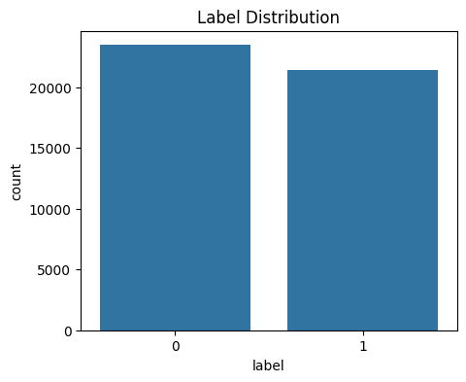
DATASET
Dataset Overview
Kaggle Fake and Real News dataset, two CSV files: Fake.csv and True.csv
23,481 Fake articles + 21,417 True articles = 44,898 total
Each row: title, article text, subject tag, publication date
Merged, labeled (0 = Fake, 1 = True), and shuffled with a fixed seed
Roughly 52% / 48% split, close enough to balanced, no resampling needed
Fig. Class distribution of the merged dataset
3

Slide 4
DATASET
Key Findings Before Any Modeling
Observation | Finding | Decision Made
Subject column | Fake spans 6 categories, True spans only 2, a near-perfect proxy for the label | Dropped (leakage risk)
Missing values | Zero missing values across every column | No imputation needed
Duplicate rows | 5,793 fully duplicated rows (12.9% of merged data) | Removed before train/test split
Empty text field | 631 articles blank text, but a usable title | Combined title + text
Catching these early, before vectorizing anything, kept the later train/test split honest.
4

Slide 5
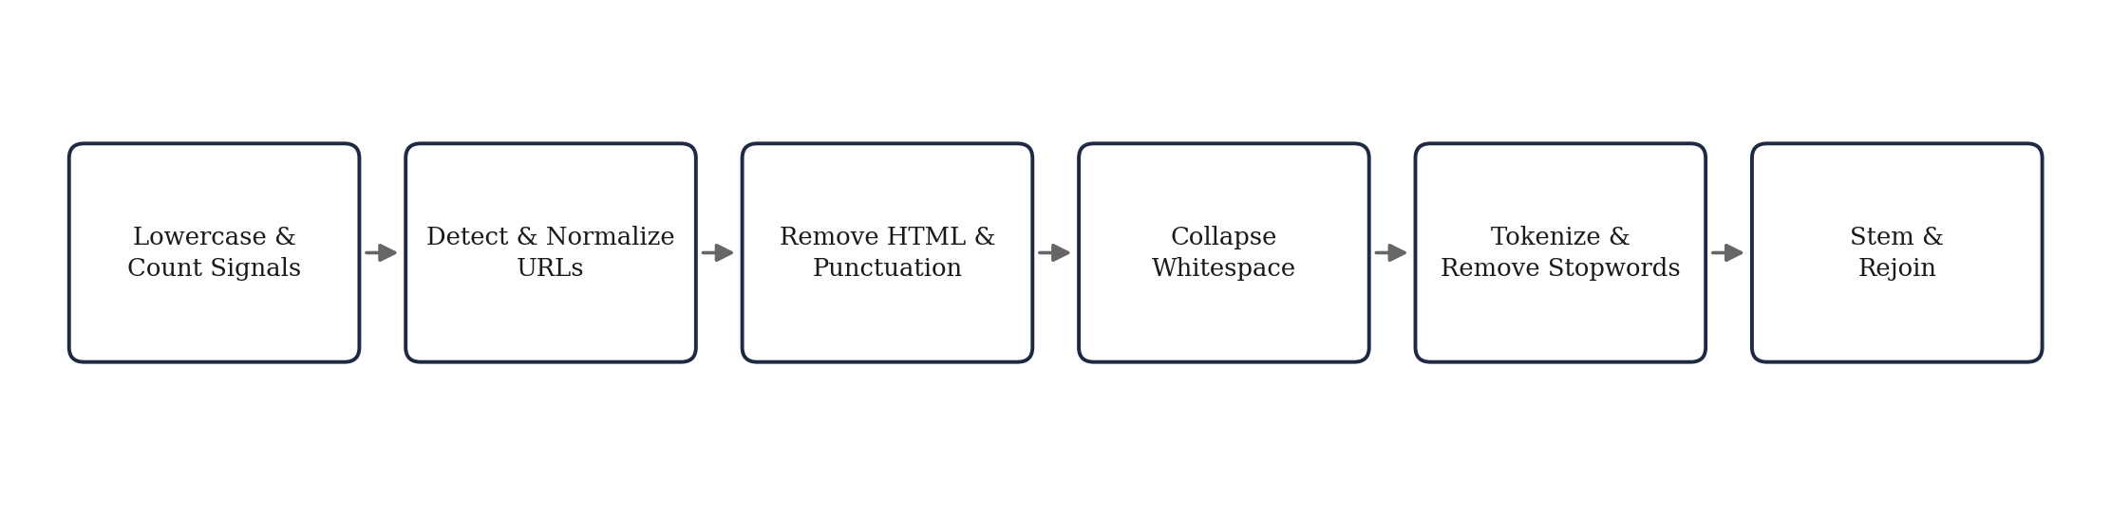
METHODOLOGY
Text Preprocessing Pipeline
Each stage runs as its own separate step, not one combined cleaning function, so its effect on the data can be checked before moving on.
5

Slide 6
METHODOLOGY
Handcrafted Behavioral Features
Feature | Fake (mean) | True (mean) | Gap | Used in enhanced model?
exclamation_count | 0.85 | 0.06 | ~13x | Yes
has_url | 14.3% | 0.2% | ~72x | No (measured only)
text_length (chars) | 2,579 | 2,444 | ~1.05x | Yes
Exclamation marks show the clearest gap between classes, worth carrying forward as its own feature.
URL presence has the largest relative gap of all three, but it was not carried into the enhanced feature set used for modeling , it was flagged as future work.
Article length barely separates the two classes; kept anyway, but expectations stayed modest.
6

Slide 7
METHODOLOGY
Three Text Representations Compared
Representation | Dimensionality | What It Captures
Bag-of-Words | 10,000 (sparse) | Raw word counts, no weighting for informativeness
TF-IDF | 10,000 (sparse) | Word counts, down-weighted by how common a word is across articles
Word2Vec (averaged) | 100 (dense) | Semantic similarity between words, learned from this corpus directly
Word2Vec is trained from scratch on this dataset's own cleaned articles, not loaded from an external pretrained source.
All three are built on the same 39,105-article corpus, so any accuracy difference between them comes from the representation itself.
7

Slide 8
METHODOLOGY
Models Used
Model | Type | Why It Was Included
K-Nearest Neighbors | Non-parametric | Simple distance-based baseline, no training phase
Logistic Regression | Parametric, linear | Strong TF-IDF baseline, coefficients are directly interpretable
Random Forest | Ensemble | Handles nonlinear splits, can act on handcrafted features directly
Neural Network | Deep learning (shallow) | Tests whether added model complexity helps on this task
All four are trained on TF-IDF first, forming the baseline comparison in the next section. Logistic Regression is then reused across the other two experiments (representation comparison, enhanced features).
8

Slide 9
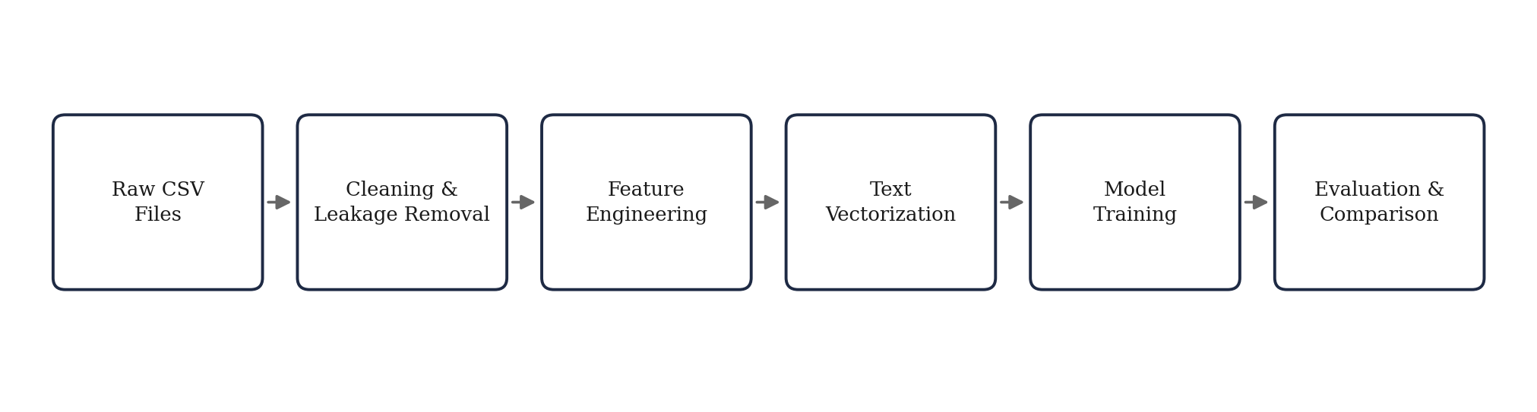
METHODOLOGY
End-to-End Workflow
Six stages, raw data to a compared set of trained models. Each is detailed in the sections just covered.
9

Slide 10
RESULTS
Baseline Model Comparison (TF-IDF)
Model | Train Acc. | Test Acc. | F1 (Fake) | F1 (True)
KNN | 0.9093 | 0.8579 | 0.8288 | 0.8786
Logistic Regression | 0.9895 | 0.9843 | 0.9827 | 0.9856
Random Forest | 0.9817 | 0.9720 | 0.9687 | 0.9747
Neural Network | 1.0000 | 0.9875 | 0.9863 | 0.9885
Neural Network leads on test accuracy (98.75%), Logistic Regression close behind (98.43%).
KNN trails well behind at 85.79%, and only catches 75% of actual fake articles. Distance-based voting struggles in a 10,000-dimension sparse space.
Neural Network hits perfect training accuracy (1.0000), worth a caution flag, though test accuracy barely drops.
10

Slide 11
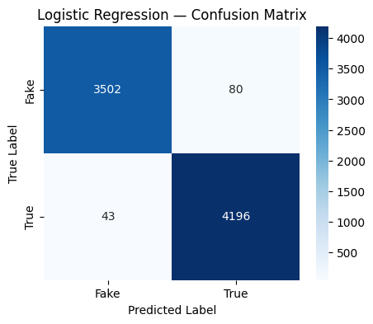

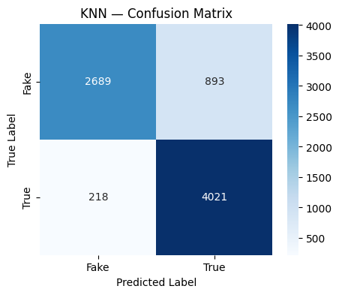

RESULTS
Confusion Matrices: Baseline Models
Every model over-predicts True slightly more than Fake, except KNN, whose Fake column is visibly leakier (893 fake articles mislabeled True).
Overall logistic Regression and Neural Network exhibit the fewest misclassifications.
11

Slide 12
RESULTS
Representation Comparison (Logistic Regression)
Representation | Train Acc. | Test Acc. | F1 (Fake) | F1 (True)
TF-IDF | 0.9895 | 0.9843 | 0.9827 | 0.9856
Bag-of-Words | 1.0000 | 0.9937 | 0.9931 | 0.9942
Word2Vec | 0.9824 | 0.9807 | 0.9789 | 0.9822
Bag-of-Words edges out TF-IDF (99.37% vs 98.43%) despite being the simpler, unweighted representation, though its perfect 1.0000 train score is the same caution flag as the Neural Network's.
Word2Vec, compressed to just 100 dense dimensions, still reaches 98.07%, barely a point behind sparse 10,000-dimension methods.
All three land within one percentage point of each other. For this specific dataset, representation choice matters comparatively little, next to how strongly the two classes separate by vocabulary and topic.
12

Slide 13
RESULTS
Feature Importance: What the Model Relies On
Toward True | Coefficient | Toward Fake | Coefficient
reuter | 21.75 | video | -8.96
said | 18.64 | imag | -8.92
washington | 6.18 | via | -8.67
us | 5.50 | gop | -5.73
A limitation, not a strength:
"reuter" is the single strongest word in the entire model, but every True article in this dataset is Reuters-sourced.
The model has partly learned to recognize a wire-service byline, not a general property of trustworthy reporting.
"video," "imag," and "via" on the Fake side point to embedded media and sensational framing, a signal more likely to generalize.
13

Slide 14
RESULTS
Do Handcrafted Features Actually Help?
Model | Test Acc. (TF-IDF) | Test Acc. (Enhanced) | Change
Logistic Regression | 0.9843 | 0.9839 | -0.0004
Random Forest | 0.9720 | 0.9744 | +0.0024
Logistic Regression: essentially flat. Two new columns get added alongside 10,000 existing TF-IDF weights, too small in relative influence to move an already-accurate linear boundary.
Random Forest: a real, if modest, gain. A tree can naturally split directly on a raw text_length or exclamation_count value, a mechanism a linear model doesn't have.
Conclusion: Engineered features help the model that can act on them directly, and do effectively nothing for the one that can't.
14

Slide 15
DISCUSSION
Error Analysis: Which False Is Costlier?
80
For a filtering tool meant to catch fake content before a reader sees it, these two errors are not equally costly. A false negative lets fabricated content reach a reader unlabeled.
A false positive wrongly flags a real article, a cost too, but one a human reviewer can typically catch and reverse.
This model's actual error mix (80 FP vs 46 FN, roughly 1.7-to-1) leans toward the safer failure direction, for that specific use case.
46
False Positives
(real news flagged Fake)
False Negatives
(fake news flagged True)
Two of the three sampled false negatives were genuine Reuters pieces critical of Donald Trump. The opinionated vocabulary may have pulled a correctly-sourced article toward a wrong prediction.
15

Slide 16
DISCUSSION
Custom Prediction: A Quick Sanity Check
“New Study Reveals That Eating Chocolate While Listening To Mozart Makes You 45% Smarter...”
Model | Prediction
KNN | Fake (correct)
Logistic Regression | Fake (correct)
Random Forest | Fake (correct)
Neural Network | Fake (correct)
Logistic Regression (Enhanced) | Fake (correct)
Random Forest (Enhanced) | True (wrong)
Only Random Forest (Enhanced) got it wrong. This snippet has zero exclamation marks and ordinary length, giving that model less to work with on the two features it relies on. This qualitative example illustrates how different models respond to the same unseen article, but it should not be interpreted as statistical evidence.
16

Slide 17
CONCLUSION
Summary, Limitations & Future Scope
Key Takeaways
Limitations & Next Steps
Logistic Regression led every comparison: highest accuracy, smallest train-test gap, and the only model whose coefficients can be inspected directly.
Recommended Model: TF-IDF + Logistic Regression — selected over Bag-of-Words despite slightly lower accuracy because it shows a healthier train–test gap and is expected to generalize more reliably.
Handcrafted features help Random Forest, not Logistic Regression, a direct test rather than an assumption.
Error mix favors false positives over false negatives, the safer direction for a filtering use case.
English-only, binary classification. TF-IDF and BoW ignore word order entirely.
Word2Vec vectors are static, not contextual.
True articles are all Reuters-sourced, part of the model's strongest signal is a source artifact, not a truthfulness signal.
Next: contextual embeddings (BERT/DistilBERT), SHAP/LIME explainability, multi-outlet sourcing to reduce the Reuters artifact.
17

