Slide 1
Multithreading in Java
Multithreading in java is a process of executing multiple threads simultaneously.
A thread is a lightweight sub-process, the smallest unit of processing. Multiprocessing and multithreading, both are used to achieve multitasking.
However, we use multithreading than multiprocessing because threads use a shared memory area. They don't allocate separate memory area so saves memory, and context-switching between the threads takes less time than process.
Java Multithreading is mostly used in games, animation, etc.

Slide 2
Life cycle of a Thread (Thread States)
A thread can be in one of the five states. According to sun, there is only 4 states in thread life cycle in java new, runnable, non-runnable and terminated. There is no running state.
But for better understanding the threads, we are explaining it in the 5 states.
The life cycle of the thread in java is controlled by JVM. The java thread states are as follows:
New
Runnable
Running
Non-Runnable (Blocked)
Terminated

Slide 3
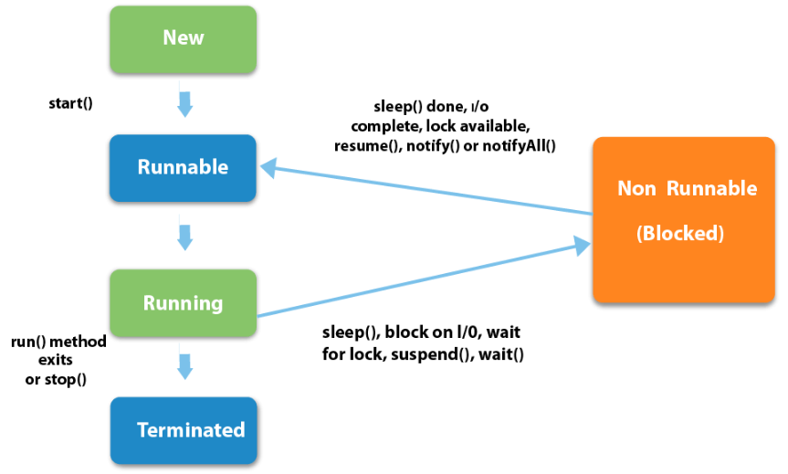
Life cycle of Thread

Slide 4
Thread Scheduler in Java
Thread scheduler in java is the part of the JVM that decides which thread should run.
There is no guarantee that which runnable thread will be chosen to run by the thread scheduler.
Only one thread at a time can run in a single process.
The thread scheduler mainly uses preemptive or time slicing scheduling to schedule the threads.
Difference between preemptive scheduling and time slicing
Under preemptive scheduling, the highest priority task executes until it enters the waiting or dead states or a higher priority task comes into existence. Under time slicing, a task executes for a predefined slice of time and then reenters the pool of ready tasks. The scheduler then determines which task should execute next, based on priority and other factors.

Slide 5
How to create thread?
There are two ways to create a thread:
By extending Thread class
By implementing Runnable interface.
1) Java Thread Example by extending Thread class
class Multi extends Thread{
public void run(){
System.out.println("thread is running...");
}
public static void main(String args[]){
Multi t1=new Multi();
t1.start();
}
}
Output:
thread is running...

Slide 6
2) Java Thread Example by implementing Runnable interface
class Multi3 implements Runnable{
public void run(){
System.out.println("thread is running...");
}
public static void main(String args[]){
Multi3 m1=new Multi3();
Thread t1 =new Thread(m1);
t1.start();
}
}
Output:
thread is running...

Slide 7
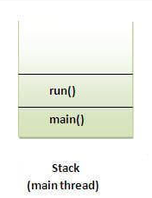
What if we call run() method directly instead start() method?
Normally each thread starts in a separate call stack but Invoking the run() method from main thread, the run() method goes onto the current call stack rather than at the beginning of a new call stack.
class TestCallRun1 extends Thread{
public void run(){
System.out.println("running...");
}
public static void main(String args[]){
TestCallRun1 t1=new TestCallRun1();
t1.run();//fine, but does not start a separate call stack
}
}
Output: running...

Slide 8
Another example to demonstrate problem if you direct call run() method
class TestCallRun2 extends Thread{
public void run(){
for(int i=1;i<5;i++){
try{Thread.sleep(500);}catch(InterruptedException e){System.out.println(e);}
System.out.println(i);
}
}
public static void main(String args[]){
TestCallRun2 t1=new TestCallRun2();
TestCallRun2 t2=new TestCallRun2();
t1.run();
t2.run();
}
}

Slide 9
Output:1
2
3
4
5
1
2
3
4
5
As you can see in the above program that there is no context-switching because here t1 and t2 will be treated as normal object not thread object.

Slide 10
Priority of a Thread (Thread Priority)
Each thread have a priority. Priorities are represented by a number between 1 and 10. In most cases, thread scheduler schedules the threads according to their priority (known as preemptive scheduling). But it is not guaranteed because it depends on JVM specification that which scheduling it chooses.
Three constants defined in Thread class:
public static int MIN_PRIORITY
public static int NORM_PRIORITY
public static int MAX_PRIORITY
Default priority of a thread is 5 (NORM_PRIORITY). The value of MIN_PRIORITY is 1 and the value of MAX_PRIORITY is 10.

Slide 11
Daemon Thread in Java
Daemon thread in java is a service provider thread that provides services to the user thread. It’s life depend on the mercy of user threads i.e. when all the user threads dies, JVM terminates this thread automatically.
There are many java daemon threads running automatically e.g. gc, finalizer etc.
You can see all the detail by typing the jconsole in the command prompt. The jconsole tool provides information about the loaded classes, memory usage, running threads etc.
Points to remember for Daemon Thread in Java
It provides services to user threads for background supporting tasks. It has no role in life than to serve user threads.
Its life depends on user threads.
It is a low priority thread.

Slide 12
Why JVM terminates the daemon thread if there is no user thread?
The sole purpose of the daemon thread is that it provides services to user thread for background supporting task. If there is no user thread, why should JVM keep running this thread? That is why JVM terminates the daemon thread if there is no user thread.
Methods for Java Daemon thread by Thread class
The java.lang.Thread class provides two methods for java daemon thread.
public void setDaemon(boolean status) is used to mark the current thread as daemon thread or user thread.
2) public boolean isDaemon() is used to check that current is daemon.

