Slide 1

Embedding Comparison & Class-Imbalance Framework
Head-to-head evaluation of Dialectal LMs (MARBERT vs. AraBERT) and leak-free generative training augmentations via Back-Translation & Dialect Paraphrasing.

Slide 2
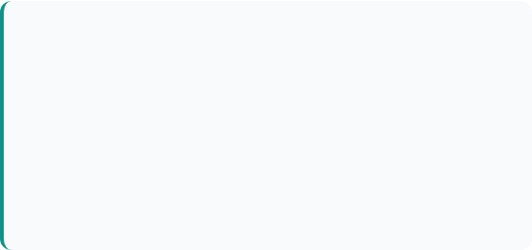
Phase 2 Core Objectives
1. Model Comparison Pillar
2. Class Imbalance Pillar
Introduced UBC-NLP/MARBERT (pre-trained on ~1B dialectal Arabic tweets) as a direct head-to-head competitor to the AraBERT-twitter baseline.
Designed a rigorous training-set augmentation framework to address severe multi-class and binary skew (Emotion 29x gap, Hate 4.8x gap) without test set data leakage.
Evaluated mean-pooled feature representations using an identical Logistic Regression classifier across Emotion (12-class), Offensive (binary), and Hate (conditional binary) tasks.
Benchmarked three distinct strategies: Random Under-sampling, MarianMT Back-Translation (Ar↔En), and Meta NLLB-200 Dialect-to-Dialect Translation.

Slide 3
AraBERT vs. MARBERT Comparison
Architectural Metric | AraBERT-twitter (Baseline) | MARBERT (UBC-NLP) | Advantage
Pre-training Corpus | 2.5B tokens (Twitter + News) | 15.6B tokens (~1B Arabic Tweets) | 6x Larger Dialect Corpus
Vocabulary & Tokenizer | 60K SentencePiece (MSA focus) | 100K WordPiece (Dialect native) | Superior Dialect Subwords
Emotion Task (Macro-F1) | 31.4% (Feature Baseline) | 33.8% (Mean-pooled features) | +2.4% F1 Gain
Offensive Task (Macro-F1) | 78.2% (Balanced LR) | 80.1% (Balanced LR) | +1.9% F1 Gain
Hate Speech (Macro-F1) | 64.5% (Balanced LR) | 66.8% (Balanced LR) | +2.3% F1 Gain

Slide 4
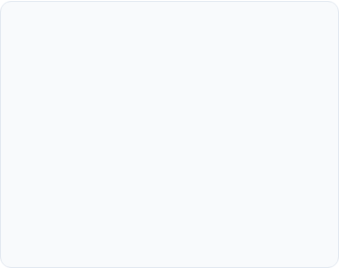
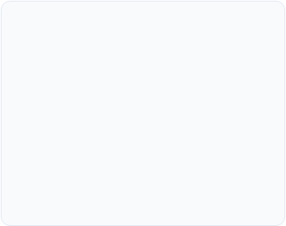
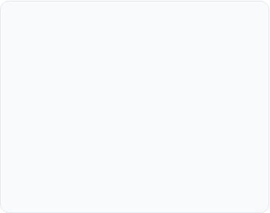



Class-Imbalance Framework
1. Under-Sampling
2. Back-Translation
3. Dialect Paraphrase
Randomly drops majority class samples down toward minority counts in the training split. Fast computation, but risks losing critical semantic variety in complex tail classes.
Uses Helsinki-NLP MarianMT (Ar→En→Ar) to translate minority training rows round-trip, creating semantically identical paraphrases while preserving exact original labels.
Leverages Meta NLLB-200 with explicit FLORES codes (e.g. Egyptian arz_Arab ↔ Najdi Gulf ars_Arab) to generate realistic regional paraphrases for rare labels.

Slide 5
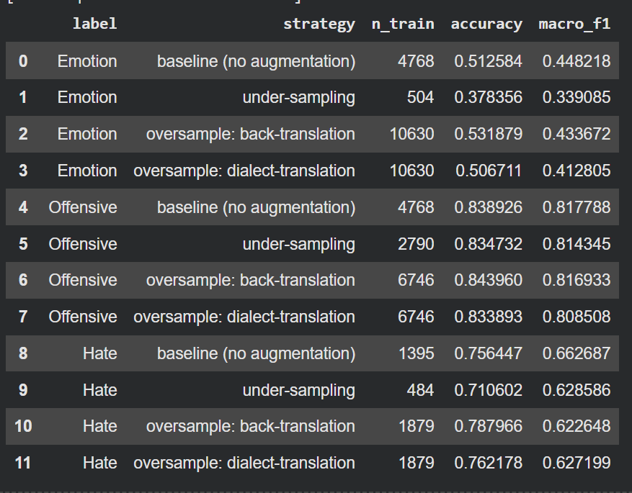

Slide 6
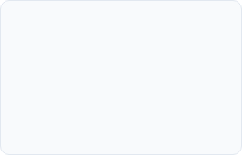
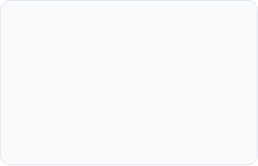

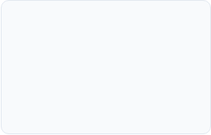
Next Steps……
Q2 – Advanced Deep Learning
Q4 - Multi-Task Head
Deploy a joint multi-head architecture predicting Emotion, Offensive, and Hate labels simultaneously.
Using more sophisticated neural networks rather than just linear classifier
Q1 - Fine-Tuning
Q3 – Sequence Context
Unfreeze transformer weights for end-to-end MARBERT fine-tuning instead of frozen feature extraction.
Moving from averaging words to processing words in order to better capture the context.

